Slide 1
“Honey, I Shrunk the CERN”
A Plasma Physics Perspective on Accelerating Electrons
Navid Vafaei-Najafabadi
navid.vafaei-najafabadi@stonybrook.edu

Slide 2
Synthesis
Particle accelerators are a critical tool for scientific research and industrial applications
A Plasma “cavity” can be used to accelerate particles at a rate that is a thousand times higher than conventional accelerators
Future research at ATF will use high power and short pulse mid-IR laser for close study of plasma accelerators
Current research is focused on developing diagnostic methods for studying the fields and density structure of the the plasma cavity
You can get involved in this research through REU research at the Center for Accelerator Science and Education (CASE), which is a collaboration between SBU and BNL
2￼

Slide 3
Plasma-Based Particle Accelerators
Particle Accelerators: Introduction and Applications
Plasma Waves as Particle Accelerators
Long Term Research Vision at ATF
Current Experimental Research at ATF
3￼

Slide 4
Plasma-Based Particle Accelerators
Particle Accelerators: Introduction and Applications
Plasma Waves as Particle Accelerators
Long Term Research Vision at ATF
Current Experimental Research at ATF
4￼

Slide 5
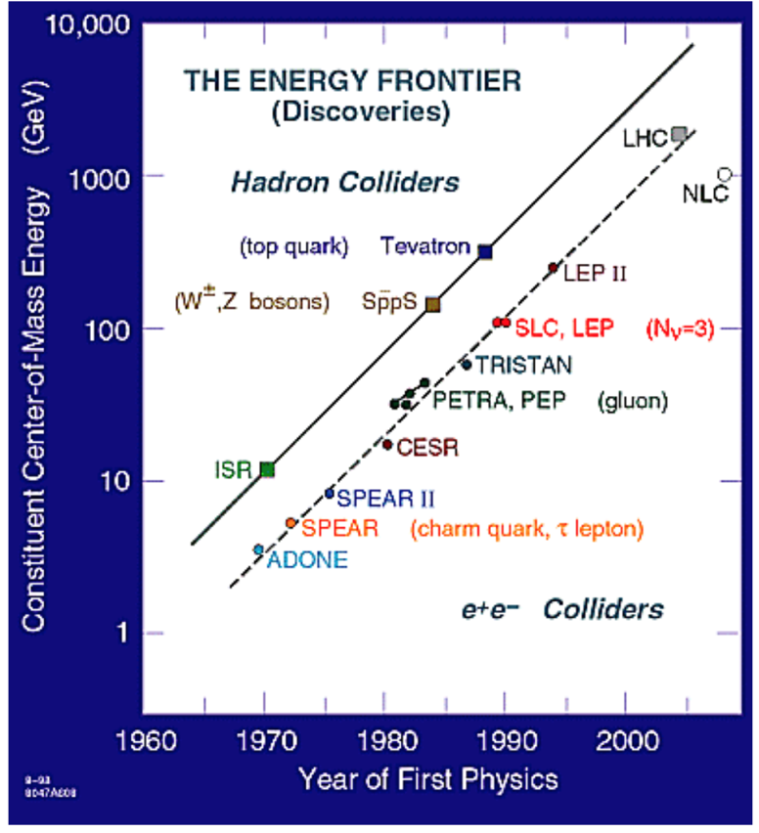
Primary Partner in Particle Discovery
High energy accelerators have enabled a series of discoveries inside atom over the last 60 years
5￼

Slide 6
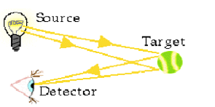
Accelerators Let Us See inside Atoms
Particles can be treated as waves, with the wavelength calculated from de Broglie equation:
𝜆=h/p
6￼

Slide 7
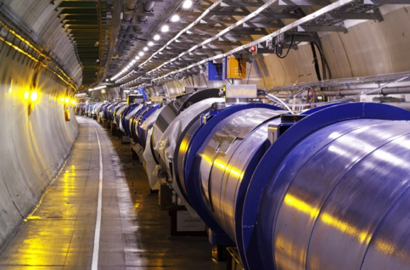
Large Hadron Collider (LHC) at CERN
Terascale Physics
14 Trillion Volts (CM) pp
27 km circumference
$6 Billion+
7￼

Slide 8
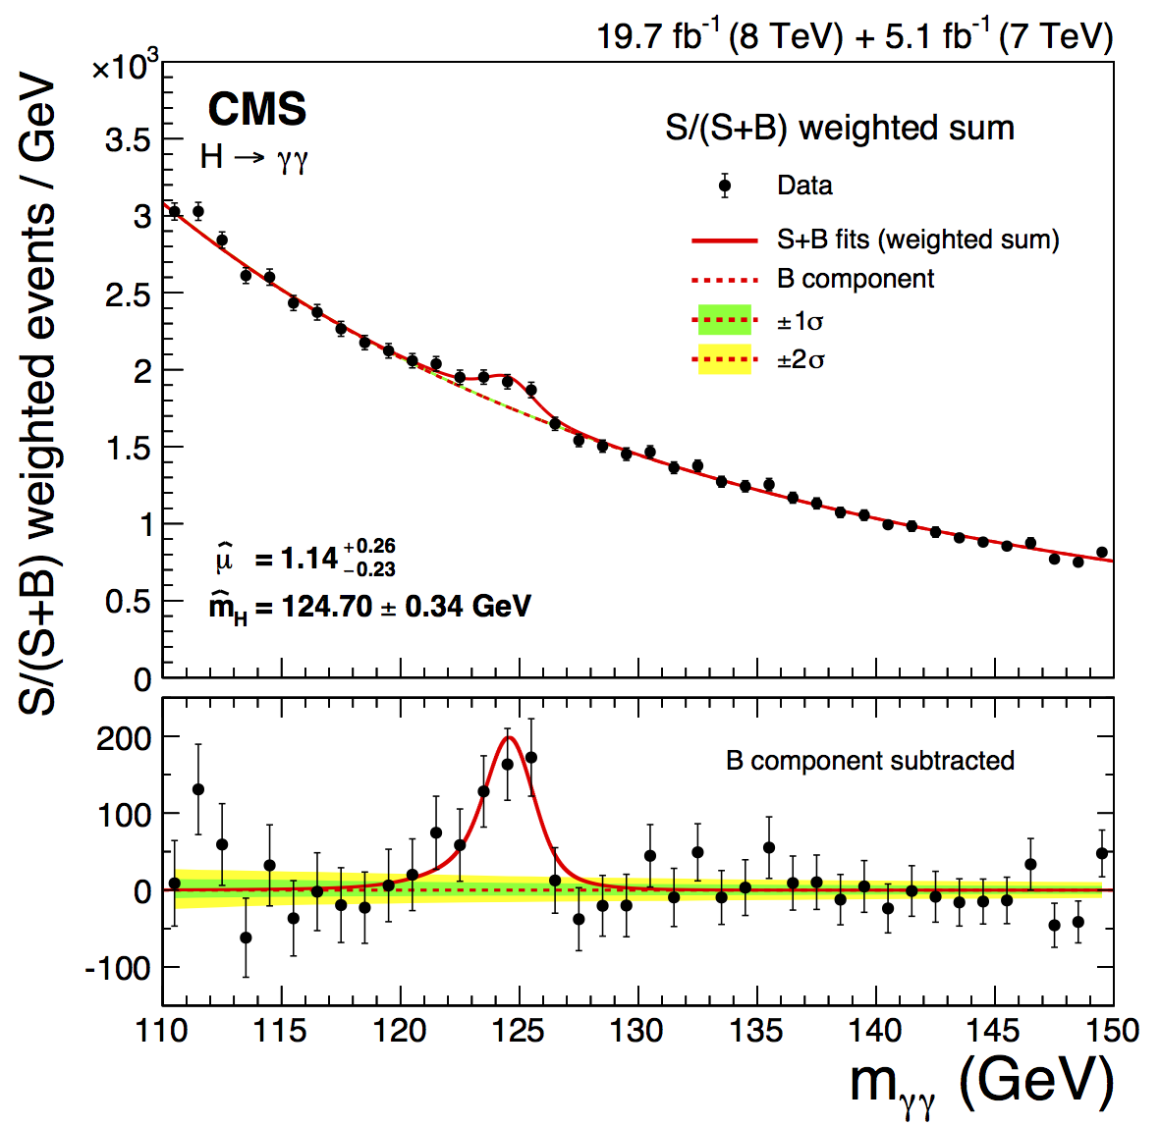
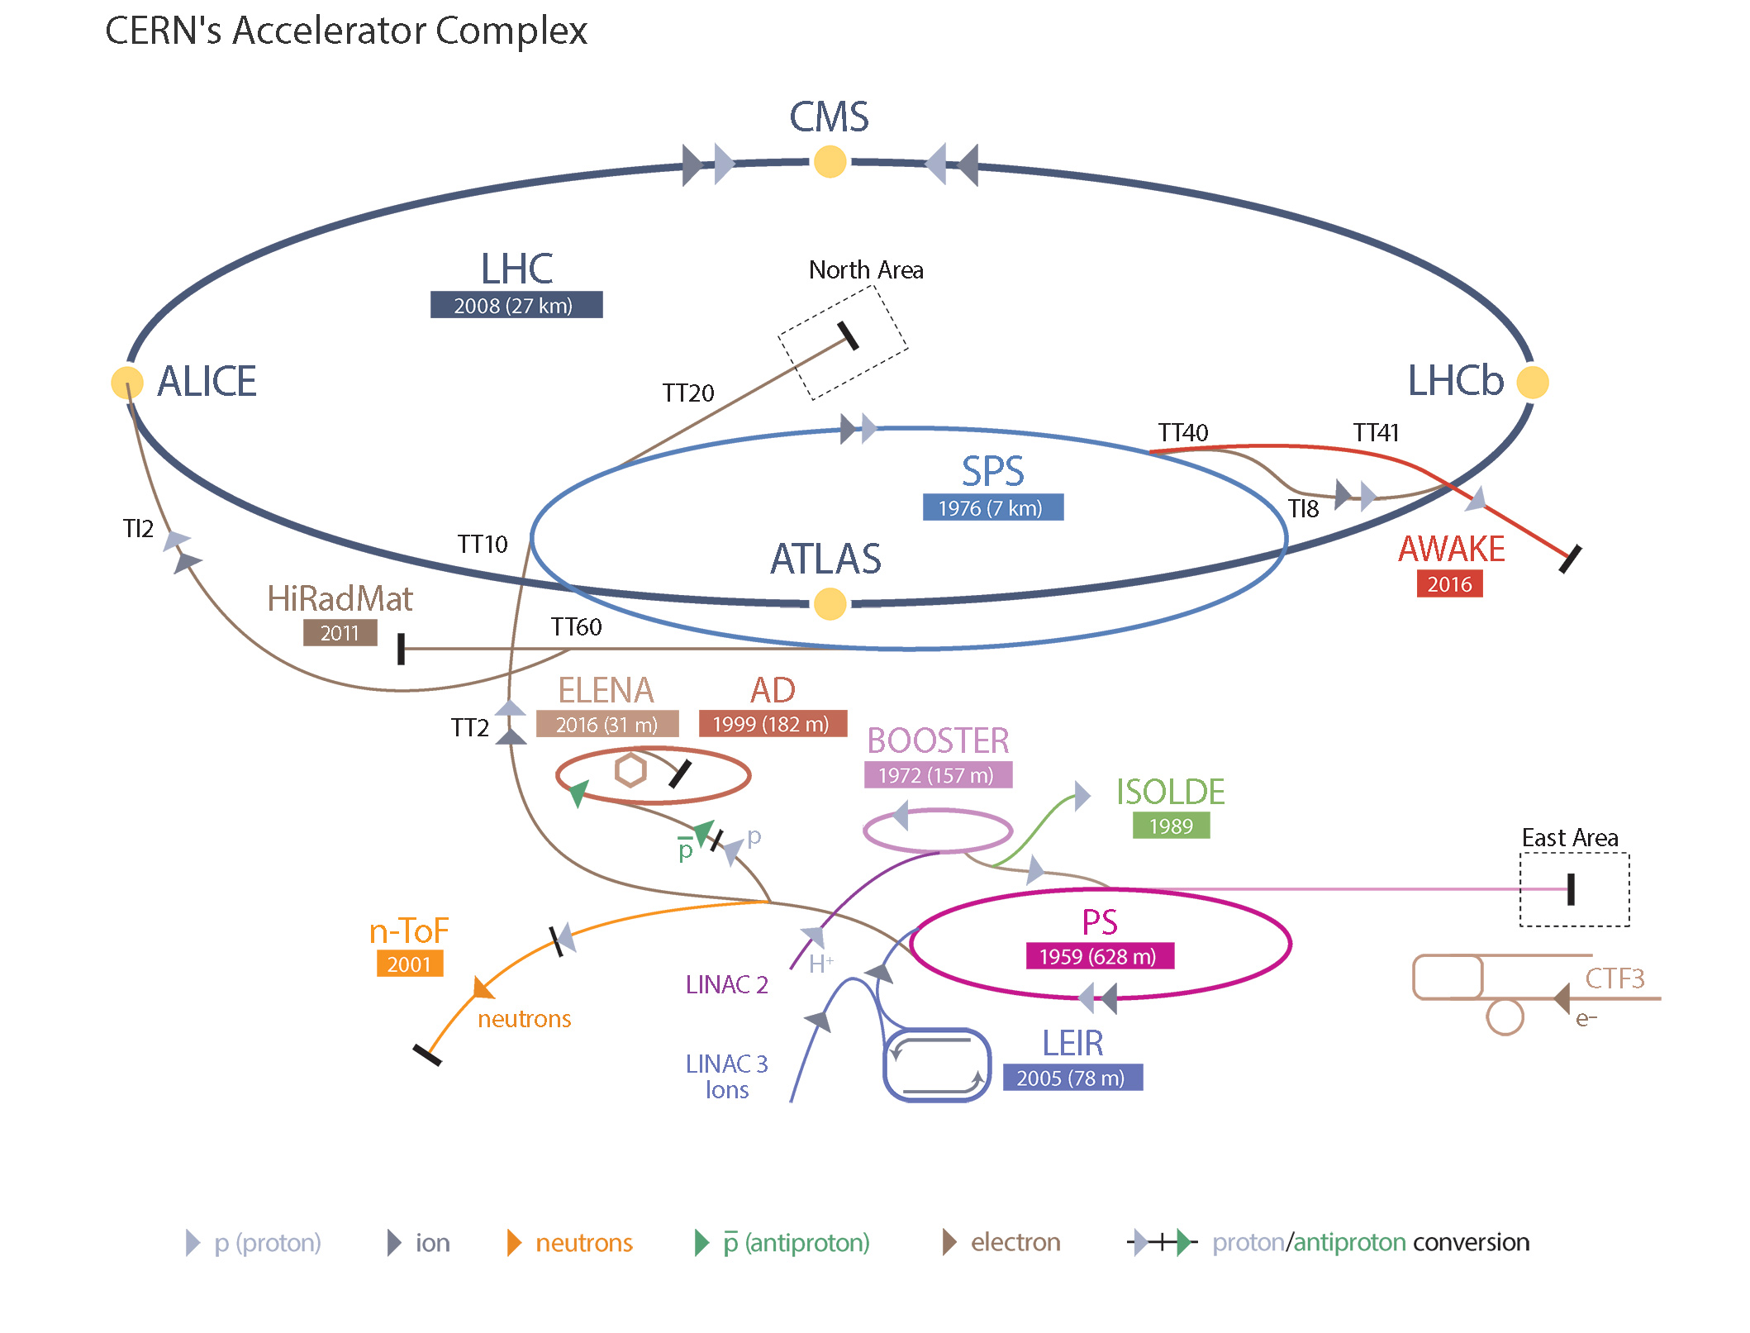
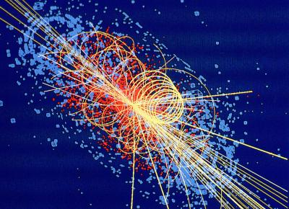
Discovery of Higgs Boson
Discovery of Higgs BosonThe Higgs boson with a rest mass of 125 GeV/c² is the latest subatomic particle discovery enabled by particle accelerators and colliders
8￼

Slide 9
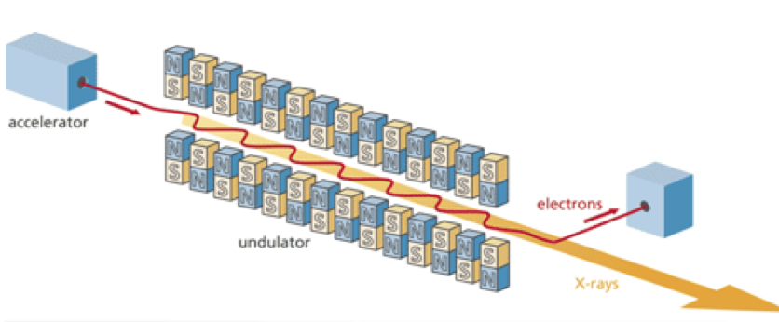
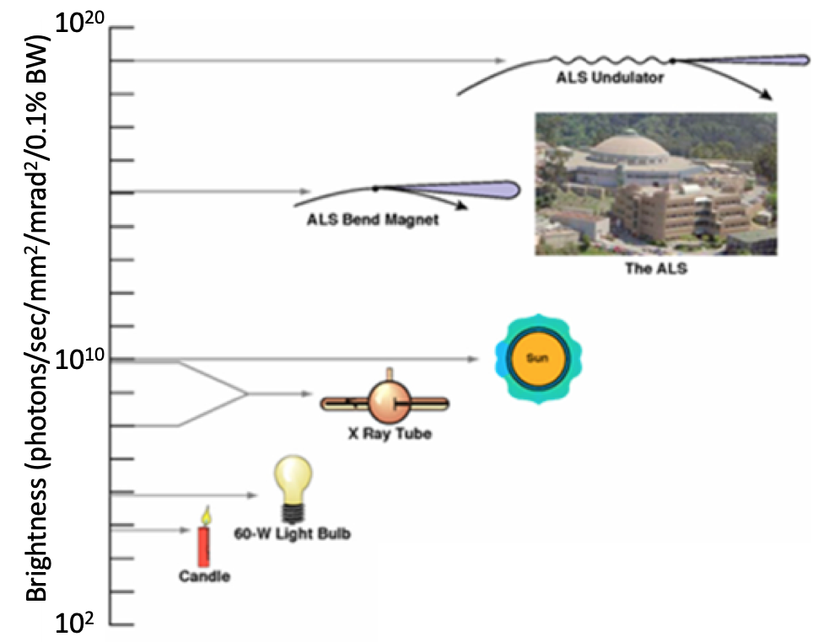
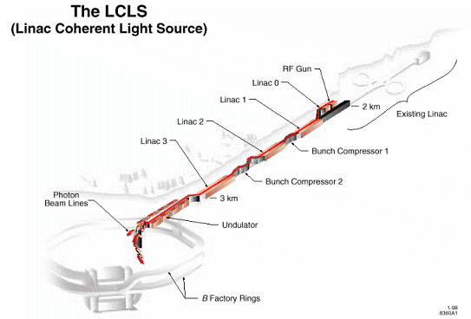
Accelerator-Based Light Sources
Modern light sources can generate very high brightness sources of radiation from IR to x-rays
9￼

Slide 10
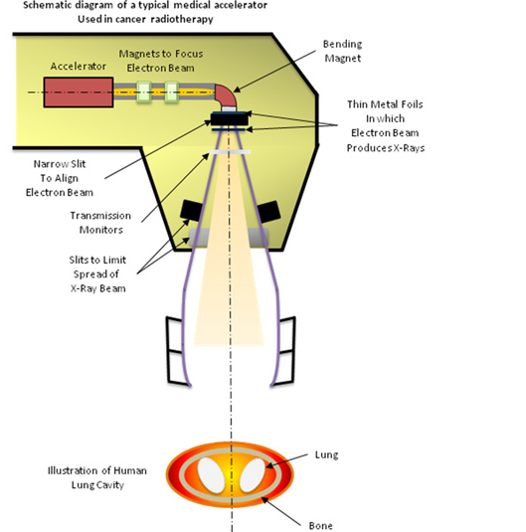
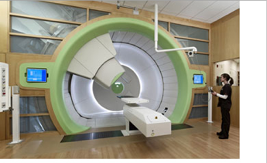
Accelerators in Medicine
Proton Therapy
Radiation Therapy
Particle and radiation beams are used for imaging, diagnosis, and therapy
10￼

Slide 11
Plasma-Based Particle Accelerators
Particle Accelerators: Introduction and Applications
Plasma Waves as Particle Accelerators
Long Term Research Vision at ATF
Current Experimental Research at ATF
11￼

Slide 12
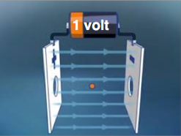
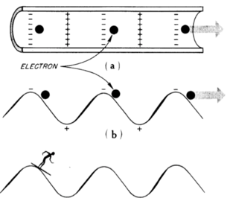
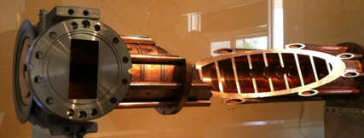
How Do We Accelerate Particles
E(MeV) | E(J) | v (e⁻)
3 | 4.8E-19 | 0.985 c
300 | 4.8E-17 | 0.9999985 c
Copper structure with irises
Structure diameter ~ 10 cm
Energy gain ~ 20 MeV/m
12￼

Slide 13
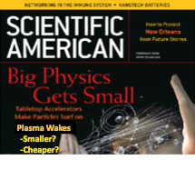
Getting a Larger Wave for Electrons to Ride
Plasma Wave
(40 GeV/m)
EM Wave in Copper Structure
(100 MeV/m)
By getting the electrons a large potential wave to ride, colliders of the future could get hundreds of times smaller
LHC: 27 km circumference -> ~70 m in length
13￼

Slide 14
Application of Table-Top Plasma Accelerators
U. Nebraska
Security
Popular Science
Free Electron Laser
Medicine
LBNL- Bella
14￼

Slide 15
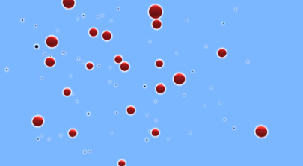
Plasma, More Common Than You Would Think
Most of the universe exist in the state of plasma
A plasma is a collection of electrons and ions that are not bound to each other
The mass of the ions are several thousand times greater than the mass of the electrons.
ions
Contemporary Physics Education Project
electrons
15￼

Slide 16
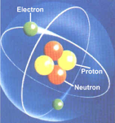
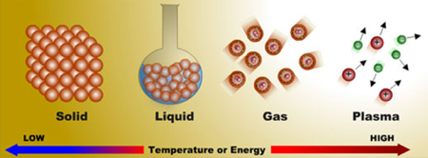
How to Make a Plasma
Must provide energy for the electron to overcome the ion’s electric attraction
1. Use heat
e.g. for air at room temperature,
ni/nn ~ 10⁻¹²²
2. Use stronger electric field
a. Light (laser)
b. particles (electron beam)
$$\frac{n_{i}}{n_{n}}=2.4×\frac{{10}^{21}T^{3/2}}{n_{i}}e^{−U_{i}/KT}$$
Energy ➙ Ionization
16￼

Slide 17
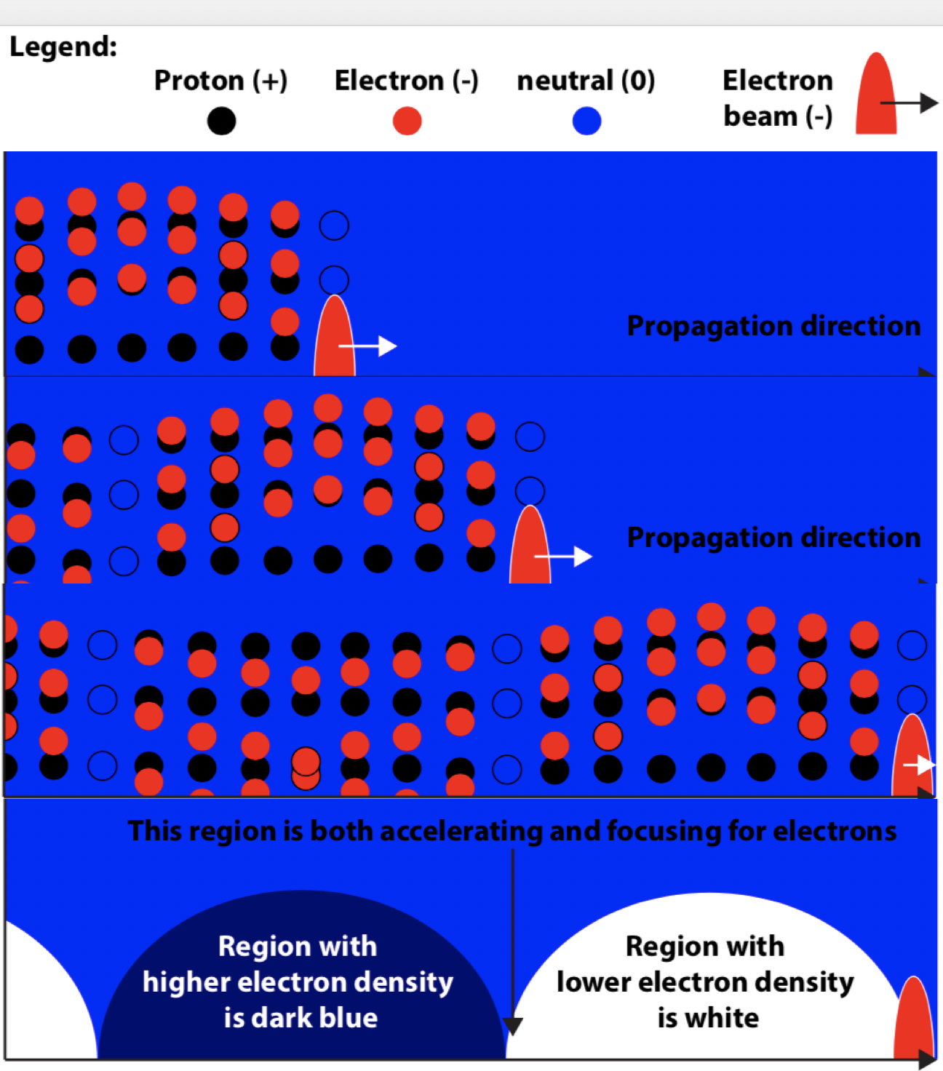
Plasma Wakefield
Density perturbations due to a powerful driver results in high amplitude accelerating field
17￼

Slide 18
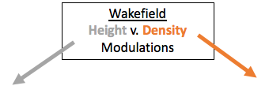
It’s Like Wake Surfing, But With a Laser/Beam Driver
Slide Courtesy of Dr. J. L. Shaw, LLE, Rochester
18￼

Slide 19
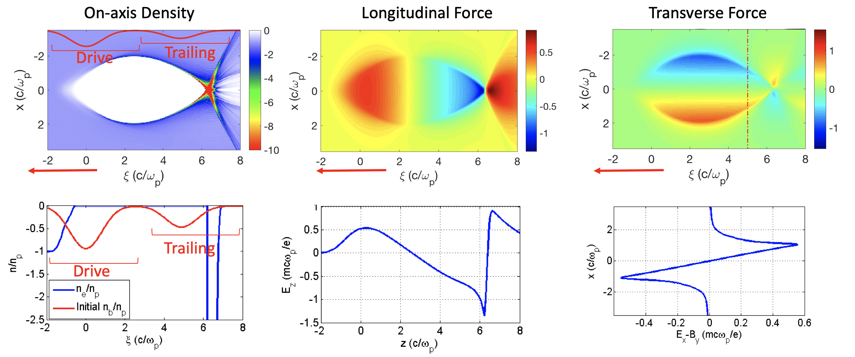
Fields Within the “Blowout” are Ideal for Accelerating and Focusing
“Blowout regime” occurs as ne➞0
Nonlinear accelerating force
E normalized to 50 GeV/m
Uniform transversely
Linear Focusing Force, similar to quadrupole magnets in a conventional accelerator
Uniform Longitudinally
19￼

Slide 20
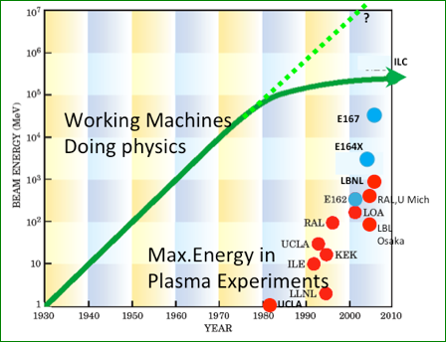
Accelerator “Moor’s Law”
Unsustainable scaling of size and cost with maximum energy has resulted in a “saturation” of peak energy of operating accelerators
20￼

Slide 21
Plasma-Based Particle Accelerators
Particle Accelerators: Introduction and Applications
Plasma Waves as Particle Accelerators
Long Term Research Vision at ATF
Current Experimental Research at ATF
21￼

Slide 22
Long Term Research Vision at ATF
CO2 Laser power upgrade will enable experimentation in the ideal “blowout” regime
Combination of this high power laser and a linac-produced electron beam makes ATF a unique facility in the US
Future scientists (you!) could study the properties of the fields in the blowout regime as well as the physics of coupling the electron beam to the plasma wake
22￼

Slide 23
Understanding the Physics Requires Complex Simulation Tools (OSIRIS) and Supercomputers (CORI@NERSC and SEAWULF@SBU)
23￼

Slide 24
CO2 Laser Pulse and H2 Plasma Chosen for External Injection of ATF Beam Into Wake
Polarization direction
Moving window
H2 plasma (2x2 particles per cell)
n0 = 6.1x10¹⁶ cm⁻³
λp = 17 µm
Electron
Beam
CO2 pulse
Propagation
direction [cm]
0
0.03
0.04
1.23
1.24
 | Duration | Power | λ0 | Spot size | Energy | Intensity | a0 | Rayleigh length | Critical power | Critical Density | Depletion length | Dephasing length
Laser | 0.2 ps | 20 TW | 9 µm | 80 µm | 4.3 J | 3.2x10¹⁸ W/cm⁻² | 14 | 0.014 cm | 0.06 TW | 1.4x10¹⁹ cm⁻³ | 1.4 cm | 1.2 cm
 | Charge | FWHM length | σz | σr | np/n0 | Energy | Emittance | Particles per cell
e⁻ beam | 0.16 nC | 30 fs | 3.8 µm | 11 µm | 2.3 | 60 MeV | 7.5 µm | 2x2
 | Simulation box - Longitudinal |  |  | Simulation box - Transversal
 | Size | Cells per λ0 | Cells per c/ωp | Size | Cells p. spot size | Cells per c/ωp | Ionization
Simulation box | 303 µm | 120 | 288 | 475 µm | 80 | 296 | Active - ADK
24￼

Slide 25
Propagation
direction
Accelerating wakefield
CO2 laser pulse drives nonlinear blowout regime in H2 plasma electrons
Electron beam is externally injected into the back of the bubble that trails the laser pulse
Beam is accelerated
while performing betatron oscillations
Laser
25￼

Slide 26
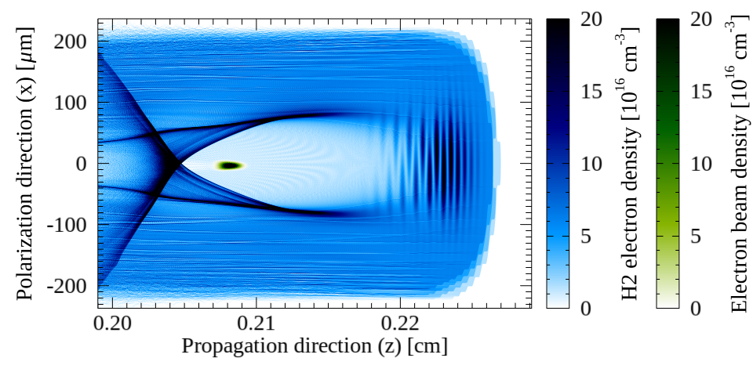
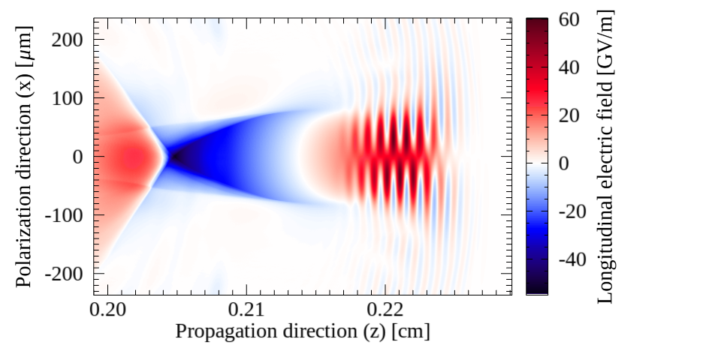
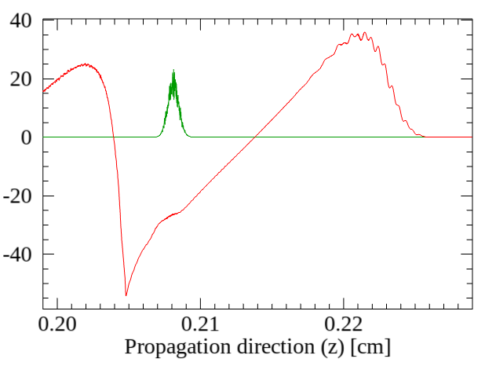
At 0.2 cm, Blowout Regime of ~ 200 µm Support Accelerating Field of 27 GV/m
Propagation
direction
On-axis longitudinal field (red) [GV/m]
On-axis beam density (green) [10¹⁶ cm⁻³]
Acceleration field
close to 27 GV/m
26￼

Slide 27
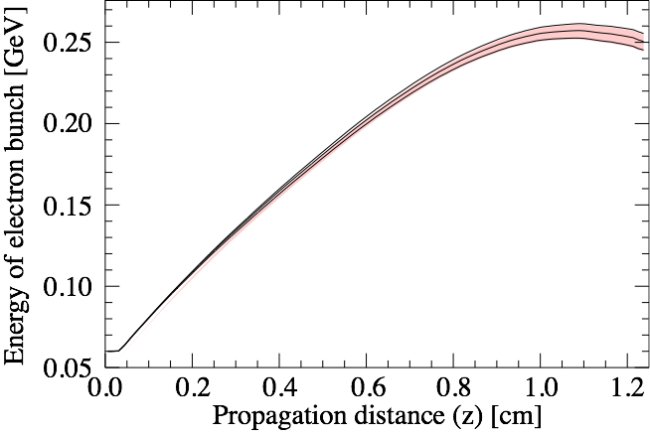
Energy Gained by Electrons
Final beam:
250 MeV with 4% energy spread
Shade indicates ±1σ deviation
from RMS energy value
This energy is consistent with acceleration in ≈1 cm long plasma inside accelerating wakefields of (initially) 27 GV/m
$$∝$$
After about 0.5cm
the beam experiences Wakefields
below the initial 20 GV/m
27￼

Slide 28
Plasma-Based Particle Accelerators
Particle Accelerators: Introduction and Applications
Plasma Waves as Particle Accelerators
Long Term Research Vision at ATF
Current Experimental Research at ATF
28￼

Slide 29
Current Research
The available laser pulse is currently much longer than the plasma wavelength
Our experiments are in a regime called self modulation, where the laser pulse is modified by the plasma wave
We are using laser and electron beam probe to characterize this plasma wave in preparation for our ultimate goal: the external injection of ATF beam into a plasma wakefield in blowout regime
29￼

Slide 30
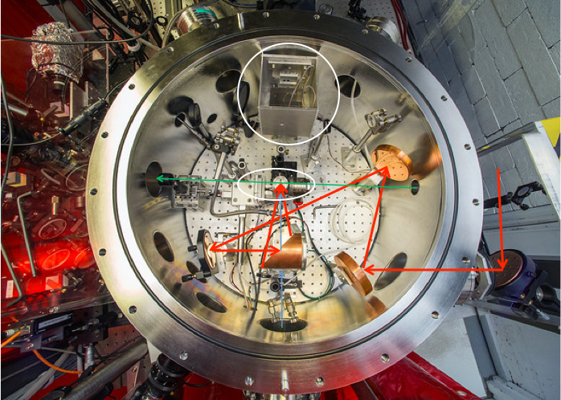
Previous Experiments with Laser Probe
Picosecond CO2 laser is focused on a gas target
Nd:YAG laser (1064/532 nm wavelength) was used as probe
The “scattered” signal was collected and sent to a “spectrometer”
YAG (Probe)
CO2
30￼

Slide 31
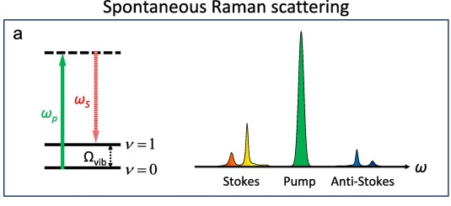
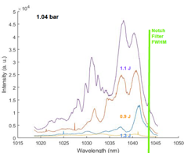
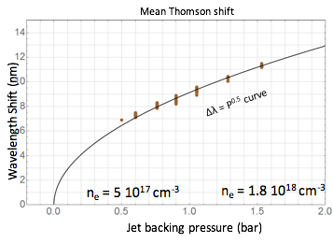
Scattering Signal
Theory:
src: H. J. Lee, Methods,128,119-128 (2017)
ATF Experimental Observations, Courtesy of James Welch:
Trend as expected
31￼

Slide 32
Numerical setup was based on AE71 experiment
at Accelerator Test Facility of Brookhaven Laboratory
Polarization direction
 | W0 | λ0 | τ (FWHM) | En | ZR | a0
CO2 | 20µm | 10.6µm | 4ps (in E) | 1J | 0,012cm | 2.1
Doubled
Yag pulse
 | W0 | λ0 | s (FWHM) | En | ZR | a0
Doubled Yag | 35µm | 0.532µm | 3ps | 1mJ | 0,72cm | 0.0014
CO2
pulse
Hydrogen
plasma
 | n0 (ions/e⁻s) | Skin depth c/ωp | Particles per cell
H2 plasma | 7.5x10¹⁷cm⁻³ | 6.12µm | 2 x 2
0
0.43
0.48
0.73
Propagation direction [cm]
Longitudinally:
163315 cells
(20/398 per λ0 Yag / λ0 CO2)
Simulation done in 2D geometry
Moving window (0.43cm long / 0.16cm wide)
Transversely:
1038 cells
(23/30 per W0 Yag / W0 CO2)
32￼

Slide 33
Transverse
Wakefields
Electron
density
Transverse direction (laser polarization) (x) [µm]
Ion
density
33￼

Slide 34
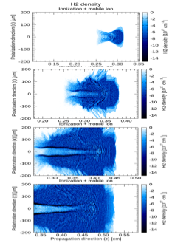
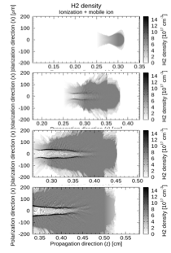
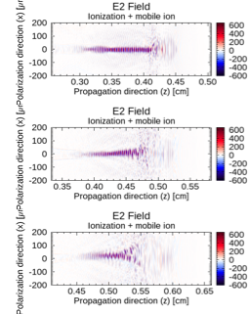
Laser Fields Show Interesting and Unexpected Instability
Electron density
Ion density
Laser Fields

Slide 35
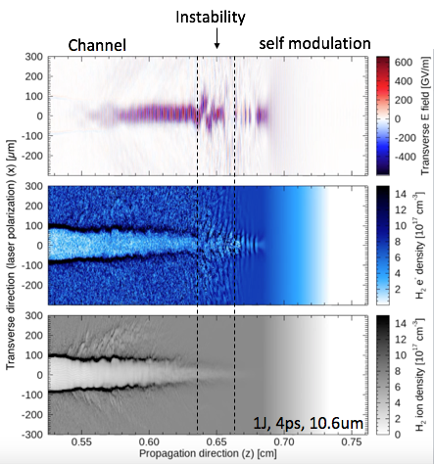
Three Interaction Region
We plan to use an electron beam probe to directly observe these regions
35￼

Slide 36
Simulation modeled upgraded CO2 pulse in
the same hydrogen plasma probed with electron beam
 | W0 | λ0 | τ (FWHM) | En | ZR | a0
CO2 | 20µm | 10.6µm | 4ps (in E) | 1J | 0,012cm | 2.1
 | n0b | Q | σz | σx/σy | En | ppc
Electron probe | 4.4x10¹³cm⁻³ | 1nC | 30fs | 1mm | 60 MeV | 2x2
CO2
pulse
Hydrogen
plasma
 | n0 (ions/e⁻s) | Skin depth c/ωp | Particles per cell
H2 plasma | 7.5x10¹⁷cm⁻³ | 6.12µm | 2 x 2
Electron beam probe
0
0.21
0.26
0.51
Longitudinally:
8000 cells
(50 per λ0 pump)
Simulation done in 2D geometry
Moving window (0.21cm long / 0.36cm wide)
ADK ionization model
Propagation direction [cm]
Transversely:
5500 cells
(30 per W0 pump)
Future AE71 (part II) experimental run at ATF-BNL
36￼

Slide 37
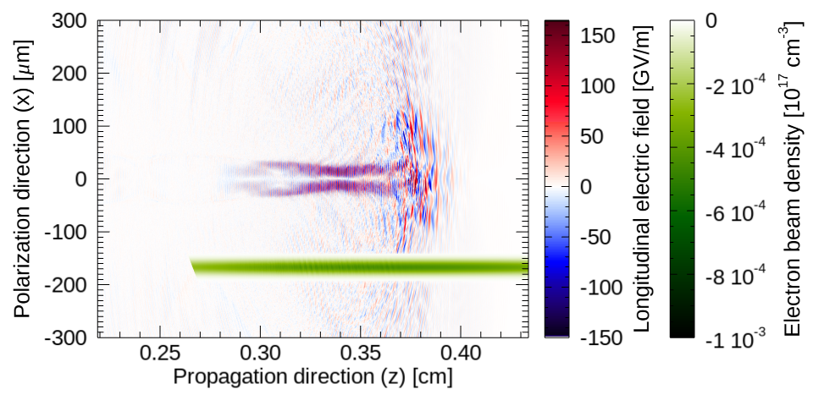
Electron beam probe preliminary results show strong density modulations
Electron beam probe
37￼

Slide 38
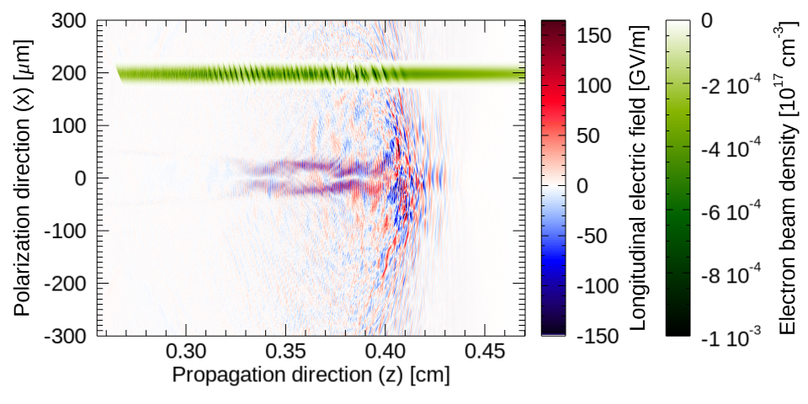
Electron beam probe preliminary results show strong density modulations
A
Electron beam probe
Part of probe beam is modulated close to CO2 frequency (inside the channel)
Electron beam probe
A
B
C
B
Part experiences the strongly nonlinear “hosing-like” fields
C
Part goes through wakefields in more linear regime where CO2 self-modulates
38￼

Slide 39
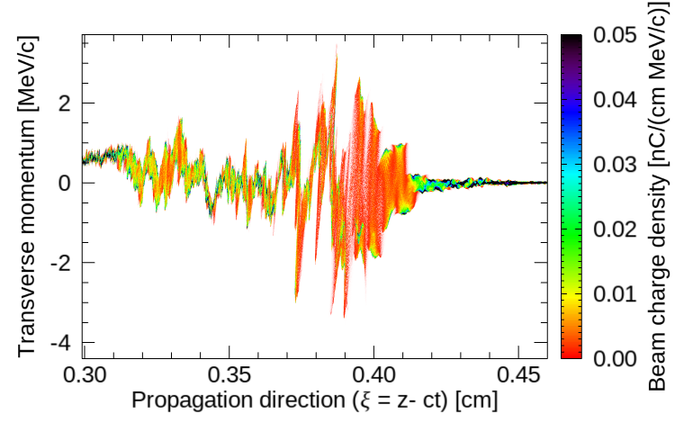
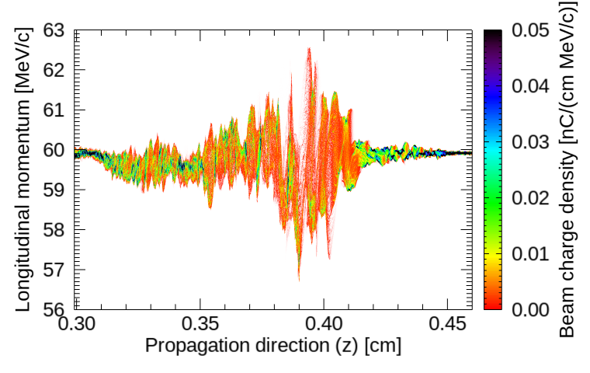
Electron beam phase space shows momentum gain (loss) of up to 2(3) MeV/c
A
B
C
A
Part of probe beam is modulated close to CO2 frequency (DLA inside the channel)
B
Part experiences the strongly nonlinear “hosing-like” fields
C
Part goes through wakefields in more linear regime where CO2 self-modulates
39￼

Slide 40
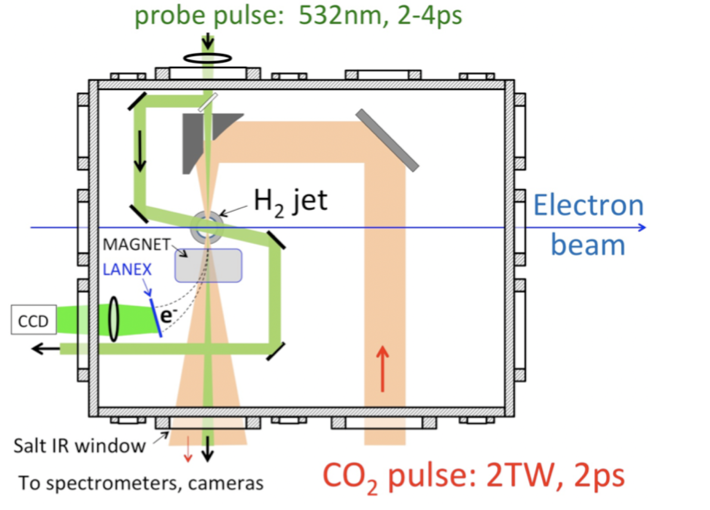
Proposed Experiment with Electron Beam as Probe
40￼

Slide 41
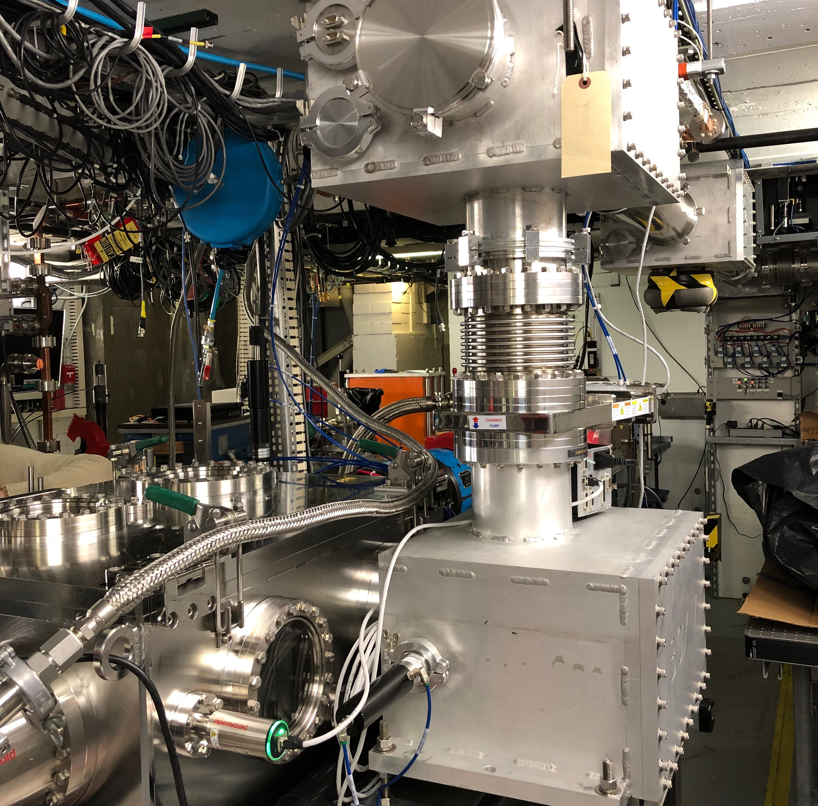
Where Things Currently Stand …
BPM 3
BPM 2
e-beam
CO2 In
LWFA Chamber
CO2 Out
41￼

Slide 42
One more thing …
42￼

Slide 44
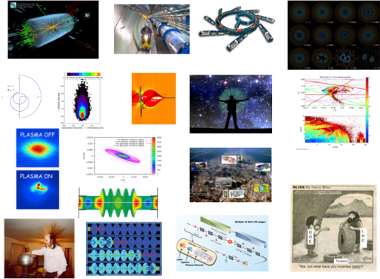
Other Accelerator Science Faculty
PHY 554
fall 2018
Vladimir
Litvinenko
Yue
Hao
Yichao
Jing
Gang
Wang
CASE faculty are involved in many exciting projects and are looking for students
Future Circular Colliders (FCC)
Coherent Electron Cooling
Plasma Wakefield Accelerators
Beam optics of a polarized proton and He3 beams
44￼

Slide 45
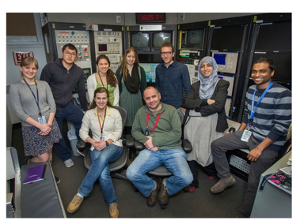
Accelerator Physics at SBU
http://case.physics.stonybrook.edu/index.php/Main_Page
45￼

Slide 46
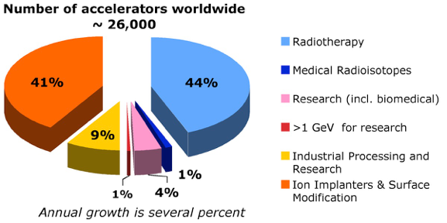
Accelerators are important to society
Sales > 3.5 B$/yr
Value of treated goods> 50 B$/yr **
Sources: W. Maciszewski & W. Scharf, L. Rivkin, * EPP2010, ** R. Hamm
46￼

