Slide 1
eRHIC Design Overview
Christoph Montag, BNL
January 30, 2019

Slide 2
Requirements for an EIC
High luminosity: L = (10³³-10³⁴) cm⁻²sec⁻¹
Large range of center-of-mass energies E_{cm}= (29-140) GeV
Polarized beams with flexible spin patterns
Favorable condition for detector acceptance such as p_{T} =200 MeV
Large range of hadron species: protons ….Uranium
Collisions of electrons with polarized protons and light ions (h³He, hd,…)

Slide 3
RHIC as a basis for an EIC
Two superconducting storage rings
3.8km circumference
Energy up to 255GeV protons, or 100GeV/n gold
110 bunches/beam
60% proton polarization – world’s only polarized proton collider
6 interaction regions, 2 detectors
In operation since 2001
Exceeded original design luminosity by factor 50 – unprecedented performance

Slide 4
Use the YELLOW RHIC ring…

Slide 5
…and add an electron storage ring

Slide 6
Beam parameters at highest luminosity ($\sqrt{s}=105GeV$)
Many bunches (up to 1320)
High beam currents (1A p, 2.5A e)
Flat beams
Short hadron bunches (5cm with cooling, 7cm without)
Crossing angle collisions with crab crossing
High luminosity: 10.1*${10}^{33}{cm}^{−2}\sec^{−1}$with cooling, 4.4*${10}^{33}{cm}^{−2}\sec^{−1}$without

Slide 7
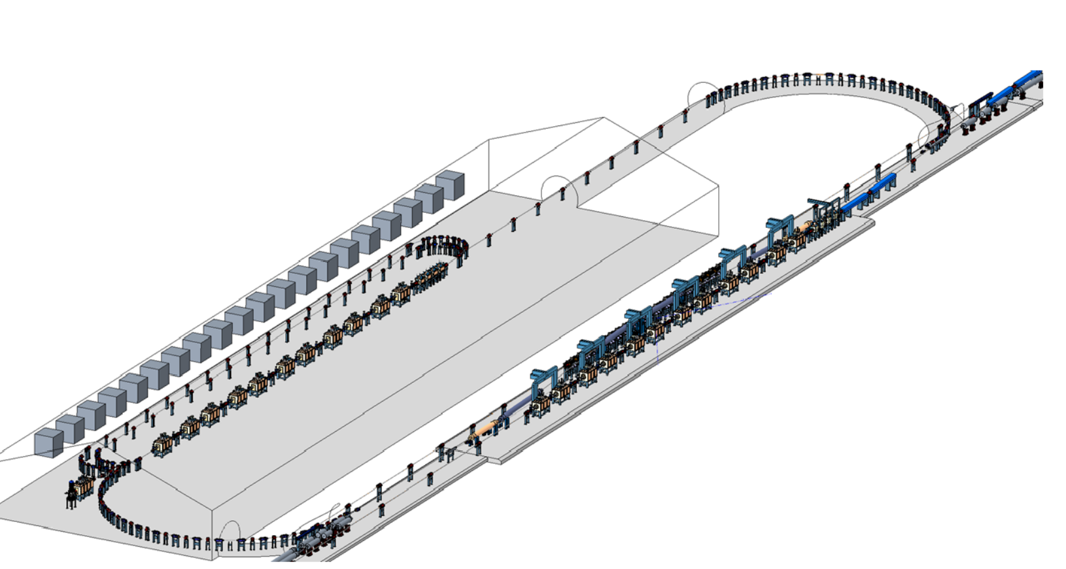
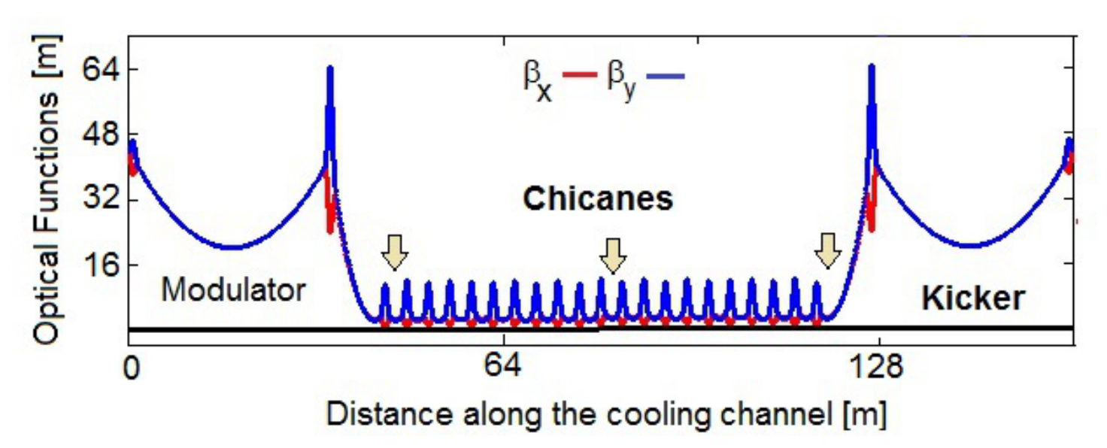
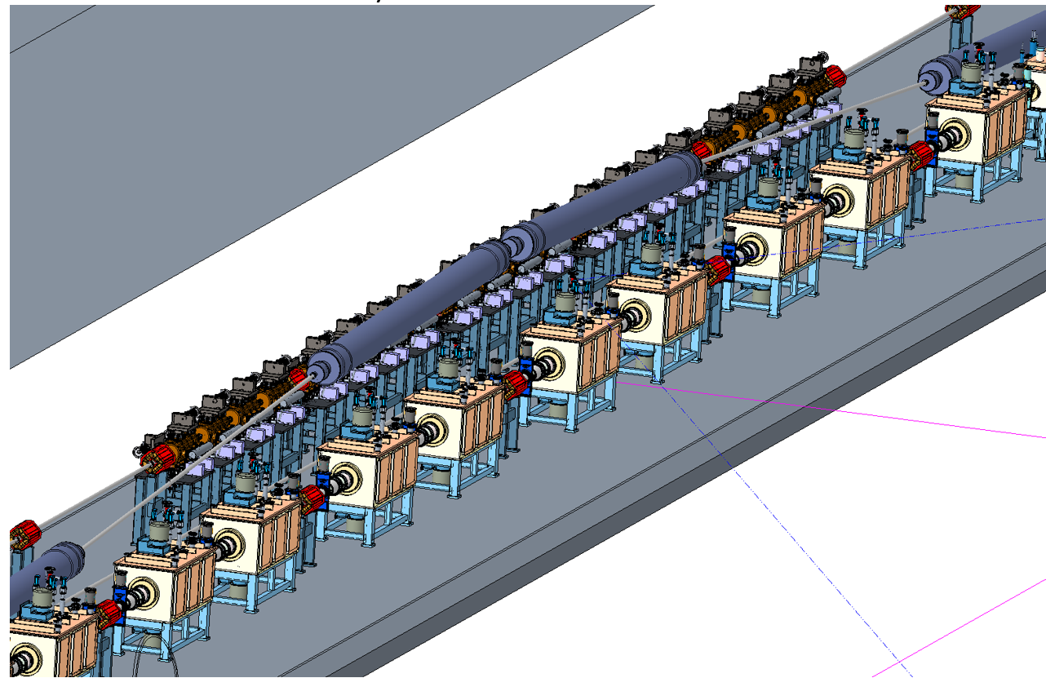
Strong Hadron Cooling
Challenges:
2 hour IBS growth times require strong hadron cooling
100 mA CW electron source is beyond state of the art
Hadron chicane to compensate for electron delay in the micro-bunching chicanes is a considerable effort (need several Blue ring s.c. RHIC magnets)
Unexplored:
Short bunches might boost the cooling rate, reduce the electron current and reduce number of amplifications.
To Do:
3-D model
Simulation including space charge and drifts
Optimization of parameters for short bunches

Slide 8
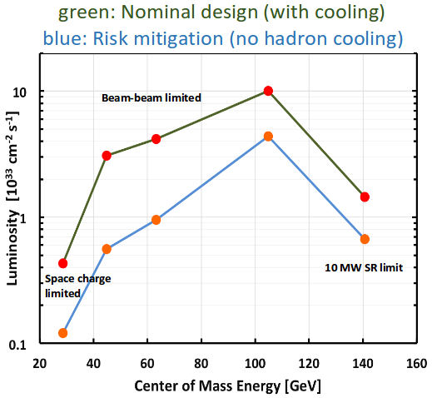
Luminosity versus Center-of-Mass Energy
Strong hadron cooling improves luminosity by factor 2.3 at $\sqrt{s}=105 GeV$ and beyond, and by factor 6-7 at lower energies

Slide 9
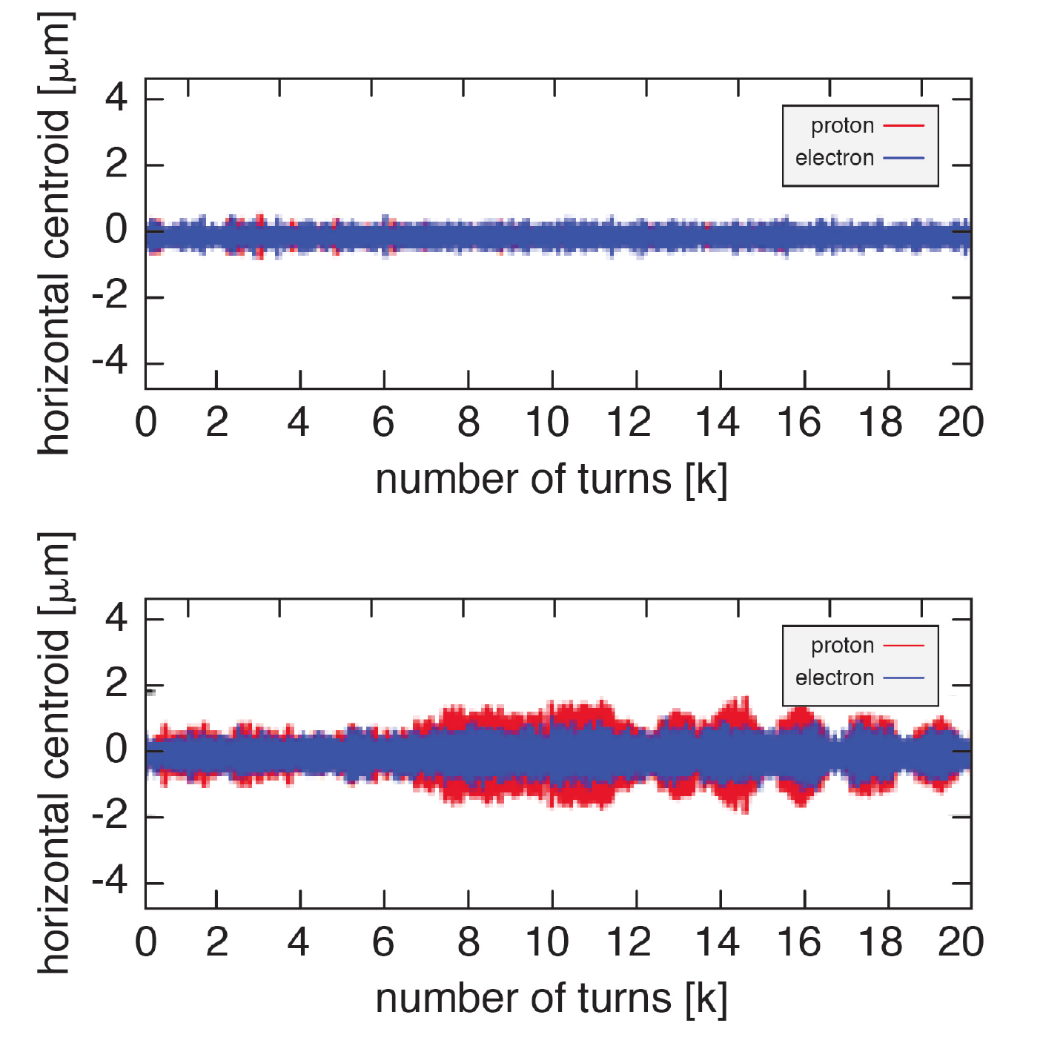
Beam-Beam Physics
Operate electron ring just above integer resonance to benefit from dynamic focusing and to stay away from half-integer spin resonance
Concerns:
Slow hadron emittance growth,
examined using long term weak-strong
simulations
No evidence in head-on collisions
Crab crossing studies still in progress
Coherent beam-beam instability,
examined by strong-strong simulations
using several codes
Threshold found
at twice the design intensities

Slide 10
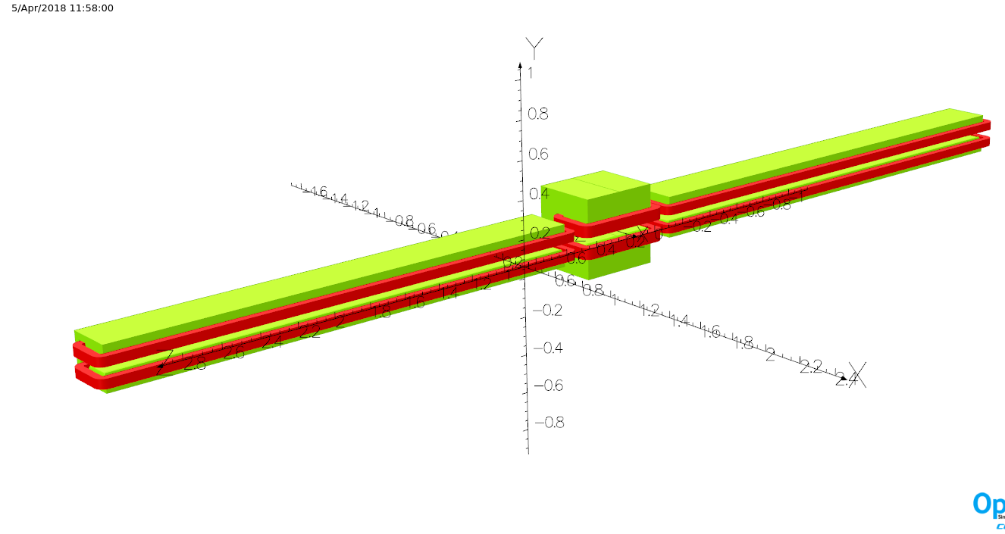
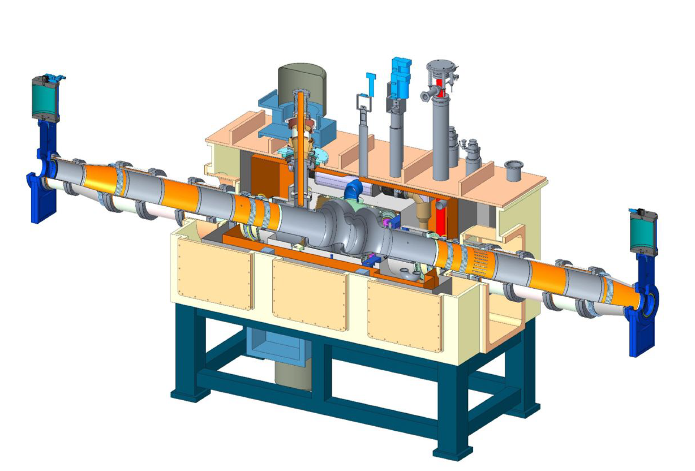
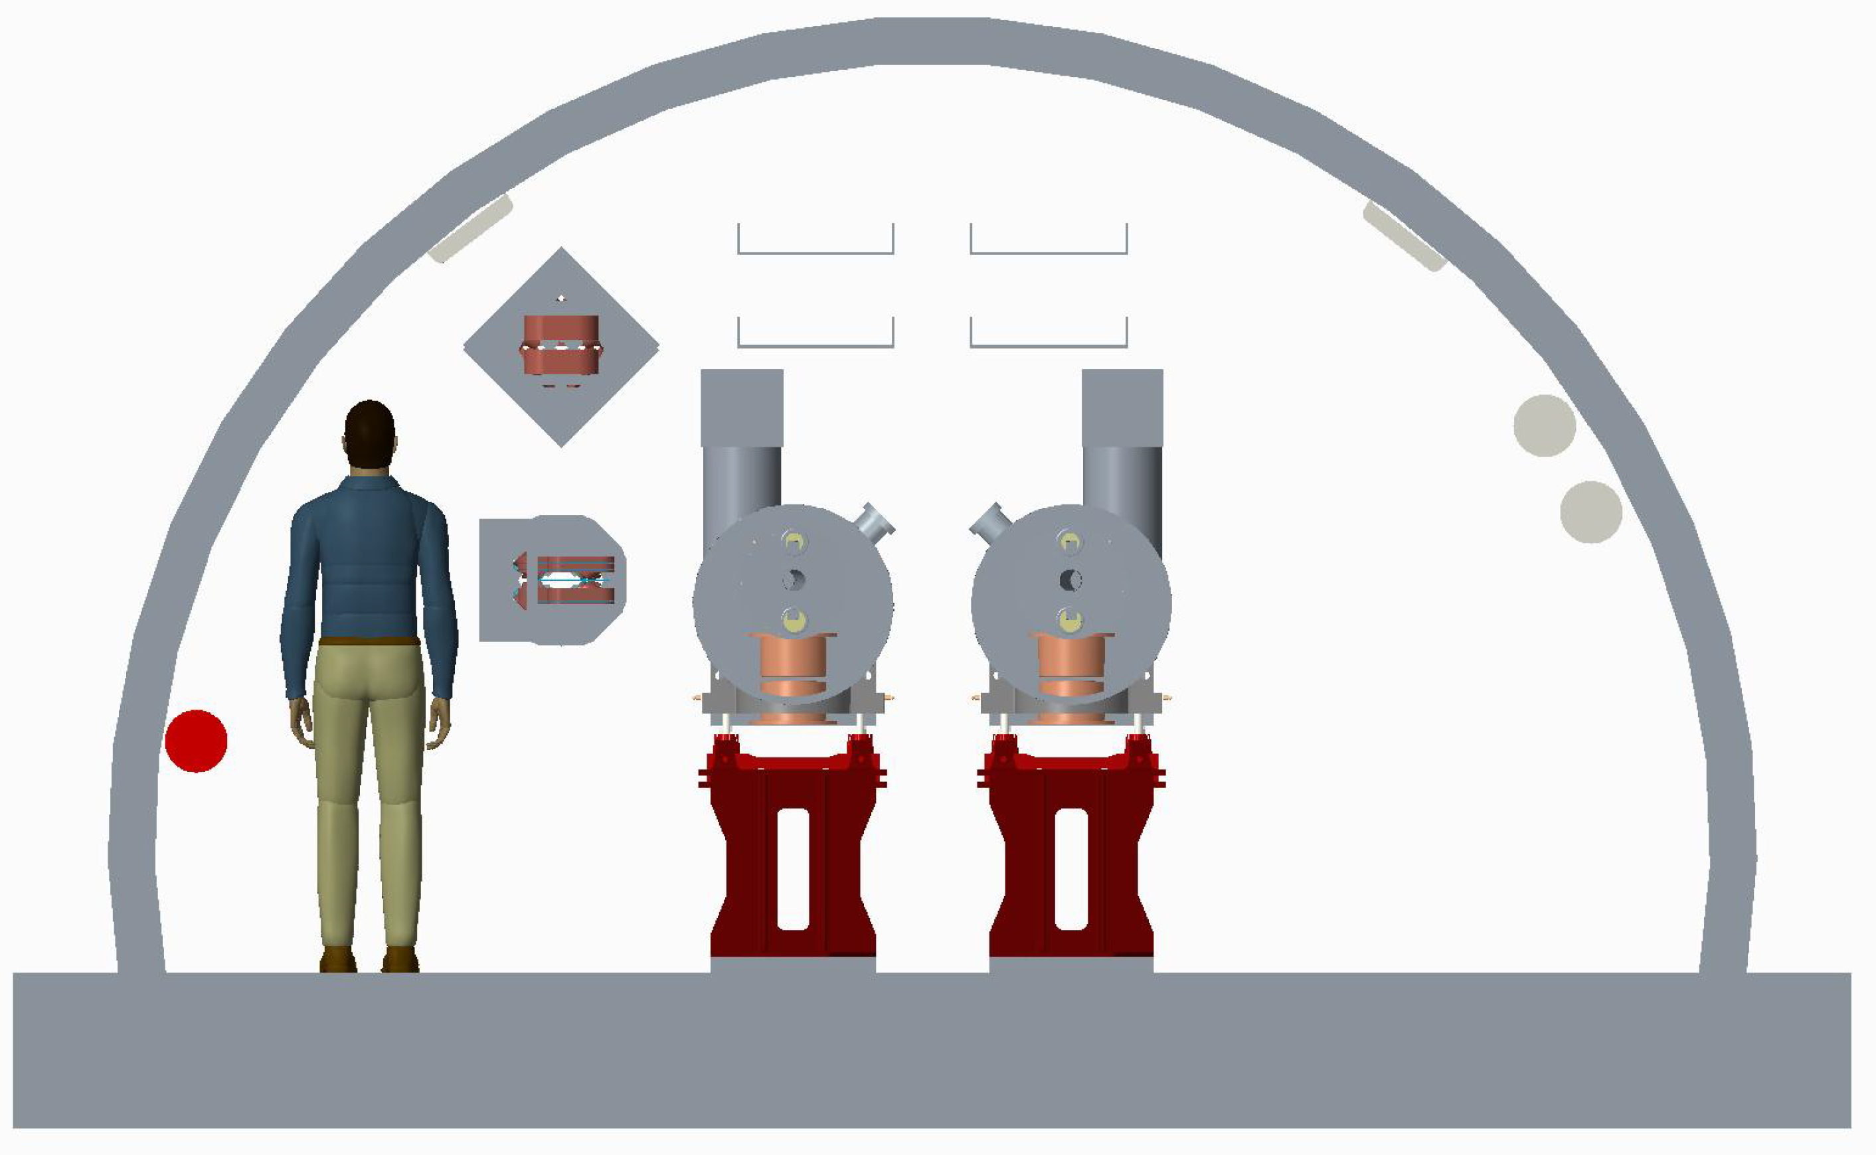
Electron Storage Ring
Composed of six FODO arcs with 60º /cell at 5-10 GeV,
90º /cell at 18 GeV for 20nm emittance at all energies
Super-bends for 5-10 GeV for emittance control and
additional radiation damping
5 straight sections with simple layout, plus IR straight
Radiate approx. 10 MW for maximum luminosity parameters at 10GeV
➔ 12 superconducting 2-cell RF cavities
Storage
Ring

Slide 11
Synchrotron Radiation
Conflicting Requirements:
- At high energy, radiation power needs to be minimized by a large dipole packing factor to allow high beam currents
At low energy, radiation damping needs to be artificially increased to allow large beam-beam parameters ξ=0.1
Solution: Super-bends

Slide 12
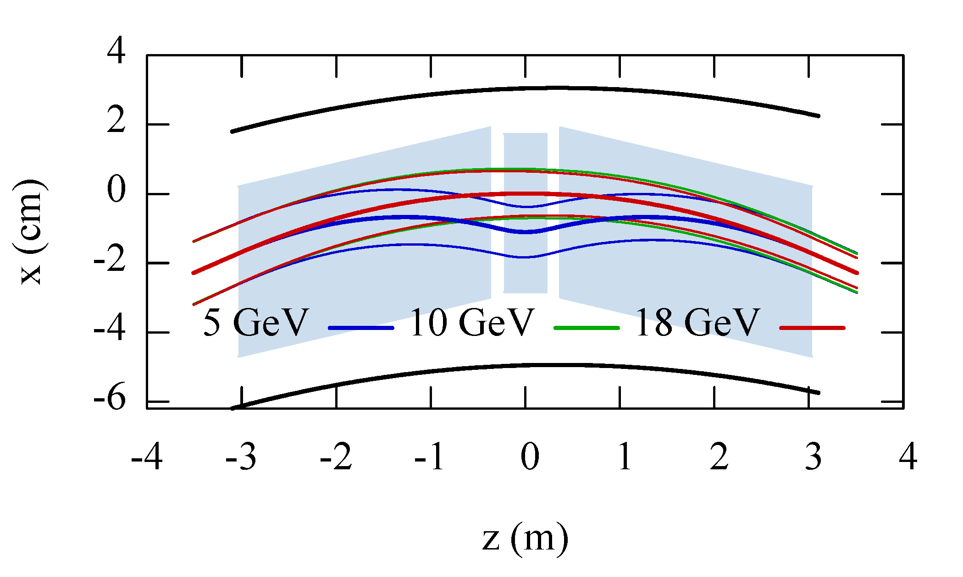
Super-Bends
Arc dipoles to be split into 3 segments:
Above 10 GeV, all segments powered uniformly to reduce SR power
At 5 GeV, short center dipole provides a reverse bend to increase damping decrement
Vacuum chamber aperture

Slide 13
Comparison with B-Factories
Parameters for 10 MW RF power are very challenging, comparable to B-Factories

Slide 14
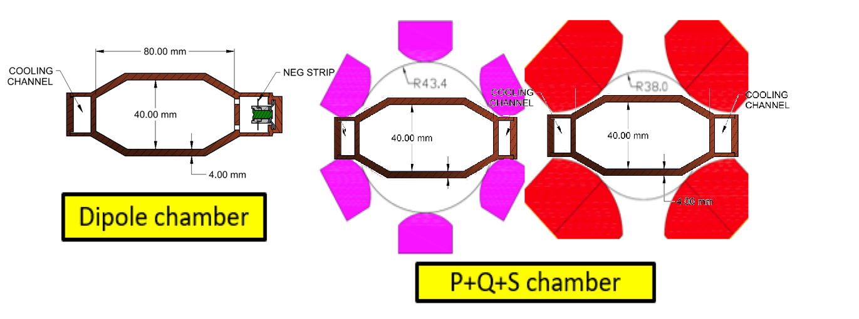
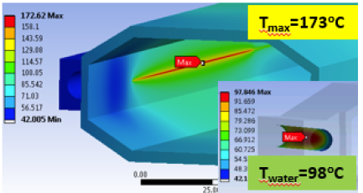
SR Vacuum System
Vacuum chamber from CuCrZr alloy
Good thermal properties
Weldable
Brazable
Easily available
Reasonable price
Thermal SR power load
ok
Maximum temperature 173°C
well below yield strength limit
Pumping based on
integrated NEG Pumps
Silver plated sleeve
Copper fingers
RF bellows:
Critical element of the vacuum system
Improved NSLS-II bellow with outside
CuCr fingers good candidate
Contact spring
RF spring groove

Slide 15
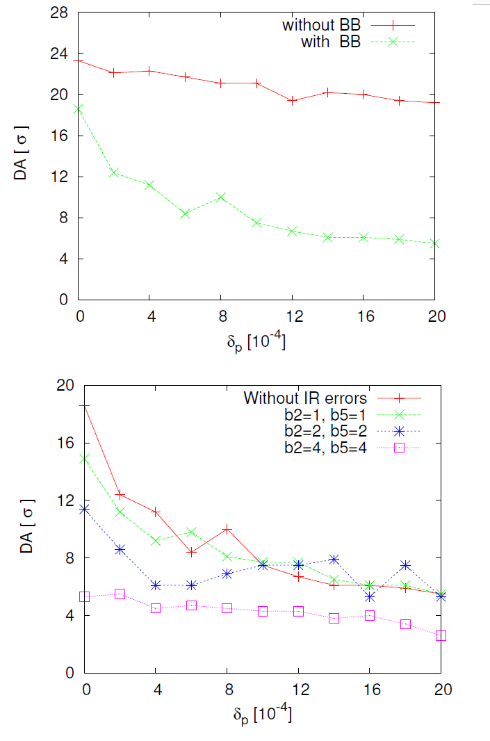
Hadron Ring Dynamic Aperture
Requirement: DA> 5 σ (RHIC experience)
Long terms tracking in eRHIC hadron ring
with beam-beam effect
with multipole errors
Beam-beam has a strong impact on DA
Systematic multipole errors in the IR should not
exceed 2 units of 10⁻⁴ @ 25mm
High demand on IR magnet design
No attempts to improve DA by nonlinear corrections yet
No study of random errors yet
Dynamic aperture comparable to present RHIC

Slide 16
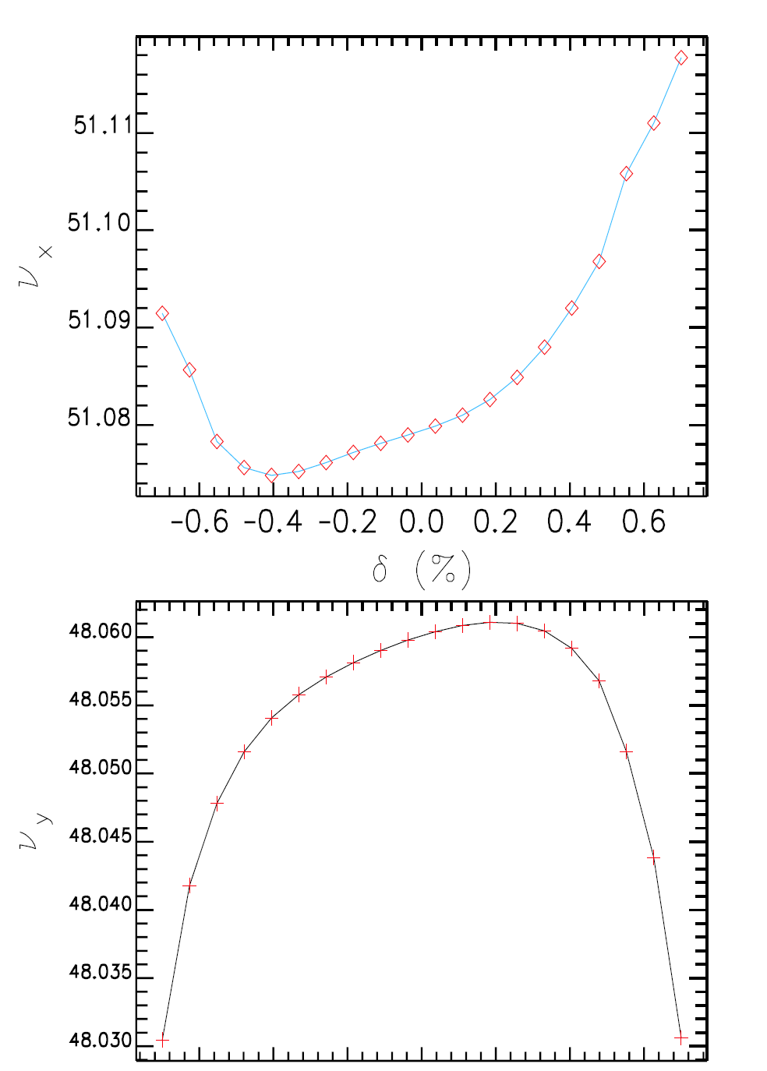
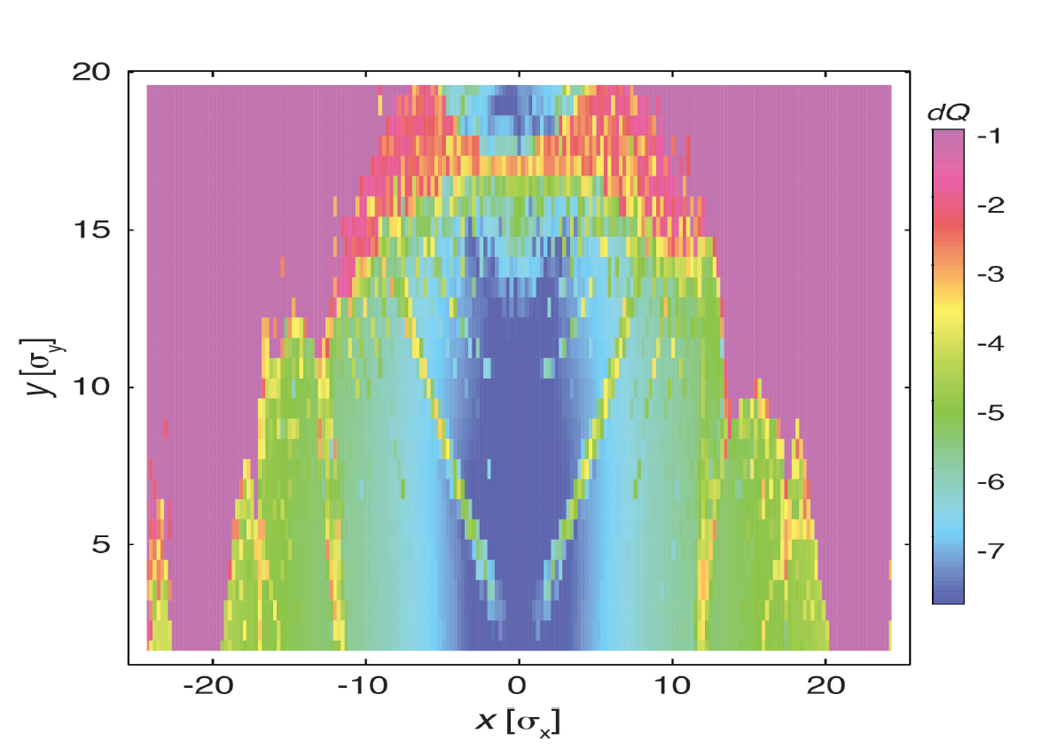
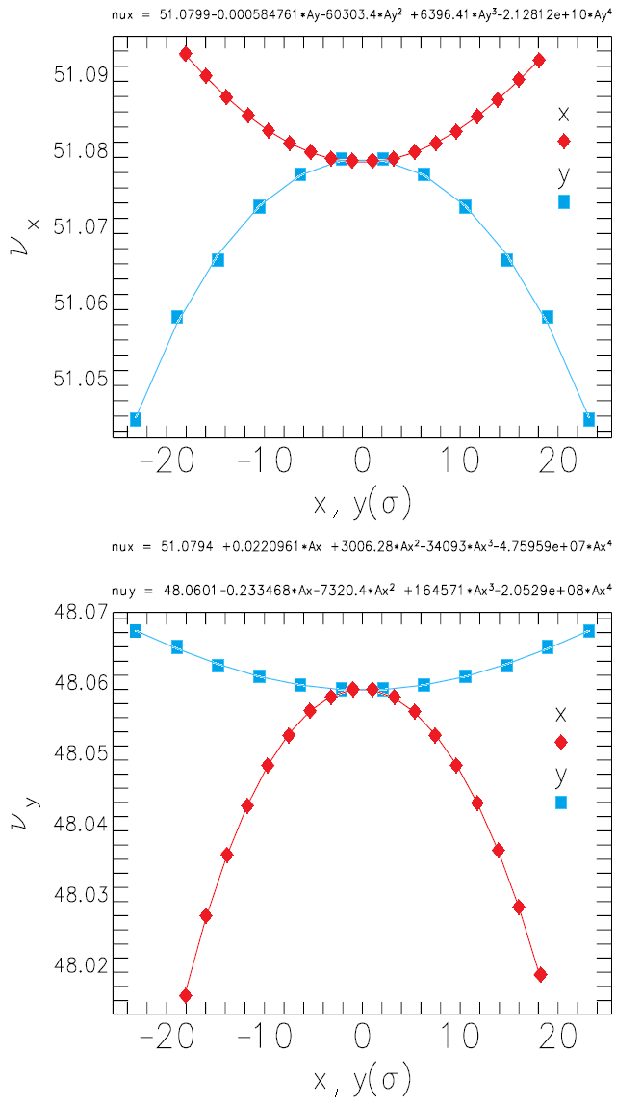
Electron Ring Dynamic Aperture
Requirement: DA > 10 σ in all three planes (lifetime)
Main issue: 2nd order chromaticity (local IR ξ_{x,y} = -30)
Sextupole scheme: A-B-E-A-B-A-B-C-A-B-C-A-B-E-A-B
Off-momentum DA still limited at 0.8% (12σ) by
2nd order vertical chromaticity
On-momentum DA ~ 20 σ, limited by tune shift with
amplitude $\frac{∂Q_{x,y}}{∂J_{y,x}}$
No results with beam-beam and imperfections yet
No optimization of non-chromatic sextupoles yet

Slide 17
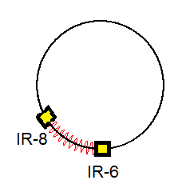
Dynamic Aperture with 2 IRs
On-momentum dynamic aperture with 2 IR and 2 family sextupole correction exceeds 20 σ in tracking studies
Off-momentum: Arrange phase advances between IRs such that IR-induced β-beats compensate each other
➔ need only 2 sextupole families (one per plane)
HERA-II experience with this concept:
- Without IR-IR compensation, no DA at desired working point
With IR-IR compensation ➔ sufficient on-and off-momentum DA
Need to confirm with systematic tracking

Slide 18
Collective Effects
Electrons:
Single bunch instabilities checked with standard code and appear to be stable.
Transverse coupled bunch modes appear to be stable.
Might need a longitudinal damper for coupled bunch instabilities.
We consider the possibility of removing the 3rd harmonic RF system ($$)
Fast ion instability is expected to be present but manageable at SuperKEKB vacuum levels.
Feedback noise might affect hadrons ➔ still needs to be studied and noise specs
need to be defined
Hadrons:
Electron cloud is most worrisome➔ Cu and amorphous carbon coating of stainless steel vacuum chamber needed (prepared and planned)
IBS: 2 hour emittance growth time horiz. and long. ➔ need strong hadron cooling
Coherent instabilities appear to be absent at top energy
Might need a narrowband damper to control coupled bunch instabilities at injection.

Slide 19
Electron Storage Ring Polarization
Physics program requires bunches with spins parallel ↑ ↑ and antiparallel ↑↓ to main dipole field simultaneously.
Sokolov-Ternov would slowly flip all bunches into antiparallel orientation
Need to replace bunches with parallel spin ↑ ↑ with a rate much faster (5 min) than Sokolov-Ternov time constant (>30 min)
Performed spin tracking to determine equilibrium polarization:
Equilibrium polarization P∞ = 50% in eRHIC sufficient
to maintain polarization with <P> = 63% (spin ↑↓➔ 80%)
Polarization with BB not studied yet
Conclusion:
Polarization ok so far
More improvements expected by longitudinal spin matching, harmonic bumps, BBA, etc.

Slide 20
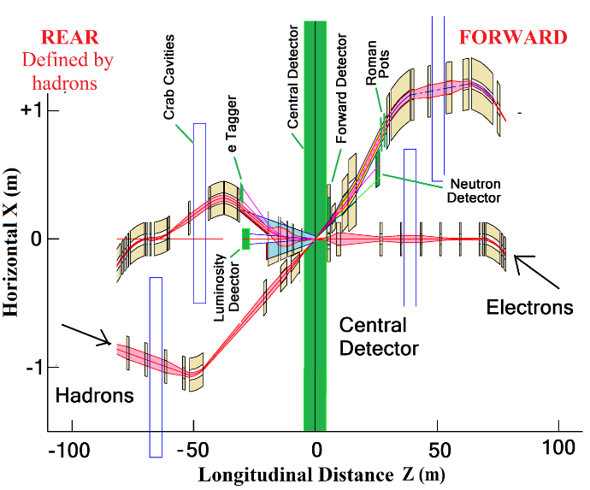
IR Layout
IR design requirements:
Small β* for high luminosity
Limited IR chromaticity contributions
Large final focus quadrupole aperture
Large detector acceptance
➔ Large quadrupole aperture, limited beam divergence
Accommodate spectrometer in the low-β optics
No accelerator magnets +/-4.5 m
25 mrad crossing angle (increased from 22 mrad to ease magnet design), crab crossing, crab cavities 90° from IP
Avoid synchrotron radiation:
- no electron bends on the forward side
- absorb SR far from IP
- need mask against backscattered SR photons
Accommodate spin rotators, spin matching
Space for luminosity monitor, neutron detector, “Roman Pots”
Design meets all requirements
➔ Very constrained systems, requires novel types of magnets in the IR

Slide 21
Multi-stage separation:
Electrons from protons
Protons from neutrons
Electrons from Bethe-Heitler photons (luminosity monitor)

Slide 22
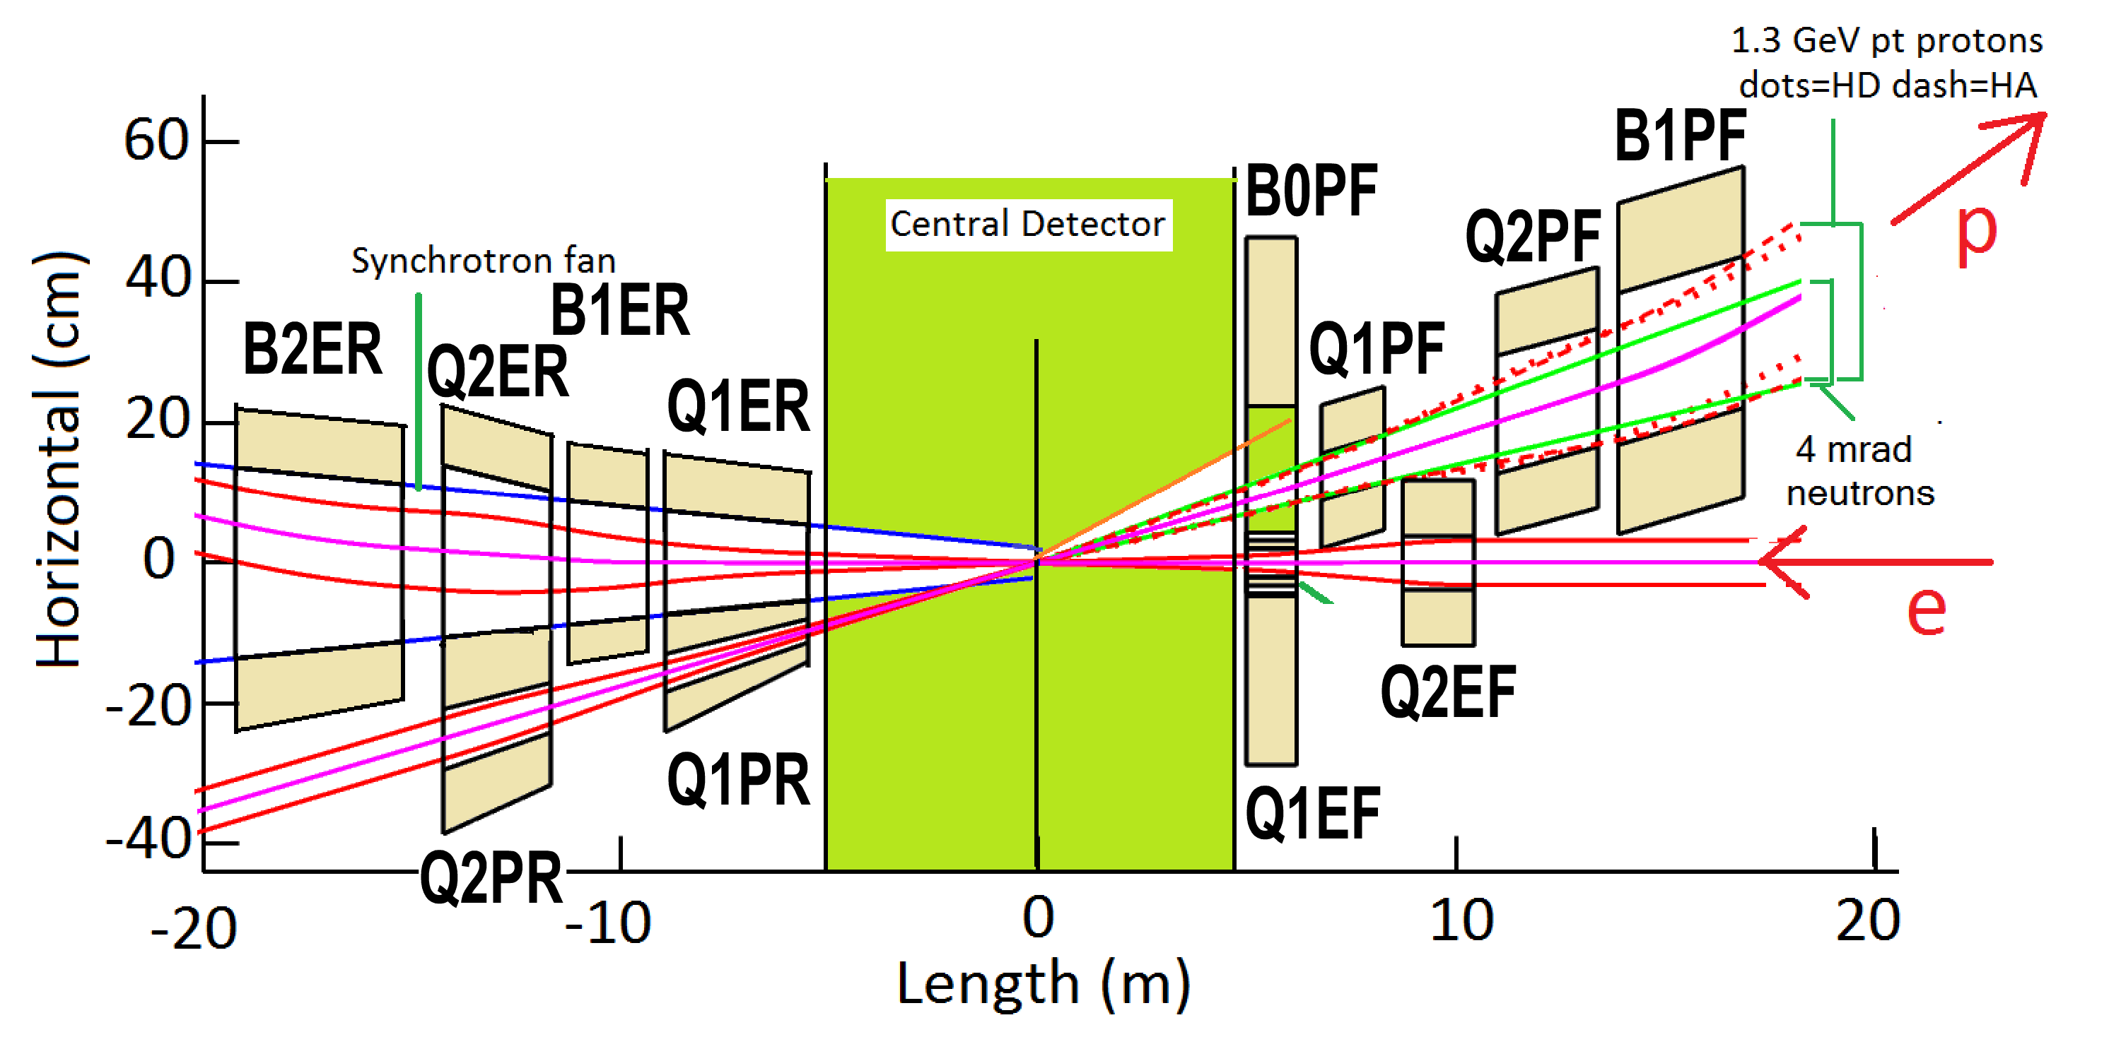
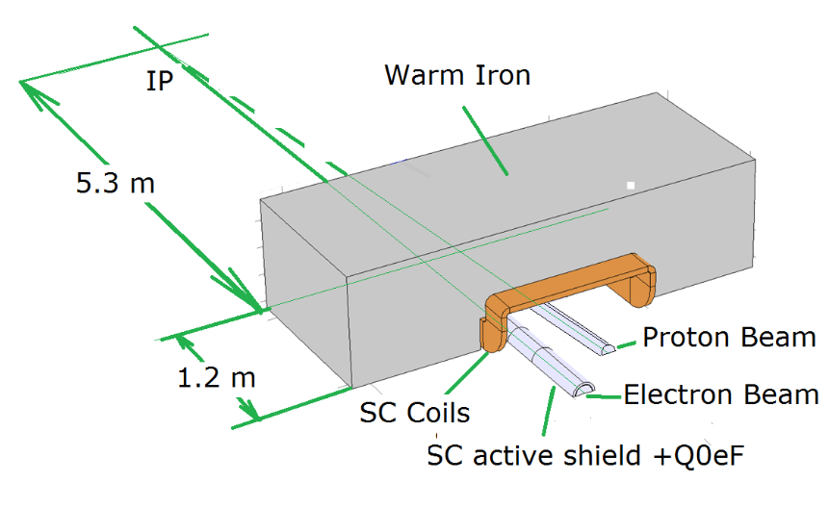
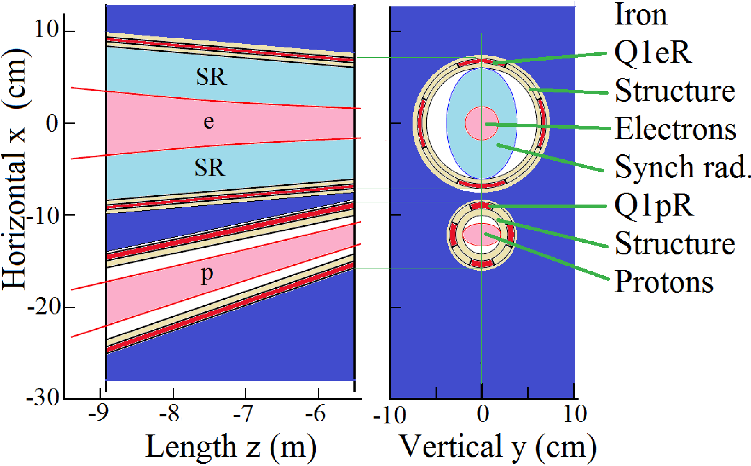
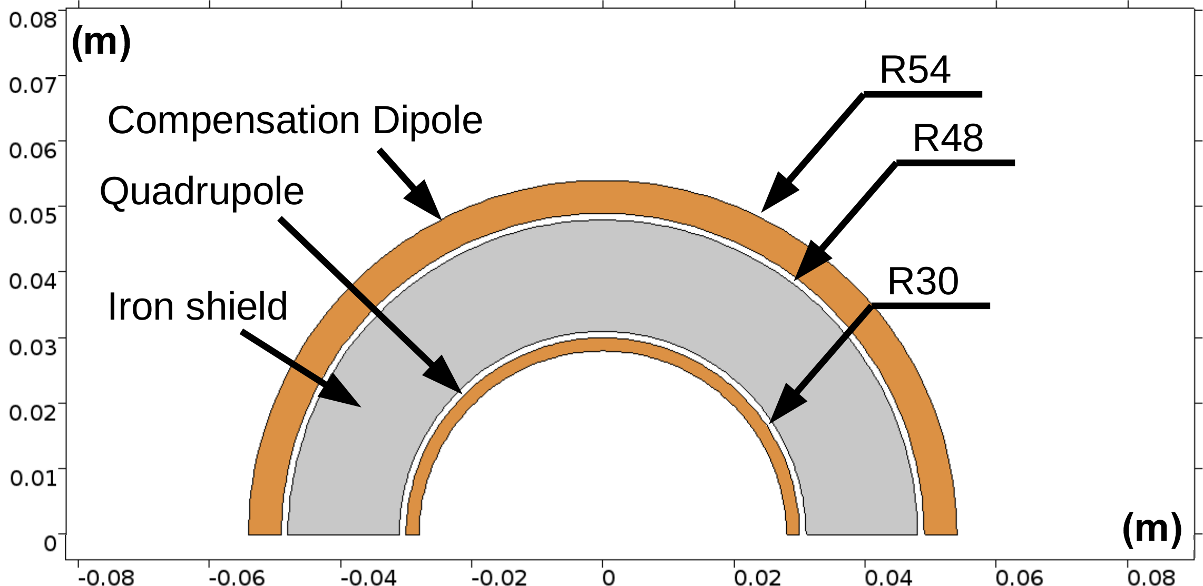
IR Magnets
1.3 T Cancel Coil Detail
Q1EF

Slide 23
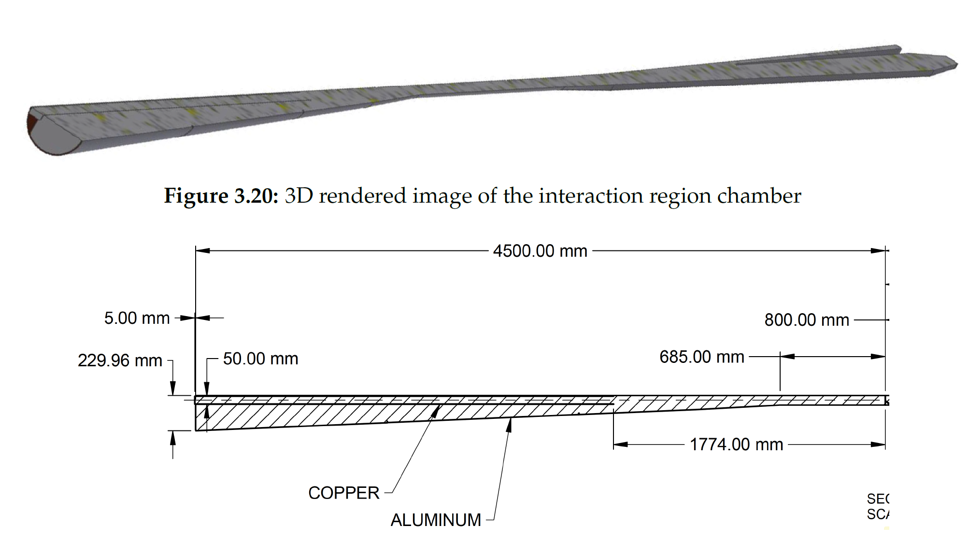
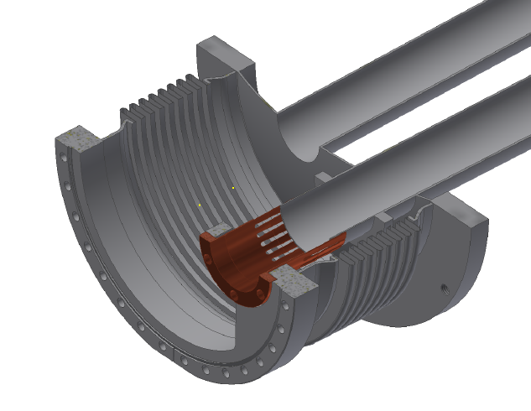
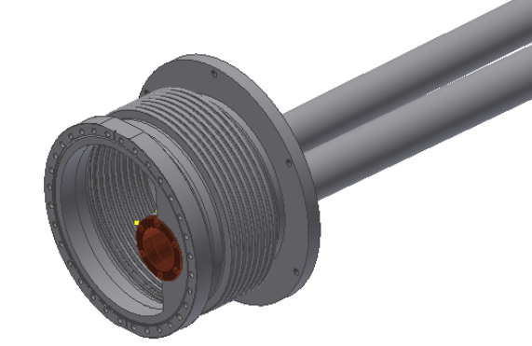
IR Vacuum
Design of the complex
IR vacuum system has
started
Lengths of warm-cold vacuum transitions taken into account in lattice design
Impedance assessment has started

Slide 24
Electron Injector Complex
Rapid-cycling synchrotron (RCS) in the RHIC tunnel
400 MeV LINAC in 2 o’clock stub tunnel

Slide 25
Rapid Cycling Synchrotron
eRHIC requires a full energy polarized injector for rapid electron bunch replacement
A rapid cycling synchrotron is the most cost effective solution
High periodicity and proper tune choice ensures polarization preservation on the ramp
Straight sections designed as unit matrices
Simulations show good robustness of spin preservation against machine errors (alignment, field errors, …)

Slide 26
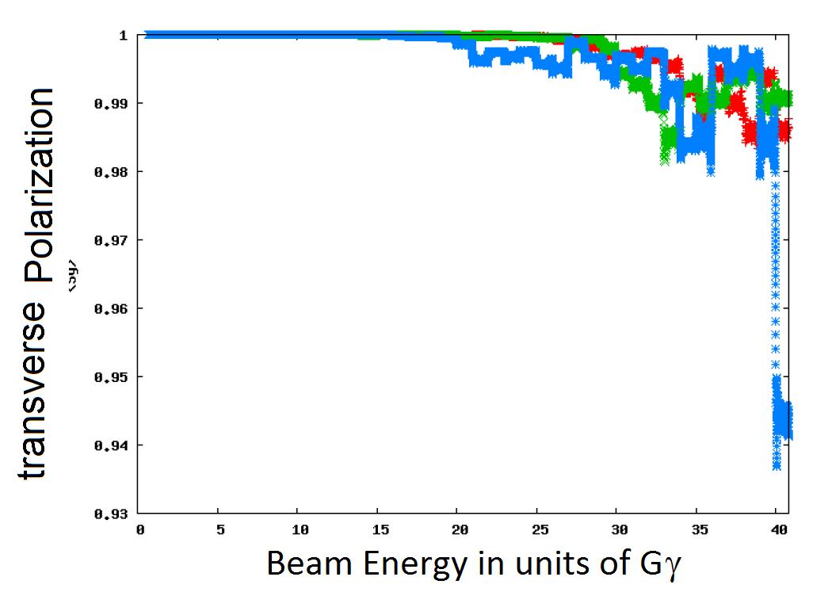
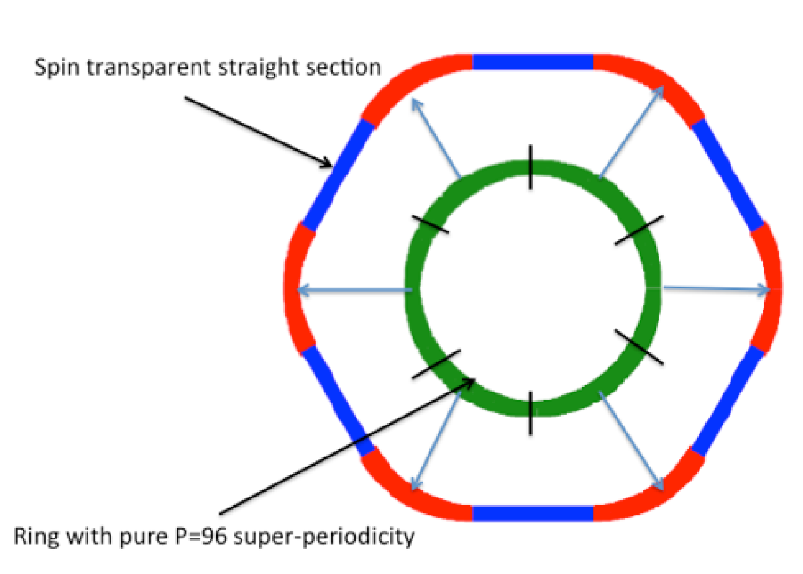
Rapid-Cycling Synchrotron Polarization
High quasi-symmetry
➔ Good spin transparency properties
Blue asterisk: 200 ms ramp time

Slide 27
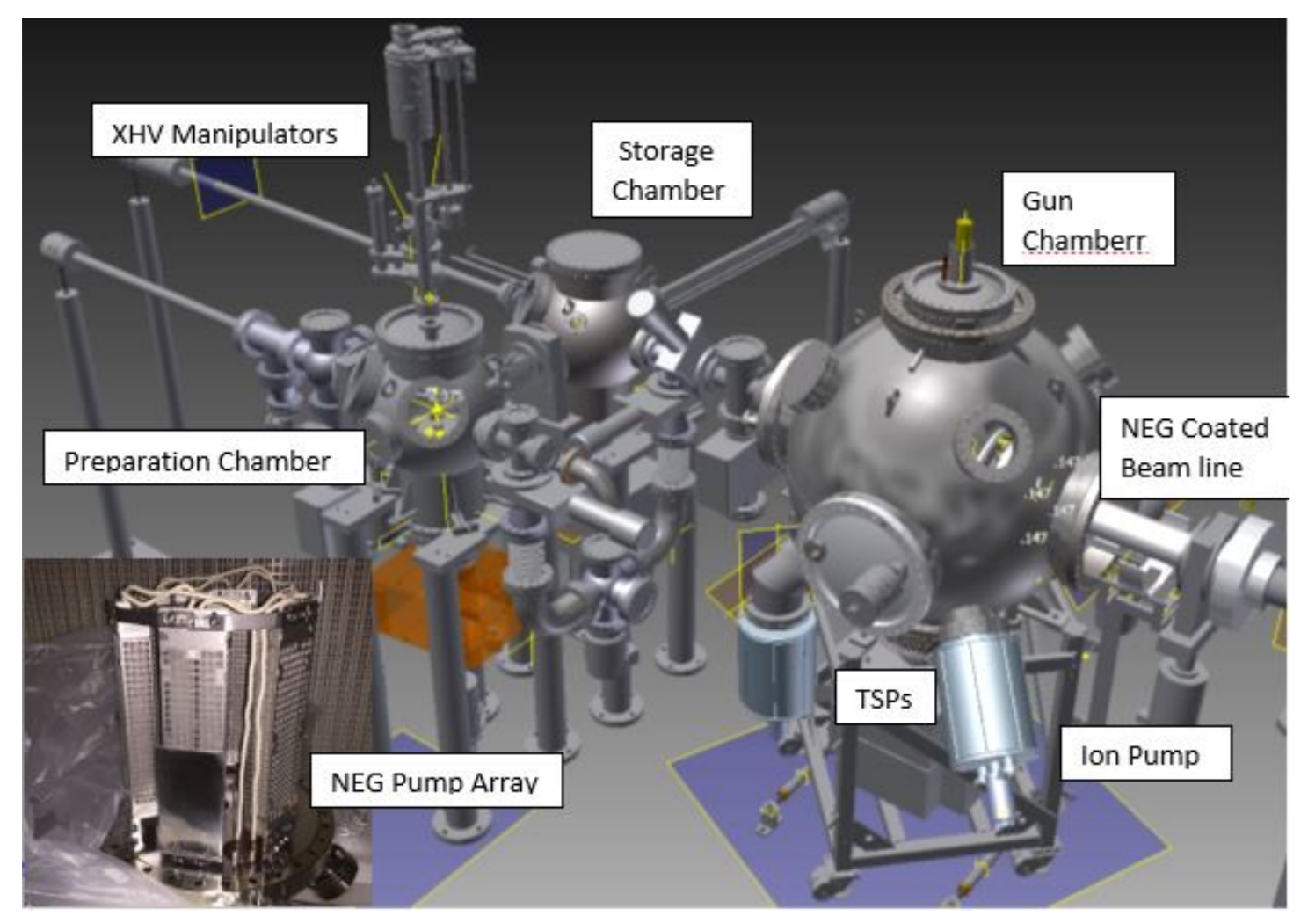
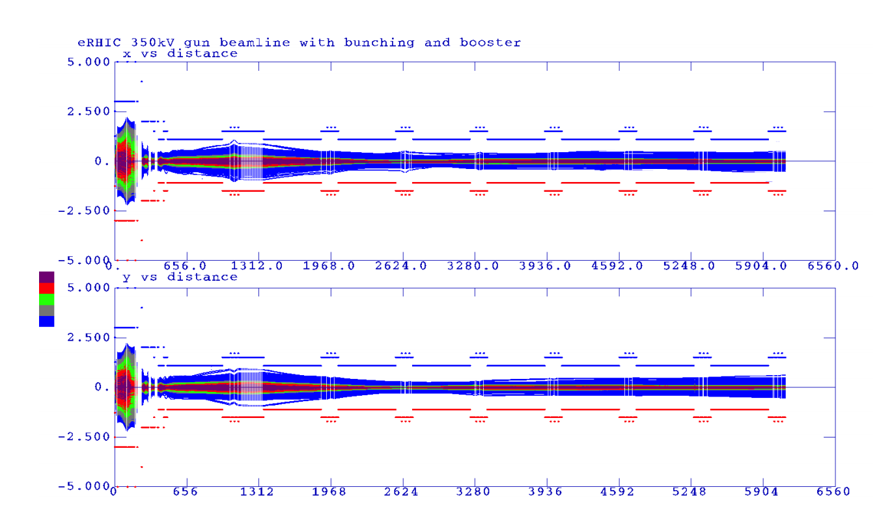
Polarized Electron Source
Need to provide 10 nC of polarized electrons/second
SLC Gun with 16 nC 120 Hz operation is the existence proof
eRHIC polarized gun is based on the JLAB inverted gun
Design verified by PIC beam dynamics simulations
400 MeV injector linac will be a SLAC type S-band linac.
Beam transport simulated and found to be ok for eRHIC beams.
Wien filter, polarimeter design already in fairly large detail

Slide 28
Hadron Storage Ring
YELLOW RHIC ring will serve as eRHIC hadron ring
In-situ beam pipe coating with copper for improved surface conductivity, and amorphous carbon to reduce SEY
BLUE arc from IR6 to IR4 as transfer line extension to new injection area
BLUE inner arc between IRs 12 and 2 for circumference matching during 41 GeV low-energy operation

Slide 29
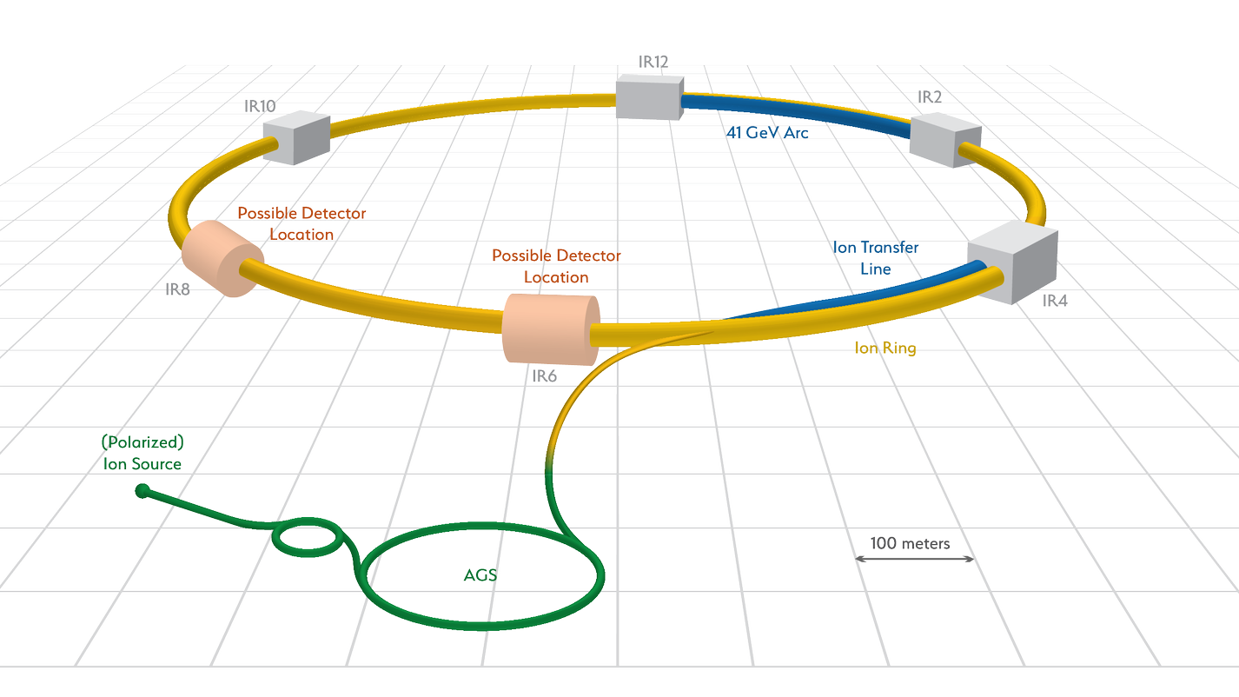
Circumference Matching and Hadron Injection
Hadron velocity varies with energy
Revolution frequency in both rings needs to be matched
Use BLUE arc between IRs 2 and 12 as shortcut for 41 GeV protons; adjust radius between 100 and 275 GeV
New injection kickers to be installed in IR4
Use BLUE arc to extend injection line and transport beam to IR4

Slide 30
Putting it all together

Slide 31
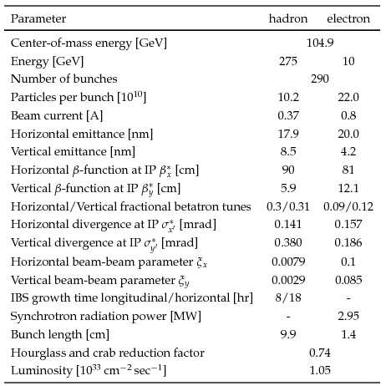
Initial operations parameters
eRHIC design parameters are quite ambitious
Experience at other facilities shows that reaching design parameters may take a while
These initial parameters can be reached with very little commissioning time
With a luminosity of $1.05∗{10}^{33}{cm}^{−2}\sec^{−1}$and a maximum center-of-mass energy of 105 GeV, this is still within the minimum requirements of the EIC White Paper

Slide 32
Summary
eRHIC design reaches a peak luminosity of
L= 1.05·10³⁴cm⁻²s⁻¹
^{with 2 hour IBS growth times}
However, this can only be achieved with strong hadron cooling, which is beyond state of the art, and is a topic of ongoing R&D.
Without hadron cooling a peak luminosity of
L= 0.44·10³⁴cm⁻²s⁻¹
is reached, with IBS growth times of 9 hours
eRHIC design has progressed very well and a tremendous amount of design work was accomplished.
There are still critical beam dynamic issues which require more effort. They could have an impact on achievable luminosity but do not constitute a risk of missing the EIC White Paper Requirement
While a large amount of work is still ahead to arrive at a Conceptual Design, we believe that the present state of the eRHIC design matches well the expectations of a Pre-Conceptual Design

Slide 33
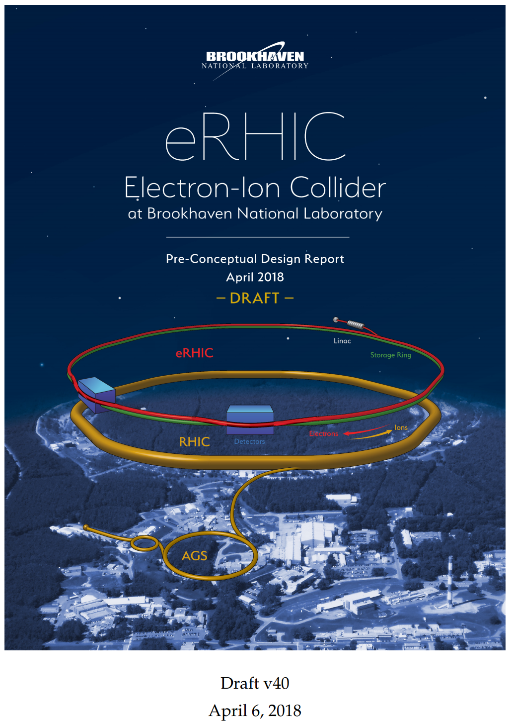
Pre-Conceptual Design Report was delivered to DOE (publication pending)
~800 pages, with many subsystems already beyond pre-conceptual stage
Active R&D program on strong hadron cooling

