Slide 1
Brookhaven National Laboratory
Accelerator Test Facility
By Mikhail Fedurin
03/24/2020

Slide 7
ATF facility and e-beam capabilities

Slide 8
ATF layout

Slide 9
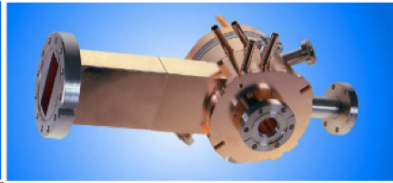
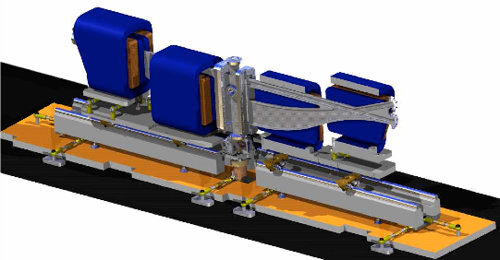
Main beam parameters
Parameter | Typical value / range | Best value
Energy | 30-80 MeV | 80 MeV
Charge | 0.1 – 1 nC | 3 nC
Repetition rate | 1.5 Hz | 10 Hz
Electron spot size on cathode | 2.86 mm | 0.2 – 4 mm
Bunch length | 1-8 ps | 100 fs with compression
Average bunch current | 100 A | 1.5 kA with compression
Emittance | 1 – 3 mm mrad | 0.8 mm mrad @ 0.5 nC

Slide 11
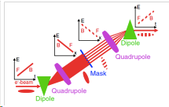
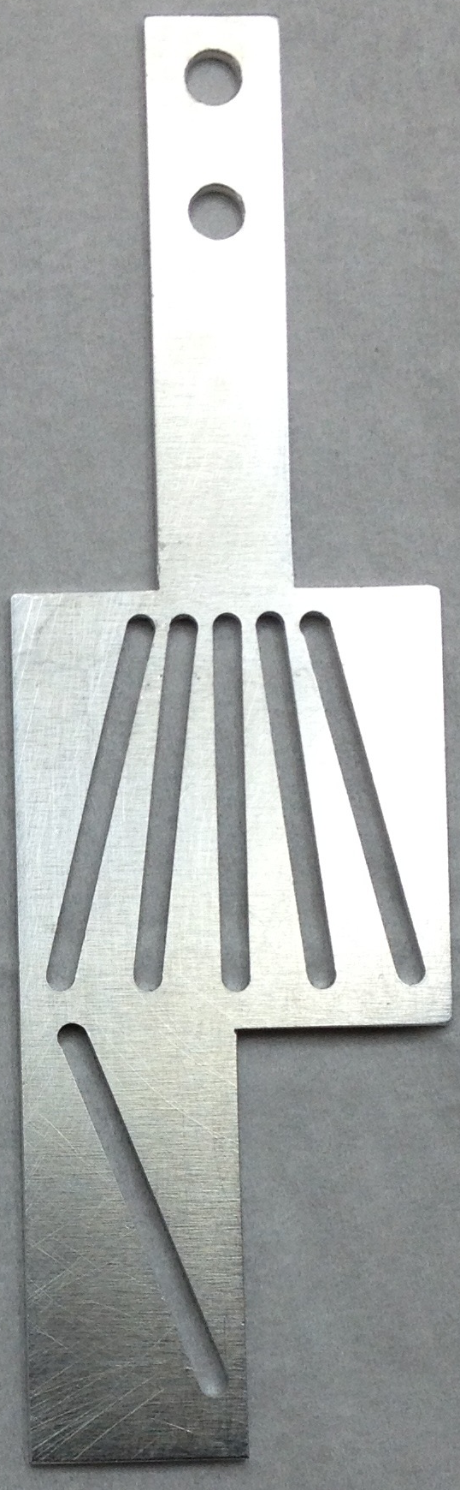
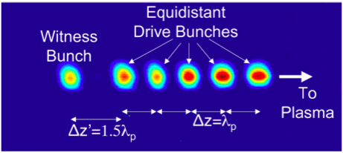
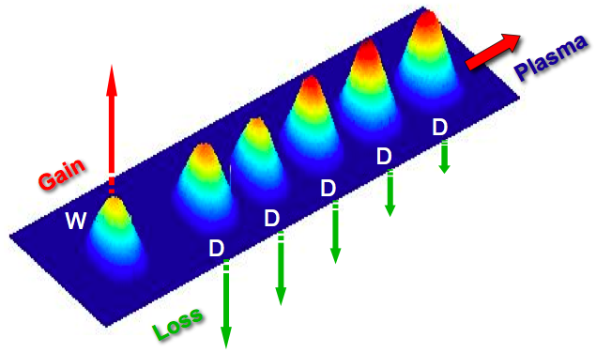
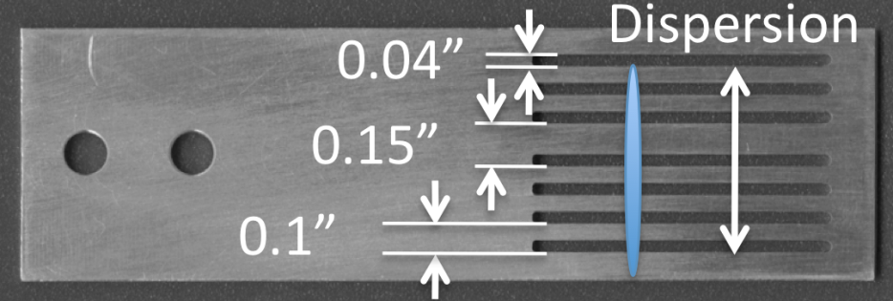
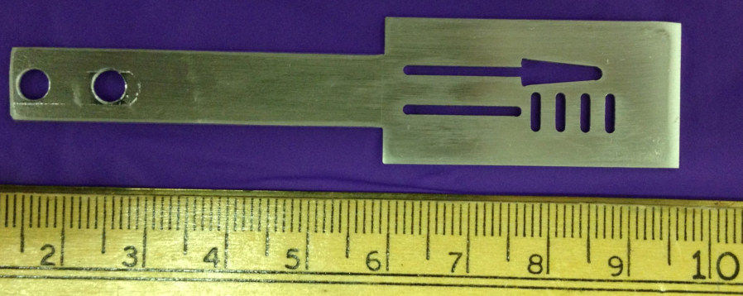
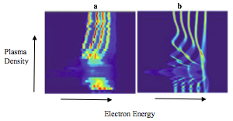
Beam capabilities: mask techniques
bunch current 100 A
30 μm bunches
Muggli, P., et al., Simple method for generating adjustable trains of picosecond electron bunches. Physical Review Special Topics-Accelerators and Beams, 2010. 13(5): p. 052803
Muggli, P., et al., Generation of trains of electron microbunches with adjustable subpicosecond spacing. Phys Rev Lett, 2008. 101(5)

Slide 12
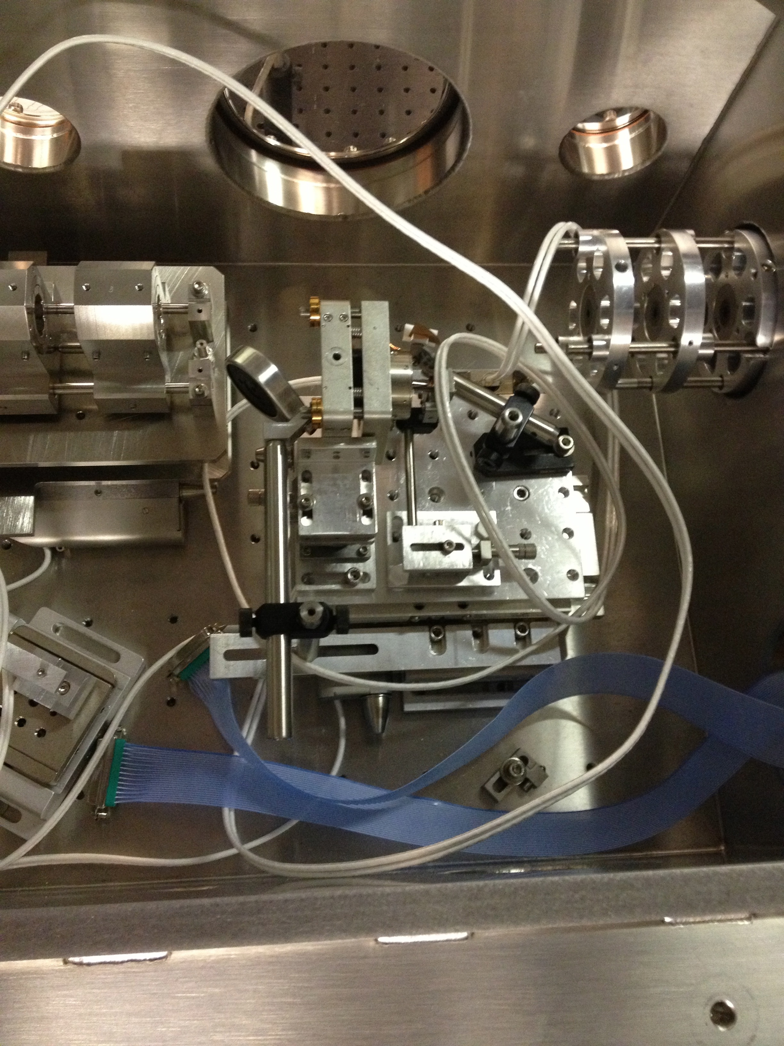
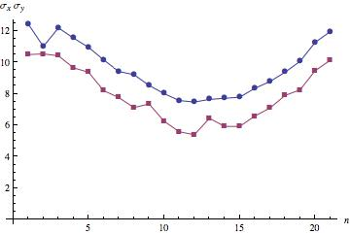
Beam capabilities: transverse size σ_{x,y} ~ 5 μm
Radiabeam PMQ triplet assembly:
K=50 T/m, triplet focal length ~20 cm
UCLA PMQ triplet assembly:
K=500 T/m,
triplet focal length ~8 cm
Microscope (25-0506 X15 Reflecting Objective NA 0.28, F~13 mm)
Basler Gigabit camera (scA 1400-17gm, F=135 mm).

Slide 14
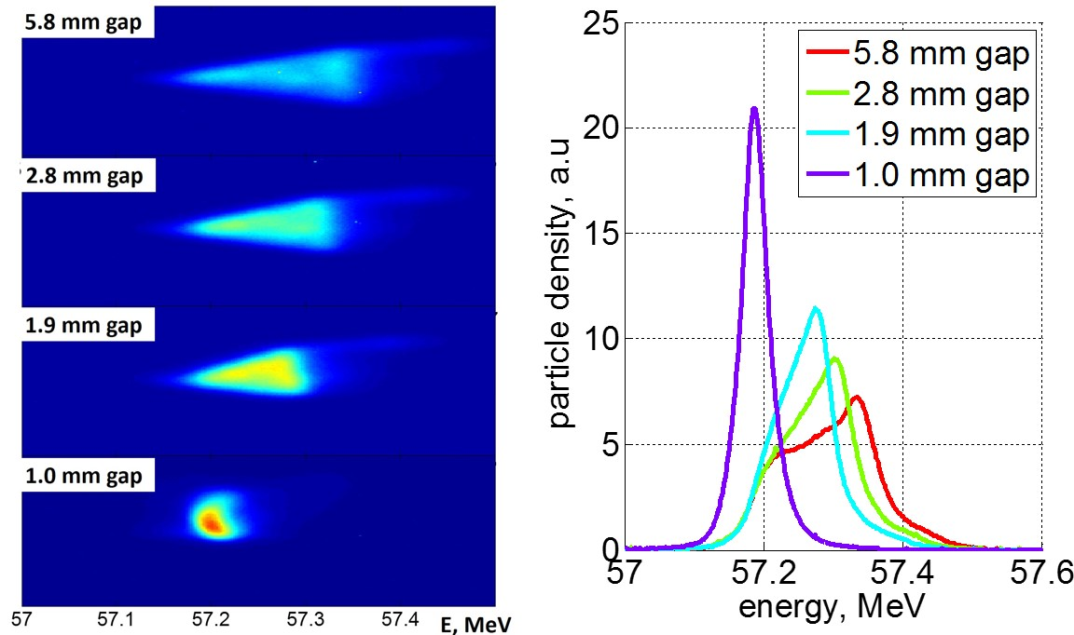
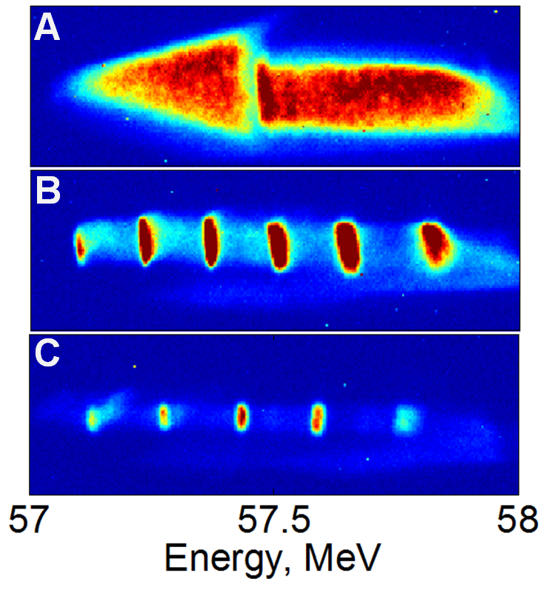
Diagnostics: spectrometer
Measurement: spectrometer
Original chirped beam
0.95 THz structure
0.76 THz structure
Triangular-shaped (current) beam with energy chirp Correlated energy spread was removed by closing the dechirper gap
Observation of energy modulation
S. Antipov, S. Baturin, C. Jing, M. Fedurin, A. Kanareykin, C. Swinson, P. Schoessow, W. Gai, and A. Zholents, Phys. Rev. Lett. 112, 114801 (2014)
S. Antipov, C. Jing, M. Fedurin, W. Gai, A. Kanareykin, K. Kusche, P. Schoessow, V. Yakimenko, A. Zholents, Phys. Rev. Lett. 108, 144801 (2012)
By courtesy of Sergey Antipov, Euclid

Slide 15
Recent experiments at ATF

Slide 26
Thank you!

Slide 28
Textbook and suggested materials
“The Theory and Design of Charged Particle Beams” by Martin Reiser, published by Wiley (1994)
“Fundamentals of Beam Physics” by James Rosenzweig, published by Oxford 2003
“Classical Electrodynamics”, third edition, by J.D. Jackson, published by Wiley (1999). Chapters 11 and 12 are of particular relevance to this course.
Accelerator Physics, by S. Y. Lee

Slide 29
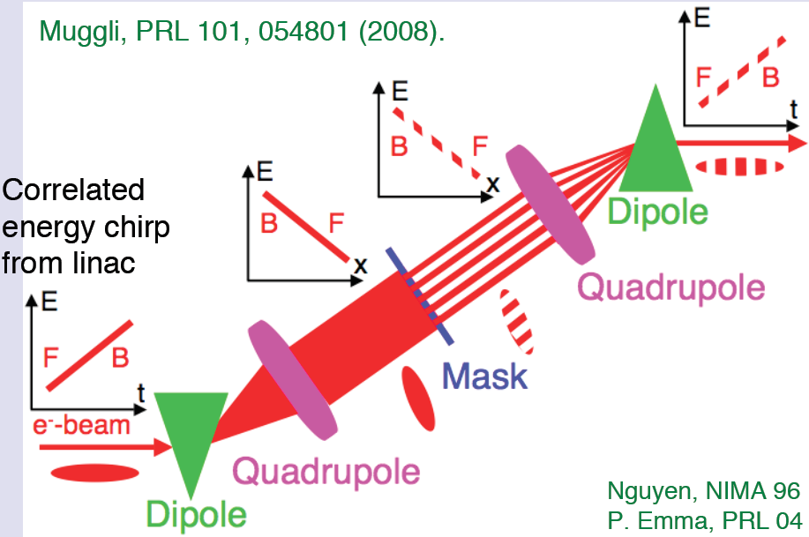
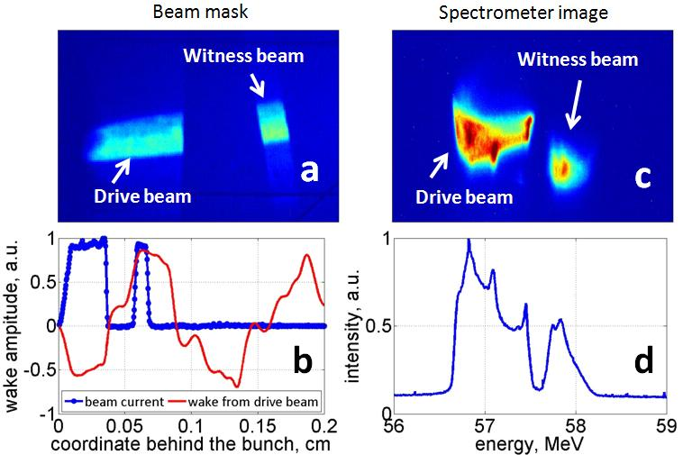
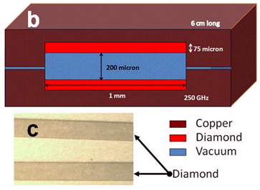
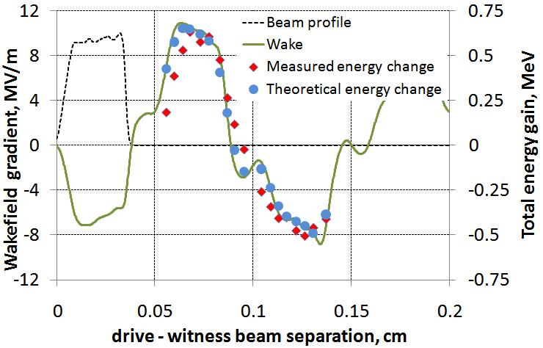
Mask technique: Wakefield Mapping
S. Antipov, C. Jing, A. Kanareykin, J. E. Butler, V. Yakimenko, M. Fedurin, K. Kusche, and W. Gai, Appl. Phys. Lett. 100, 132910 (2012)
By courtesy of Sergey Antipov, Euclid

