Slide 1
PHY542. photocathode QE measurements homework
D. Kayran, M. Fedurin
Data from was taken on March 20, 2023
PHY 542 Fundamentals of Accelerator Physics and Technology with Simulations and Measurements Lab

Slide 2
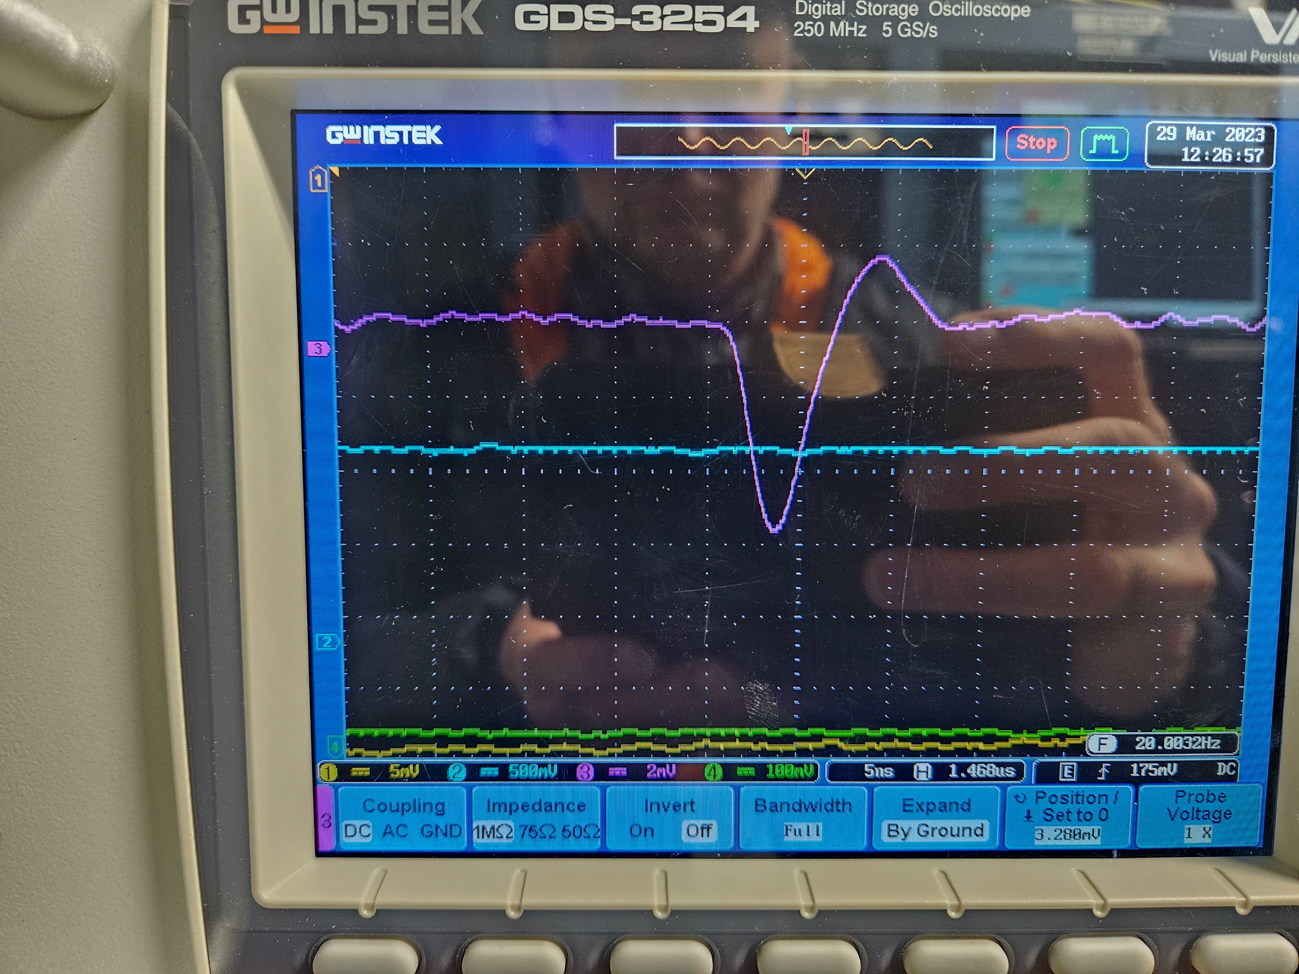
Photocathode QE measurements (work flow chart)
Collect data
Pay attention to units
Transfer to Excel
E_laser(nJ) | FC signal (mV) | Charge (C) | Nγ | Ne⁻
180 | 5 | 4E-13 | 2.38E+11 | 2500000
150 | 4 | 3.2E-13 | 1.98E+11 | 2000000
130 | 3.2 | 2.56E-13 | 1.72E+11 | 1600000
110 | 2 | 1.6E-13 | 1.46E+11 | 1000000
95 | 1.6 | 1.28E-13 | 1.26E+11 | 800000
80 | 0.8 | 6.4E-14 | 1.06E+11 | 400000
65 | 0.4 | 3.2E-14 | 8.6E+10 | 200000
Make a plot, Find correlations
Get a result
QE= numbers of electrons/numbers of photons
QE=??
-Are we done?
-Nope
Additional information
Laser wavelength 3rd harmonics
λ=262 nm
Electron charge: 1.6e-19 C
Plank constant: 6.6E-34 m²kg/s
Speed of light: 3E8 m/s
See next page

Slide 3
For the short report
Error analysis?
How good we measured each of the data points and why do you think so?
Laser energy? (+/- ???nJ)
Faraday cup signal? (+/- ??mV)
Numbers of photons? Numbers of electrons?
What is a resulted QE error? +/-?
Results analysis?
Does it make any sense?
Why not use red line? It starts from (0,0) no laser no bunch? But black line fits much better why?
How your results comparable with other similar experiments (if available)
Prepare and submit the report
For 15-20 minutes final presentation be ready to describe the effect and how it was measured
Don’t hesitate to ask for more details and material

