Slide 1
Coherent electron Cooling Experiment - Physics
Igor Pinayev
ICFA Mini-Workshop CeC 2019
July 25, 2019

Slide 2
Outline
Project overview
Accelerator performance
Experiments with FEL-based system
Run19 results
Future plans
Conclusions

Slide 3
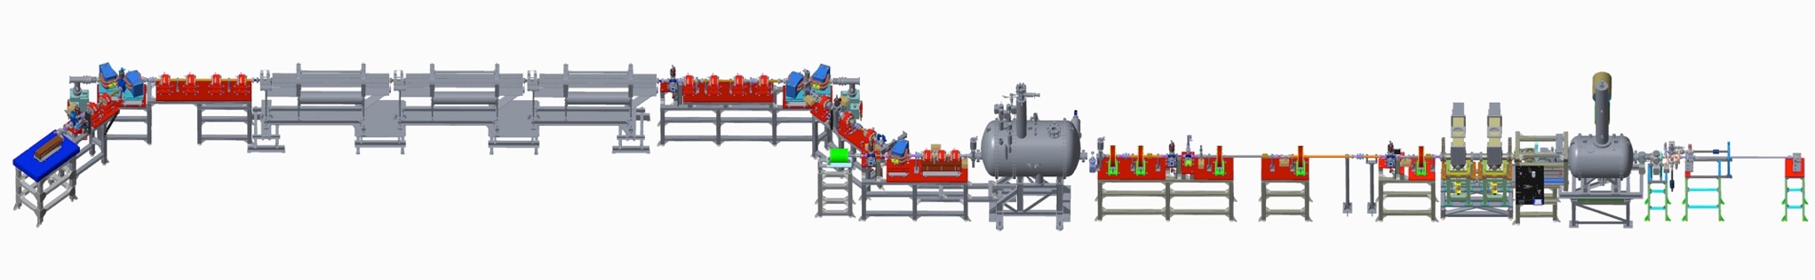
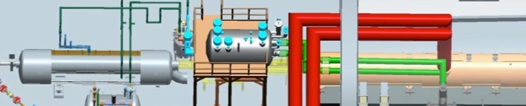
Coherent Electron Cooling Proof-of-Principle Experiment
Kicker
Modulator
hadrons
“garage”
FEL Structure
Accelerator
LEBT
Gun
The goal of the experiment is to demonstrate longitudinal cooling of a single Au⁺⁷⁹ bunch in the Relativistic Heavy Ion Collider.
The circulating hadron beam imprints its distribution on the electron bunch in the modulator section. The longitudinal charge modulation is amplified in the free-electron laser structure comprising three helical permanent magnet wigglers with a_{w}=0.5. The electrical field accelerates and/or decelerates hadrons in the kicker section.
Required electron beam parameters
Normalized emittance < 5 mm mrad
Relative energy spread σ_{E}/E < 10⁻³
Bunch charge 500 pC – 1.5 nC
Repetition rate 1 Hz – 78 kHz
R.m.s. bunch length 10-50 psec
Peak current > 75 A
Kinetic energy 14.5 MeV
IR FEL wavelength 30 microns
Hadron beam parameters
Energy 27 GeV/u
Intensity 10⁹ hadrons/bunch (12 nC)
R.m.s. bunch length 5 nsec
Revolution frequency 78 kHz

Slide 4
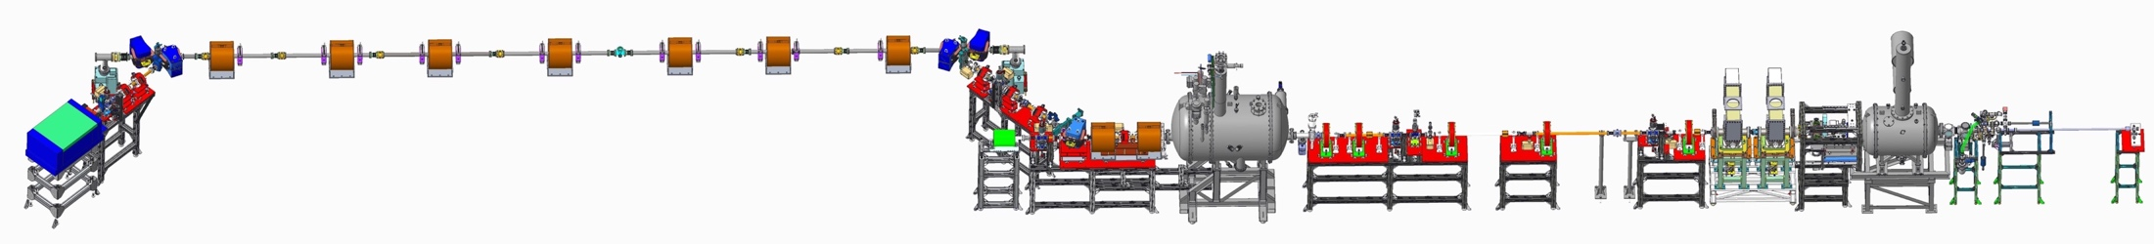
PCA based CeC System
Kicker
Modulator
4-cell PCA
Mechanical design of new CeC system is completed
We procured and commissioned new laser system with controllable pulse structure
All new vacuum chambers with beam diagnostics are built
All supports are built and installed
All solenoids are designed, manufactured, delivered and undergo magnetic measurements
Assembly of the plasma-cascade based CeC can be completed during this year’s RHIC shut-down
Required electron beam parameters
Normalized emittance < 5 mm mrad
Relative energy spread σ_{E}/E < 10⁻³
Bunch charge 0.5 – 1.5 nC
Repetition rate 1 Hz – 78 kHz
R.m.s. bunch length 10 – 25 psec
Peak current 50-100 A
Kinetic energy 14.5 MeV

Slide 5
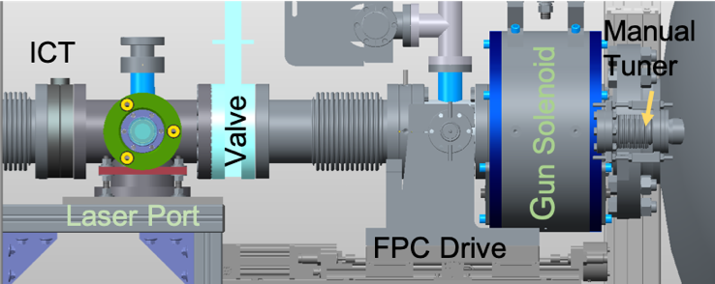
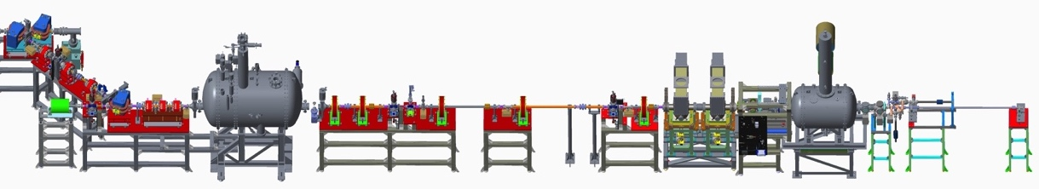
Accelerator System
Profile monitor with slits
Buncher cavities
Profile monitor
Profile monitor
Garage for
3 cathodes
Dogleg
Triplet
Dump with
Faraday cup
Gun
Profile monitor
113 MHz SRF gun with CsK₂Sb photocathode. Cathode operation – weeks.
532 nm drive laser
Two 500 MHz copper cavities for ballistic compression to the required peak current
704 MHz SRF accelerator cavity
FEL structure with three helical undulators and three phase shifters
6 solenoids, 16 quadrupoles, and three dipoles
Demonstrated electron beam parameters
Normalized emittance 3 – 4 mm mrad
Relative energy spread σ_{E}/E < 3x10⁻⁴
Bunch charge 0.03 – 10.7 nC
Repetition rate 1 Hz – 78 kHz
R.m.s. bunch length 10 – 500 psec
Kinetic energy 14.5 MeV
Challenges
Gun axis is tilted by 11.1±0.1 mrad
Buncher cavities generate time-dependent transvers kick
Linac axis is 3 mm lower than median plane

Slide 6
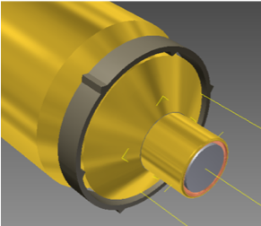
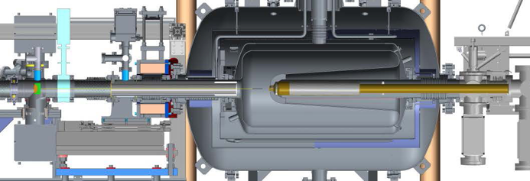
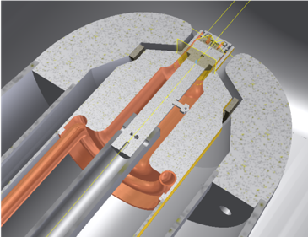
113 MHz RF Gun
Solenoid
FPC
Challenges
Strong multipacting barrier at 30-40 kV
Dependence of the cavity frequency on coupling
Location of the cathode puck vs nose is not fixed
Quarter wave design
Operates at 4.2ºK
Cathode is at room temperature
Stalk serves as field pick-up
Manual coarse tuners
FPC serves as fine tuner
Maximal CW voltage 1.25 MV
Maximal charge 10.7 nC

Slide 7
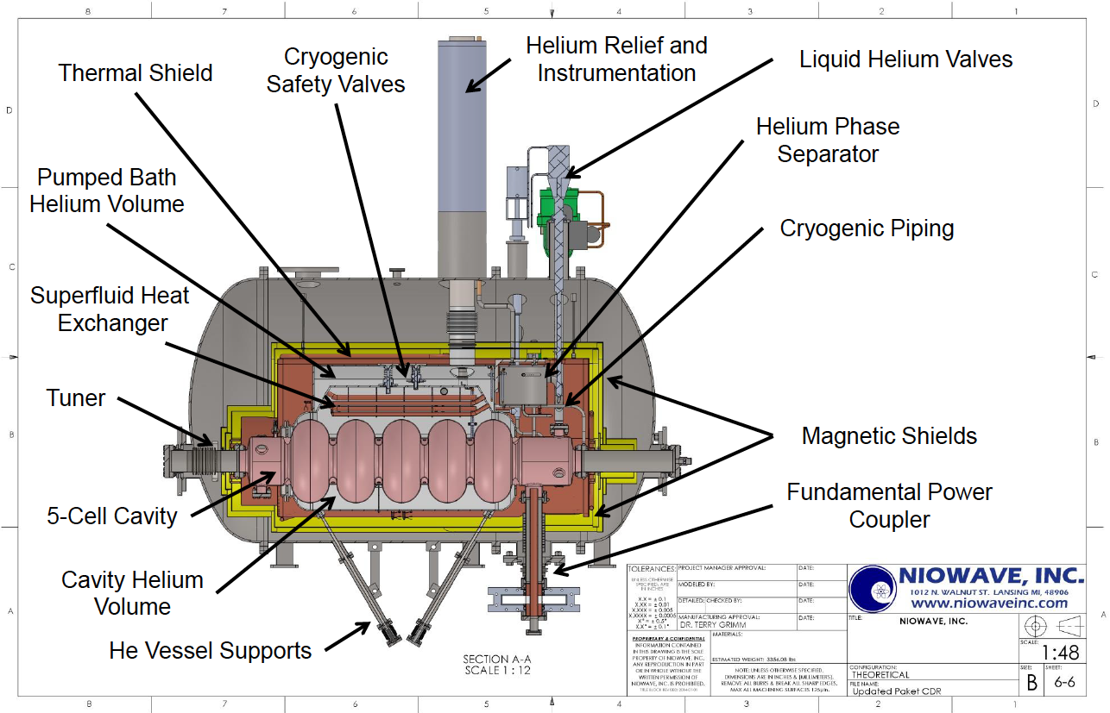
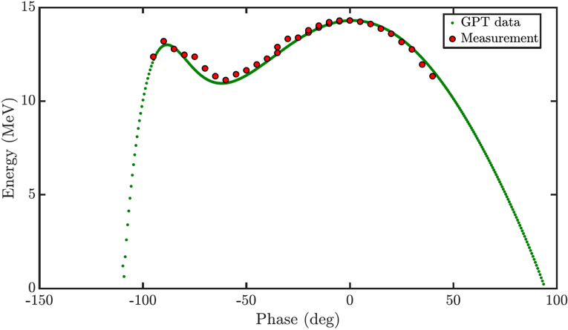
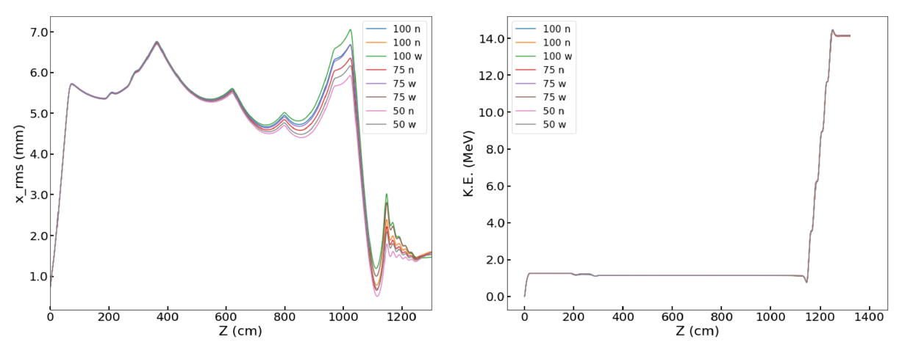
704 MHz SRF Linac
Operation temperature 2 ºK
Superfluid head exchanger
Maximal voltage – 13.5 MV
Very complicated beam dynamics in the first cell – beam is decelerated and strongly focused

Slide 8
Drive Laser
The seed laser with tunable longitudinal profile provides the input for the regenerative amplifier.
The regenerative amplifier has successfully suppressed the accumulation of nonlinear effects that caused the distortion of the temporal pulse profile which is crucial for CeC operations. In addition, the power fluctuations of the seed laser have been significantly mitigated.
The resulting excess power produced by the amplifier offers two additional advantages:
the high available power allows for electron beam generation at a lower photocathode quantum efficiency
the higher power allows for producing a significantly more uniform transverse intensity distribution on the photocathode due to overfilling of the aperture imaged onto the photocathode.
Laser Shed
Challenges
Pointing stability
Pulse jitter
Temperature drift of diode laser causes two lines generation and hence charge modulation at high frequencies
Relay table
Gun table

Slide 9
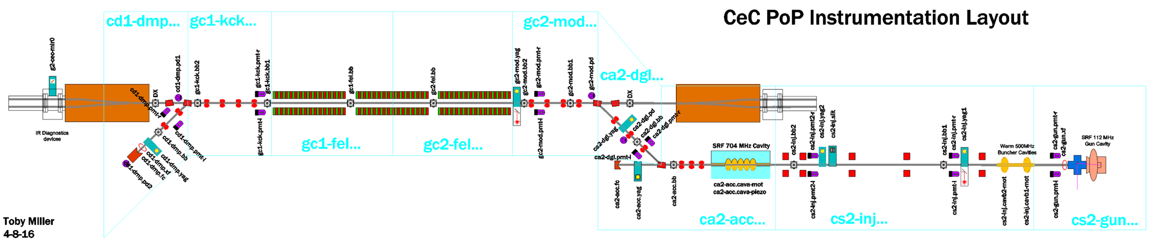
Instrumentation
Two integrating current transformers by Bergoz
Two beam dumps with incorporated Faraday cups
Fifteen single pass BPMs by Instrumentation Technologies (11 tuned to 500 MHz, 1 tuned to 352 MHz, 3 tuned to 9.37 MHz)
15-mm diameter buttons BPM pick-ups designed at BNL and manufactured by MPF
Six profile monitors with YAG:Ce screens
Set of slits for emittance measurement
IR diagnostics (sensors, monochromator, iris for profile scan)
4 GHz Teledyne LeCroy WR640Zi oscilloscope
PMT based beam loss monitors (JLab development)
RHIC instrumentation for hadrons (orbit, tunes, profiles, …)
No longitudinal beam profile diagnostics

Slide 10
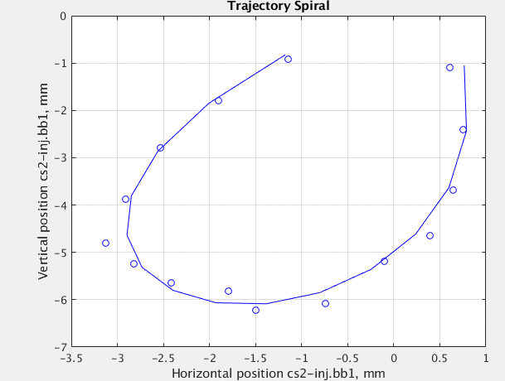
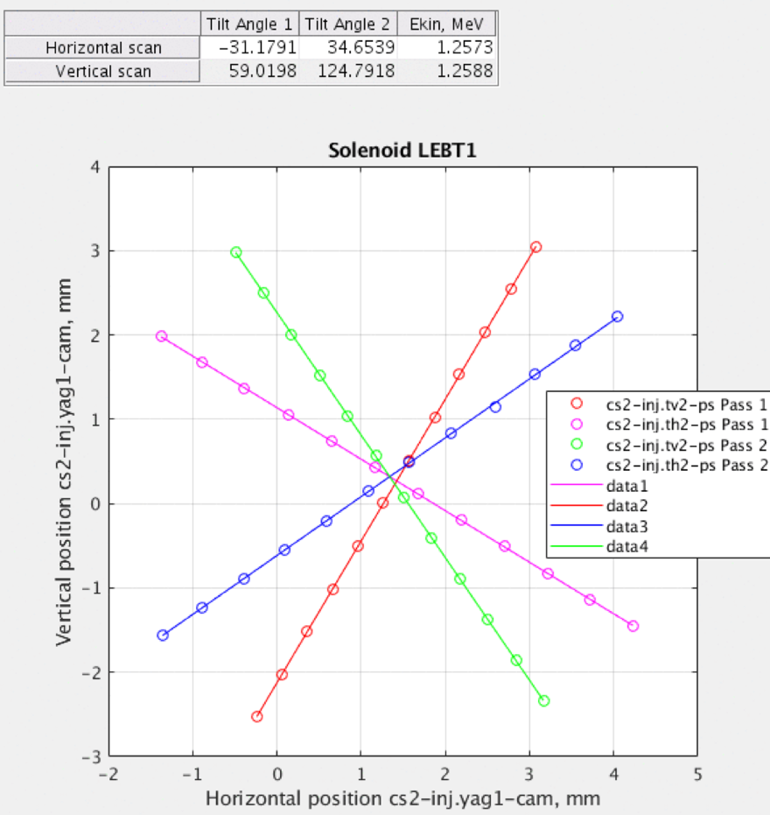
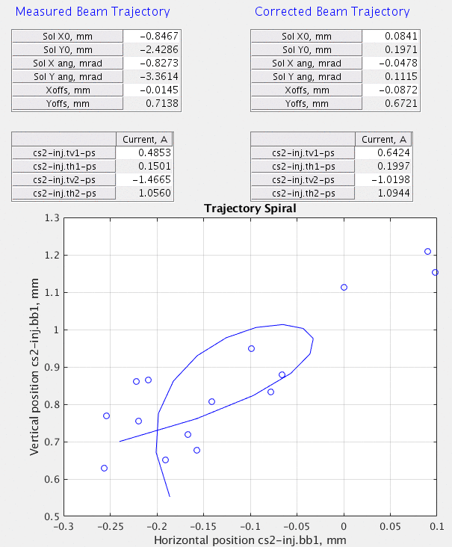
Beam Parameters Measurement with Solenoid
Energy measurement is based on the rotation of the betatron motion by solenoid
Beam is steered by a trim before the solenoid and position is measured with a signal from downstream BPM or profile monitor
Tilt angle gives beam energy with accuracy better then 1%
For trajectory measurement solenoid is treated as sequence of the ”hard-edge” short solenoids (from the magnetic measurements).
Transfer matrix is calculated for each solenoid current and beam position is measured. Beam trajectory vs solenoid axis is found as solution of the system of linear equation.

Slide 11
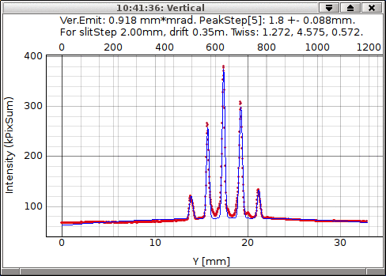
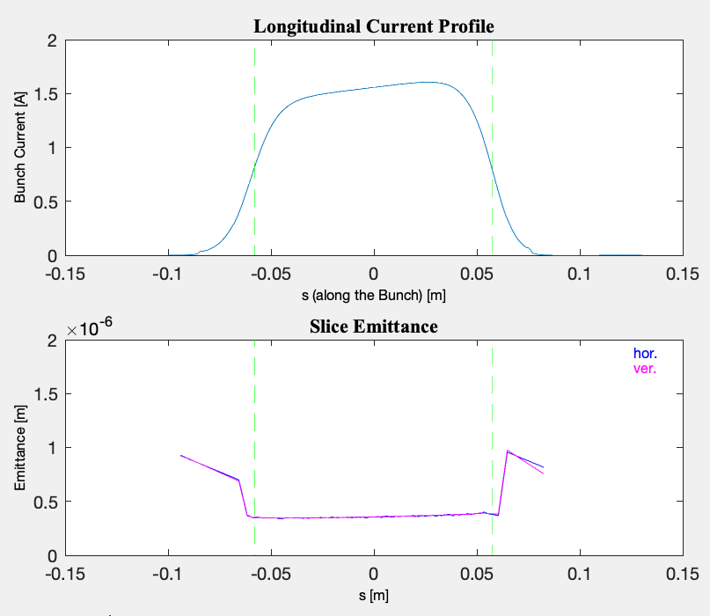
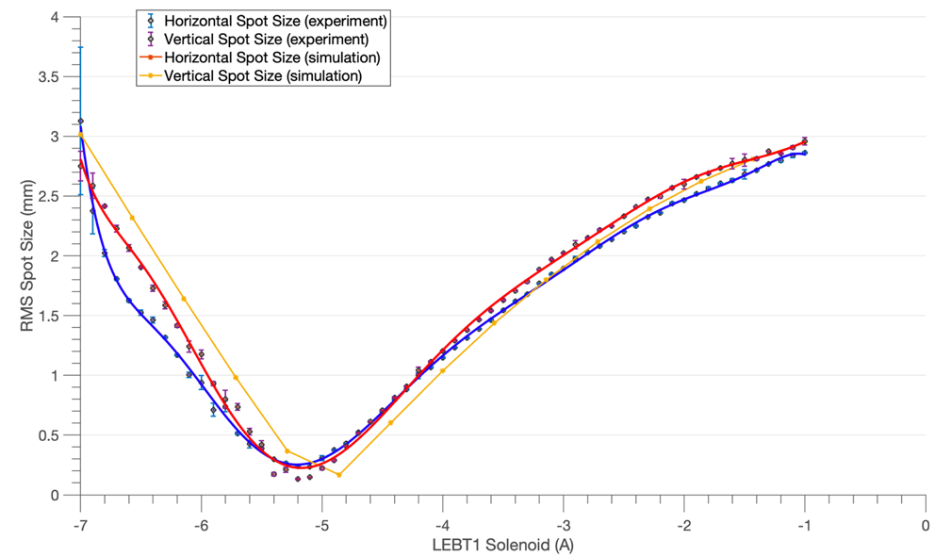
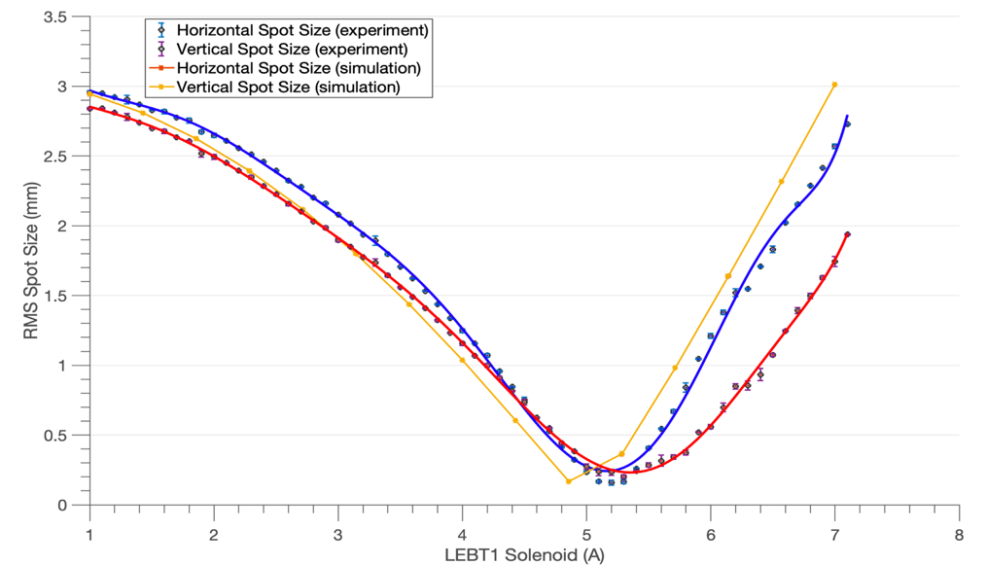
Emittance Measurement
Gun energy: 1.25 MV
Laser spot on cathode r.m.s. size: 0.8mm (3.2 mm diameter)
Bunch charge: 600 pC
Bunch length: 400 ps
Gun solenoid: 8.6 A
LEBT1 solenoid varied from -7 to -1 A (left) and 1 to 7 A (right)
Slits were used for measurement of the space charge dominated beam (1.5 nC bunch charge).
Projected normalized emittance - 0.57 mm mrad
Normalized core slice emittance - 0.35 mm mrad

Slide 12
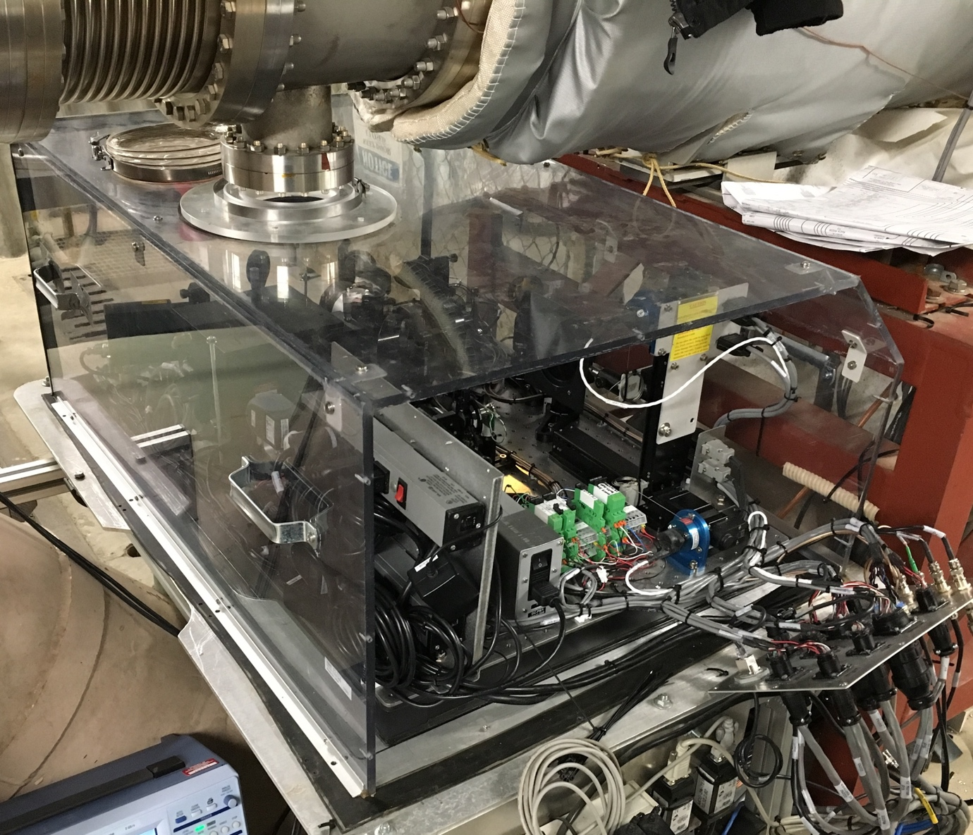
Infrared Diagnostics
Insertable copper mirror
ZnSe window was replaced with diamond window transparent at 30 microns
Chopper
Golay cell
Pyroelectric detector
Monochromator
The power meters were intended to tune FEL (up to 6 orders of magnitude power level change). We expected 3-fold increase in power when electron beam intersects with hadrons.
Monochromator is used to measure FEL wavelength and precise measurement of the beam energy.

Slide 13
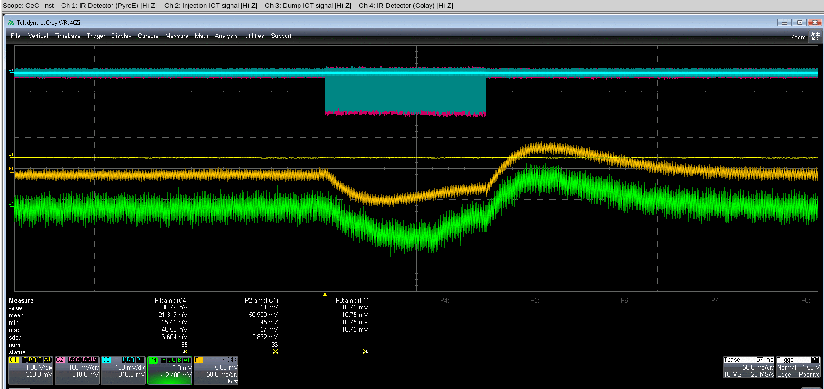
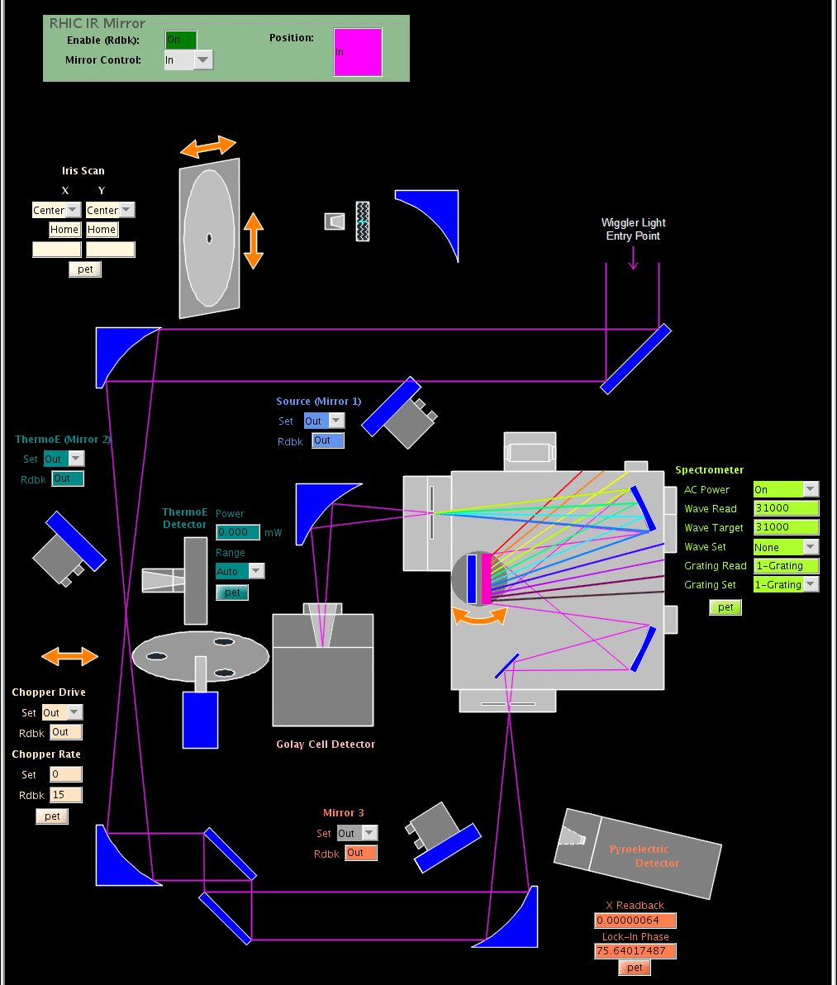
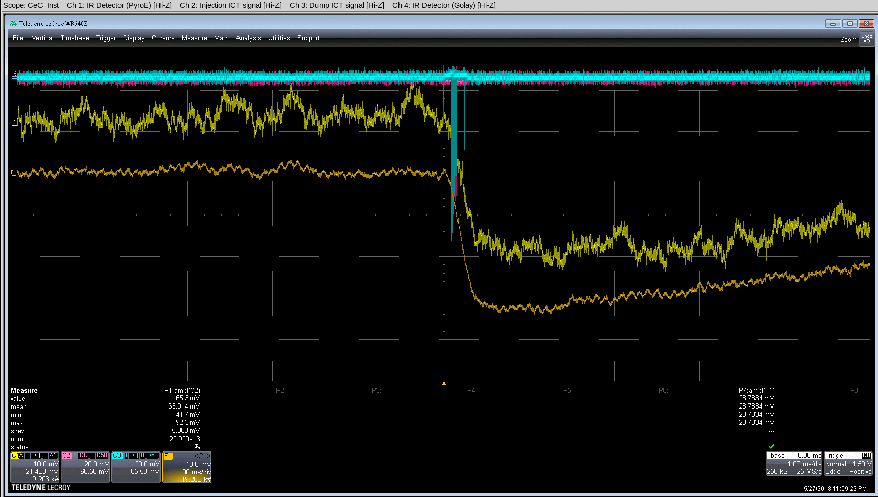
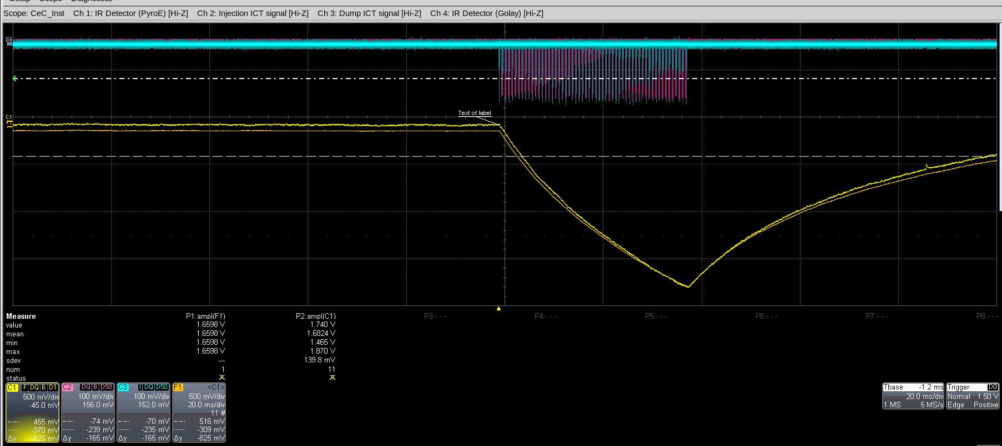
Infrared Diagnostics (2)
Golay cell signal (green)
Pyroelectric detector signal (yellow)
ICTs signals are cyan and magenta

Slide 14
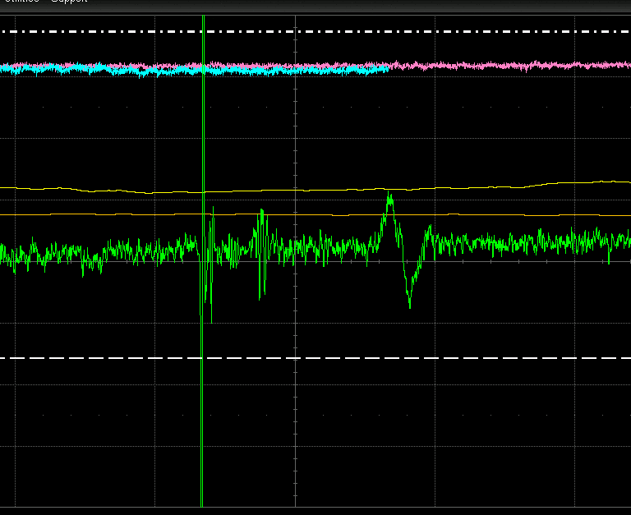
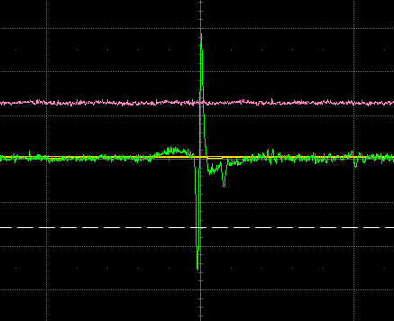
Synchronization of Hadron and Electron Bunches
No overlap (50 ns, 2 mV per division)
Overlap (20 ns, 10 mV per division)
Synchronization was achieved by observation of the signal from the BPM pick-up electrode in the FEL section.

Slide 15
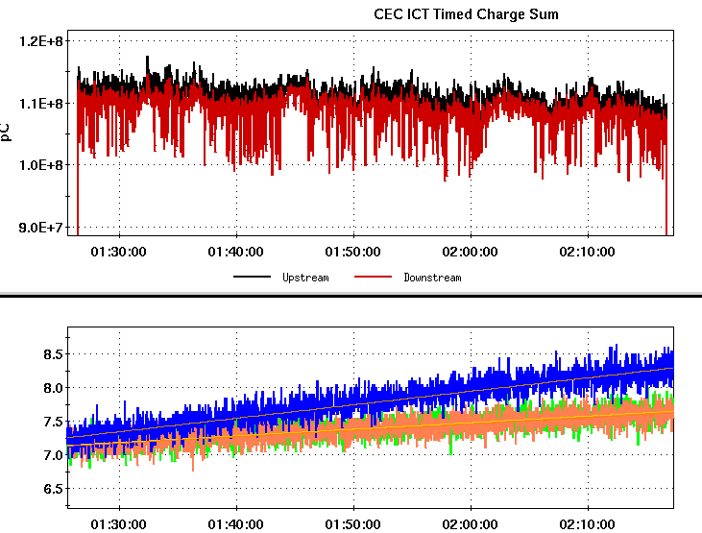
Puzzle of the CeC Run 18
Search for ion’s imprint
Top plot: electron beam current through the CeC ~ 110 μΑ or 1.4 nC per bunch at 78 kHz. Bottom plots: evolution of the bunch lengths for interacting (blue trace) and witness bunches (orange and green traces).
Expected and measured relative change in the FEL signal with overlapping and separated beams. Each point corresponds to 16 or more cycles of 20 FEL power measurements for overlapped and separated beams. Data analysis indicate RMS error of 2%.
Heating of ion beam was occurring only with a perfect overlap of the beams and high FEL gain. Reducing the FEL gain eliminated the heating.
We have not observed growth of the FEL power due to the interactions with hadrons because of the beam instability due to PCI and/or overbunching
Notes:
Proving expectations wrong is one of important roles played by experiment

Slide 16
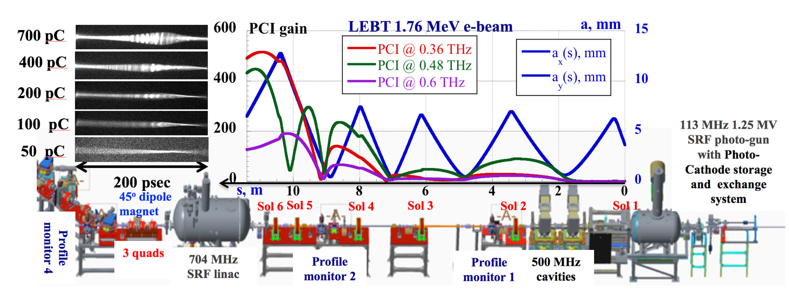
Uncompressed Bunch: Simulations
and Experiment in September 2018
(a)
Measured time profiles of 1.75 MeV electron bunches emerging from LEBT. Charge per bunch was from 0.45 nC to 0.7 nC;
Seven overlapping spectra of measured bunch density modulation and PCI spectrum simulated by SPACE (slightly elevated yellow line);
Clip shows a 30-psec fragment of seven measured relative density modulations.

Slide 17
Goals during Run 19
Demonstrate generation of electron beam with beam parameters satisfying or exceeding requirements for CeC demonstration experiment
          * minimal goal
Demonstrate control of newly discovered Plasma-Cascade Instability (PCI) and develop means of its suppression in the CeC accelerator ballistic compression beam-line

Slide 18
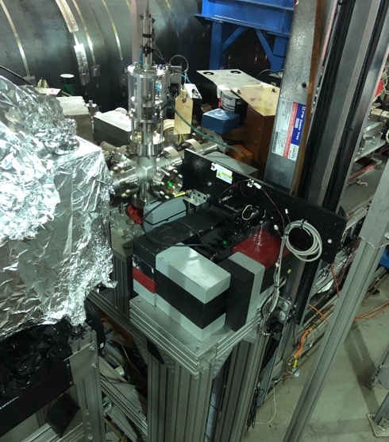
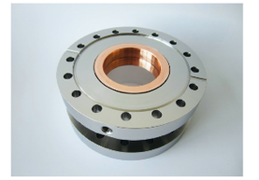
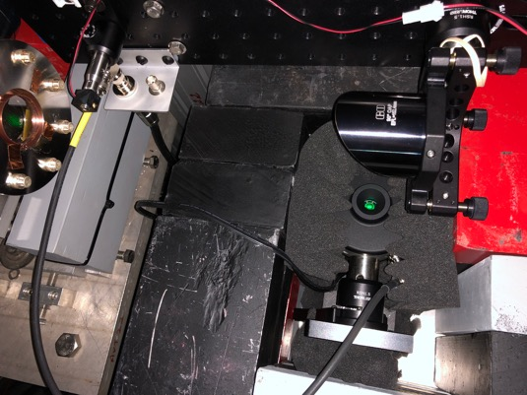
IR Diagnostics During Run19
Utilized high-sensitivity CCD camera for the dogleg profile monitor
YAG was removed from low-power dump profile monitor. Viewport was replaced with CVD diamond window. IR detector was installed. Mesh was installed to suppress THz radiation.
Mirror Actuator
1” CVD diamond window covered with 1.4 mm x 1.4 mm metal mesh to suppress GHz radiation
IR detector
Added lead shielding

Slide 19
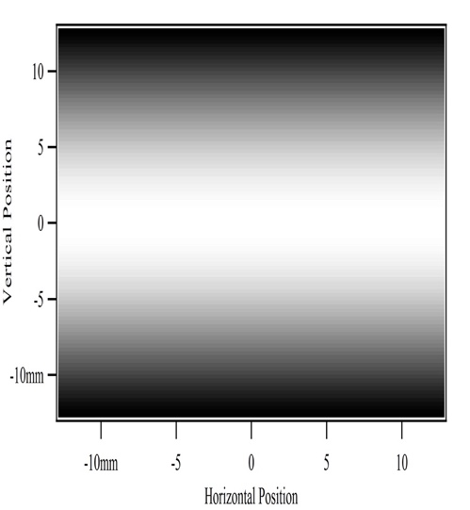
SR Radiation and IR Detector Sensitivity
IR power is measured by a very slow AC pyroelectric detector, which is calibrated for periodic 100 msec pulses separated by 100 msec: 2.12E6 V/J
We cross-calibrated it for shorter 1.5 msec to 6.5 msec pulses (trains less then 600 bunches)
We operated CeC accelerator short 100 to 500 bunch trains repeated typically with 10 Hz and used lock-in amplified. We cross-calibrated the lock-in amplifier output for such signal to be (4±0.4).10⁶ V/J
Power reaching the insertable the 1” Cu mirror was calculated using Igor-Pro for beam in a measured magnetic field of the 45-degree dipole operated at 140 A – it was is very good agreement (within 10%) with analytical estimations
We expected that 1.4 mm x 1.4 mm metal mesh installed at he exit window has ~ 50% transparency
With 50% reaching IR detector we expected 130 V/C/sec (30 μW/A) locking amplifier signal. With typical 1.5 μA beam current, we expected signal ~ 200 μV (~ 45 pW power)
This expectations are in reasonable agreement with the measured level of radiation from relaxed beam
Pyroelectric detector
The range from 0.1 to 30 THz (10 μm – 3 mm)
Response : 2.12 mV/nJ
Resolution of the system: ~0.1 nJ
Noise equivalent: 0.6 nW/Hz^{1/2}

Slide 20
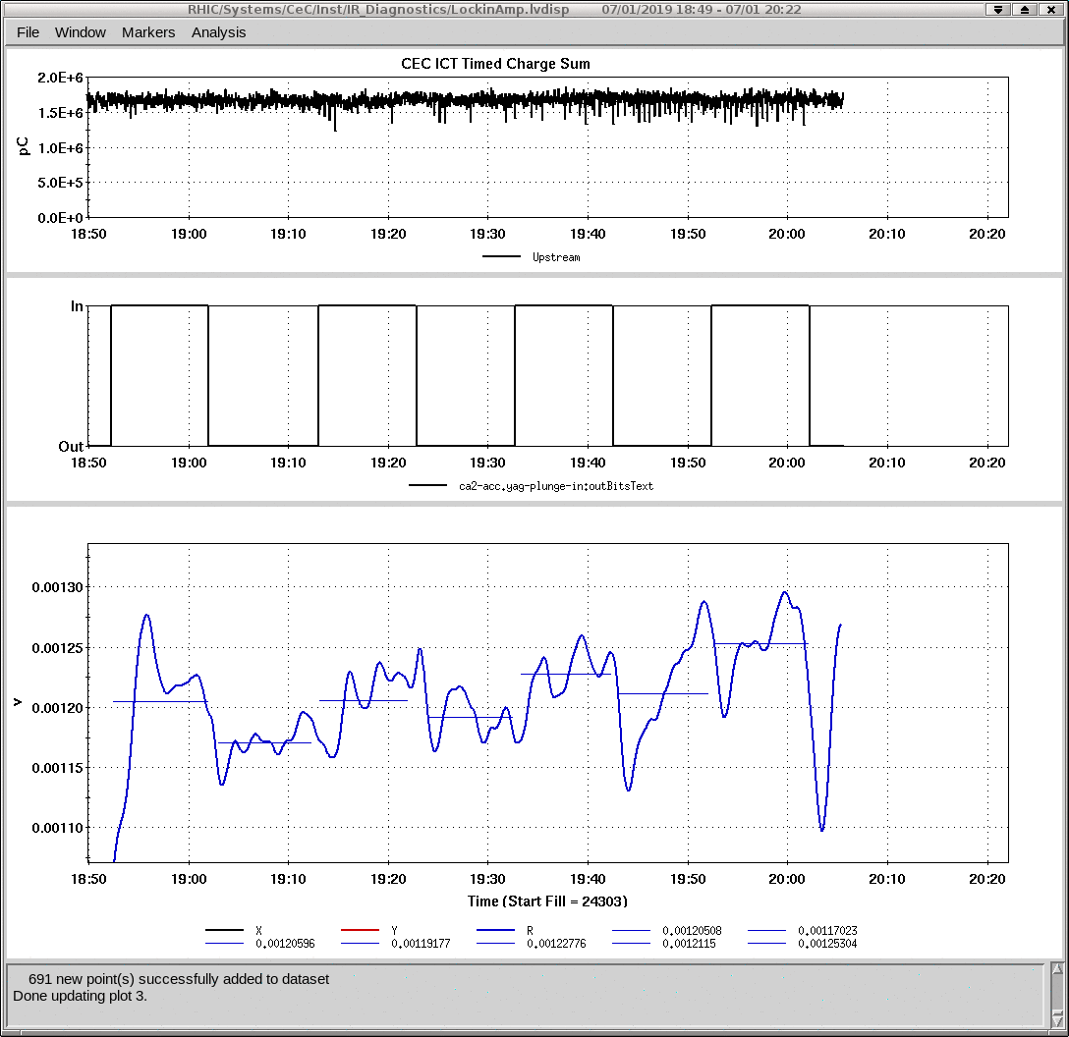
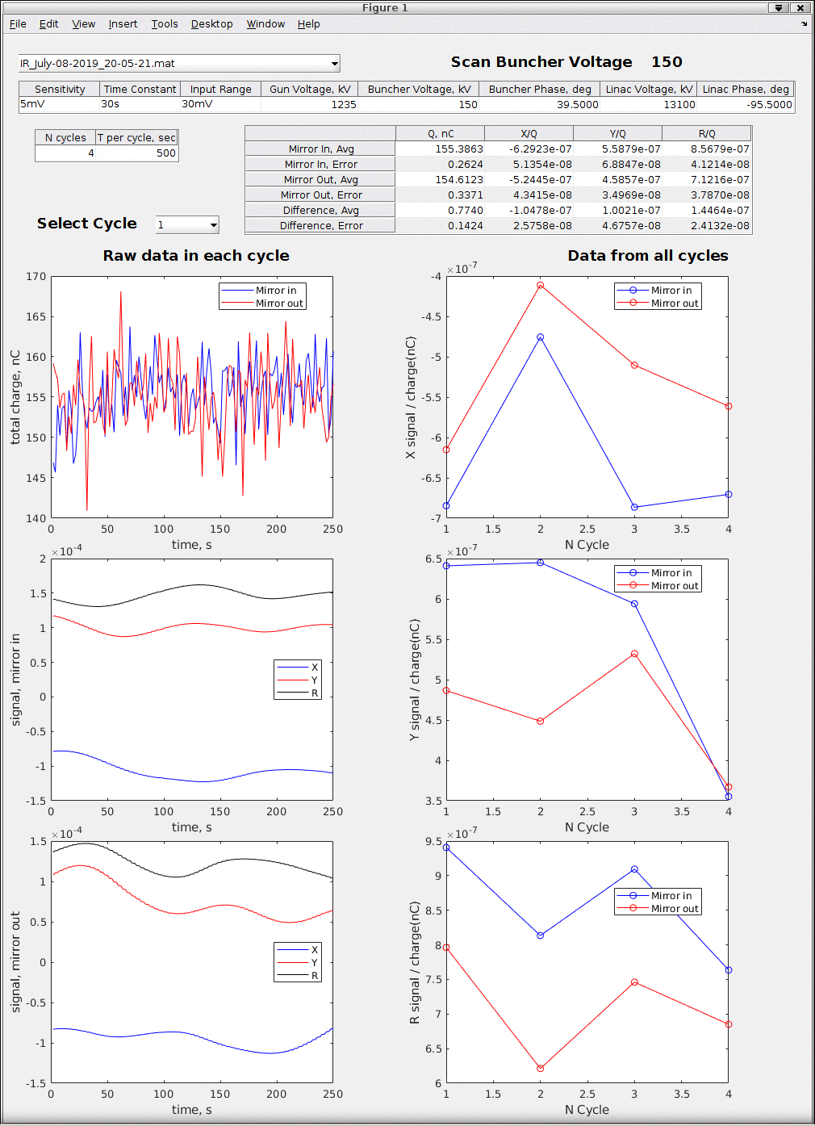
Shot Noise Level Measurements
MDM application
Logview data
Measured signal 95 V/C
~ 60% of expected without losses
I = 105 V/C
Q = 100 V/C
R = 145 V/C
The measurements were performed for modestly (4-fold) compressed beam with 1.5 and 0.3 nC charges per bunch in relaxed LEBT lattice. Averaged over 4 long scans the lock-in amplifier MDM signal was 145 V/C (24 μW/A) with RMS error of 15 V/C (3 μW/A). This value is at 40% level of synchrotron radiation that reaches the Cu mirror.

Slide 21
Typical Long Scans
Current scan in LEBT1 solenoid
Linac dropped
MDM signal
Fixed – app waits for system to be brought tot specs
Current scan in LEBT3 solenoid
MDM signal
Break-
waits to
restore status

Slide 22
Dependence on the Bunching Voltage and Checking Run 18 Set-up
1.5 nc per bunch
Run 18 lattice and beam: 0.6 nC per bunch
Large signal of 25,000 V/A ~ 250-fold above base line. Can be seen both on scope and measured easily
No Cooling -
Heating zone
No Cooling -
Heating zone

Slide 23
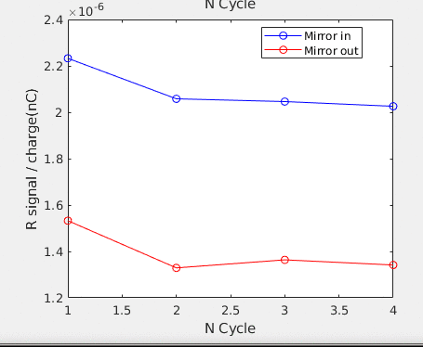
LEBT Optimization
No Cooling -
Heating zone
As a result of optimization we were able to achieve the FIR signal only factor two above shot noise level.
The optimized set-up has rather flat response of the noise on the variation of the solenoid current leaving sufficient headroom for optimizing other beam parameters.

Slide 24
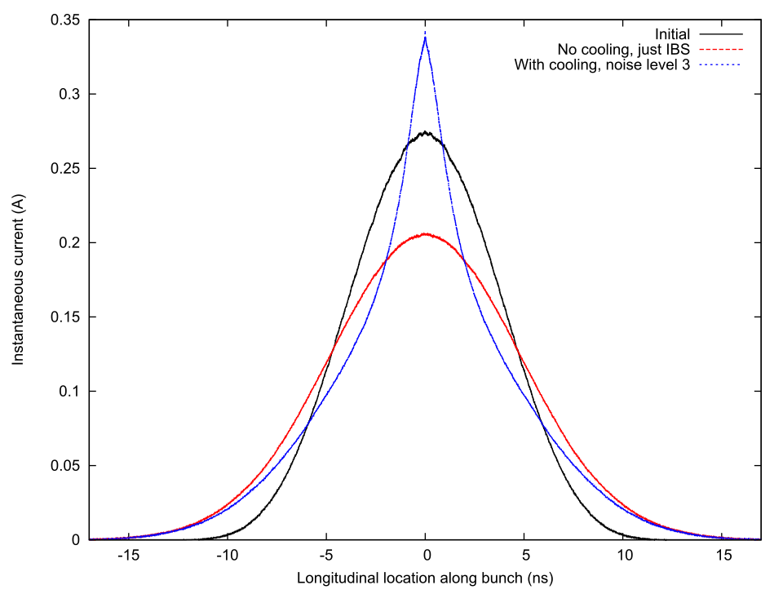
Plans for PCA based CeC
Shutdown jobs
  Install new elements into the common section
  Add IR diagnostics: two sets – one after DX magnet, another at low power dump
Run 20
  Establish electron beam operation in the background mode in parallel with RHIC operation
  Optimize electron beam parameters
  Establish high-current operation and demonstrate interaction with hadrons circulating in RHIC
Demonstrate longitudinal cooling during Run 21
Perform cooling experiments including transverse and/or 3D cooling during Run 22

Slide 25
Conclusions
Accelerator delivered the beam with parameters suitable for the CeC PoP experiment
  Electron normalized emittance as low as 0.3 mm mrad was measured
  Relative energy spread 3x10⁻⁴ was demonstrated
Two new methods for measuring beam trajectory vs. solenoid axis (position and angle) and energy utilizing solenoid were developed
We were unable to demonstrate the imprint of the hadrons on the electron beam due to the discovered plasma cascade instability and/or overbunching
The development of the PCI was experimentally confirmed in the dedicated studies and methods for it suppression were developed
The PCA based CeC system will be tested during Runs 20-22

Slide 26
Results of Emittance Measurements

Slide 27
Hadron Beam Instrumentation
Three 9-MHz tuned BPMs for monitoring position in the common section (trajectory should coincide within 100 microns)
RHIC instrumentation: BPMs, wall current monitor, tune and emittance measurement systems
Signal from the pick-up electrode for overlapping electron and hadrons beams

