Slide 1
Theoretical Session Wrap-up

Slide 2
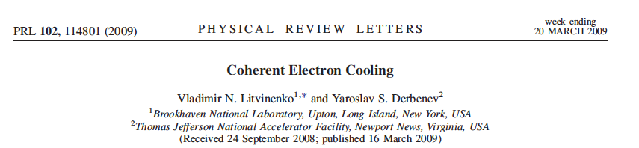
What is Coherent electron Cooling
Short answer – stochastic cooling of hadron beams with bandwidth at optical wave frequencies: 1 – 1000 THz
Longer answer
Amplification
Momentum correction
Imprint by hadrons

Slide 3
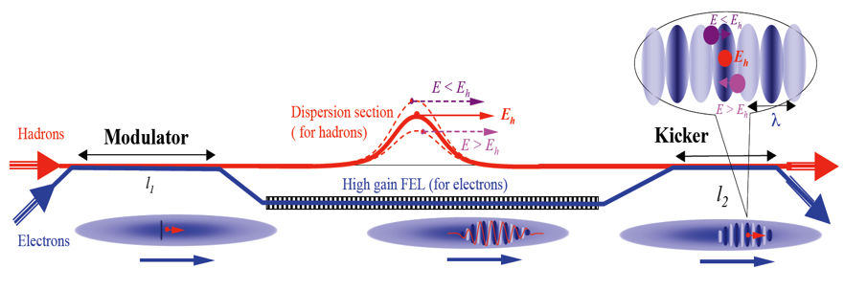
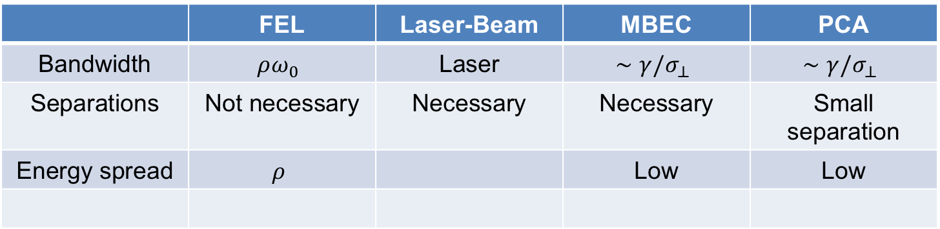
Options of Amplifiers
 | FEL | Laser-Beam | MBEC | PCA
Bandwidth | $$ρω_{0}$$ | Laser | $$∼γ/σ_{⊥}$$ | $$∼γ/σ_{⊥}$$
Separations | Not necessary | Necessary | Necessary | Small separation
Energy spread | $$ρ$$ |  | Low | Low
FEL, Litvinenko, Derbenev, PRL 2008
PCA, Litvinenko, Wang, Kayran, Jing, Ma, 2017
Plasma cascade
micro-bunching amplifier
MBEC, Ratner, PRL 2013, Stupakov, PRAB 2018 & 2019
Laser-Beam, Litvinenko, Cool 13

Slide 4
The role of theoretical tools
Make predictions for an ideal/simplified system:
  Validate numerical simulations;
  Improve our understandings of the physical processes involved in CeC and if possible, obtain scaling laws;
Theoretical tools are often inadequate for accurate prediction of a realistic CeC system (requires numerical simulation).

Slide 5
Analytical Tools for the Modulation Process I
Cold uniform electron beam (© V.N. Litvinenko)
  Density modulation:
  Energy modulation ( ):
Warm uniform electron beam with k-2 velocity distribution
  Density modulation:

Slide 6
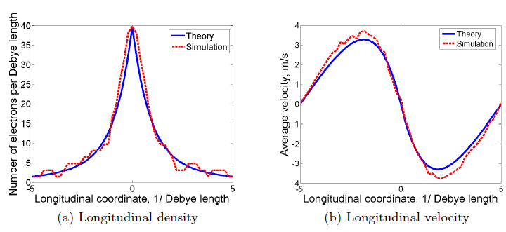
Validating Numerical Simulations with Theoretical Prediction
Simulations based on perturbative trajectory approach (© J. Ma, with code SPACE)
  Benchmarked with theory for uniform warm beam

Slide 7
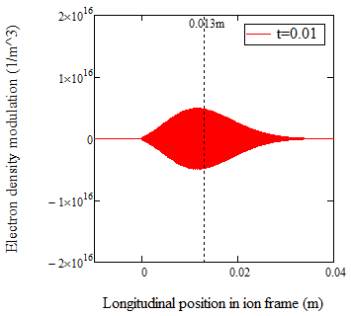
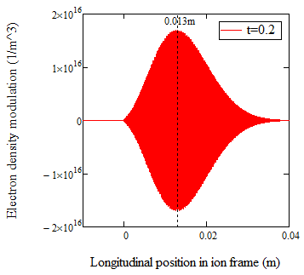
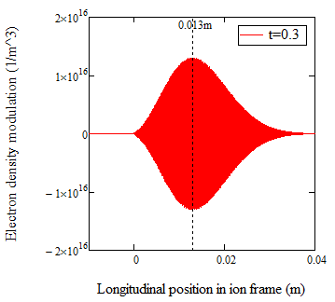
Analytical Tools for Kicker
Dynamic equation in Kicker is very similar to that in the modulator except the initial modulation in 6D phase space dominates the process. For 1D FEL output with the certain assumptions for the transverse distribution, the following analytical formula for density modulation can be derived

Slide 8
Simulation tools for predicting the influences of CeC to a circulating ion beam II
Assuming the ion density does not vary significantly over the width of the wave-packet
The one-turn energy kick due to CeC is
Diffusive kick induced by neighbor electrons, i.e. electrons’ shot noise

Slide 9
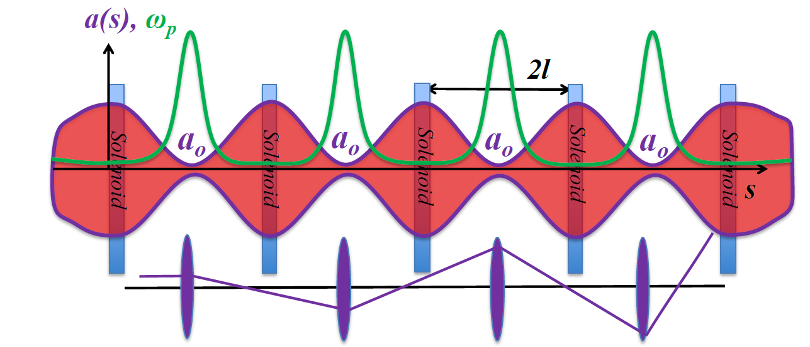
Plasma-Cascade Instability
Longitudinal plasma oscillation with periodically varying plasma frequency
Betatron motion in a FODO cell
Stability condition

Slide 10
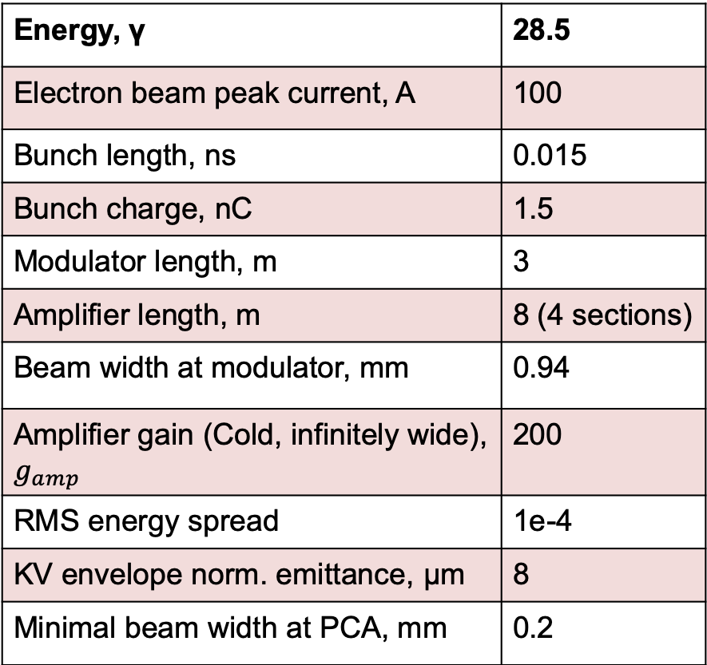
Estimate Cooling Force for PCA-based CeC: Parameters
Energy, γ | 28.5
Electron beam peak current, A | 100
Bunch length, ns | 0.015
Bunch charge, nC | 1.5
Modulator length, m | 3
Amplifier length, m | 8 (4 sections)
Beam width at modulator, mm | 0.94
Amplifier gain (Cold, infinitely wide), $g_{amp}$ | 200
RMS energy spread | 1e-4
KV envelope norm. emittance, μm | 8
Minimal beam width at PCA, mm | 0.2

Slide 11
Estimate Cooling Force for PCA-based CeC: Longitudinal Electric Field in the Kicker Section
The electric potential induced by the line density perturbation is determined by the following equations
If we take the transverse distribution of the electrons as
The electric field can be solved as
For easy implementation into ion tracking code, we use the fitting formula:

Slide 12
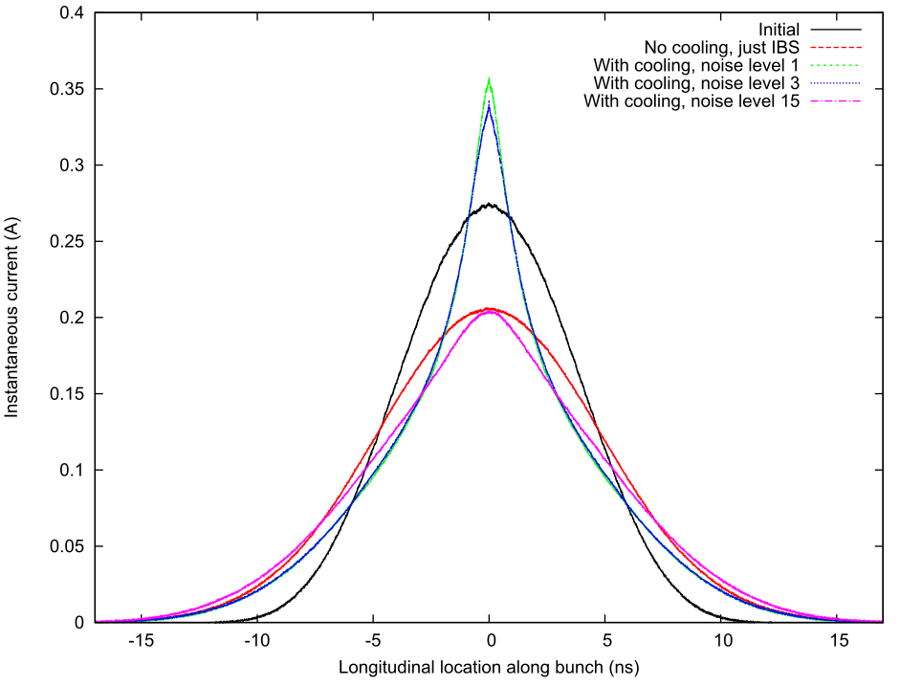
Tolerance of PCA-based CeC on the noise of electron beam
According to the simulation, the noise power in the electron beam should not exceed 200 times of the shot noise power.

Slide 13
Some Preliminary Estimates for eRHIC
In Beam frame
In lab frame

Slide 14
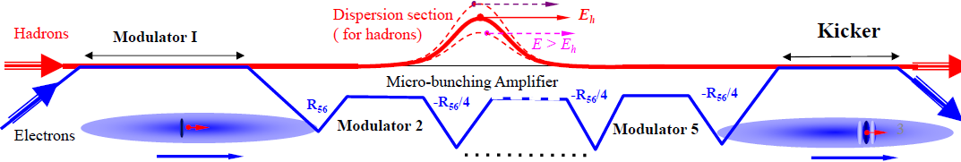
MBEC (Chicane-based CeC)
Enhanced bunching: single stage – VL, FEL2007
Micro-bunching: MB Amplifier, Single & Multi-stage, D. Ratner, PRL, 2013
Cooling rate for microbunched electron cooling without amplification, G. Stupakov, PRAB, 2018
Microbunched electron cooling with amplification cascade, G. Stupakov and P. Baxevanis, PRAB, 2019

Slide 15
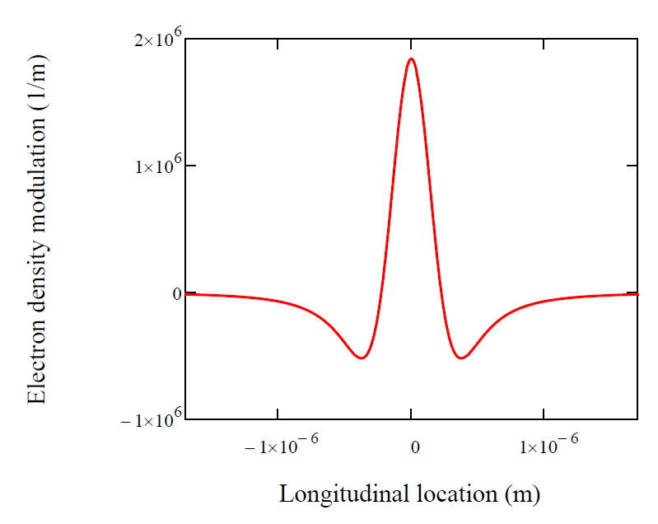
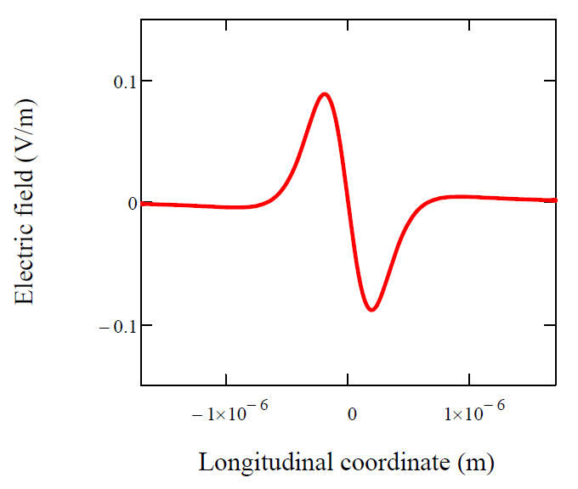
Analysis of MBEC: Single Ion Approach III
The following shows an example of our analysis:
Maximal reduction of energy error in one pass:
*This is the cooling time for energy spread and the cooling time for emittance should be a factor of 2 shorter.
Local cooling time:

Slide 16
Analysis in Frequency Domain by G. Stupakov and P. Baxevanis
(PRAB 21 (2018), 114402)
© G. Stupakov
Single pass energy kick
Impedance due to MBEC
Cooling rate in 1/number of turns
Cooling rate is maximized at

Slide 17
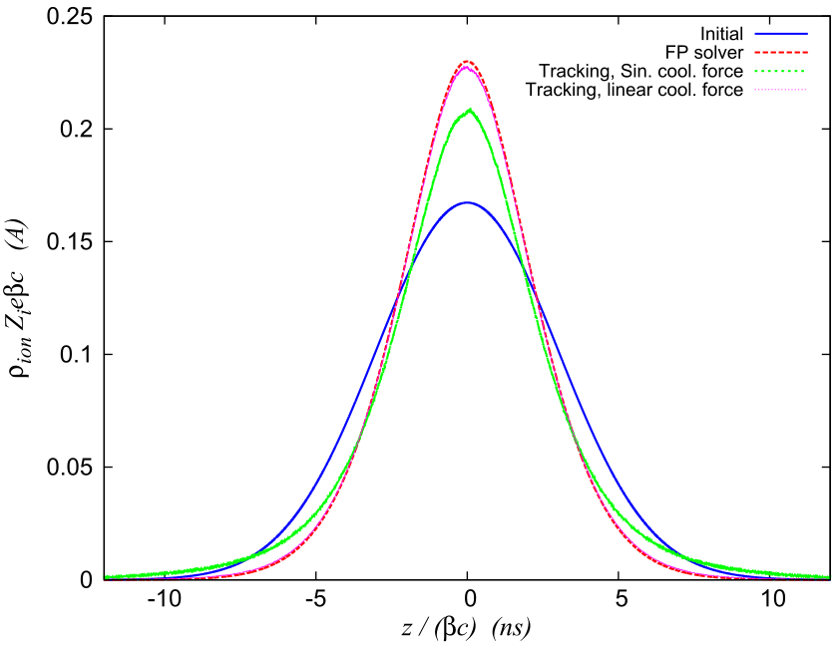
Comparison with Macro-particle Tracking
Some limitations of the Fokker-Planck solver:
The Fokker-Planck solver assumes constant cooling rate (linear cooling force) inside electron bunch while macro-particle tracking assume sinusoidal cooling force;
The Fokker-Planck solver does not account for particle leakage from rf bucket or other rf-related effects.
The diffusion coefficients applied in Fokker-Planck equation does not change with time.

Slide 18
Future Work and Challenges
Since PCA-based CeC is planned to be tested in the next two years, it is our main focus to complete and improve the existing model:
  Develop PCA model for electron bunch with initial energy chirp;
  Develop PCA model for electron bunch with acceleration;
  Investigate how transverse-longitudinal coupling affects PCA;
  Exploring how cooling performance scales with various beam/accelerator parameters and searching for optimal settings;
  Develop 3-D model for PCA (Plasma oscillation with finite transverse size, transverse mode…).
Further improvement of MBEC may also include study the 3-D effects to cooling rate (plasma oscillation with finite transverse size) as well as how space charge (longitudinal and transverse) and emittance limit the gain.
For predicting the evolution of ion beam with cooling, further improvements include solving Fokker-Planck equation for non-linear cooling force and including transverse cooling into ion tracking code.
Further improvement of theoretical model for FEL-based CeC involves incorporating 3-D model for FEL at diffraction dominated regime, which has relative low priority at the moment.

Slide 19
Open Questions
Theoretical 3-D model possible?
Gain more insight in how PCA scheme react on longitudinal/transverse noises, together with simulation? Benchmark with the existing CEC @ RHIC experiment results?

