Slide 1
Cryogenics : The cool part of accelerators.
Dhananjay K Ravikumar
December 15, 2016

Slide 2
What and why?
Cryogenics: Science of producing and maintaining ultra cold temperatures.
Needed in accelerators for:
Superconducting components such as magnets and RF cavities
Lesser costs involved (Capital and operational) in commissioning superconducting machines

Slide 3
How?
Cryo R&D involves Thermodynamics, Fluid Mechanics and Heat Transfer
Managing heat loads (Static and Dynamic) are very real constraints on the feasibility of any design (RF/Magnet).
Studies are performed to solve heat transfer problems and to try and work around these constraints while keeping the physics performance in mind.

Slide 4
Thermodynamics
The laws of thermodynamics have to be satisfied for any realistic system design.
First and second law analysis are performed to come up with a feasible design of the refrigeration system used to cool the operational fluid to cryogenic temperatures.
A variety of refrigeration cycles can be employed with increasing complexity to improve the efficiency of the system.

Slide 5
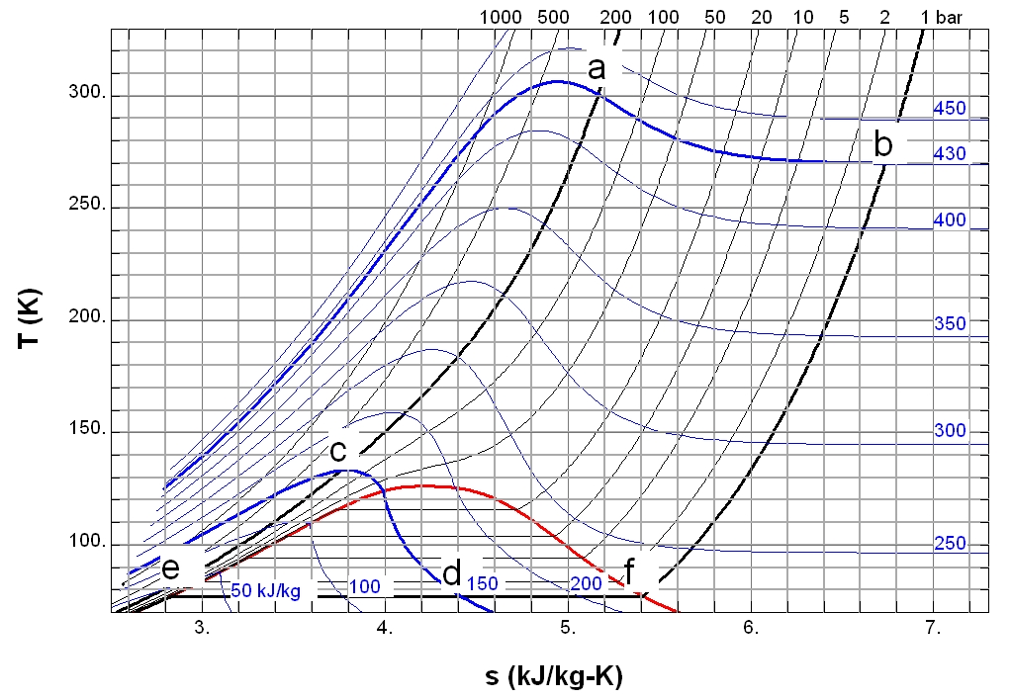
How is cooling achieved?
Applying basic energy conservation to an expansion device
Q_{in} + m(h_{in} + v_{in}²/2 + gz_{in}) = W_{out} + m(h_{out} + v_{out}²/2 + gz_{out})
There is no heat in and work done and changes in kinetic and potential energies are negligible which results in h₁ = h₂
Expansion is a constant enthalpy process
Notes:
Point out inversion curve

Slide 6
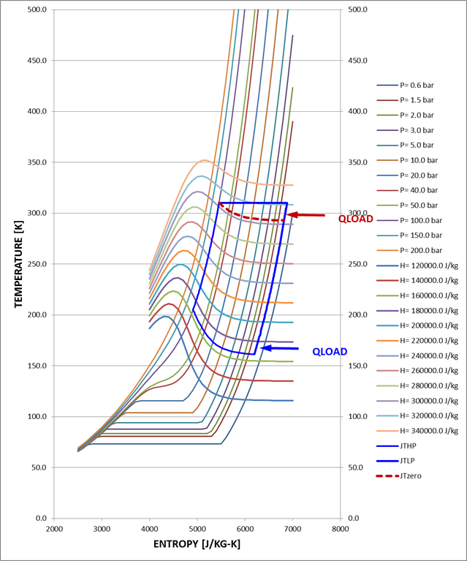
Thermodynamic properties of Fluids are available as Excel packages. (GASPAK and HePAK)
Entire cryogenic systems are “designed” in microsoft excel.
Closed Cycles. (He costs 22$ / gallon)
Figure to the left shows a basic J-T expansion cycle with a HX stack to improve efficiency
Thermal Shields
Notes:
Point out inversion curve

Slide 7
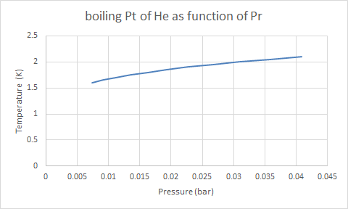
Colder than outer space
Boiling point of Liquid helium is set by the vapor pressure.
1 bar is atmospheric pressure.
2K boiling pt corresponds to a pressure of 30 mbar so
Vapor pressure of evaporating He must correspond to
30mbar if it should boil at 2K.
More fascinating things start to happen at these
temperatures.

Slide 8
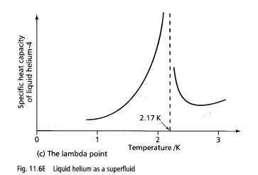
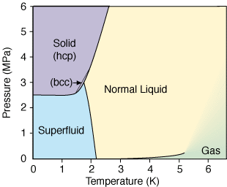
The curious case of Superfluid He
Why is the Helium boiling as
it is being cooled?
Phase diagram
Of Helium

Slide 9
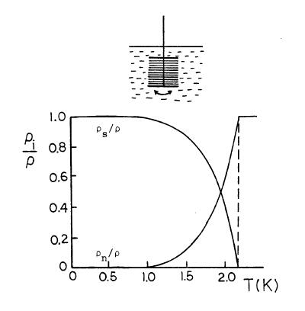
The two fluid model and heat transfer
Superfluid Helium exhibits remarkable thermal properties.
Hence used in cooling to 2K. (not that we have other choices.)
Superfluid has zero entropy! How is it so efficient in heat transfer?
Superfluid pressure transducers.

Slide 10
Heat Transfer
Three modes of heat transfer
Conduction
Convection
Radiation
Heat Transfer analysis is performed to estimate heat loads in accelerator structures such as Waveguides, RF cavities
Done to estimate heat loads that have to be handled by the cryogenic system

Slide 11
Conduction
Mainly involves solving the diffusion equation in 3D with various boundary conditions (to suit the problem at hand)
Very hard to solve analytically especially when K is f (T) and when there are multiple materials (Ex: Cu coated Stainless steel)

Slide 12
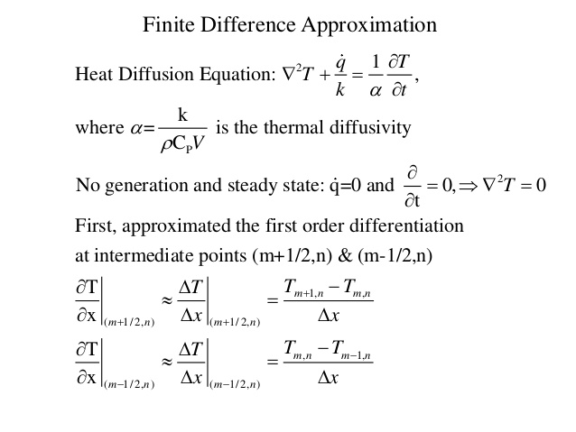
Numerical heat transfer
3 ways of discretizing the PDE
Finite difference, Finite element & Finite volume
Only approximate at
best!

Slide 13
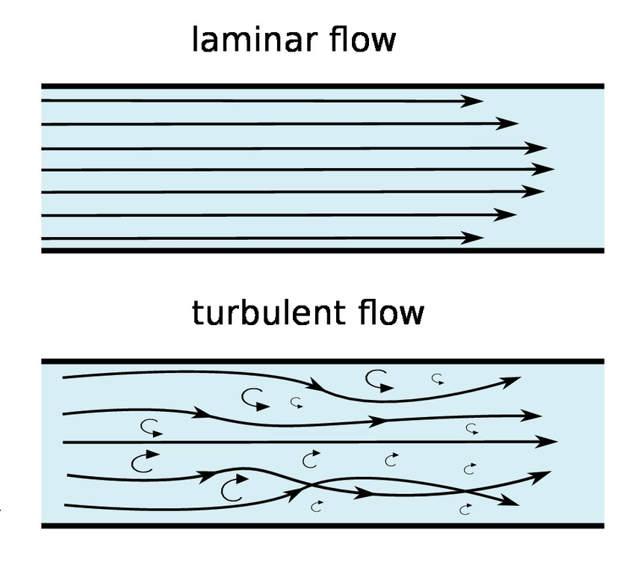
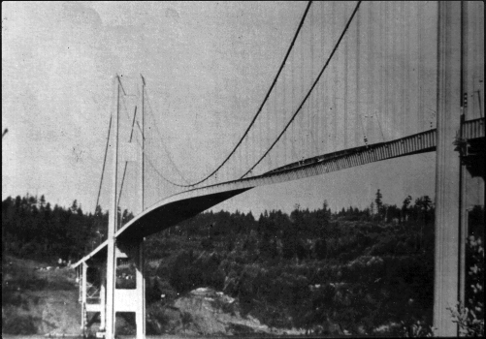
Fluid flow and convection
Fluid flow can be classified in many different ways. For forced convection , our main concern is whether it is laminar or turbulent
Turbulence is chaotic
Major characteristics are enhanced rates of momentum and energy diffusion
Downside for accelerator applications is that the pressure fluctuations induce structural vibrations
Vortex shedding and the plight
Of Tacoma Narrows bridge.

Slide 14
The Navier Stokes Equations
Remain unsolved in the 200 years since they were written.
1 of 7 problems for which the clay mathematical institute offers a prize 1 million dollars.
Problem is not even to solve the equations. it is to either prove it can be or cannot be solved.
Notes:
Kazakh mathematician Oct 2013

Slide 15
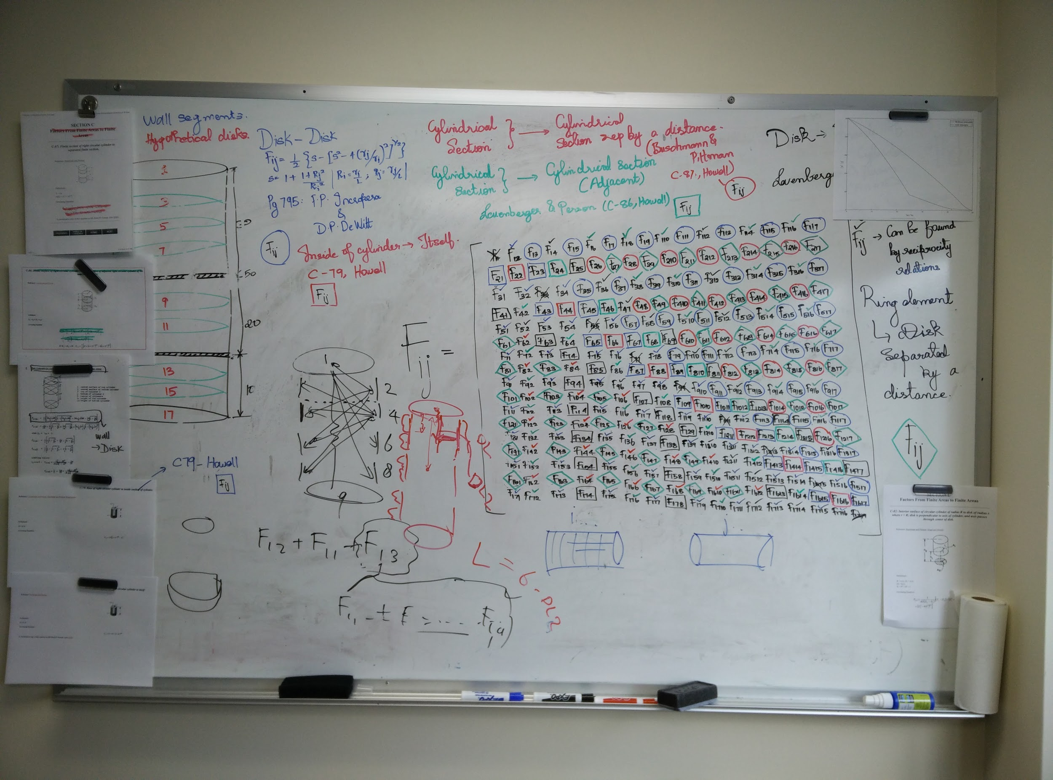
Radiation
Radiation heat transfer is more geometry than heat transfer.
Sample form factor calc for a cylindrical geometry (beam pipe)

Slide 16
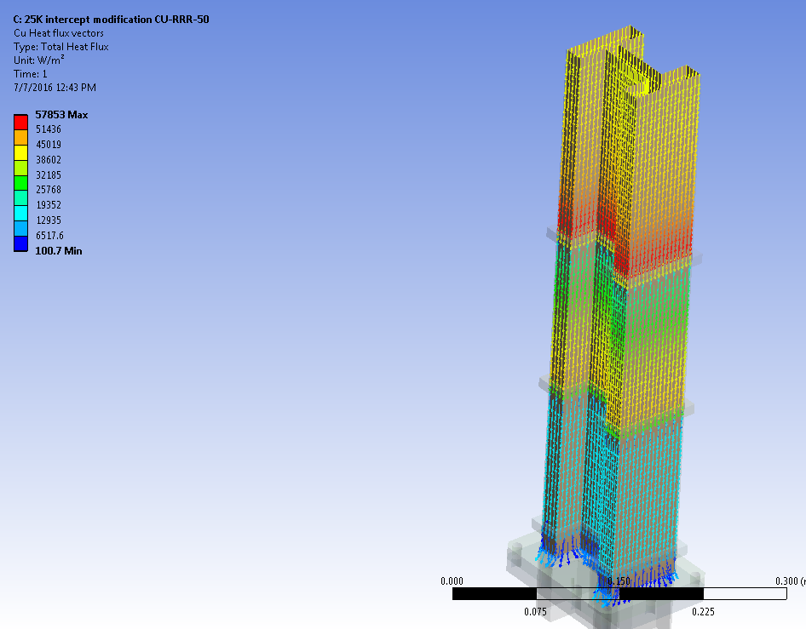
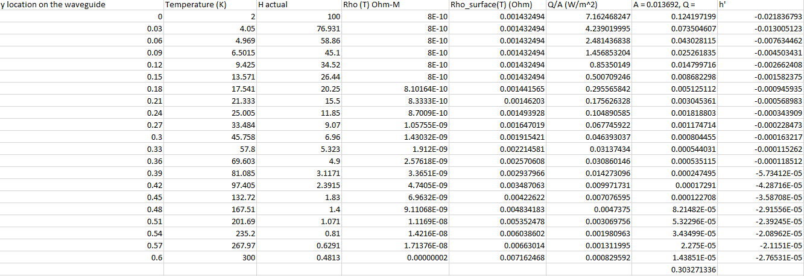
Case study - Thermal analysis for the HOM waveguide

Slide 17
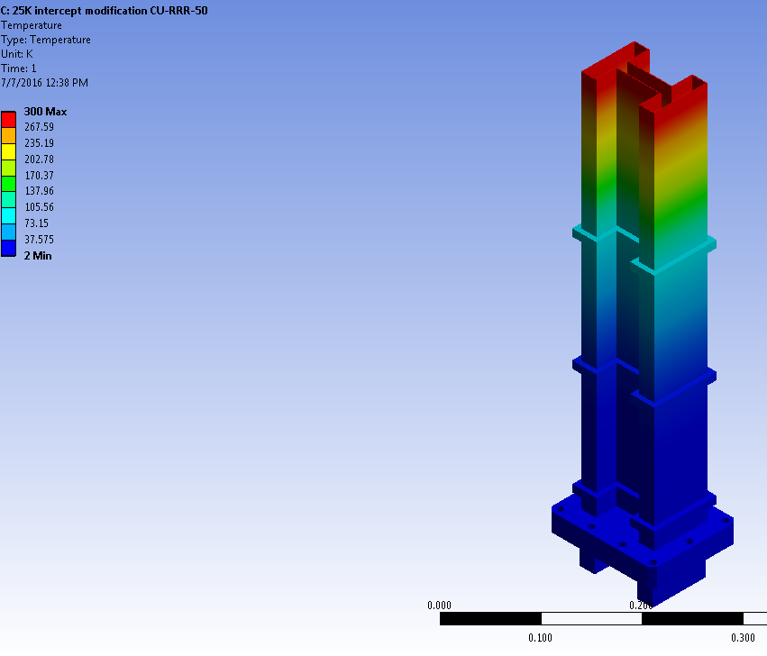
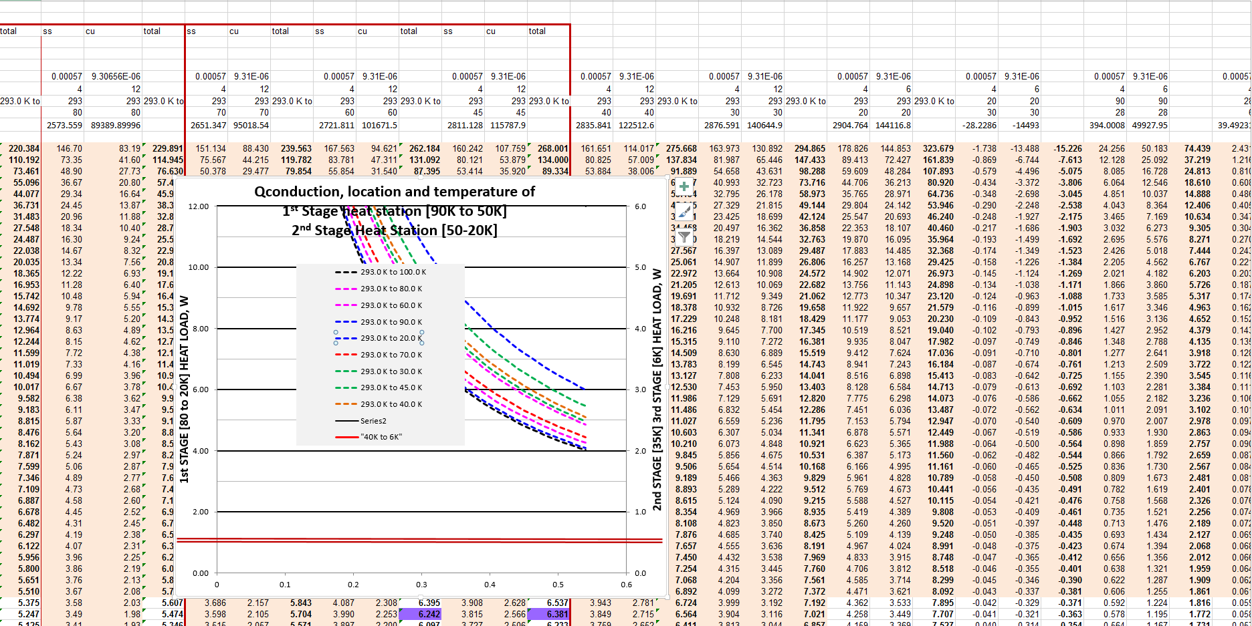
Temperature profiles along the length of the waveguide

