Slide 1
Space charge effect
Dec 7th , PHY554
Kentaro Mihara

Slide 2
Outline
Space charge overview (Direct space charge)
Space charge in KV envelope equation
Transverse tune shift
Beam Break up effect (Indirect space charge)
Longitudinal tune shift
Compensation technique for S.C

Slide 3
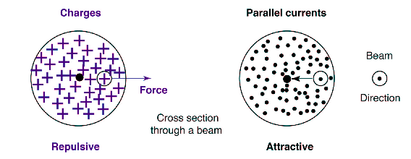
Space charge
“Collective effect” space charge is the coulomb force the particle experiences by its surrounding
Proportional to its intensity
Adversely affect the beam stability

Slide 4
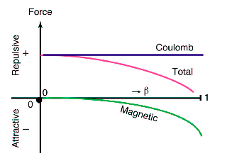
Cancelation at ultrarelativity
Repulsive force by radial E field is canceled by azimuthal B field at relativistic limit

Slide 5
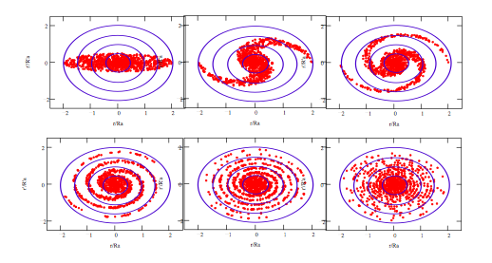
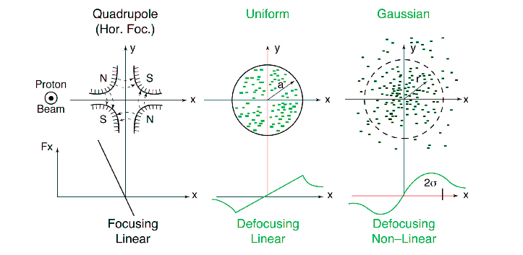
Nonlinearity of S.C
Although S.C has linear form for uniform distribution, it gives rise to non-linear form for more realistic dist.

Slide 6
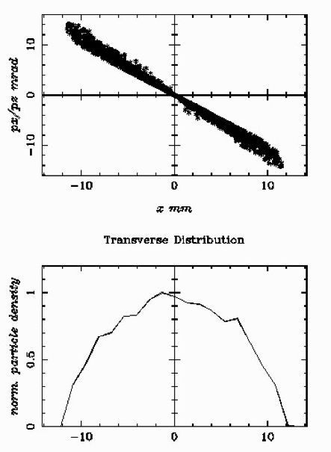
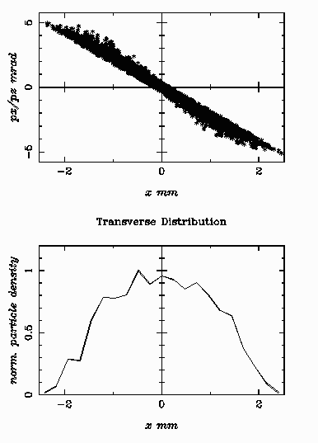
Phase space SRF112Mhz Gun
2000 particles with 2nC and 1.5MeV with and without S.C

Slide 7
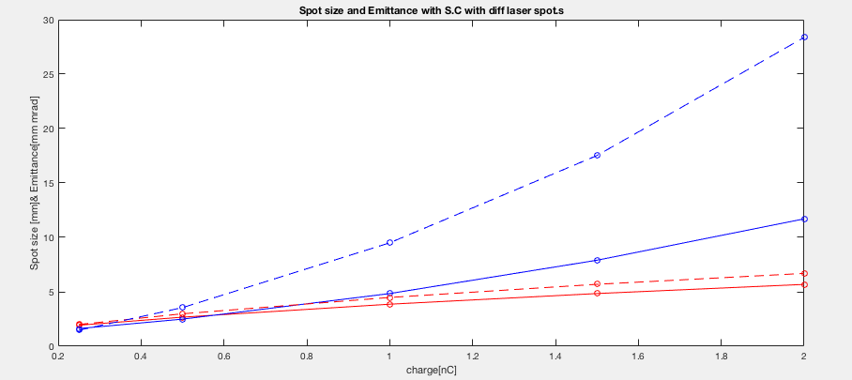
Charge as variance
Fig. S.C effect for 112 SRF Gun
Spotsize and emittance with charge 0.25 ~ 2 nC
Solid line has 1.5mm and dashed line has 0.75mm laser spot size

Slide 8
S.C in envelope equation
Envelope equation
Simplest consistent model incorporating applied focusing, space­charge defocusing, and thermal defocusing forces
Starting point of almost all practical machine design!

Slide 9
Hill’s equation
Transverse particle dynamics
Deviation from reference particle in Frenet-Serret coordinate
Hill’s eqn with Floquent theorem, periodic lattice condition gives x with periodic amplitude

Slide 10
Courant Snyder Invariant
Hill’s eqn (linear beam dynamics) gives rise to invariant.
This Ai is called Courant Snyder Invariant
Energy of the beam, amplitude of oscillation

Slide 11
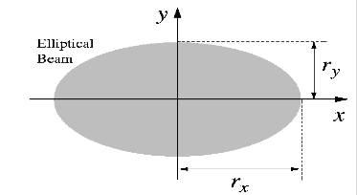
KV distribution
4D KV. D gives elliptical uniform dist in any 2d projection
Not realistic but highly investigated and used for accelerator designing.
So the Poisson eqn would be calculated as

Slide 12
Space charge in KV.D
Poison eqn is written by
Analytical solution of space charge potential inside of the beam is linear form

Slide 13
Envelope equation
Define emittance as maximum C.S invariant
Means the edge of the distribution
Hill’s eqn can be written by envelope rx as follows

Slide 14
Envelope equation
Projection of 4D invariant KV distribution
If not KV dist, E.E is given equivalently by moments(statistical information)

Slide 15
Transverse phase shift
Space charge acts as defocusing
Generate tune shift from designated P.A is called depressed P.A
Each limit is called S.C or Emittance dominated beam

Slide 16
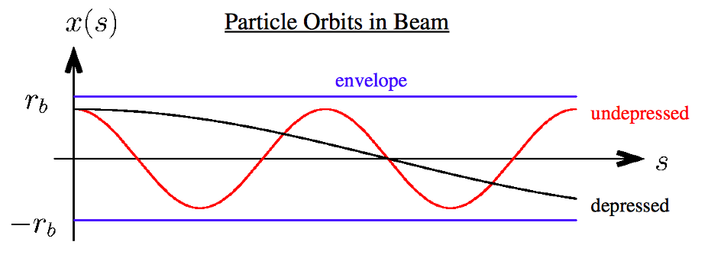
Incoherent tune shift by S.C
With constant focusing strength
Also for individual particle, tune spread will emerge due to their position.

Slide 17
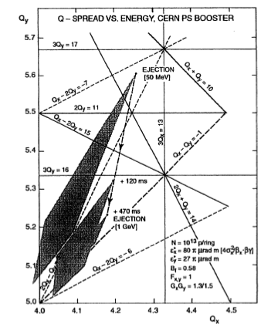
Incoherent T.S
It is cast into tune spread => more likely to cross the resonance tune => undesirable beam loss
CERN Proton Synchrotron Booster

Slide 18
Longitudinal tune shift
Longitudinal eqn of motion follows
Unlikely the transverse one, longitudinaly tune shift could be focusing or defocusing depending on whether it is below or above transition

Slide 19
Indirect space charge effect
Beam interacts with the surrounding (pipe)
beam induces surface charges or currents into this environment that act back on the beam, possibly resulting in an ‘indirect’ space-charge
Called Wake field
Example) Beam breakup instability
Bunch entering with offset from the center of the pipe in linac creates transverse wake field and it will acts back on the tail

Slide 20
Indirect space charge effect
BBU instability
In long linac with high current beam, this effects amplifying the distortion of the beam shape into a “banana” like shape.

Slide 21
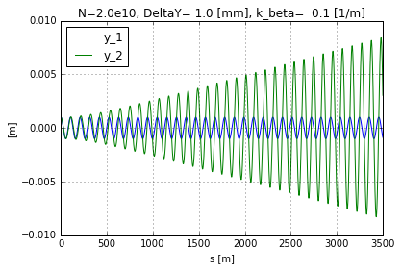
Indirect space charge effect
BBU instability

Slide 22
So far..
Non linearity of S.C causes instability of the beam such as emittance growth, incoherent tune shift => tune spread!!
How can we compensate those effect?
A lot of work is going on for this subject.

Slide 23
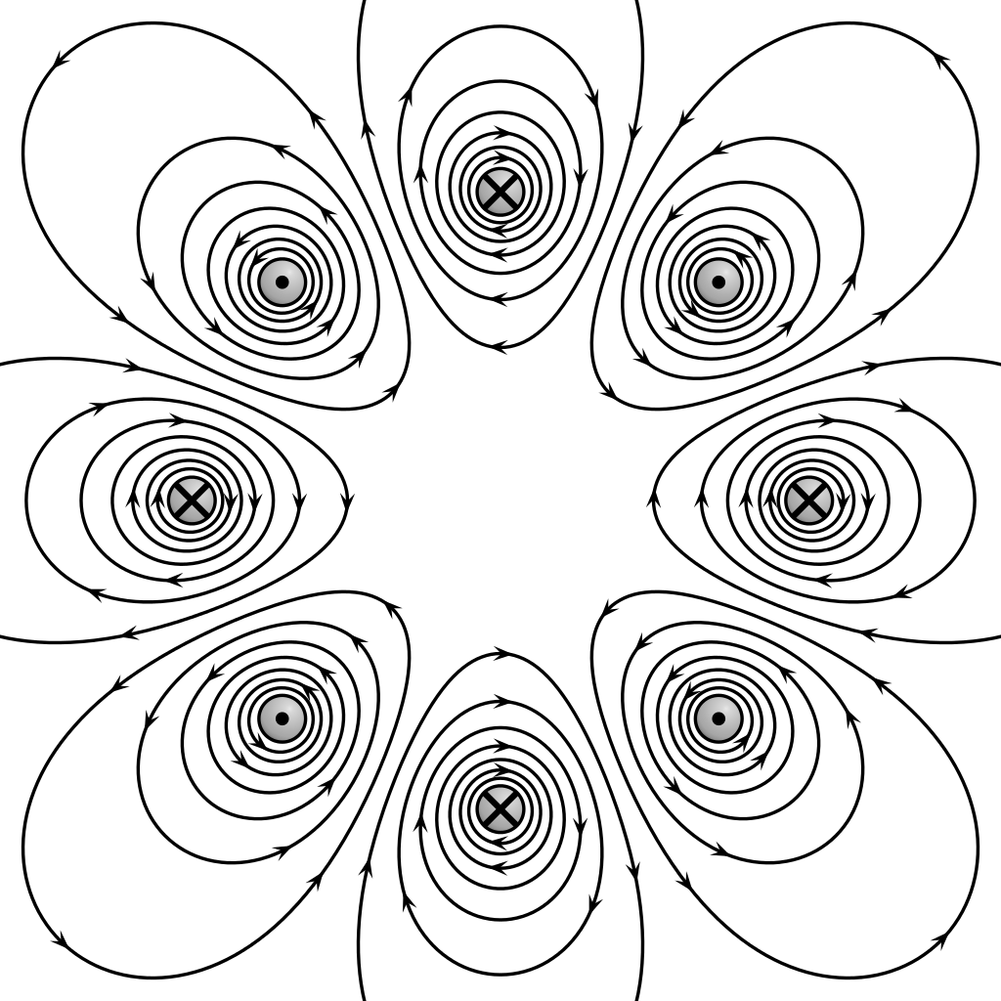
Compensation of S.C
Octupole

Slide 24
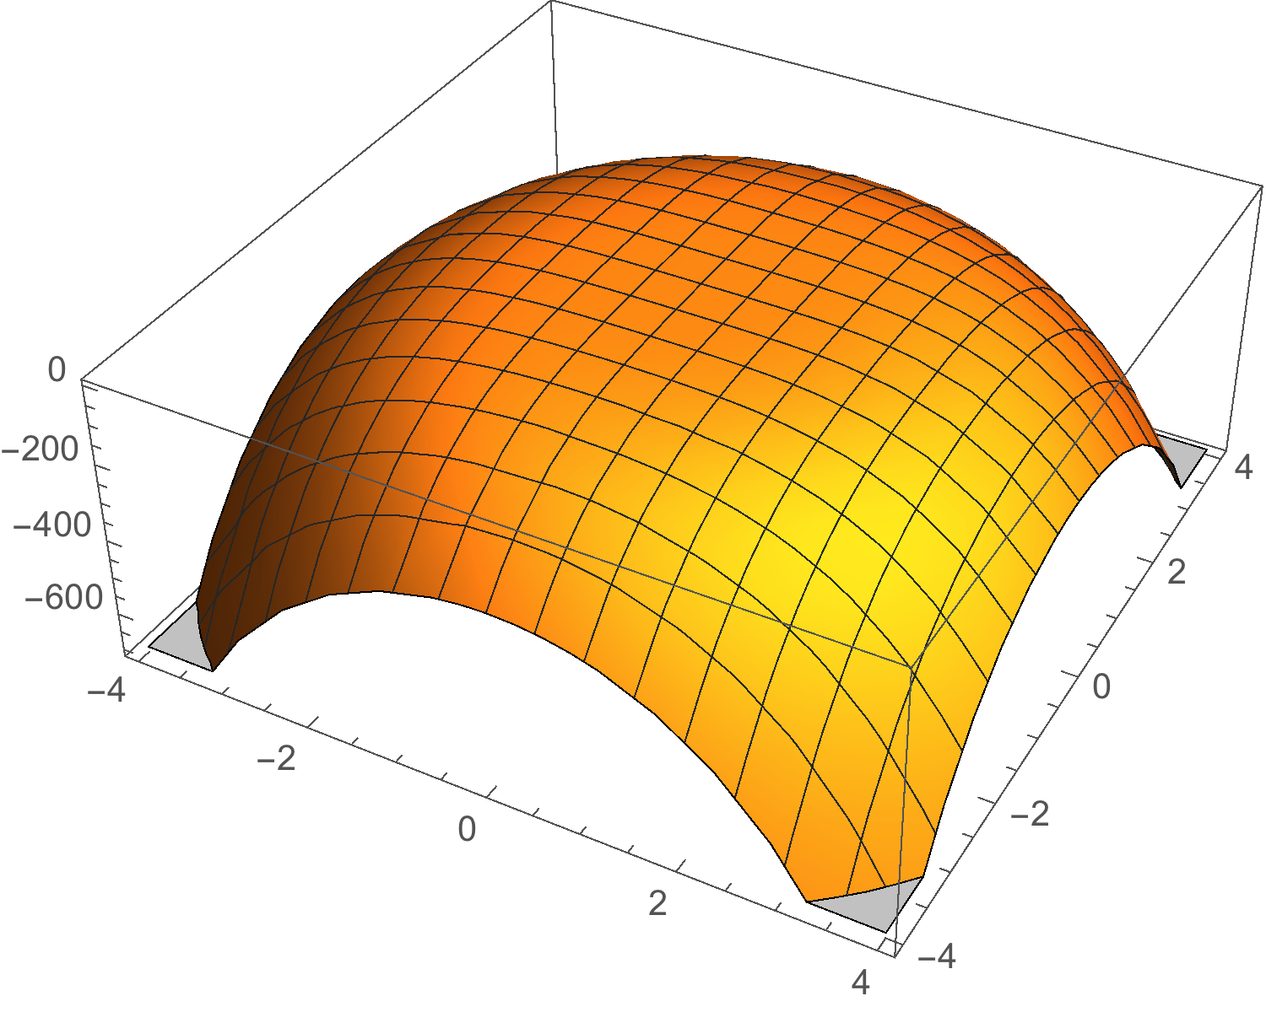
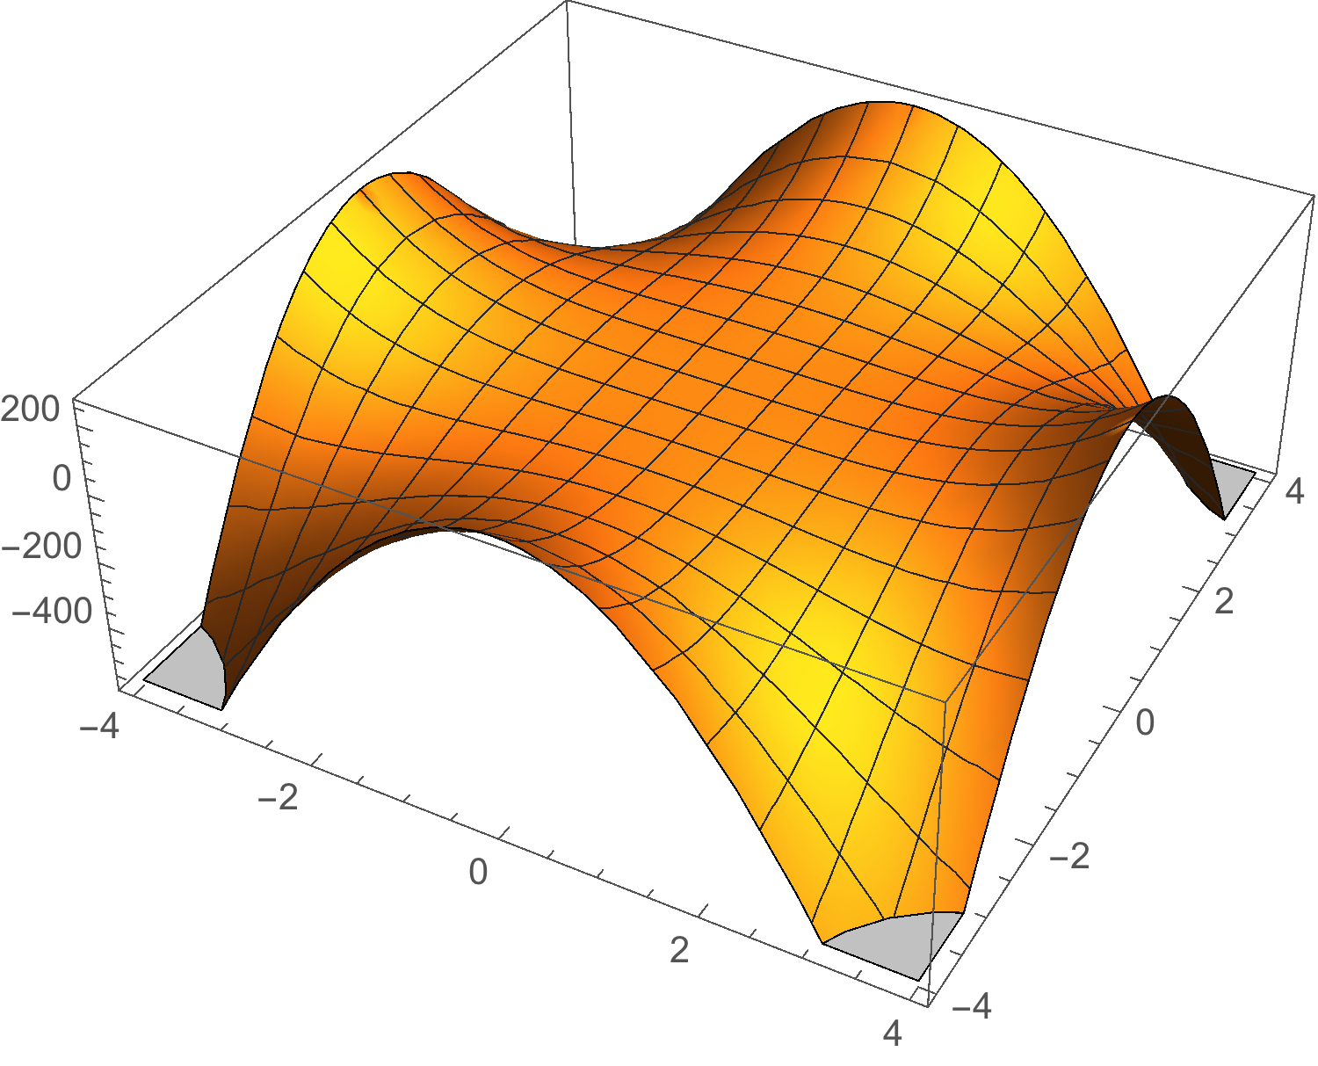
Compensation of S.C
Potential of family of Octupole can suppress the 2nd leading order of S.C
+
Space charge
Octupole

Slide 25
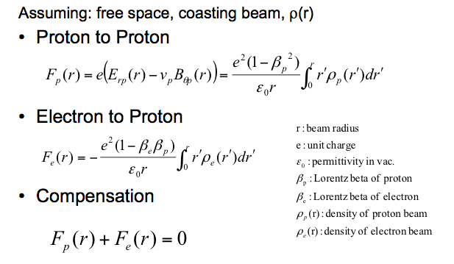
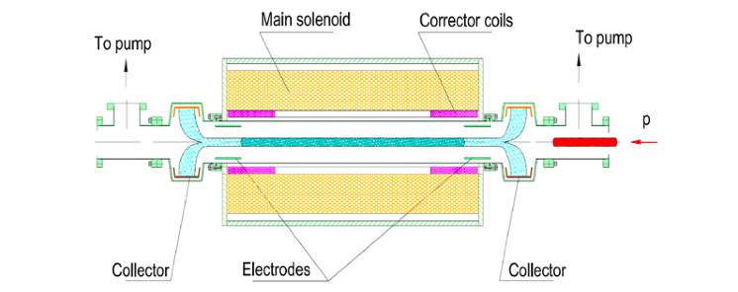
Compensation of S.C
Compensate the S.C force by static force with electrons
Electron lenses, in which a negatively charged electron beam collides with the proton beam inside a strong solenoid field, could also compensate the s.c.

Slide 26
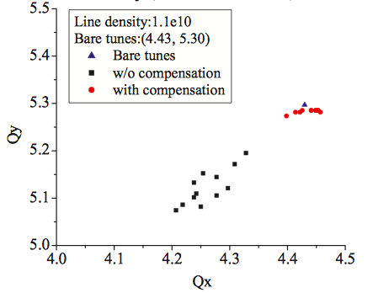
Compensation of S.C
Simulation for PS booster at CERN
4 electron lens with 10 keV, 1.2A
Incoherent tune spread is suppressed by seeing 12 particles located at sigma to 2 sigma

Slide 27
Summary
Nonlinearity of S.C causes instability such as emittance growth
Introduced the S.C effect in EV envelope eqn
Transverse and longitudinal tune shift and its incoherence could cause undesirable beam loss
S.C compensation technique is going on and challenging topic

Slide 28
References
https://acceleratorinstitute.web.cern.ch/acceleratorinstitute/ACINST89/Schindl_Space_Charge.pdf
SPACE-CHARGE COMPENSATION OPTIONS FOR THE LHC INJECTOR COMPLEX∗ M. Aiba, M. Chanel, U. Dorda, R. Garoby
https://acceleratorinstitute.web.cern.ch/acceleratorinstitute/ACINST89/Schindl_Space_Charge.pdf
http://uspas.fnal.gov/materials/09UNM/Unit_4_Lecture_13_Beam_loading_&_wakefileds.pdf
Transverse Equilibrium Distributions* Prof. Steven M. Lund
USPAS2016 Collective Instability by Alex Chao

Slide 29
Thank you for your attention!!

Slide 30
Longitudinal S.C
Unbunched uniform longitudinal dist gives only transverse field by symmetry
Non uniform dist gives rise to S.C in s direction.
Elamda(s-betact) with lamda being line charge density
S.C proportional to lamda prime and 1/gamma can be gessed.

Slide 31
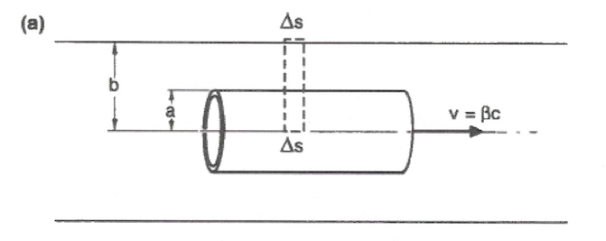
Longitudinal S.C
Faraday’s law gives Es

Slide 32
Longitudinal S.C
Opening angle is small
So Er and Bseta would be
Line integral for Faraday’s law gives Es as follows

