Slide 1
Longitudinal Dynamics of Charged Particle

Slide 2
6-D Phase Space
A complete description of a charged particle motion with respect to the ‘ideal particle’ must be done in 6D.
Longitudinal dynamics is important in
  Storage rings
  Beam transport in Linac
  Applications, such as Free Electron Laser

Slide 3
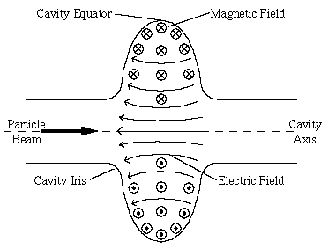
Charged Particle in RF Cavity
Let us consider a ultra-relativistic particle passing a RF cavity, with the field E and voltage V.
The energy gain of one charged particle with position z in a bunch:
T(transit time factor)V
Notes:
E(s,t)=E_0(s)\sin(\omega t+\phi_s)
\Delta U=\int_{-\infty}^{\infty}E_0(s=ct+z)\sin(\omega t+\phi_s)cdt
\Delta U=e\int_{-\infty}^{\infty}E_0(s)\cos({ks})ds\times\sin(\phi)

Slide 4
Synchrotron Motion in a Storage Ring

Slide 5
RF Synchronization in a ring
The frequency of the cavity must satisfy:
Circumference:C
Revolution frequency:ω₀
h is called harmonic number.
h Ideal particles can co-exist in the ring, named Synchronous particles

Slide 6
Longitudinal Dynamics I
We start with the energy gain of a particle at z:
If we use the energy deviation variable:
The change of δ in nth to (n+1)th turn in the ring:
Now we know, longitudinal coordinate offset→Energy deviation from the synchronous particle.
Notes:
\Delta U=eV\sin(\phi)
\dot{U}=\frac{dU}{dt}=\frac{eV}{T}\cos(kz+\phi_s)
\dot{\delta}=\frac{eV}{TE_0}\cos(kz+\phi_s)
\delta_{n+1}-\delta_{n}=\frac{eV}{\beta^2E_0}(\sin\phi_n-\sin\phi_s)
\phi_n=\omega t_n+\phi_s=-kz_n+\phi_s

Slide 7
Longitudinal Dynamics II
Now Let’s consider the consequence of the energy deviation
  Its velocity changes:
  And the pass length change
The arrival time difference
Notes:
\frac{\Delta v}{v}=\frac{1}{\gamma^2}\delta
\frac{\Delta C}{C}=\oint \frac{x(s)}{\rho}ds=\oint \frac{D(s)}{\rho}ds\delta=\alpha_c \delta

Slide 8
Longitudinal Dynamics III
Then we can translate the arriving time to the rf phase variable:
Change to turn by turn mapping format:
Combined with the earlier map, we have the longitudinal map:
Notes:
\Delta \phi=\omega \Delta t+\phi_s
{\color[rgb]{0.501961,0.000000,0.250980}\phi_{n+1}-\phi_{n}=}\omega T\eta\delta_{n+1}={\color[rgb]{0.501961,0.000000,0.250980}2\pi\eta\delta_{n+1}}

Slide 9
Fix Points
For any nonlinear map, the first knowledge is get by finding fix point(s) of the system.
The fix point is trivial by letting:
Then the fix points are
Next question→Are the fix points stable?
  The next example will demonstrate

Slide 10
An Example
Consider the example with following parameter:
  Proton beam with 100 GeV or 15 GeV
  Cavity voltage 5MV, 360 harmonic
  Compaction factor 0.002
  No net acceleration.
  Initial condition:

Slide 11
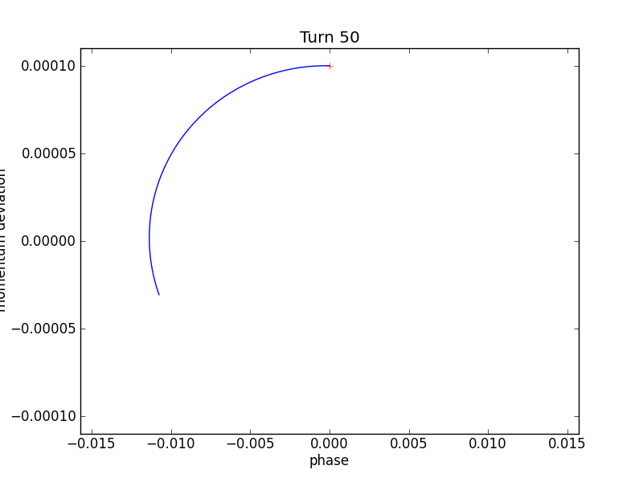
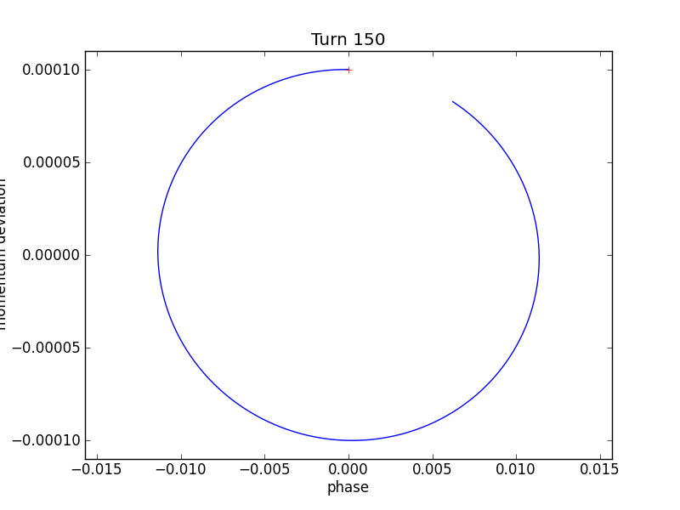
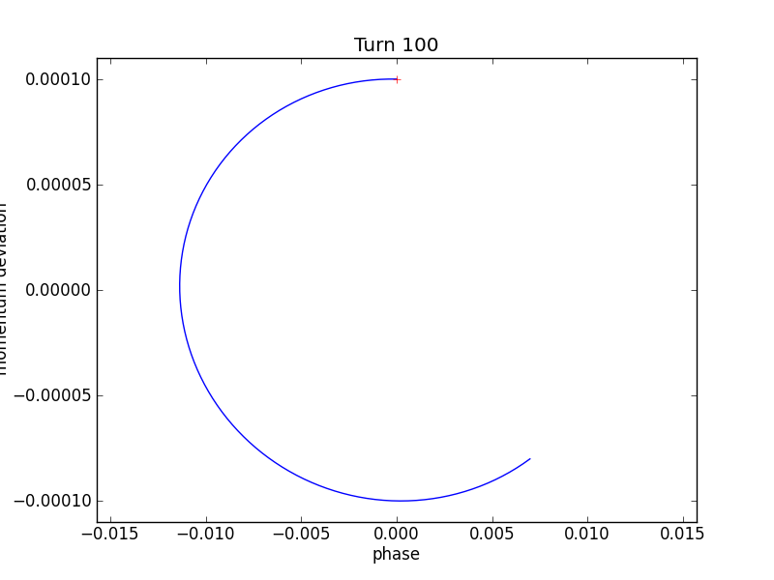
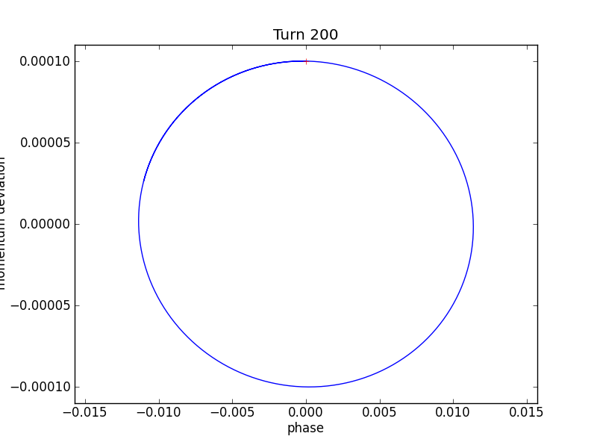
Phase stability for 15GeV

Slide 12
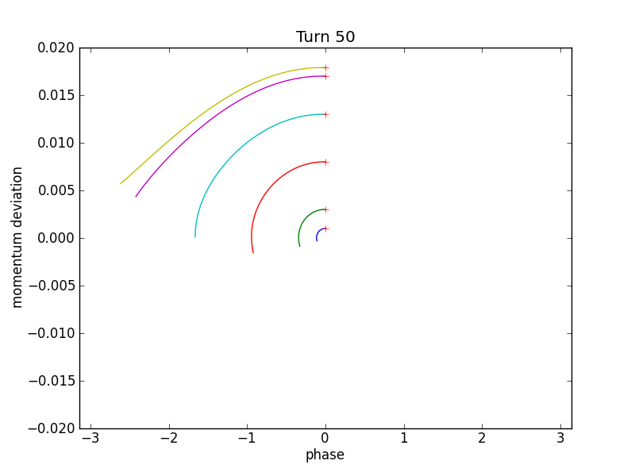
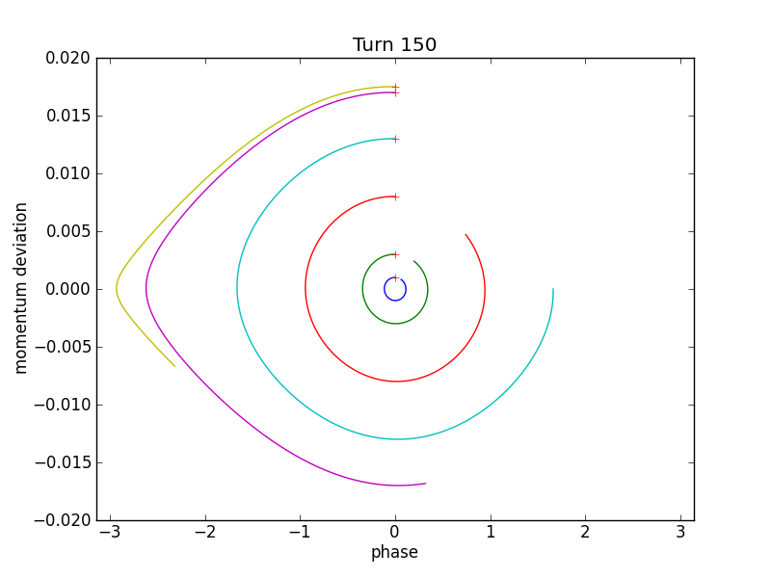
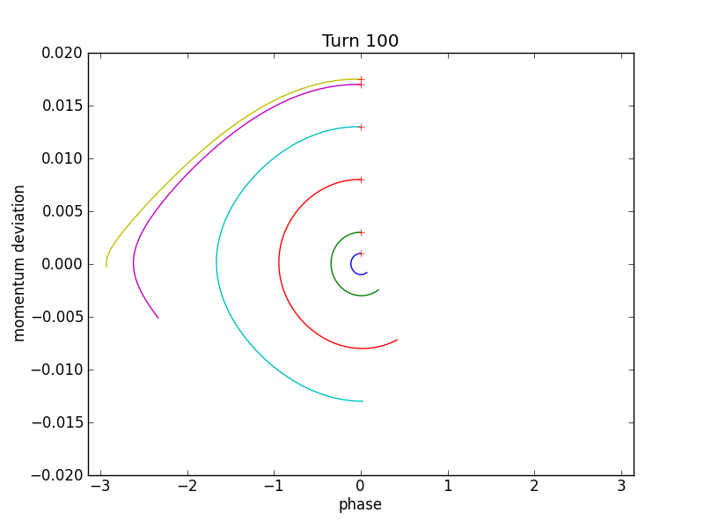
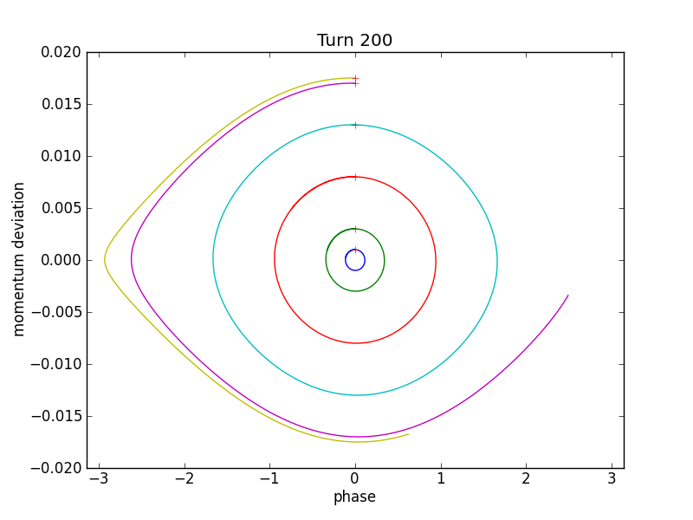
Phase stability, cont’d

Slide 13
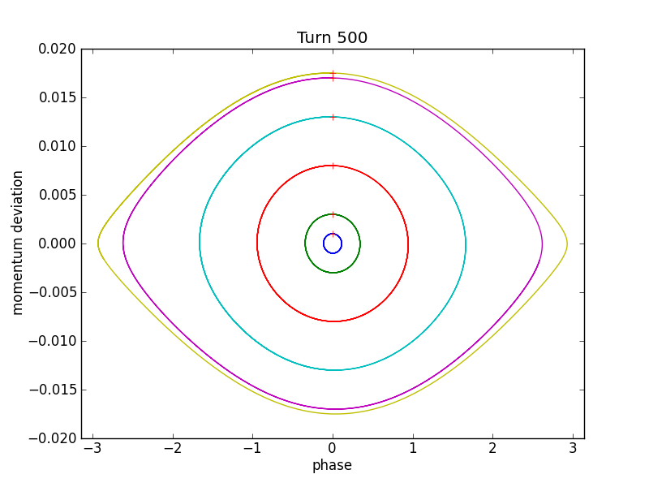
Phase stability cont’d

Slide 14
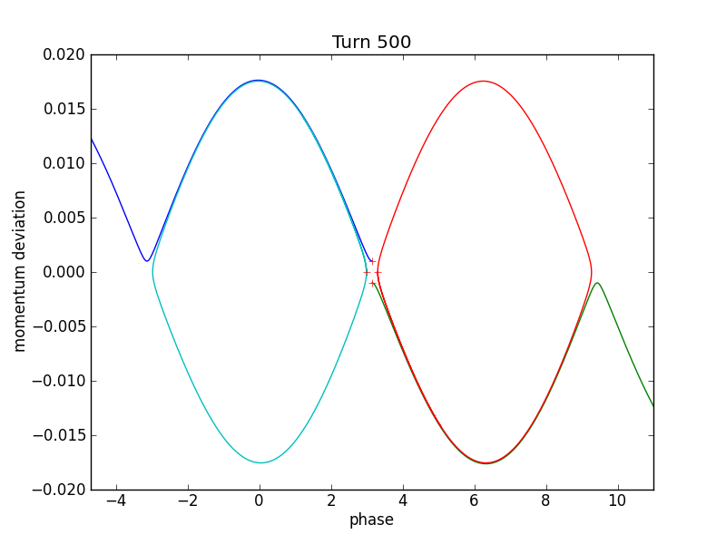
Phase stability, cont’d

Slide 15
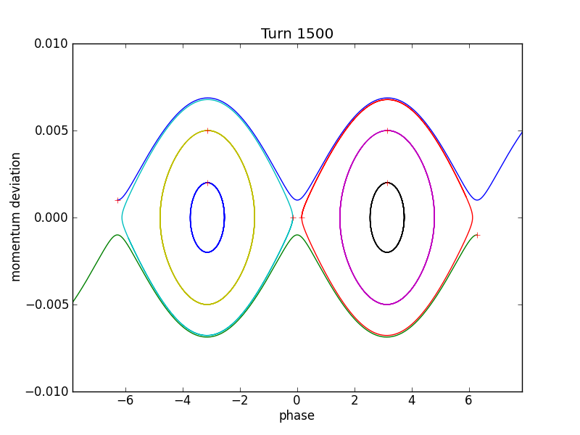
Phase stability for 100 GeV

Slide 16
Map→Hamiltonian
The energy change is not continuous (only in cavities).
Over many turns, we consider the energy change and phase change are continuous and change to maps to two differential equations and change to an effective Hamiltonian
Notes:
\dot\delta=\frac{eV\omega_0}{2\pi\beta^2E_0}\left(\sin\phi-\sin\phi_s\right)
H=\frac{1}{2}h\omega_0\eta\delta^2+\frac{eV\omega_0}{2\pi\beta^2E_0}\left[\cos\phi-\cos\phi_s+\sin\phi_s\left(\phi-\phi_s\right)\right]
\ddot\phi=\frac{eVh\eta\omega_0^2}{2\pi\beta^2E_0}\left(\sin\phi-\sin\phi_s\right)

Slide 17
Similarity to pendulum
@zero accelerating phase
‘MASS’
(not unique)
Stable phase
Bucket height
For stable motion
Angular frequency for small oscillation
Notes:
H=\frac{1}{2}h\omega_0\eta\delta^2+\frac{eV\omega_0}{2\pi\beta^2E_0}\left(\cos\phi-1\right)
\pm\sqrt{\frac{2eV}{\pi\beta^2E_0h\left|\eta\right|}}
\omega_0\sqrt{\frac{-eVh\eta\cos\phi_s}{2\pi\beta^2E_0}}

Slide 18
Small amplitude approximation
Stability criterion
Back to the 2nd order differential equation
Define the angle deviation (small)
Stable condition:
Notes:
\ddot{\Delta\phi}=\frac{eVh\eta\cos\phi_s\omega_0^2}{2\pi\beta^2E_0}\Delta\phi

Slide 19
Synchrotron tune
The ‘tune’ is extracted as
Define synchrotron tune
Typical Numbers
  Hadron rings: ~1e-3
  Electron rings: ~1e-1
Notes:
Q_s=\sqrt{\frac{-eVh\eta\cos\phi_s}{2\pi\beta^2E_0}}\equiv\nu_s\sqrt{\left|\cos\phi_s\right|}
\nu_s=\sqrt{\frac{-eVh\eta\cos\phi_s}{2\pi\beta^2E_0}}

Slide 20
Small Amplitude Approximation
Hamitonian
When the phase is close enough to the synchronous phase:
The phase space trajectory will be upright ellipse for fixed ‘energy’
Notes:
H=\frac{1}{2}h\omega_0\eta\delta^2+\frac{eV\omega_0\cos\phi_s}{4\pi\beta^2E_0}\Delta\phi^2
\left(\frac{\delta}{\left<\delta\right>}\right)^2+\left(\frac{\Delta\phi}{\left<\Delta\phi\right>}\right)^2=1
\frac{\left<\delta\right>}{\left<\Delta\phi\right>}=\sqrt\frac{eV\left|\cos\phi_s\right|}{2\pi h\left|\eta\right|\beta^2E_0}

Slide 21
Transition
Transition happens when:
Below transition: Faster particle arrives first
Above transition: Slower particle arrives first

Slide 22
Physics Picture
Above Transition
Below
Transition

Slide 23
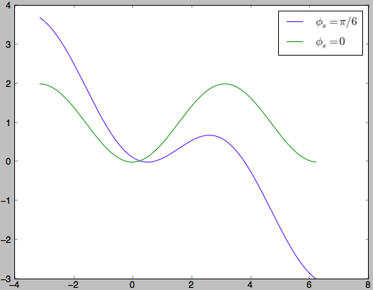
Non-zero acceleration phase
In storage rings, we need acceleration for synchronous particle to compensate energy loss.
For now, we assume that the energy loss per turn is energy independent, and not net acceleration for synchronous particle.
Stable region

Slide 24
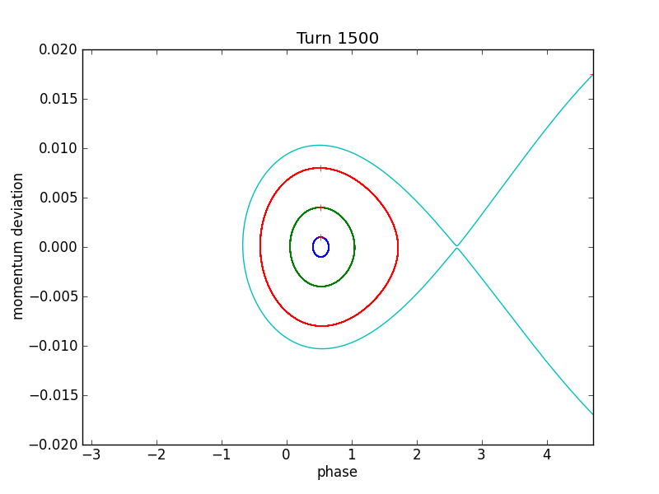
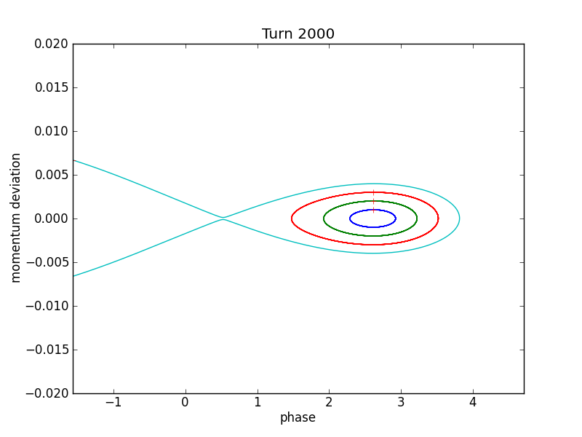
Phase space
15 GeV
100 GeV

Slide 25
Longitudinal Phase Space
We can define longitudinal phase space area from the conjugate variables.
The phase space area remain constant even in acceleration
If we stay with, , the phase space area is constant only without net acceleration.
Notes:
\left(t

Slide 26
Longitudinal Phase Space II
We may take a Gaussian beam distribution then the rms phase space area is simply:
The area is conserved only
  When the beam distribution matches the bucket
  When the beam oscillation is very small (linear).

Slide 27
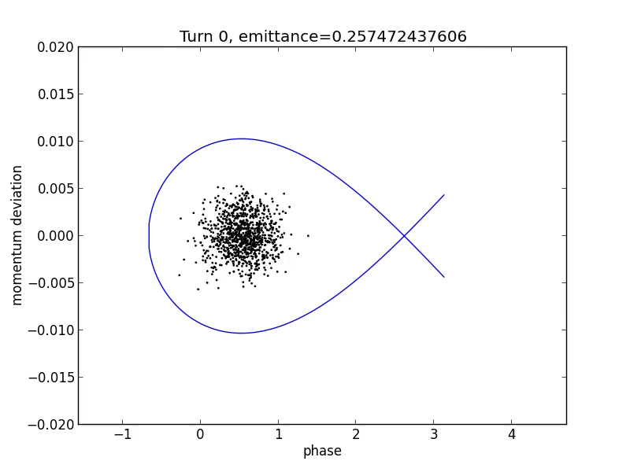
Phase Space Area
Examples and Evolution I
A Matched case
(Perfect injection):
Initial condition matches:

Slide 28
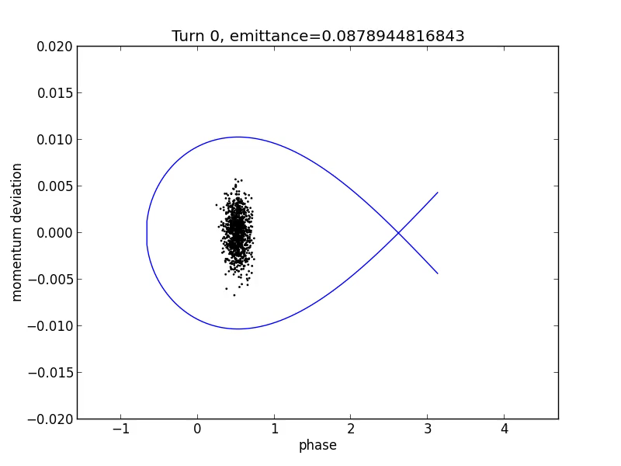
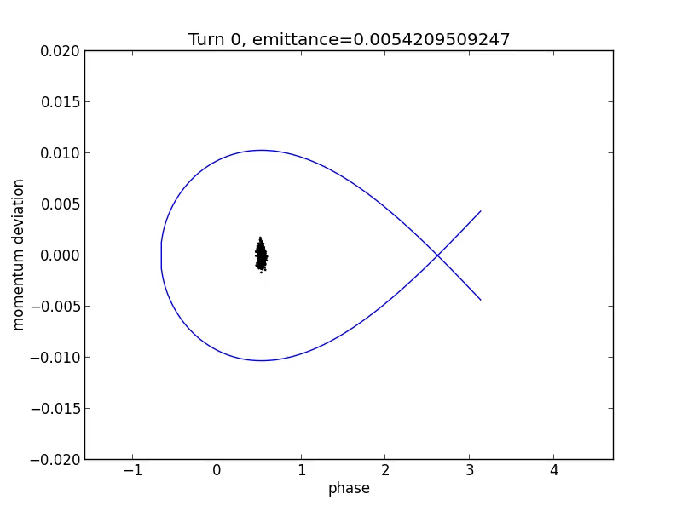
Phase Space Area
Examples and Evolution II
A Unmatched case
Notes:
\frac{\left<\delta\right>}{\left<\Delta\phi\right>}=\frac{3Q_s}{h\left|\eta\right|}

Slide 29
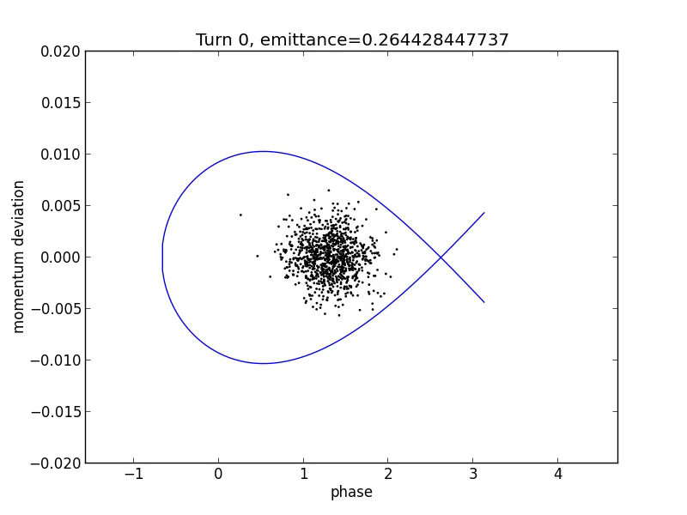
Phase Space Area
Examples and Evolution III
Time jitter at injection, other wise same as the matched case:
The phase error is:

Slide 30
Acceleration Case
Assuming no energy loss, there will be net acceleration even with synchronous particle.
The frequency of RF need to be synchronized with the increased revolution frequency.
So does the magnets.
The phase space area (DE-t) conserves

Slide 31
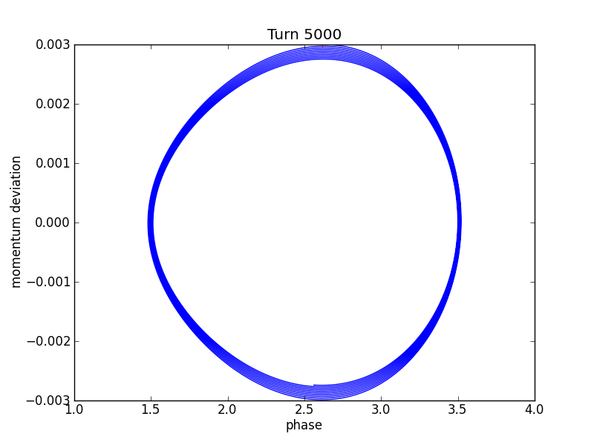
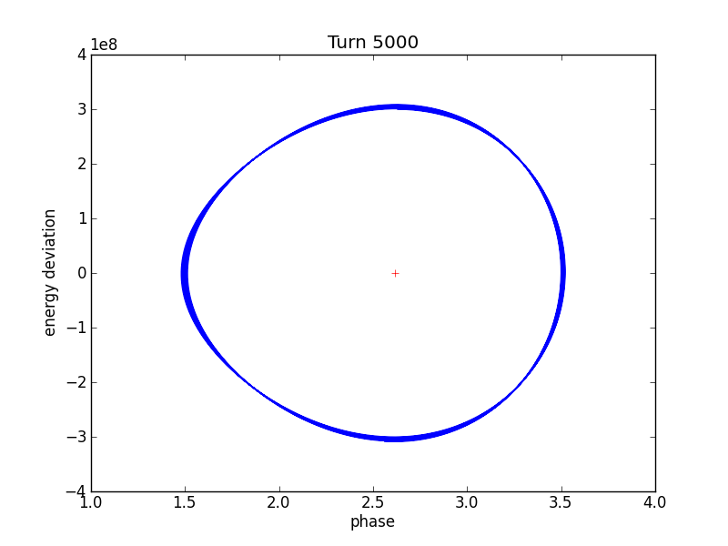
Phase Space

Slide 33
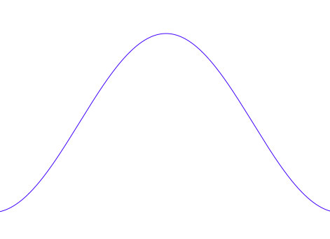
Charged Particle in RF Cavity II
We name the synchronous particle’s phase
For many good reasons, we don’t want the particle to experience the highest accelerating voltage (on crest).
Notes:
\Delta U=eV\sin(\phi+\phi_s)

