Slide 1
Beam Dynamics in Electron Storage Ring

Slide 2
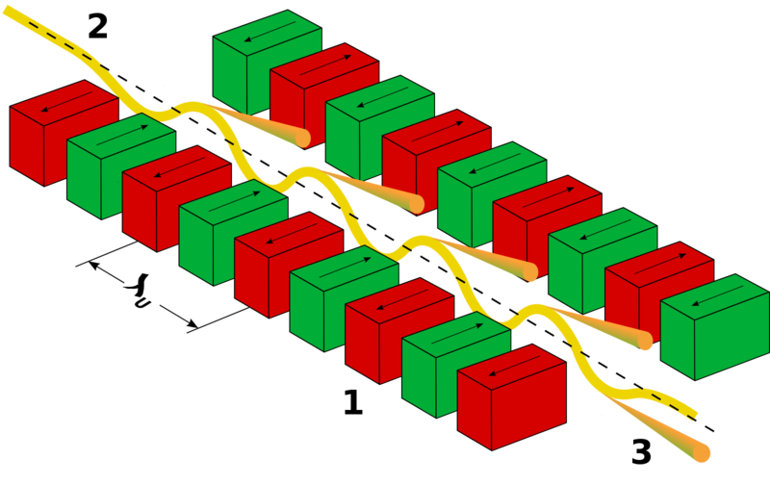
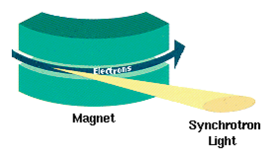
Why electron storage ring is different?
SYNCHROTRON RADIATION
Origin: Energy emitted to infinity or other boundary condition.
  Form: Electromagnetic wave
  Source: the charged particles
  Direction: Along the tangent of the beam trajectory curve.

Slide 3
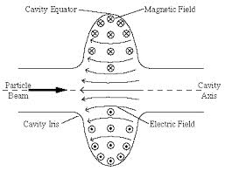
SR Power
The power and its distribution can be calculated from the ‘retarded potential’
Radiation due to
Acceleration
(Negligible)
Radiation due to
Bending
(Dominating)

Slide 4
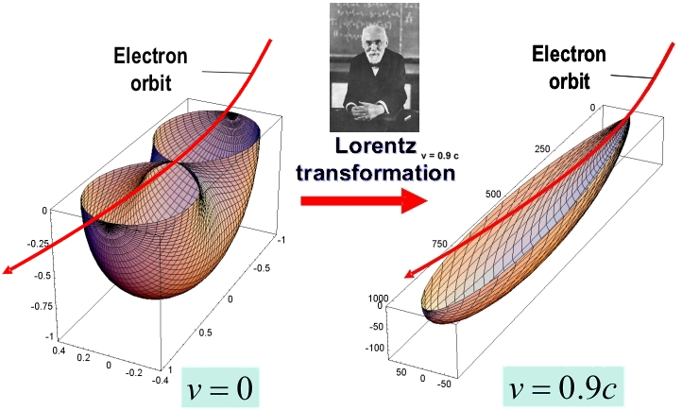
Radiation Angular Distribution
Opening angle in lab frame:

Slide 5
SR in storage ring
The power of SR radiation

Slide 6
Energy Loss in e-ring
In one turn, the energy loss is
In a iso-magnetic ring:
The 2nd radiation integral I₂.
Notes:
\Delta U=-\oint{P_{SR}(t)}ds/c
=-\frac{e^2\gamma^4}{6\pi\epsilon_0}\oint{\frac{1}{\rho^2}ds}
\Delta U=\frac{e^2}{3\epsilon_0}\frac{\gamma^4}{\rho}

Slide 7
Energy losses, Numbers
For e-beam:
For Proton:
The energy loss per turn is much less than the beam energy, and should be restored by RF cavity.
Notes:
\Delta U_{p}(keV)=6.03\frac{E(TeV)^4}{\rho(m)}

Slide 8
Now we know
The SR energy loss per turn and power are energy dependent.
The 2nd radiation integral I₂.
Notes:
c_\gamma=\frac{4\pi}{3}\frac{r_0}{m^3c^6}=8.85\times10^{-5} m/(GeV)^3
P=\frac{cC_\gamma}{2\pi}\frac{E^4}{\rho^2}=\frac{e^2c^3}{2\pi}C_\gamma E^2B^2

Slide 9
The longitudinal motion, revisit
Notes:
\frac{d\Delta E}{dt}=\frac{eV\omega_0\cos\phi_s}{2\pi}\omega_{rf}\tau{\color[rgb]{0.501961,0.000000,0.250980}-\frac{\omega_0}{2\pi}\frac{dU}{dE}\Delta E}
\frac{d^2\Delta E}{dt^2}=\frac{eV\omega_0^2h\cos\phi_s\eta}{2\pi E_0}\Delta E{\color[rgb]{0.501961,0.000000,0.250980}-\frac{\omega_0}{2\pi}\frac{dU}{dE}\frac{\Delta E}{dt}}

Slide 10
Damped Motion
The second order DF equation becomes
If the damping effect is very small, the oscillation and damping are separated
Notes:
\frac{d^2\Delta E}{dt^2}+2\alpha_E\frac{\Delta E}{dt}+\omega_s^2\Delta E=0
\Delta E=A\exp(-\alpha_E t)\cos(\omega_s t+\phi_0)

Slide 11
Energy Loss per Turn
In this lecture, we will ignore beta (good for electron beam)
In longitudinal dynamics, we want to know the SR energy loss per turn for non-synchronous particle.
Different energy has different radiation power
Different energy has different travelling time
Notes:
U=\oint P_{SR} dt=\oint P_{SR}(1+x/\rho)ds/c
=\oint P_{SR} (1+\frac{D}{\rho}\frac{\Delta E}{E_0})ds/c

Slide 12
Radiation Power
Dipole field is constant for any energy deviation.
How about Quadrupole?
Both energy and radius are function of energy deviation.

Slide 13
Energy loss dependence
Here, we ignore second order terms:
Notes:
\frac{dU}{dE}=\oint\left[\frac{dP}{dE}+\frac{DP}{\rho E}\right]\Bigg|_{E=E_0}ds/c
\frac{dU}{dE}=\oint\left[\frac{2P}{E_0}+\frac{2PD}{B_0E_0}\frac{dB}{dx}+\frac{PD}{E\rho}\right]\Bigg|_{E=E_0}ds/c
\alpha_E=\frac{1}{2T_0}\frac{dU}{dE}=\frac{U_0}{2T_0 E_0}\left[2+\oint \frac{D}{\rho}\left(1/\rho^2+K(s)\right)ds/I_2\right]

Slide 14
Damping Partition Number
And the damping factor becomes
For separate function, uni-magnet ring:

Slide 15
Transverse Damping (Vertical)
The particle loose it’s momentum in the cone of 1/gamma angle, and regain its energy in RF in desire direction.
If we jump to the result: the damping rate in vertical plain is half of that in longitudinal plane.

Slide 16
Transverse Damping (Horizontal)
This case is more complicated because of the dispersion function.
Dispersion will ‘heat up’ the horizontal motion. Luckily we have similar damping scheme as in vertical plain.
Notes:
\alpha_x=\frac{U_0}{2T_0E_0}(1-\bar{D})

Slide 17
Quantum Fluctuation
Synchrotron radiation is not a continuous emission, instead, is quantum procedure.
The emission obey Poisson distribution.
It is a noise source to heat up the electron beam.
If u is the emitted photon energy, the average amplitude of energy deviation is
Notes:
\frac{d\left< A^2\right>}{dt}=\int n(u)u^2du=N\left< u^2\right>

Slide 18
Equilibrium energy spread
The damping and excitation will reach the a balance point.
The rms energy spread is:
Notes:
\frac{d\left< A^2\right>}{dt}=N\left< u^2\right>-\frac{\left< A^2\right>}{\tau_E/2}
\left< A^2\right>=N\left< u^2\right>\tau_E/2\sim 2\sigma_E^2

Slide 19
Equilibrium energy spread II
The equilibrium of the energy spread:
Amazingly it does not depend on the RF voltage. However the bunch length does.
Radiation Integral I₃
Radiation Integral I₂
Notes:
\left(\frac{\delta_E}{E}\right)^2=\frac{C_q \gamma^2}{(2+\bar{D})}\frac{\left<1/\rho^3\right>}{\left<1/\rho^2\right>}

Slide 20
Transverse equilibrium
Horizontal equilibrium
Vertical equilibrium
  Almost zero size in vertical direction.
Notes:
\sigma_x^2(s)=C_q\frac{\gamma^2}{\rho}\left[\frac{\beta_x(s)\left<H\right>}{1-\bar{D}}+\frac{D^2(s)}{2+\bar{D}}\right]

Slide 21
Transverse Coupling
In reality vertical emittance/beamsize cannot be zero.
There are other effects that dominate over the equilibrium→ Coupling

Slide 22
Summary: Radiation Integral
Index | Integrals | Properties
1
2
3
4
5
Notes:
I_3=\oint 1/\left|\rho\right|^3ds
I_4=\oint \left(D/\rho\right)\left( 1/\rho^2+2K\left(s\right)\right)ds
I_5=\oint H\left(s\right)/\left|\rho\right|^3ds

Slide 23
Beam life-time
Quantum lifetime
  Although the equilibrium emittance is small, there is chance that, for one single electron, continuous random emission drive the electron out of aperture
  Longitudinal or Transverse.
Touschek lifetime
  Coulomb scattering in the bunch may transfer transverse momentum to longitudinal plane and cause beam loss.

Slide 24
Typical numbers
Revolution time: ~ micro second
Longitudinal oscillation: sub millisecond
Damping time: few thousand turns
  Several millisecond
Energy spread ~1e-3
Rms transverse emittance sub nm-rad
Rms vertical emittance several pm-rad

