Slide 1
CeC Engineering
Presented by Jean Clifford Brutus
On behalf of CeC Team
ICFA Mini-Workshop CeC
July 25, 2019

Slide 2
Outline
1002 Building Layout
CeC Cryogenic Model
CeC PoP Beam line layout
CeC PCA Beam line layout
113 MHz SRF Gun, FPC, Cathode Stalk and Cathode Injection Design
500 MHz Dual Buncher Cavities
704 MHz 5-Cell LINAC Design, Components and Repair
45º Dipole Modification
PCA Water cooled Solenoids
Summary

Slide 3
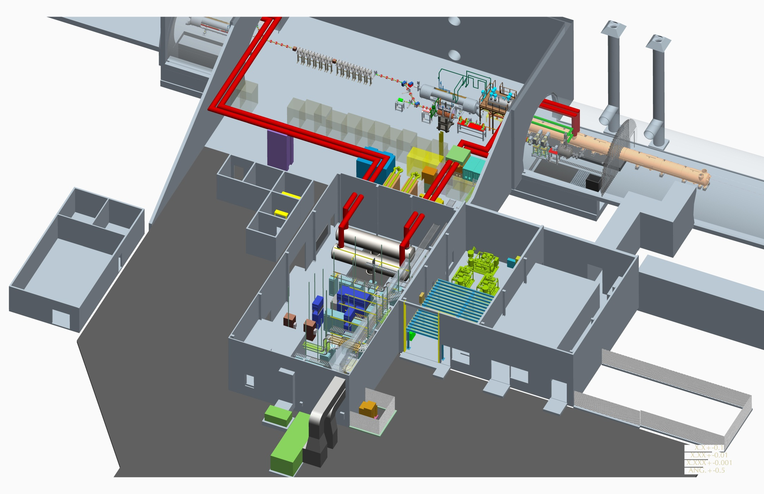
1002 Building Layout
704 MHz Linac
IP2 – CeC Common Section
113 MHz SRF Gun
Laser Trailer
Coax Penetrations
Amplifiers

Slide 4
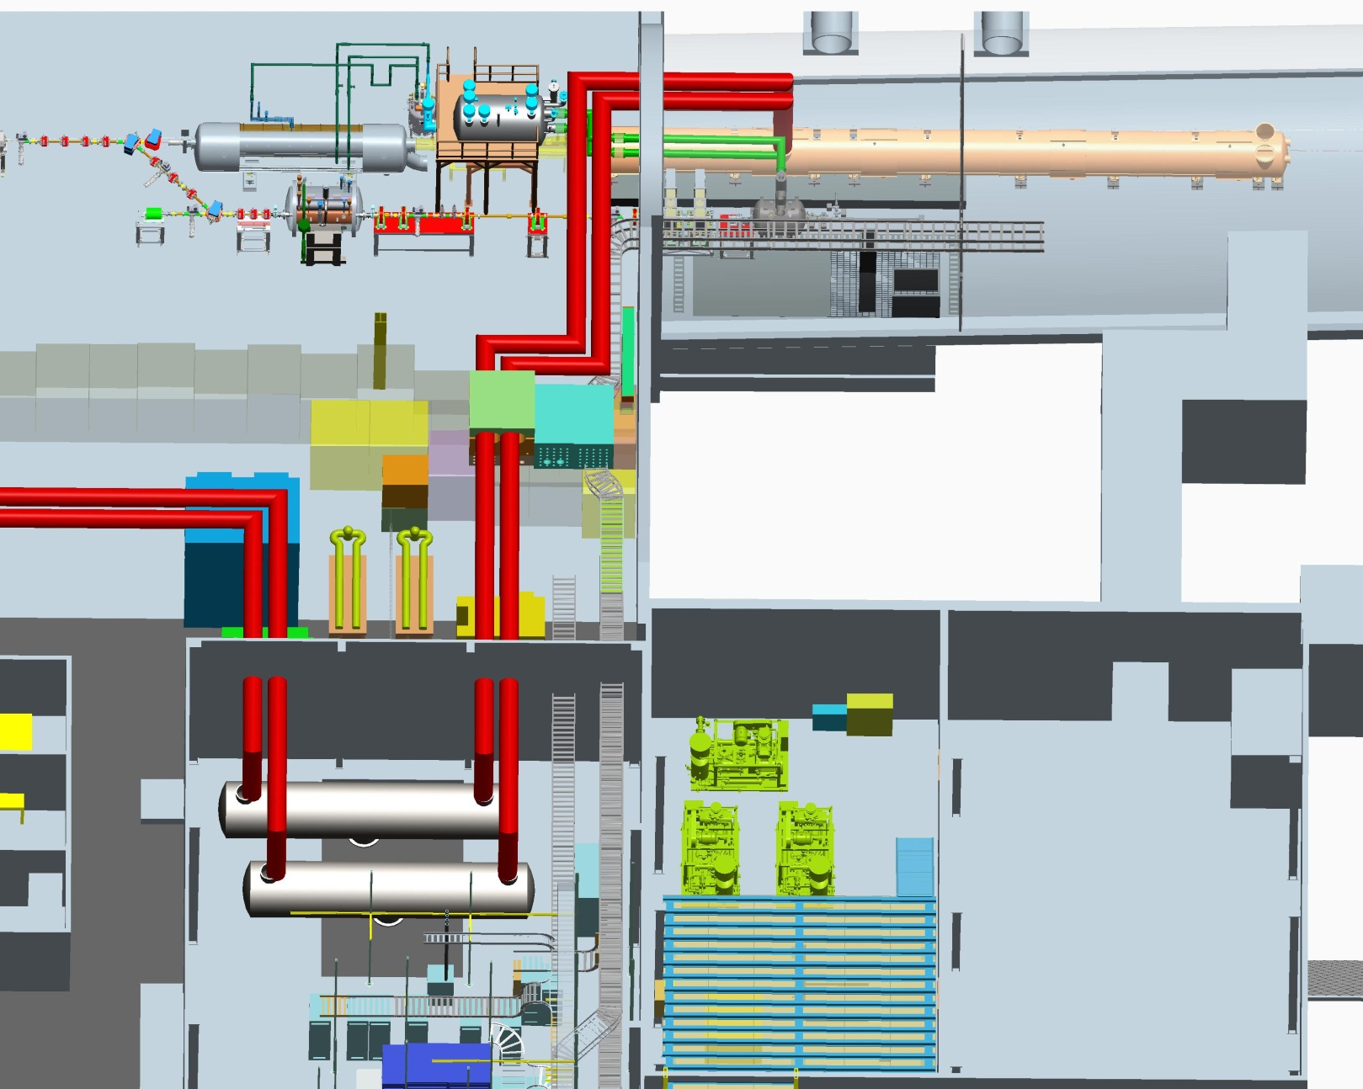
CeC Cryogenics Model
WR
113MHz SCRF Cavity – 4.2K
RHIC tap
704MHz SCRF Cavity - 2K
Quiet Helium Source
Phase Separator
Vacuum Pump Skids
Helium Compressor
20 Torr of vacuum heater is to warm up 2k gas from 704 and LeREC. Need to warm gas before it gets to vacuum pumps.
Vacuum pump skids are needed to get from 4k to 2K.

Slide 5
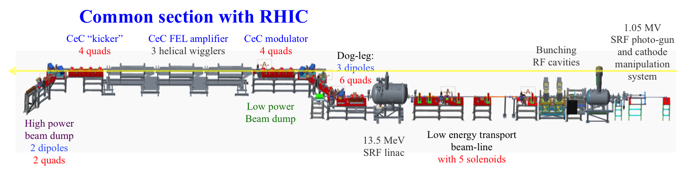
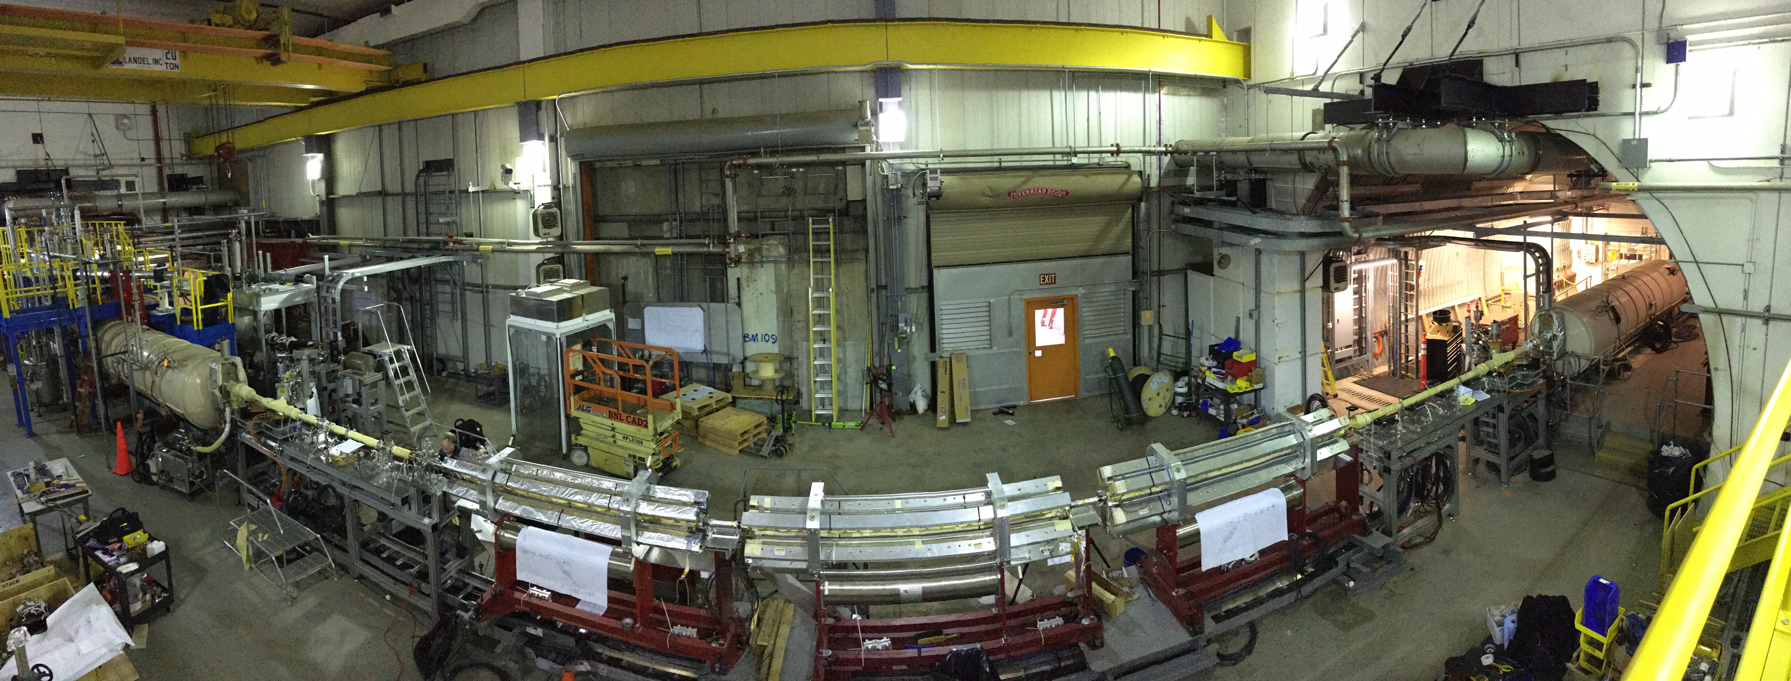
CeC PoP Beam Line
2 profile monitors
1 V/H slit
BPMs

Slide 6
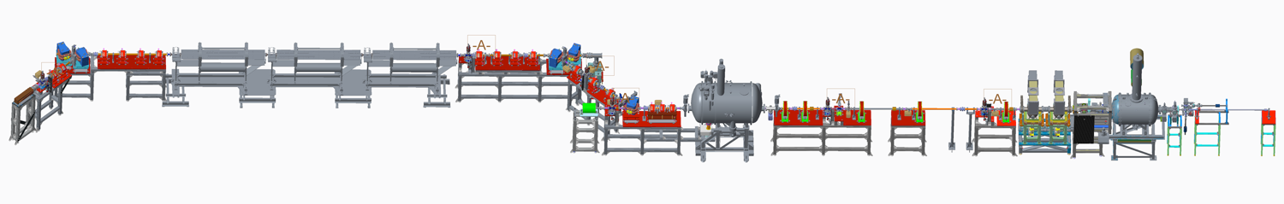
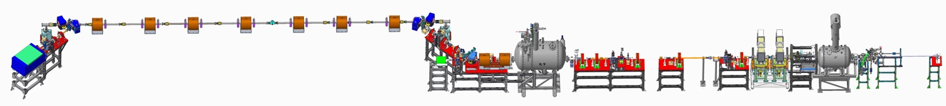
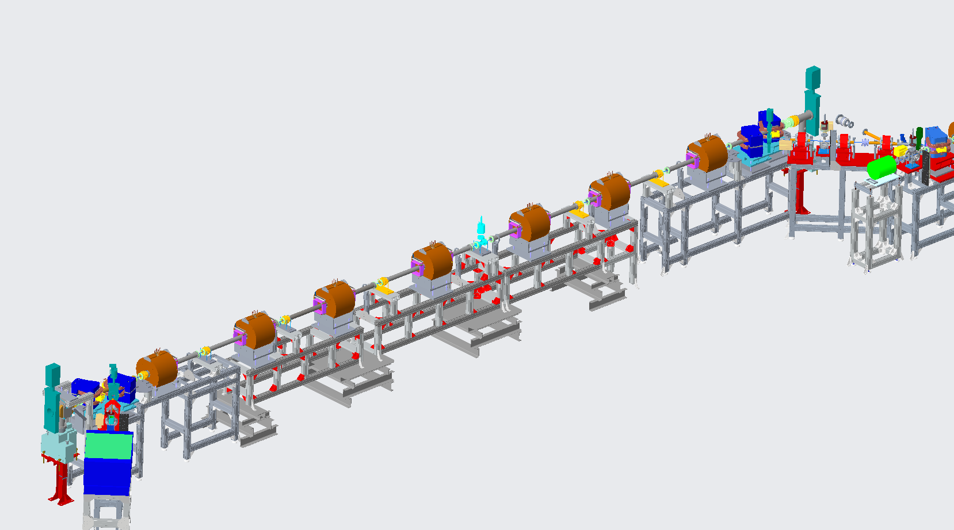
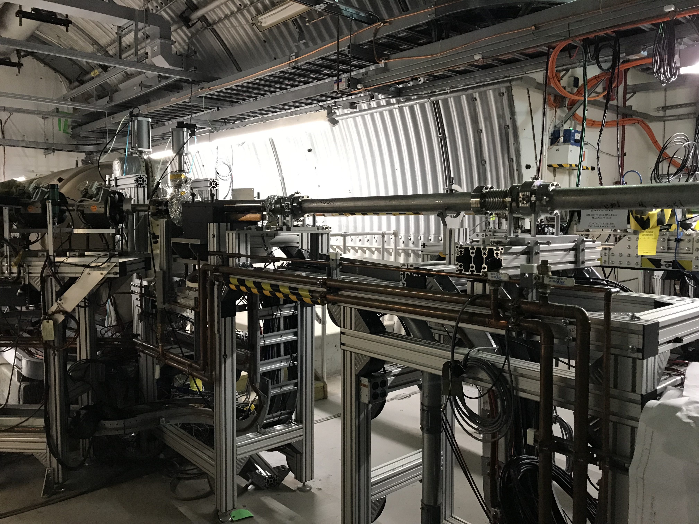
CeC PCA Beam Line
CeC SRF accelerator
Unchanged
Kicker
Modulator
4-cell PCA
Unchanged
New water cooled solenoids
Dipoles gap modification
New Stands
New Profile Monitor
New BPM housing and buttons
6 pairs of corrector magnets
New Y vacuum chamber for dipoles
New NEG coated beam line vacuum chambers
New stand supports for magnets
New RF shielded bellows
New conical transitions to RHIC
New beam line supports
Water Manifold for Solenoids
BPM
Solenoid
Profile Monitor
V/H Trims

Slide 7
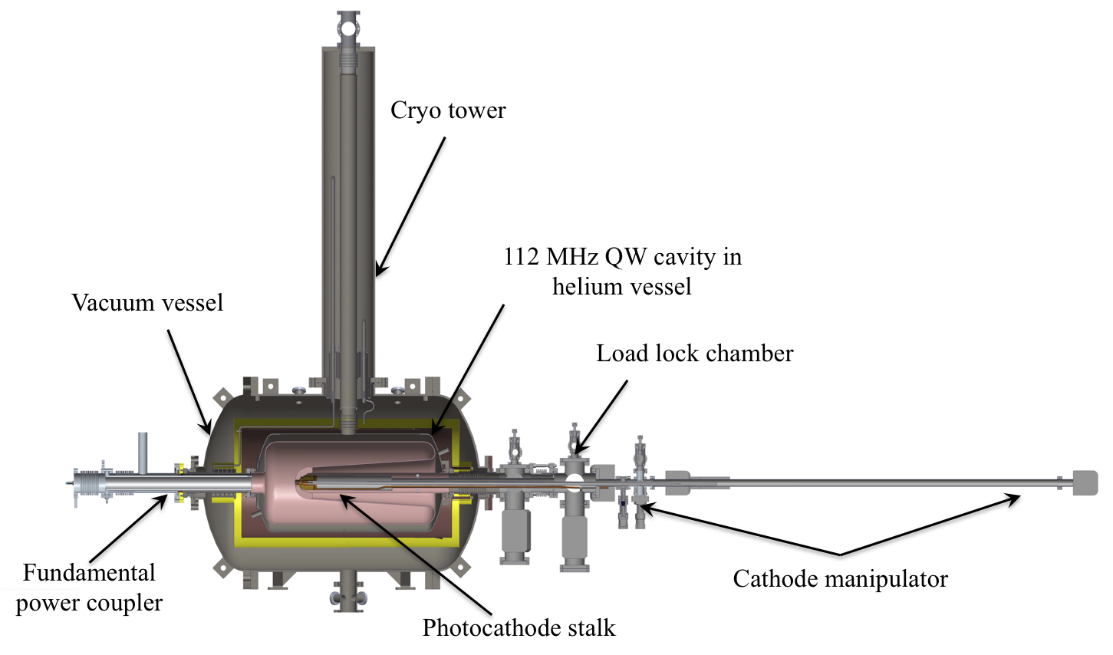
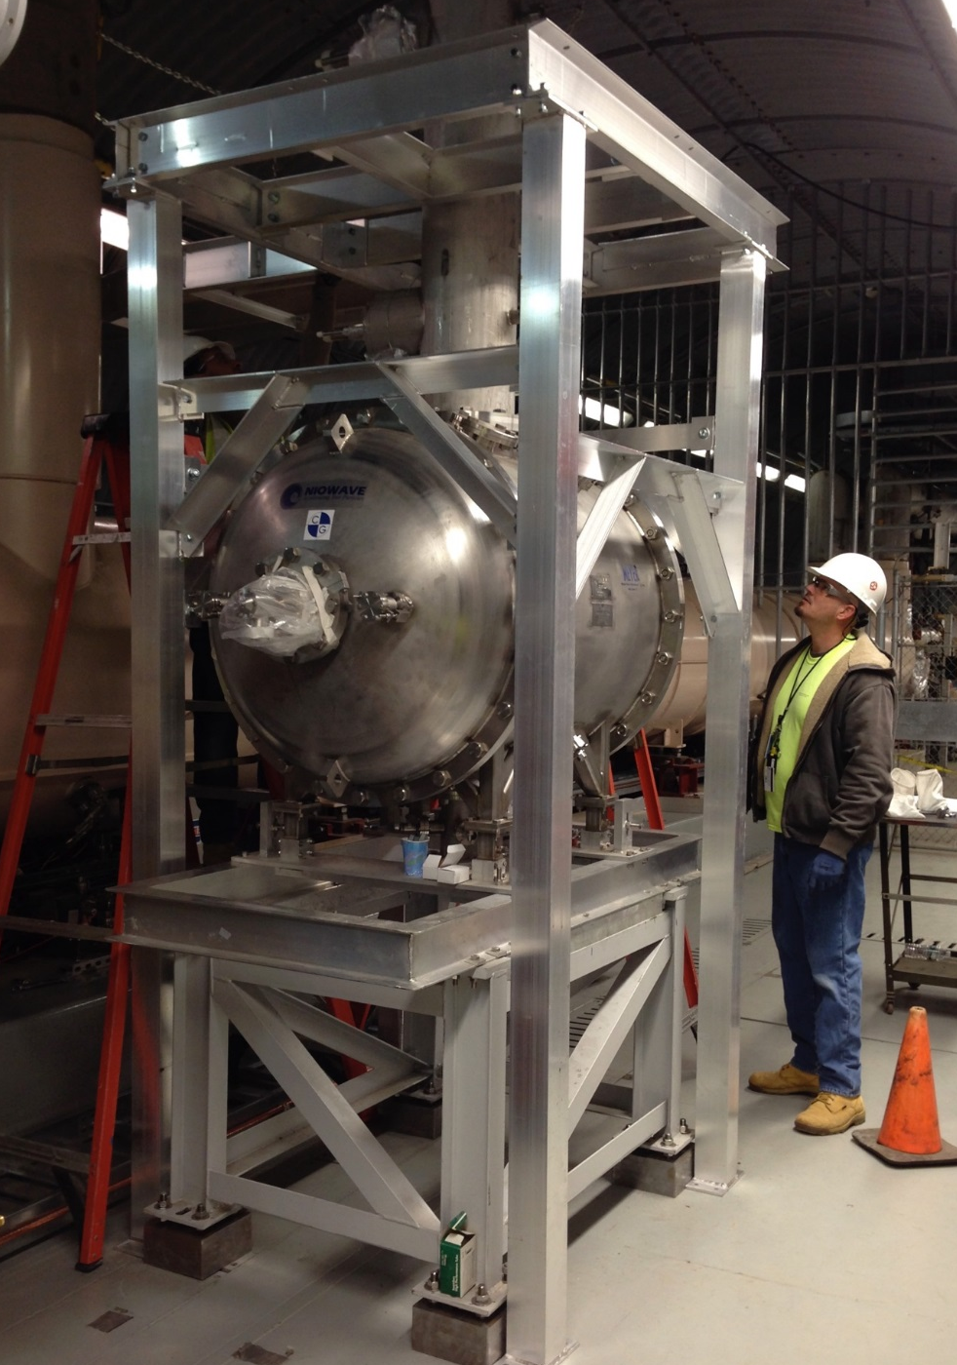
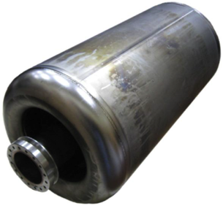
113 MHz SRF Gun
Quarter wave design
Operates at 4.2ºK
Cathode is at room temperature
Stalk serves as field pick-up
Manual coarse tuners
FPC serves as fine tuner
Maximal CW voltage 1.25 MV
Maximal charge 10.7 nC

Slide 8
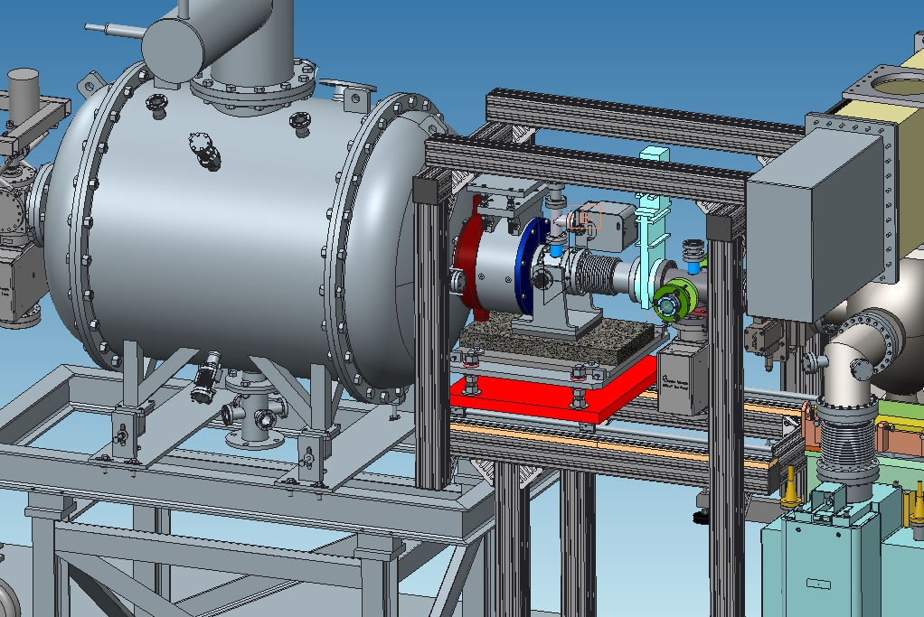
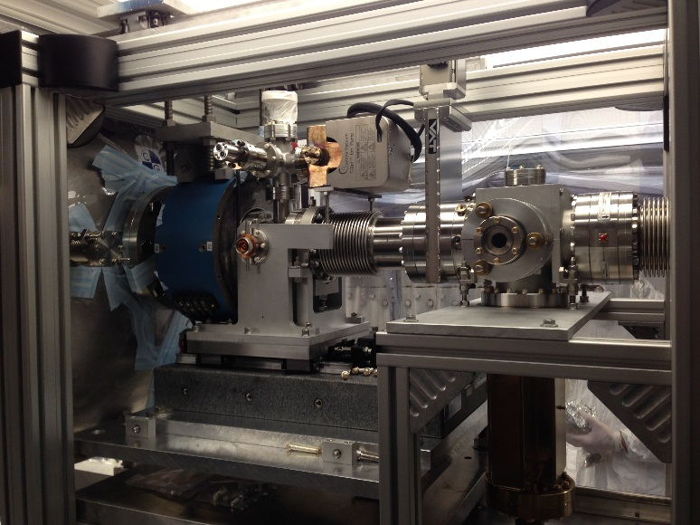
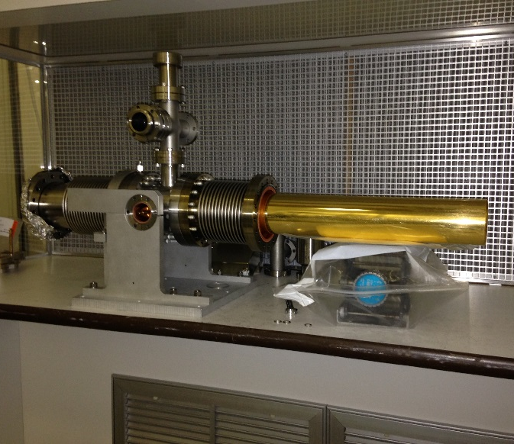
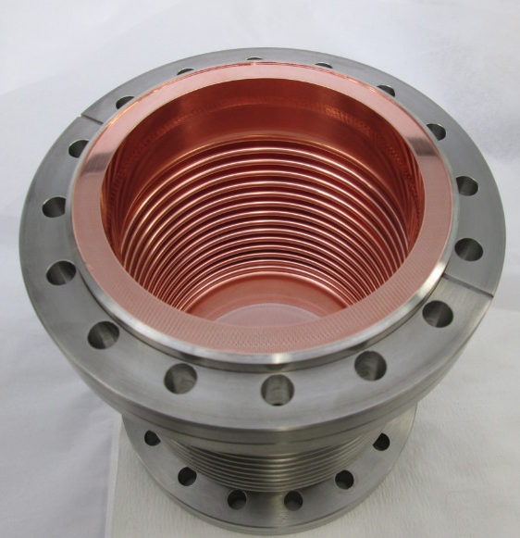
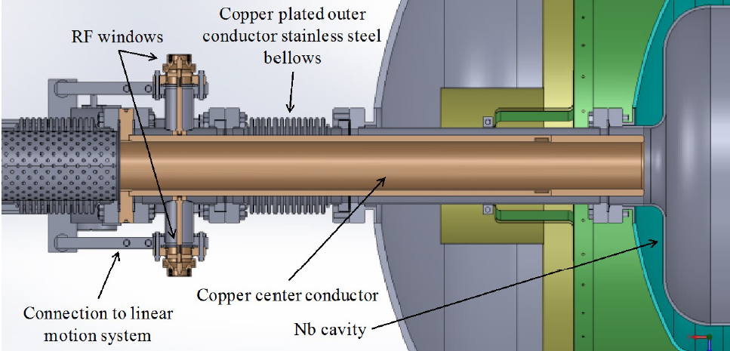
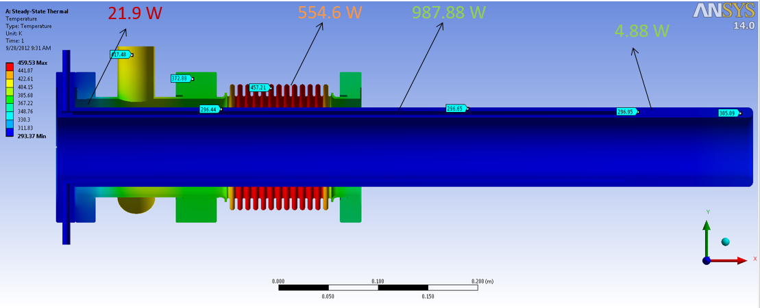
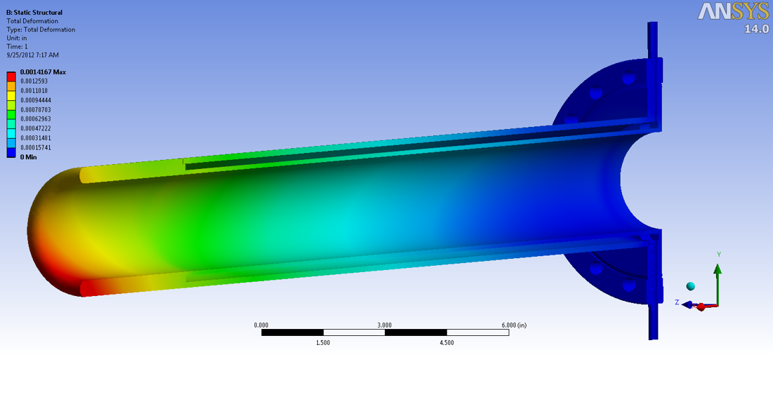
113 MHz Fundamental Power Coupler
The fundamental power coupler(FPC) is a coaxial-type coupler similar to one used in the Naval Postgraduate School (NPS) gun.
The FPC is attached to the beam exit port of the SRF gun.
Its hollow center conductor, or coupling tube, allows the passage of the laser and electron beams.
The cavity’s resonant frequency can be tuned by adjusting the penetration of the coupling tube as well as adjust the coupling strength.
The FPC is gold plated to reduce radiation heat load into 4.2K niobium cavity.

Slide 9
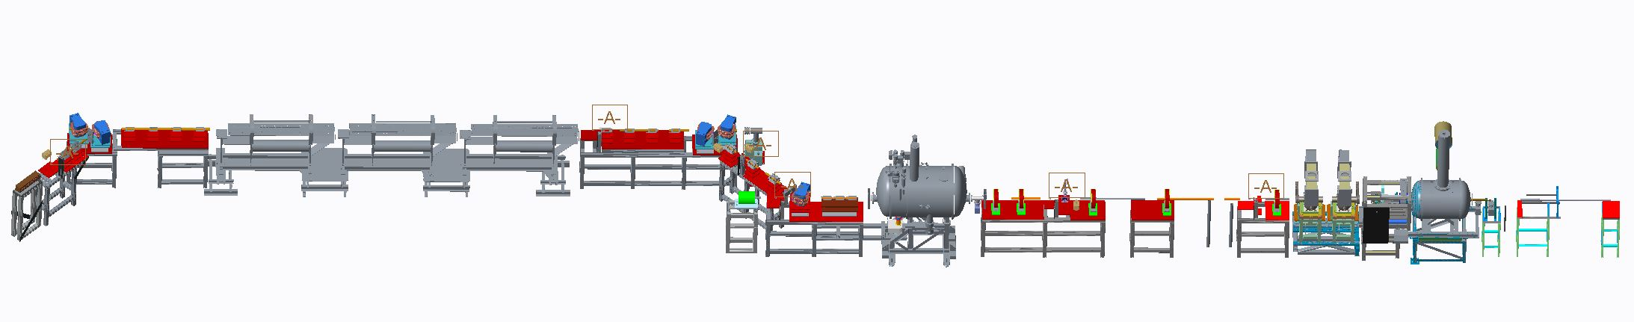
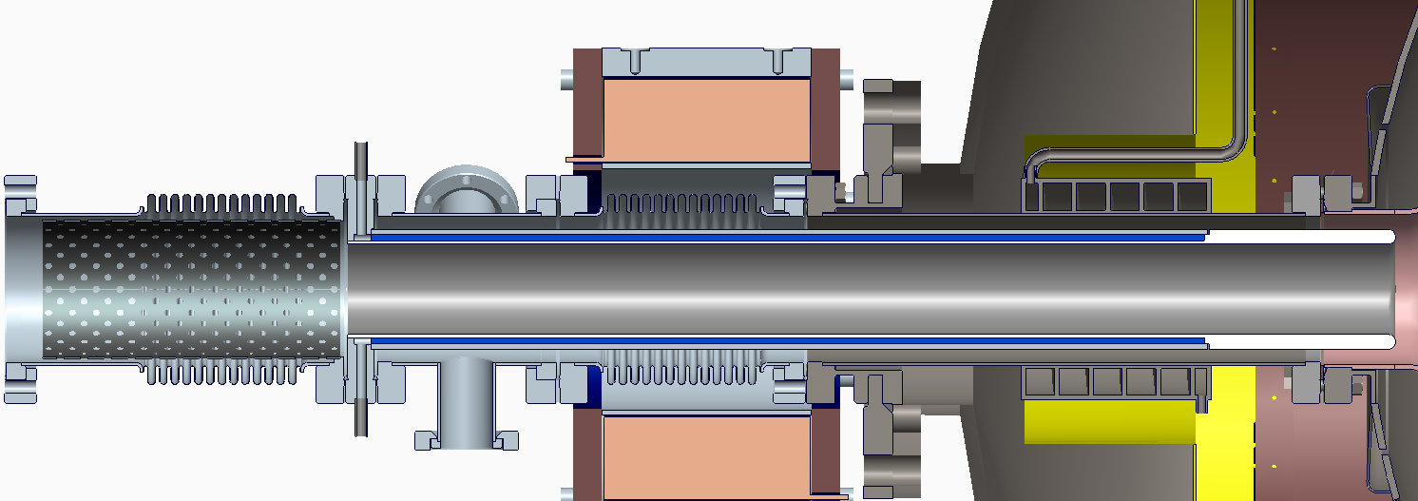
113 MHz Fundamental Power Coupler
Cooling of inner and outer conductor for heat load shown below
FPC Inner conductor is Water Cooled
FPC Outer conductor is forced Air Cooled
Tuning range 4cm with special bellows allowing + .984” travel from Ameriflex
Position Resolution 500nm
Copper plate (25 microns) ID of outer conductor (including formed bellows and antenna)
Copper plate (25 microns) OD of inner conductor
1 cm thick inner conduction with 5mm radius at the end
1 kW
554.6 W
21.9 W

Slide 10
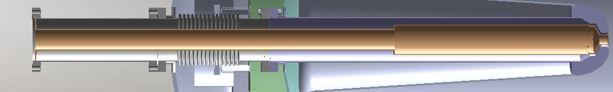
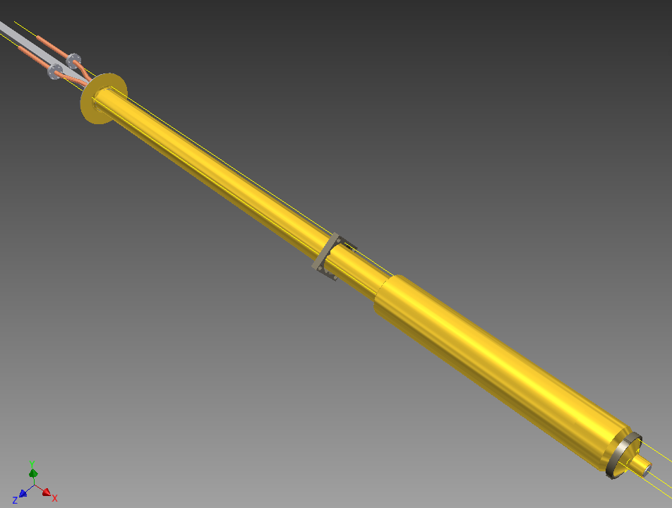
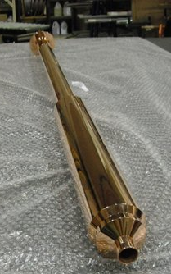
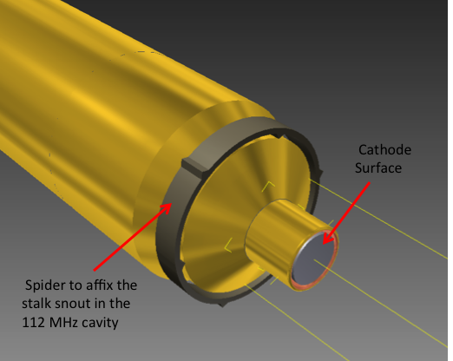
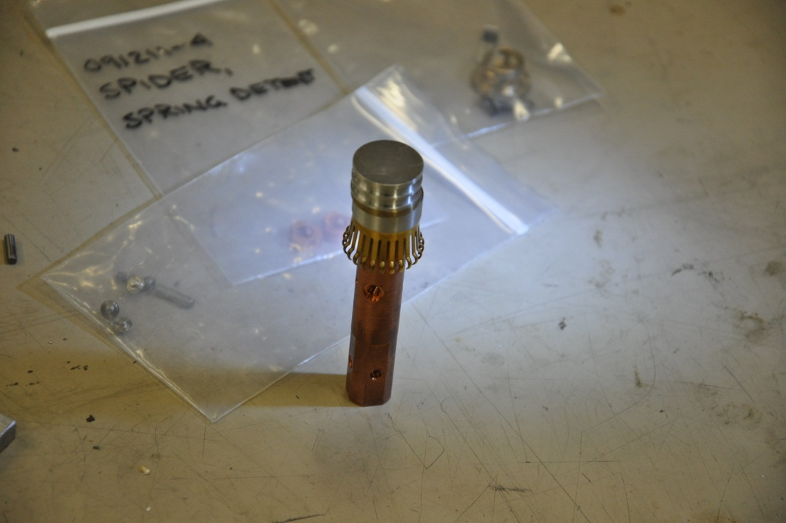
113 MHz RF Cathode Stalk
Center support
Stainless Steel tubes plated with 25 microns of copper and 1 micron of gold
Water connections
2” Stalk tube section
3”Stalk tube section
The cathode stalk is a hollow center conductor of the coaxial line formed by the stalk and the cavity.
The stalk is shorted at one end and is approximately half wavelength long. It will be permanently installed in the gun.
A step at l/4 from the short creates a quarter-wave impedance transformer and reduces RF losses in the stalk from ~65 W to ~25 W.
The gold plating is aimed to reduce radiation heat load from the RT stalk to the cold (4.2 K) niobium.
A small cathode puck is inserted inside the stalk and can be replaced when necessary with a new one.

Slide 11
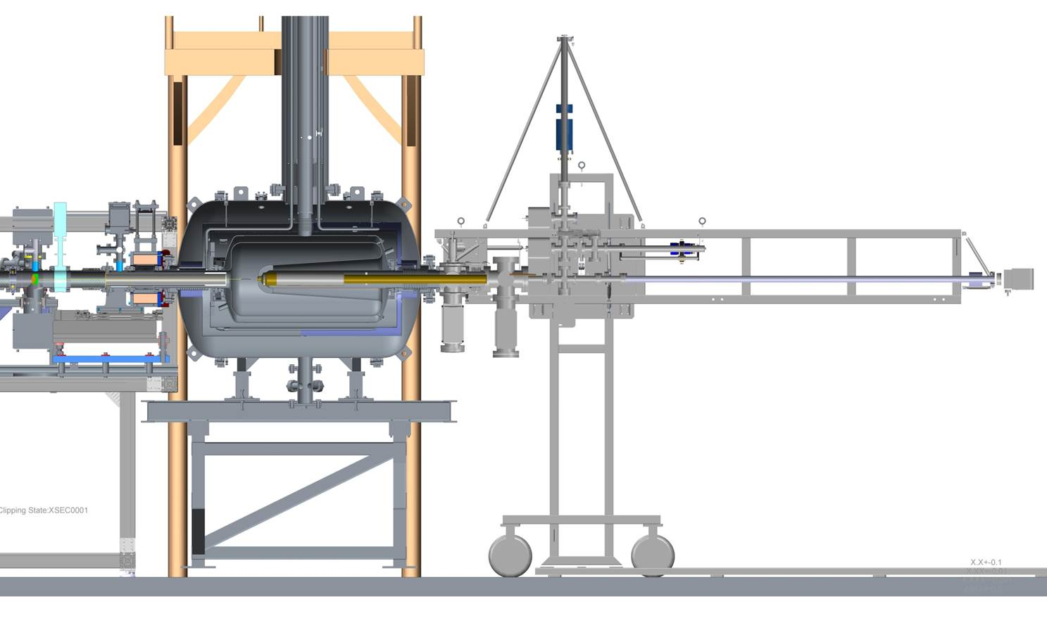
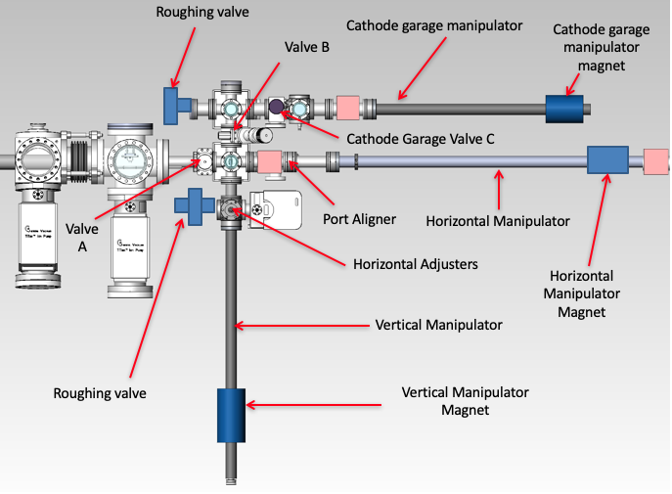
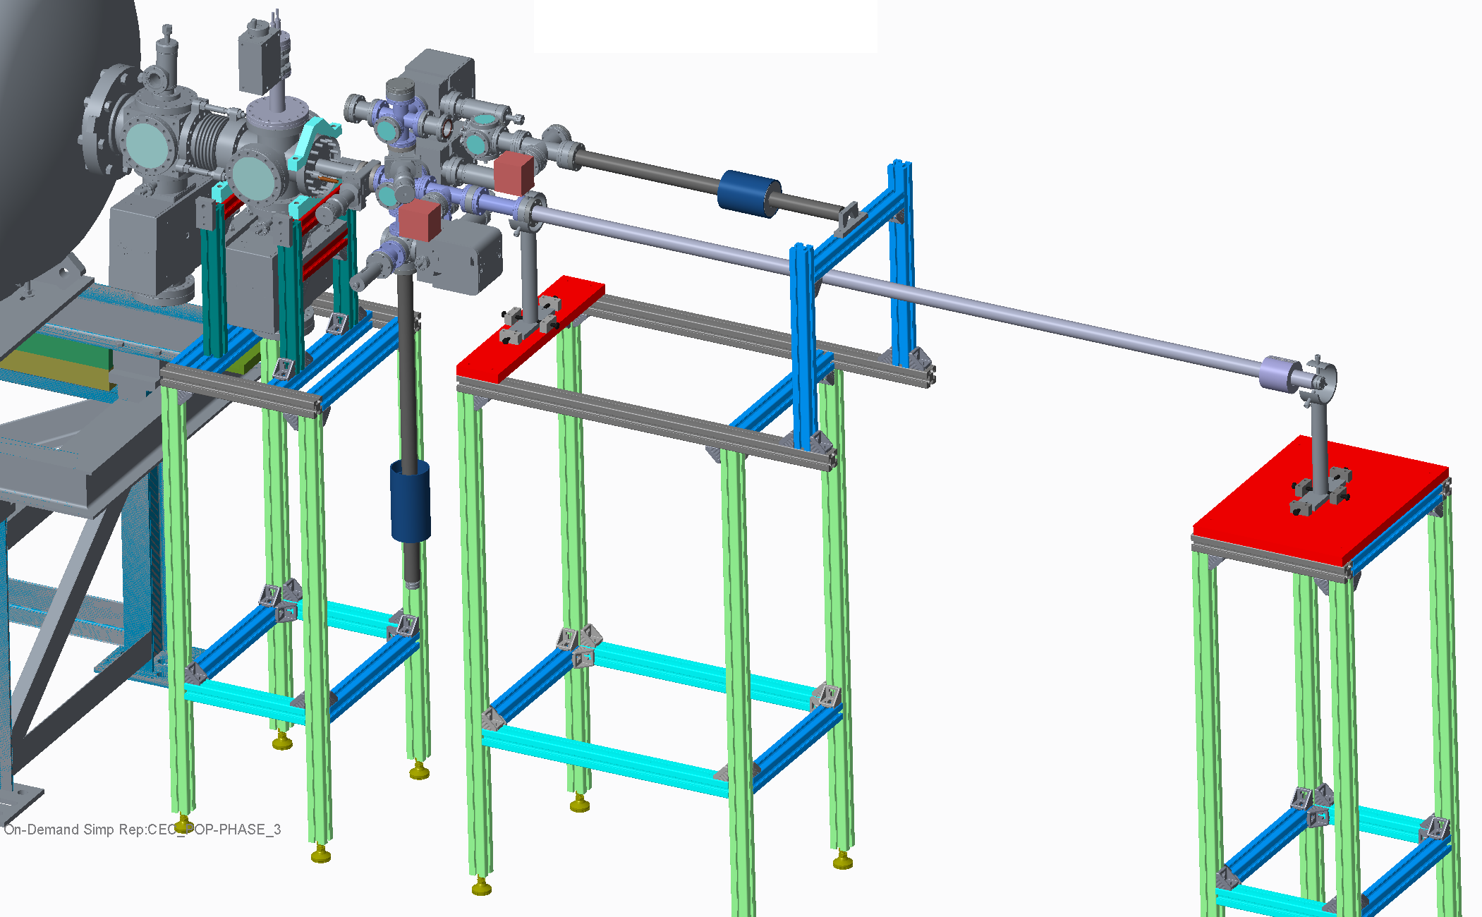
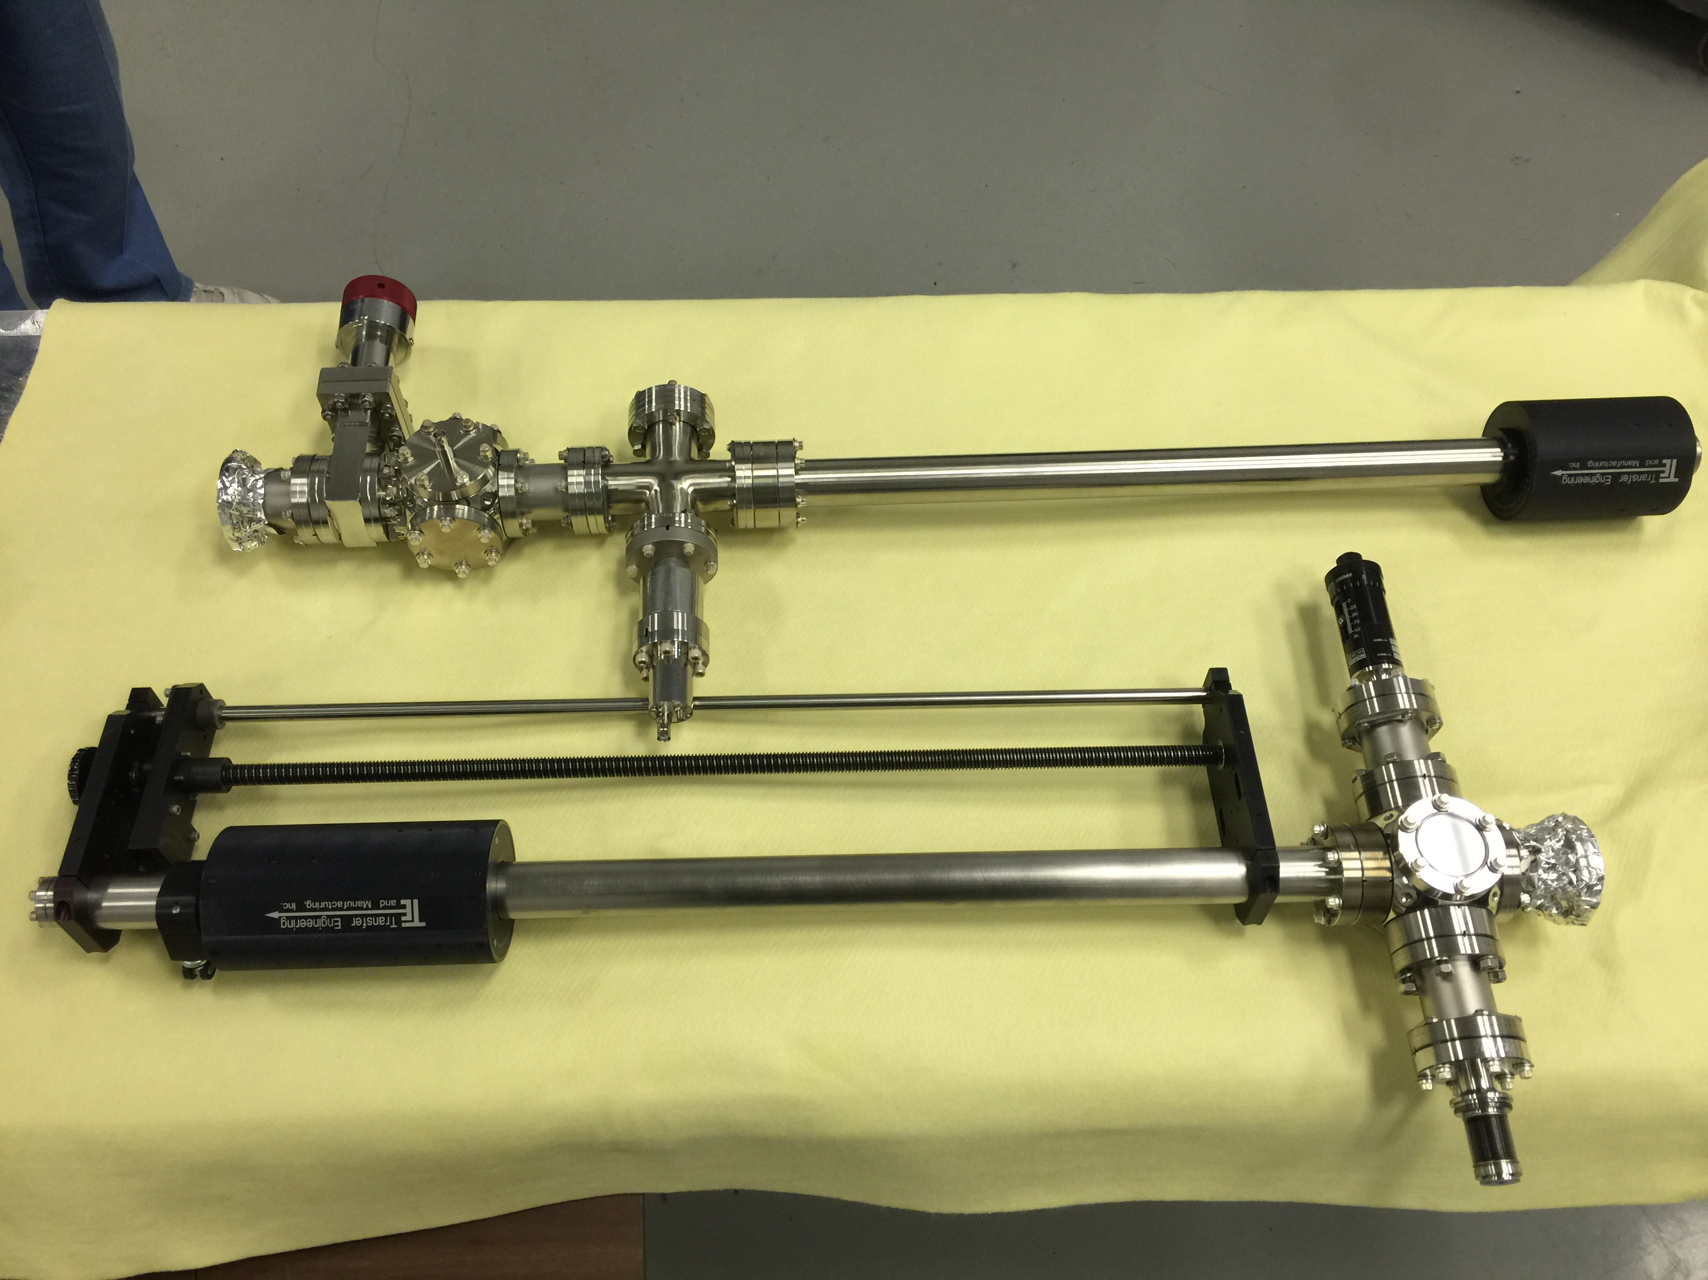
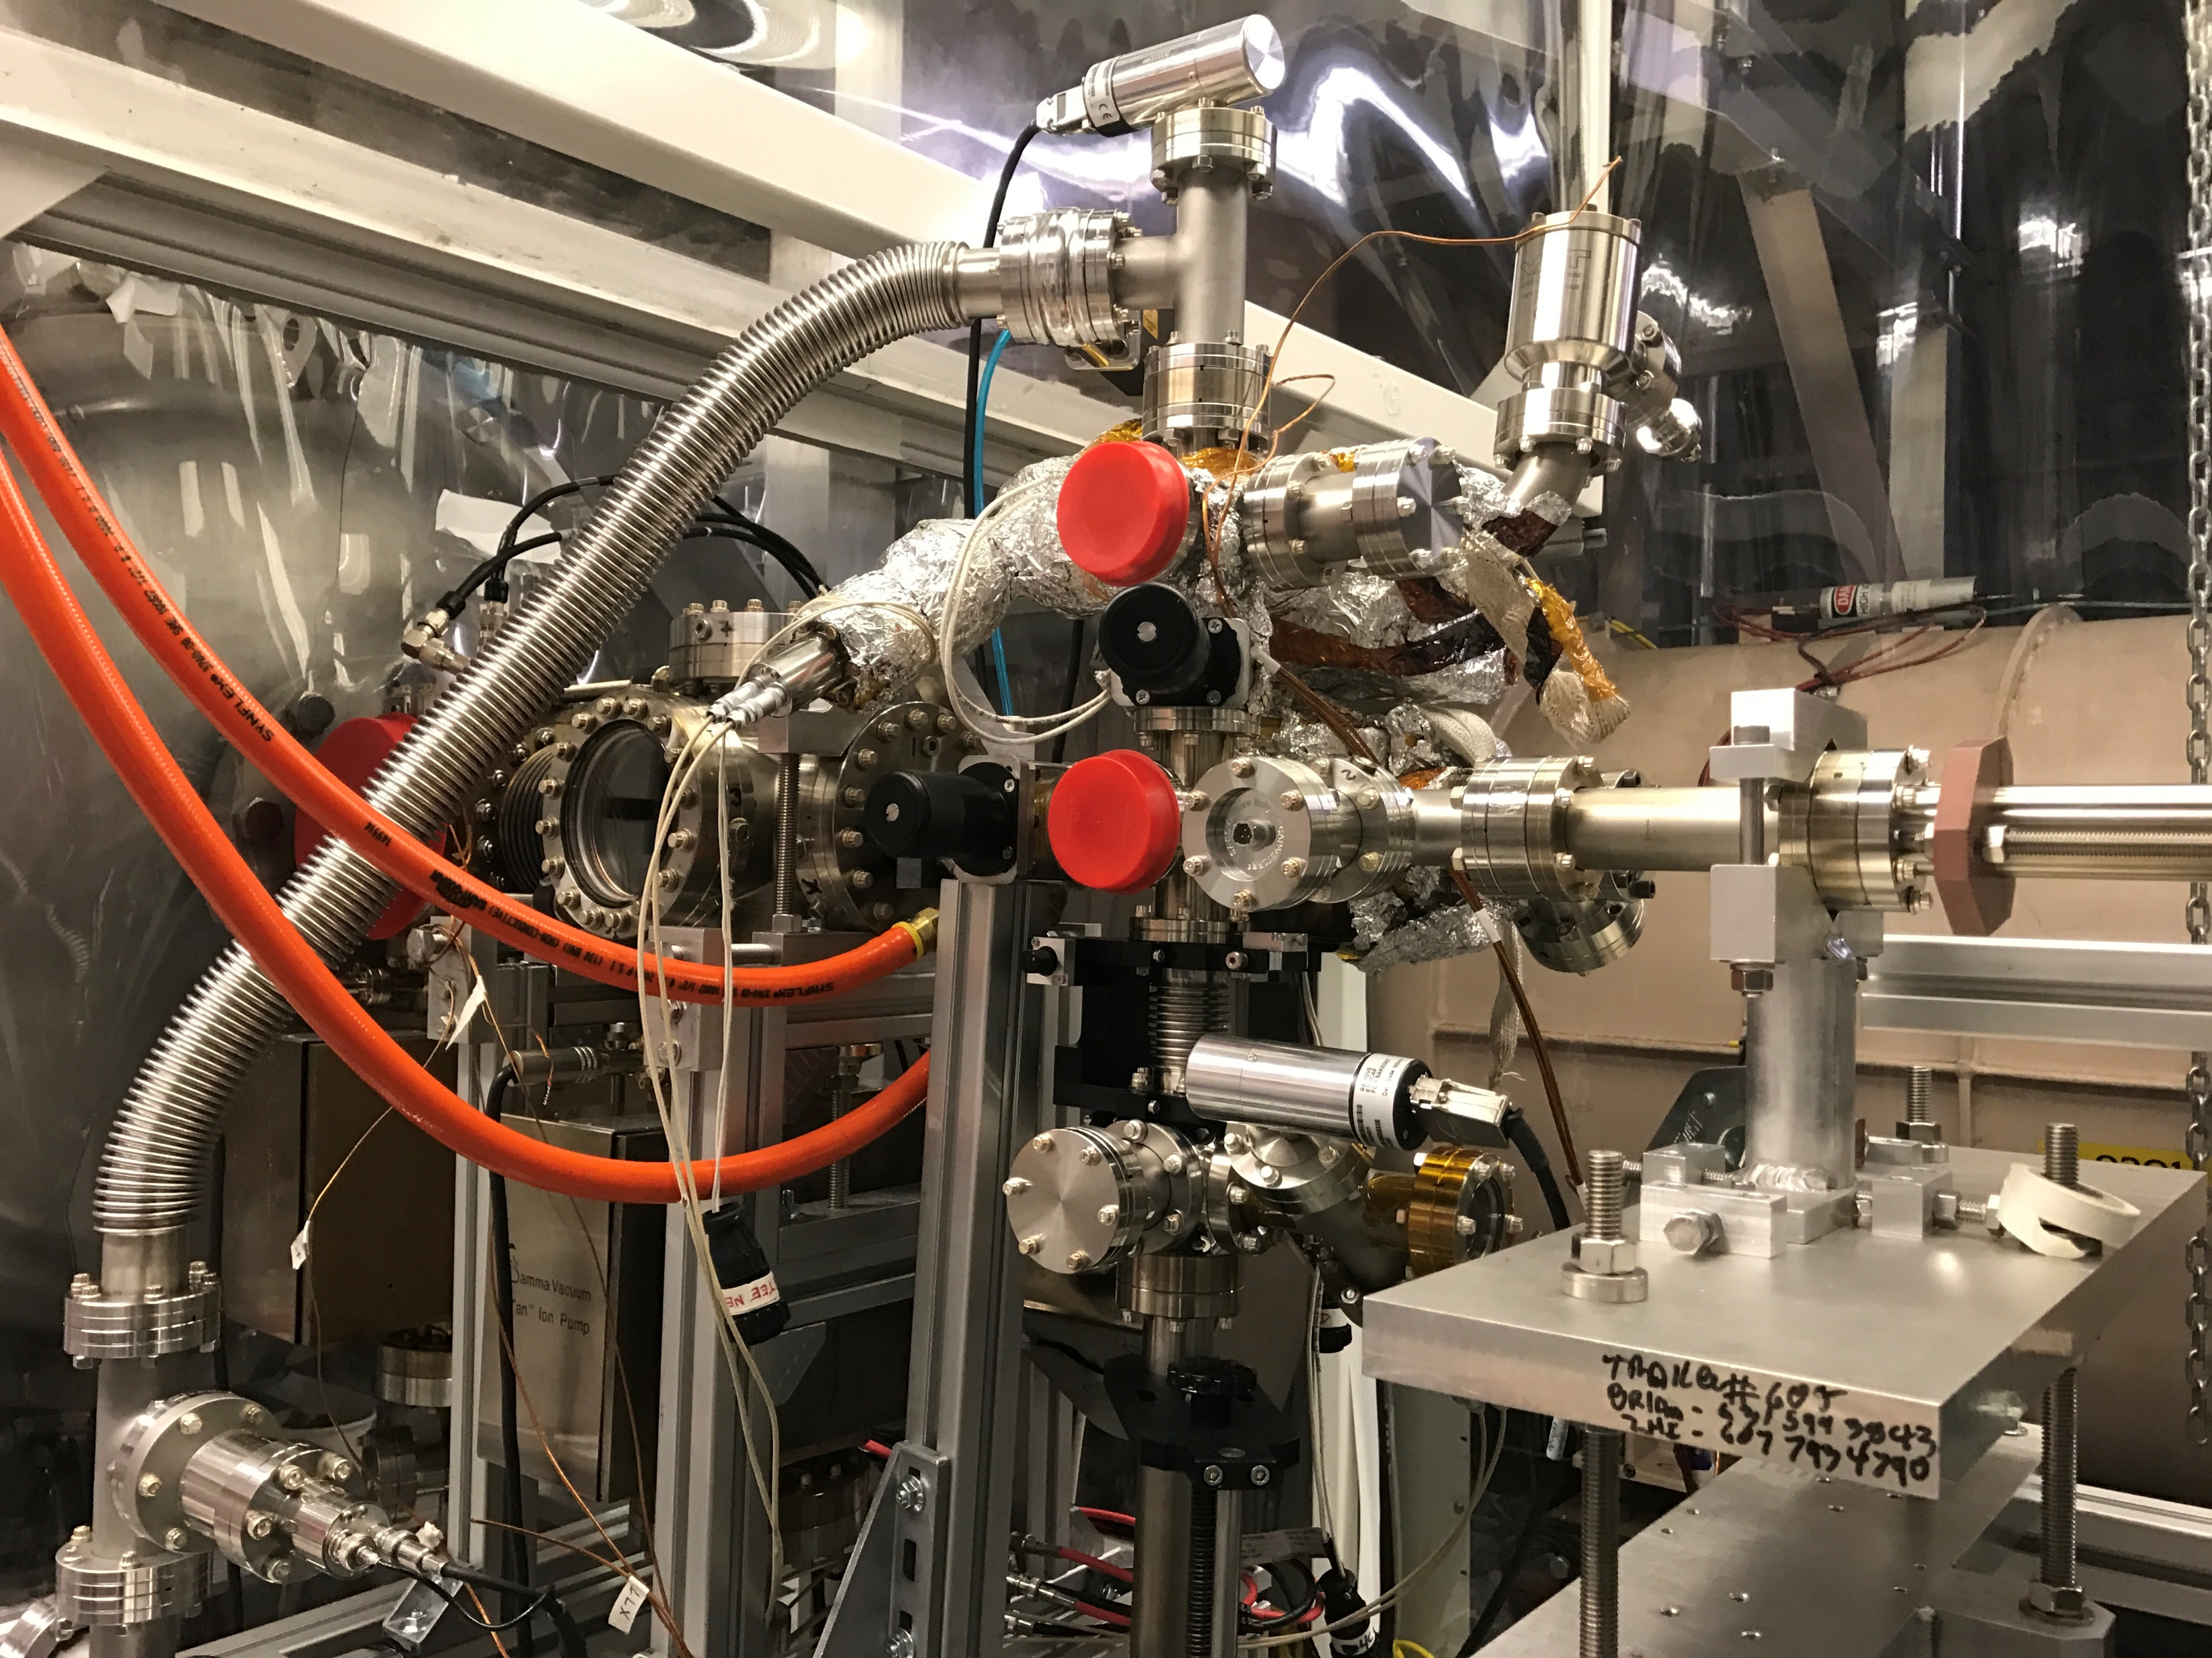
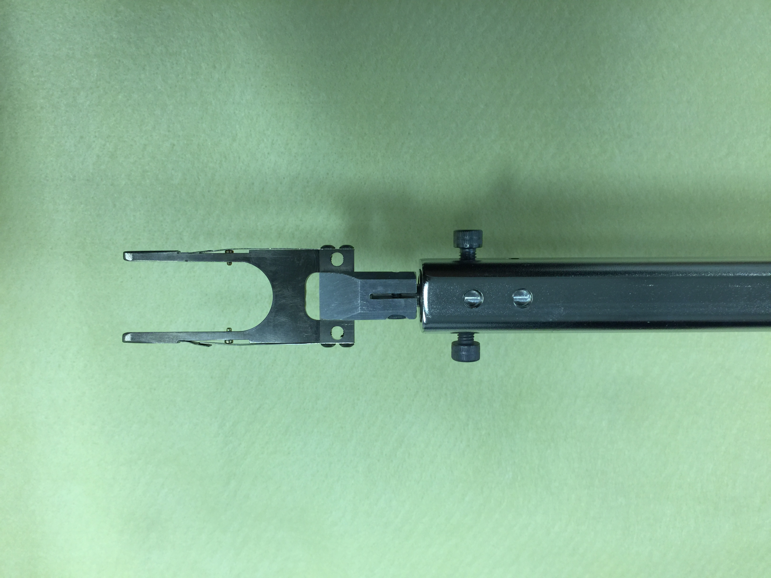
113 MHz Cathode Injection System
Original Design
Increase accessibility
Increase stability
Better pumping
Port aligner for cathode alignment
New Design

Slide 12
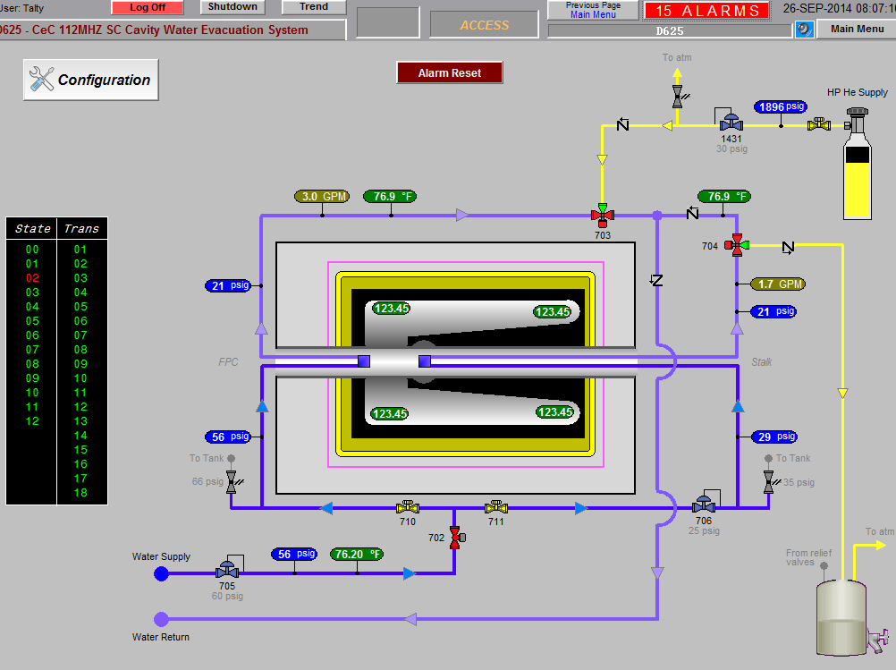
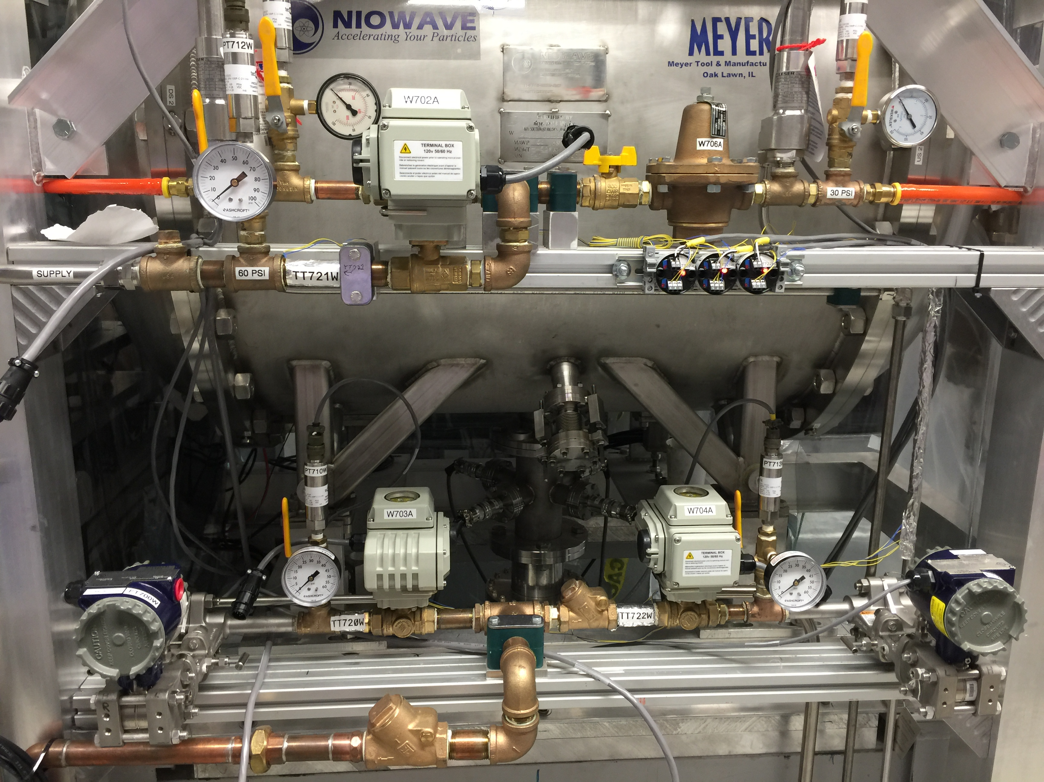
113 MHz Water Interlock System
Prevent catastrophic damage from water freezing
Fully automated system
Helium bottle
Monitor: temp, flow and pressure
Blows down water in FPC and Cathode Stalk

Slide 13
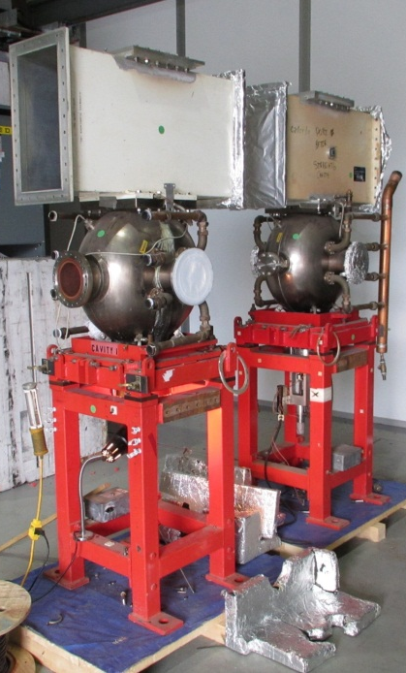
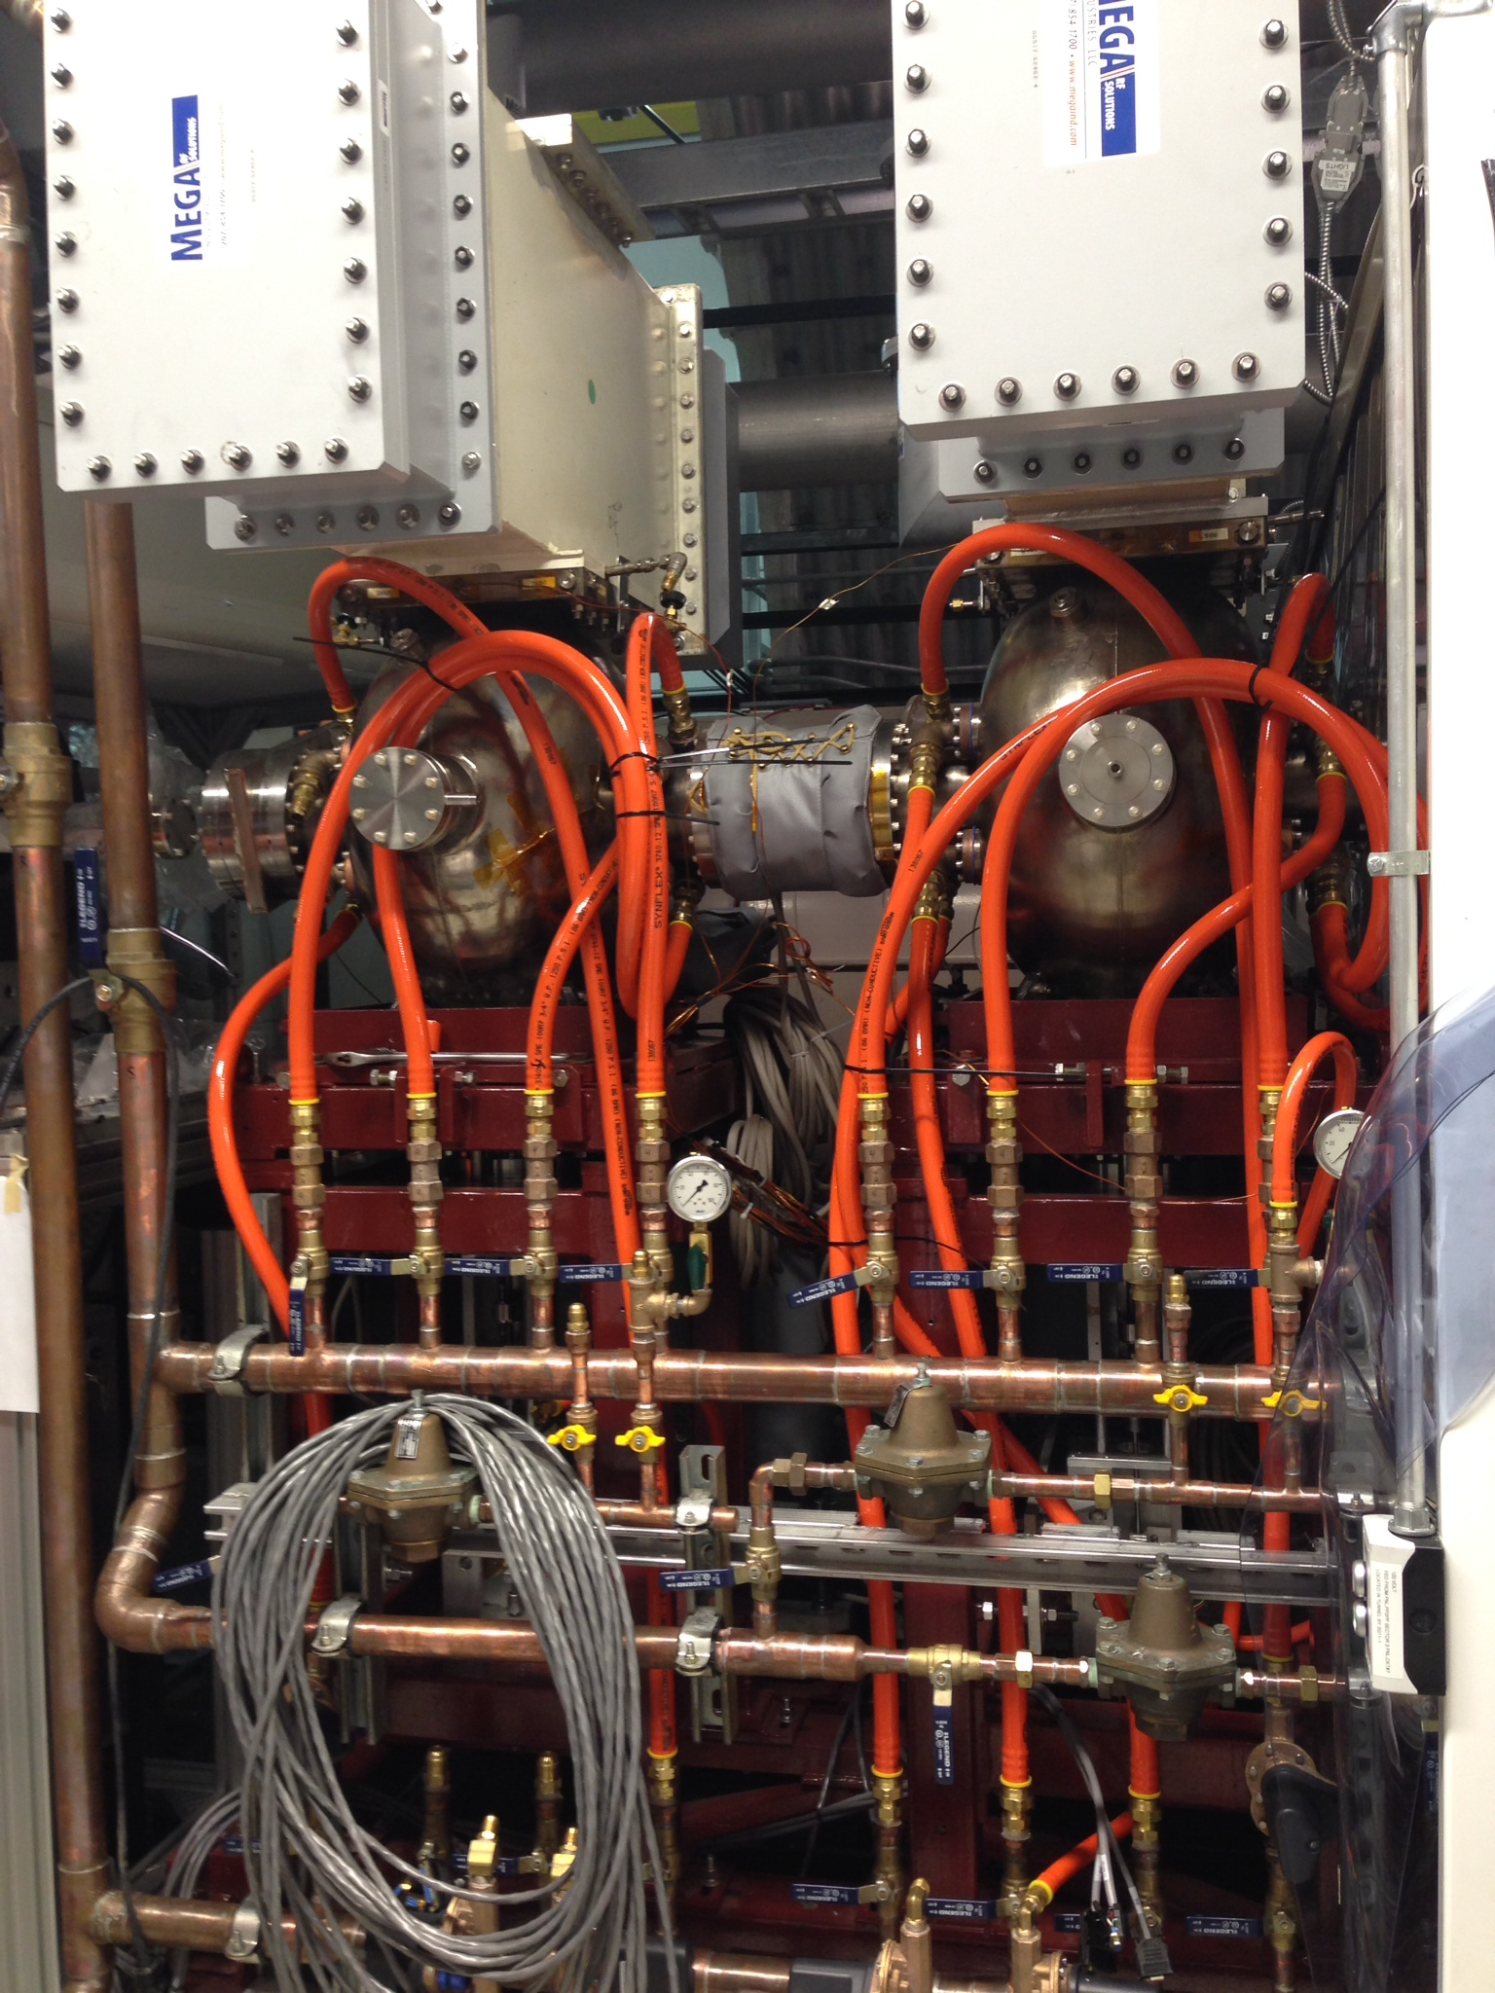
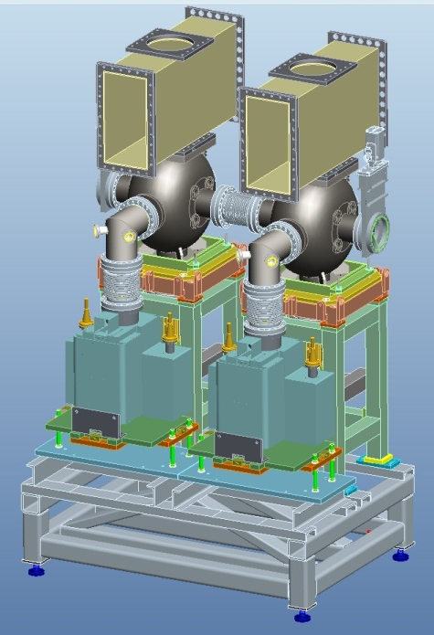
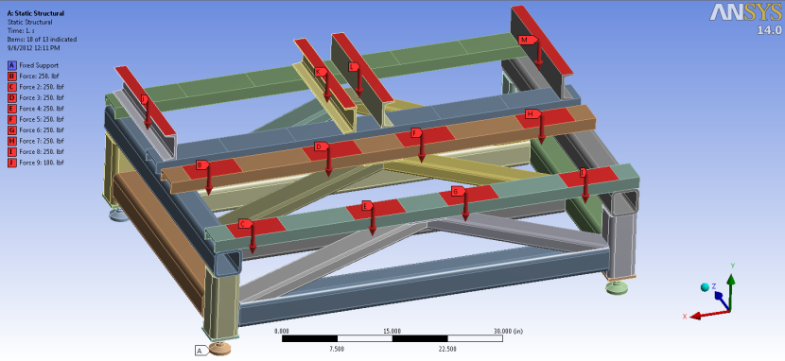
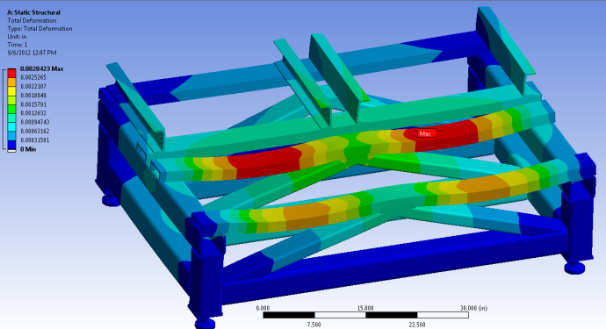
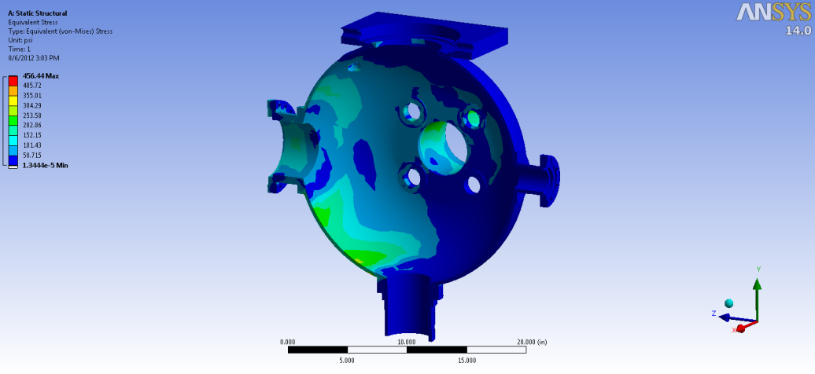
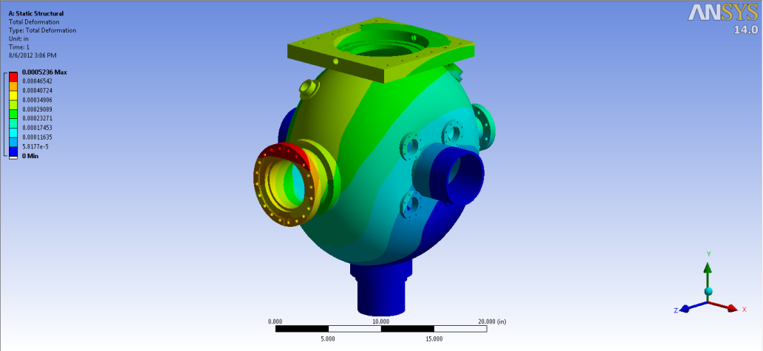

500MHz Buncher Cavity System
Stress 6547.2 PSI
Deflection 0.0028”
Stress 456.44 PSI
Deflection 0.0005”

Slide 14
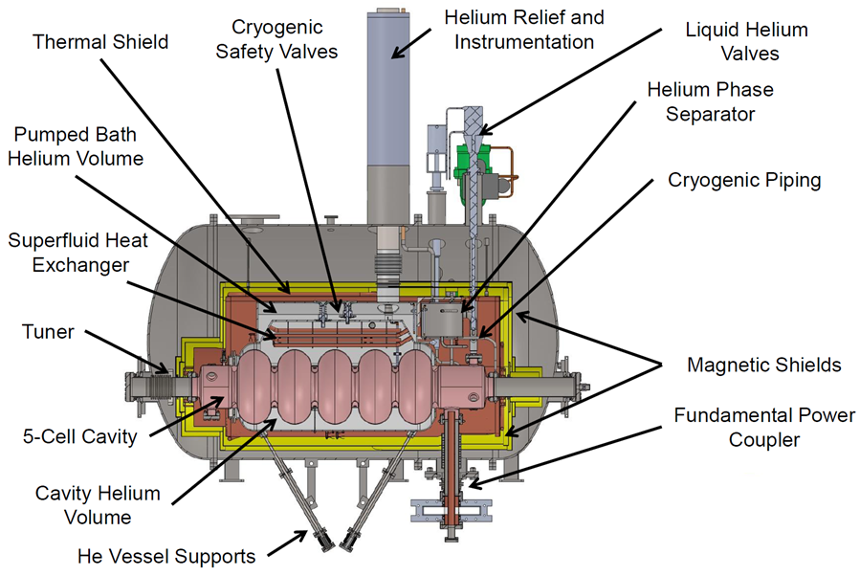
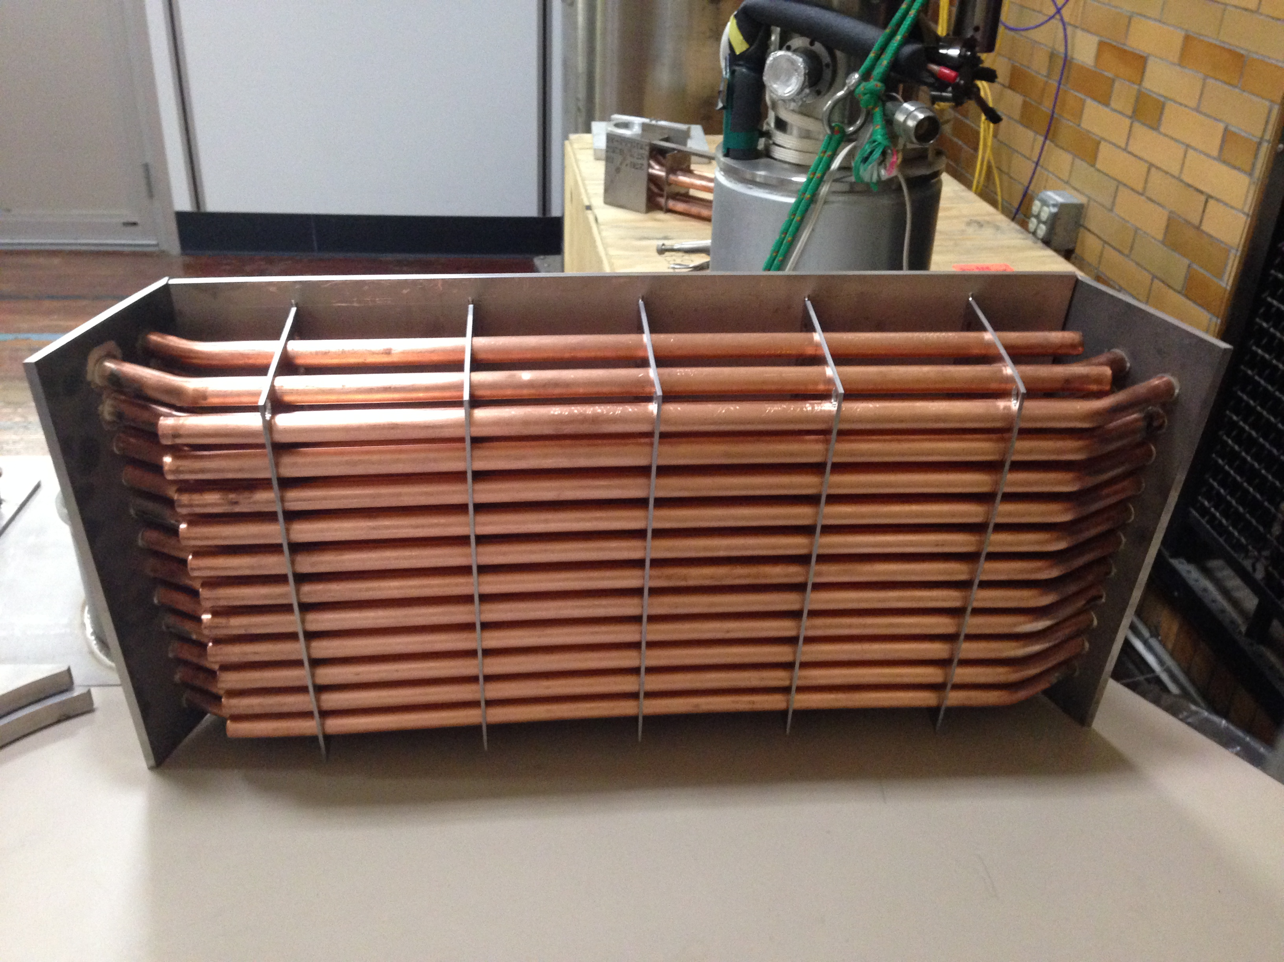
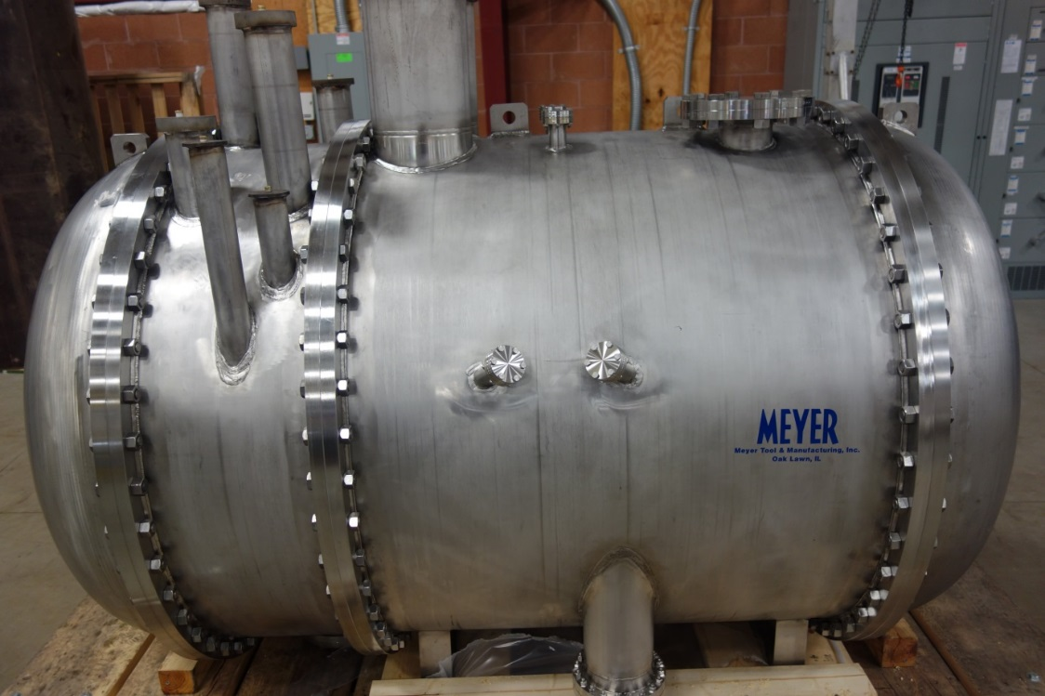
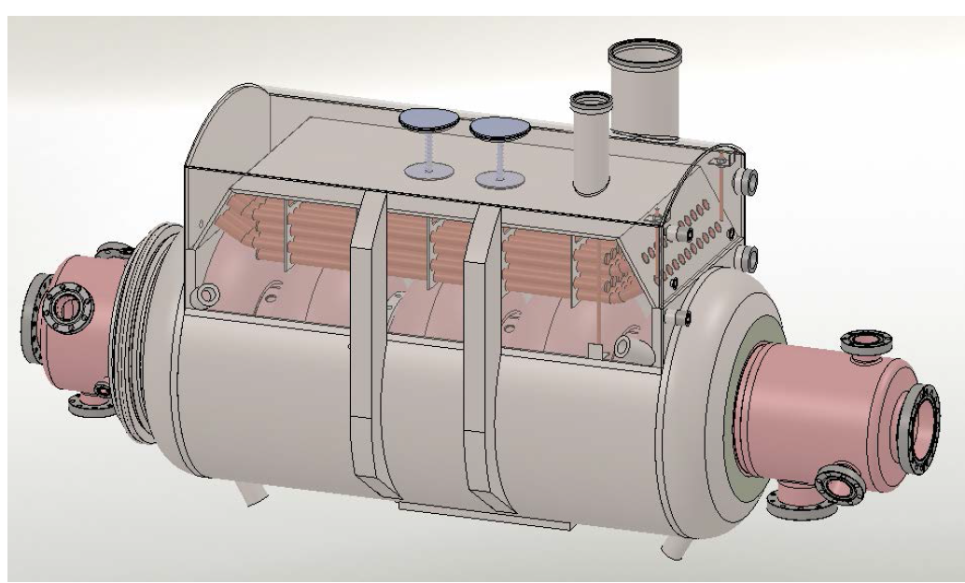
704 MHz SRF Booster Cryomodule
Booster parameters
RF frequency | 704 MHz
Maximum energy gain | 13.5 MeV
Cavity RF losses | 37 W
Frequency tuning range | 78 kHz
Available RF power | 20 kW
RF power amplifier | Solid State
ASME Code Stamped Vessel
Cavity in helium vessel
20 Torr vacuum heater
Operates at 2K with an internal HEX to better isolate the cavity from microphonic noise coming from cryogenic system.
704 MHz booster limited at 13.5 MeV due to quenching
Maximal voltage – 13.5 MV

Slide 15
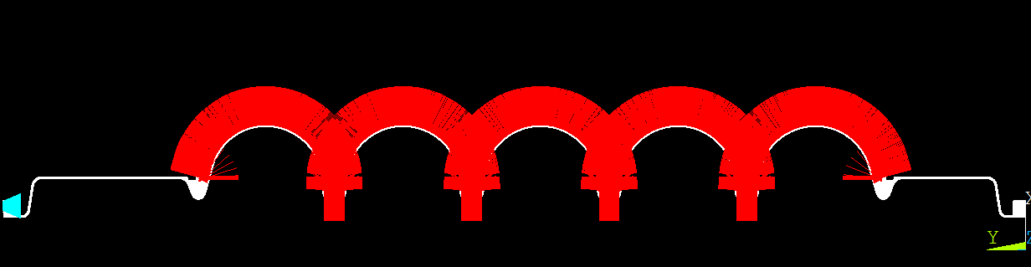
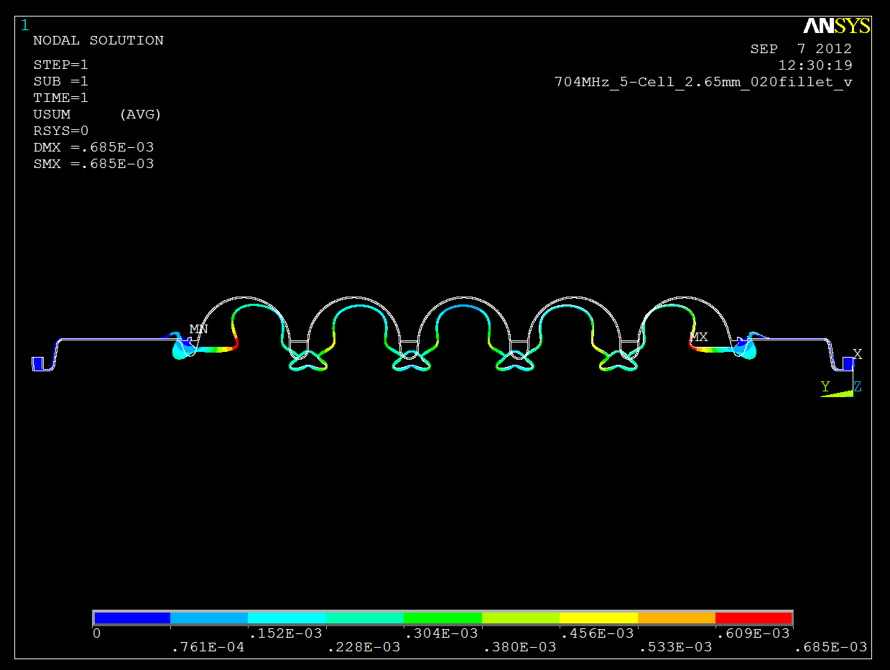
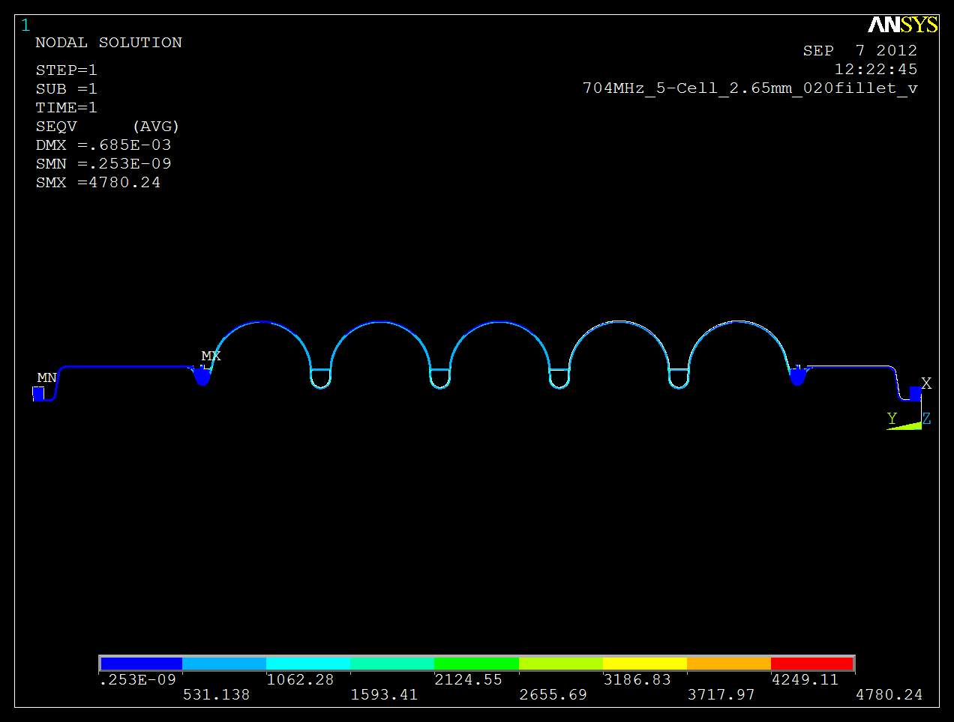
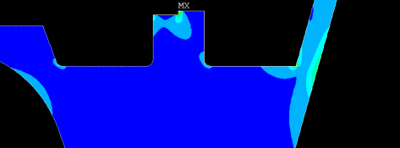
704 MHz 5-Cell Cavity
He Pressure 23 psi
No plastic deformation anywhere in the shell
Stress 4780.24 PSI
Deformation .0006”

Slide 16
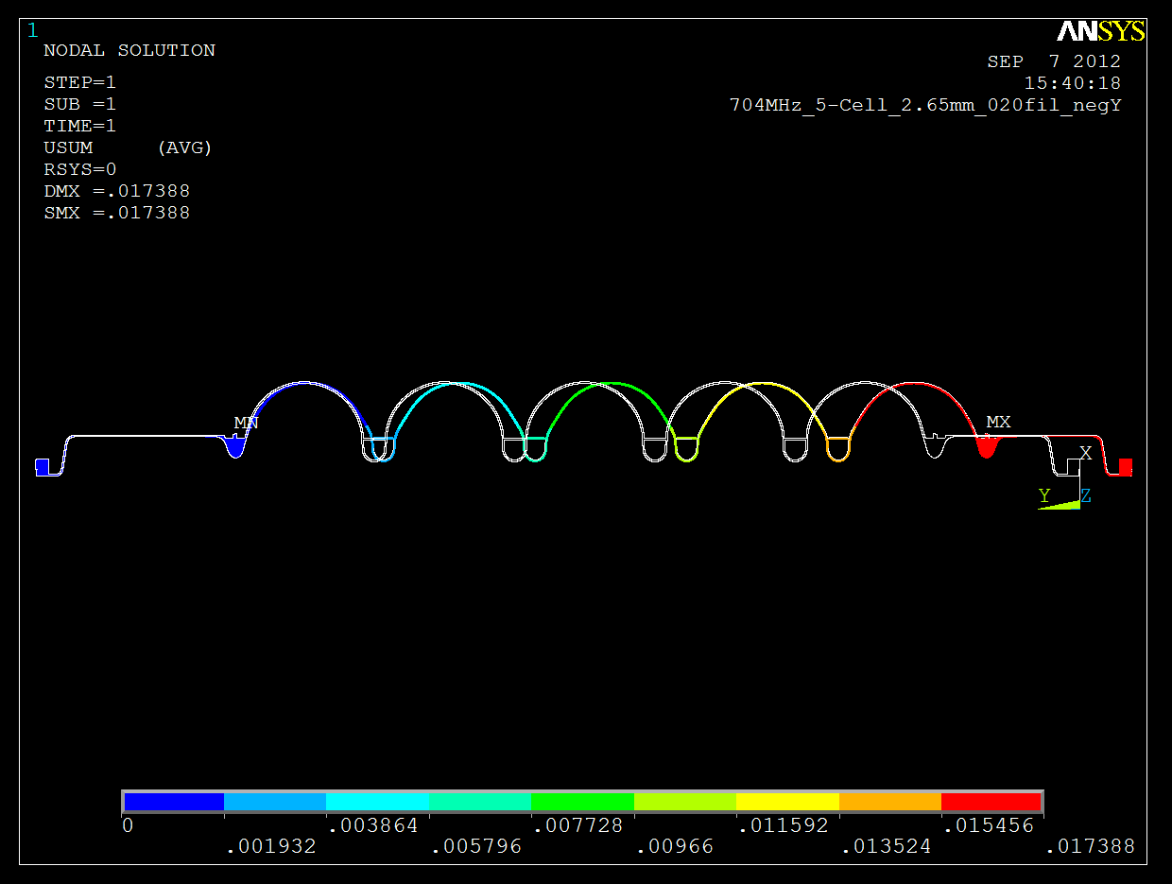
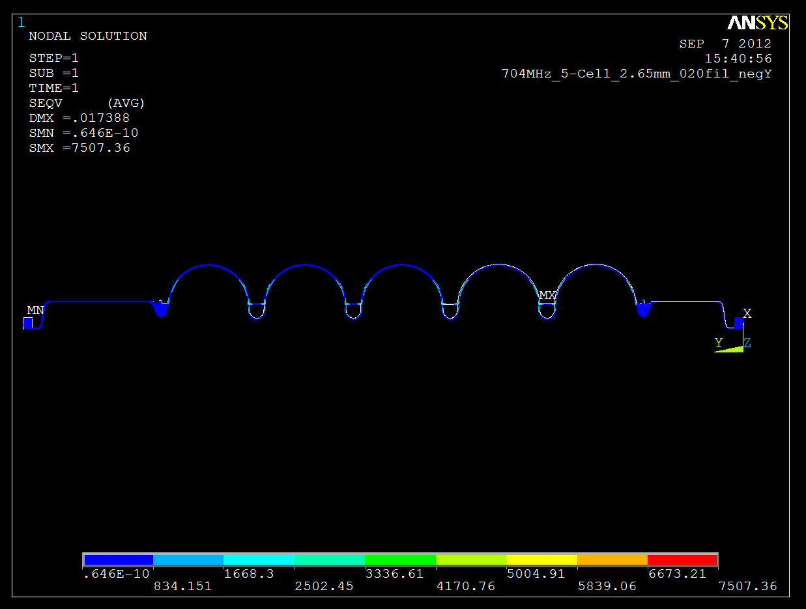


704 MHz 5-Cell Cavity Tuning Analysis
Tuning sensitivity 171.639 KHz/mm
384lbs force deformed the cavity by 0.442mm up to the yield point of Niobium at room temperature

Slide 17





704 MHz SRF Cavity FPC
Conditioned during commissioning of cavity
Arc detector
Capable to deliver up to 20 kW CW RF power to the SRF cavity.
Coaxial RF window/antenna assembly from Toshiba Electron Tubes & Devices Co.
The vacuum side outer conductor of the coaxial line will be cooled by 5K helium gas, the vacuum side of the inner conductor will be cooled by air and the RF window will be cooled by water.

Slide 18







704 MHz SRF Cavity Tuner
Dial Indicators for Deflection Measurements
Relaxed and deformed shapes of the cavity
Original design very problematic
Full range of tuner was tested.
The results show that the cavity is tuned linearly with the actuator displacement.
Tuning is uniform across the cavity
Tuner was redesigned to include a piezo, potentiometer, encoder and relocate the stepper motor outside the cryomodule.

Slide 19









704 MHz SRF Cavity Repair
BCP and HPR by ANL
He vessel and phase separator leak repair (3 leaks)
New 4.5K heat intercept to reduce heat leak into Nb cavity
FPC cleaning and inspection
New heat shield heat intercept straps location based on simulations.
After repair, cavity field emission dropped significantly, but max voltage stayed to same around 13.4 MeV

Slide 20




Solenoids
Sigmaphi China
Magnetic Field Measurement in progress
Installation RHIC shutdown 2019
New water manifold required at IP2
Number of Wraps, Na | 36
Number of layers | 18
Number of circuits | 2
Circular Flow Diameter [in] | 0.25
Pressure Drop, psi | 76.5
Flow, GPM/ path | .375
Velocity, ft/s | 2.5
Hollow Conductor Size, mm | 9.52 x 9.52
Conductor Area, in^2 | 0.09
Power, W | 3860
Current Density, J [amps/mm2] | 2.48
Total Voltage, V | 26.75
Resistance, ohms | .186
Current, A | 144.3
Measured on-axis Bz,
Bz = 0.283 T at center (0,0,0)
Max Bz = 0.288 T, ~7.5 cm away from center

Slide 21





Y dipole chamber
Old Y chamber
New Y chamber

Slide 22




Dipole Gap Modification
Spacer
Aperture 3.25”

Slide 23




Profile Monitor
Simplified design
Removed RF finger, RF shields
Using existing actuator assembly
2.75CF viewport with a glass size of 1.44” instead of a 4.5CF viewport
ID of the nipple tube is 1.375”

Slide 24


RHIC to CeC Transition
Shielded Bellows Conical Reducer
RHIC BPM
Independent Y Chamber support

Slide 25



CeC CPA Common Section
Use of existing wiggler stands
New magnet stands have been installed
Supply/Return water manifold to be installed
Magnet cables on order

Slide 26

CeC CPA Common Section
Modified solenoid support
Stand will remain the same

Slide 27
Summary
Many challenges during commissioning were addressed with design changes:
- 704 MHz: tuner, microphonic suppression, repair
- Aluminum beam dump
- Shielding from RHIC magnets
- Cathode injection stand
- Profile monitor RF shielding
- New BPMs
- Ion pump shielding
- Wriggler polarity and RF shield fingers
- New correctors
- water interlock system
704 MHz booster limited at 13.4 MeV even after repair
Magnetic field measurement of solenoid in progress
Installation RHIC Shutdown 2019

Slide 28
Acknowledgment
Team Work ……
J. C. Brutus, S. Belomestnykh, I. Ben-Zvi, S. Gerbick, T. Grimm, Y. Huang, R. Jecks, M. Kelly, V. Litvinenko, I. Pinayev, T. Reid, J. Skaritka,L. Snydstrup, R. Than, J. Tuozzolo, Wencan Xu, J. Yancey, T. Xin, Alex Z., Tom H., Kevin S., Geetha N., Fredie S., George M., Rob K., Scott S., Harold D., Richard H., Matt I.,
....

Slide 29







113 MHz FPC Components
Shielded bellows
FPC Inner conductor
FPC outer conductor with antenna and ion pump
Copper plated bellows
3
4
1
2

Slide 30





113 MHz RF Cathode End
Photocathode end assembly
Cathode end cap multiple groves allows manipulation and extraction in and out of the system
Interface with manipulator arm
Centering standoffs prevents damage to cathode on injection, Rolling contacts limit chip generation
Cathode puck
Gold plated RF spring finger contacts

Slide 31



112 MHz FPC Inner Conductor Analysis
Stress ~ 2600psi
Deflection 0.001”
MAX Temp 305K
Water Volume Flow Rate, Q | 4.0023 | gpm
Pressure Drop | < 2 | psi
Inlet - Outlet Temp Difference | 0.8805 | K
Top and Bottom Inside Wall Temp Difference | 0.4402 | K
Temperature Difference between Fluid and Inside Surface | 2.0648 | K
Local heat transfer coefficient h = | 3217.3941 | W/m^2-K
Temperature

