Slide 1
Why Strong Hadron Cooling Is Needed
Thomas Roser
Coherent electron Cooling WS
July 24, 2019

Slide 2
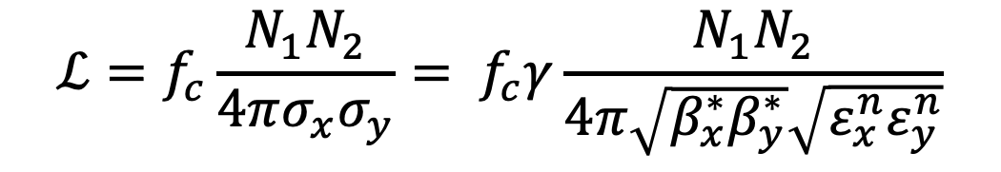
Luminosity of Storage Ring Colliders
$$ℒ=f_{c}\frac{N_{1}N_{2}}{4πσ_{x}σ_{y}}= f_{c}γ\frac{N_{1}N_{2}}{4π\sqrt{β_{x}^{∗}β_{y}^{∗}}\sqrt{{ε_{x}^{n}ε}_{y}^{n}}}$$
Luminosity is inversely proportional to transverse beam size (σ_{x}σ_{y}) at the collision point
Extreme focusing to reach small transverse beam size is limited by short focal length, short vertex length (hour glass effect) needing short bunches and high peak current and large non-linear optical effects
Full energy beam cooling gives small transverse beam size without the need for extreme focusing. Beam cooling can also reduce beam halo and reduces beam losses and detector background.

Slide 3
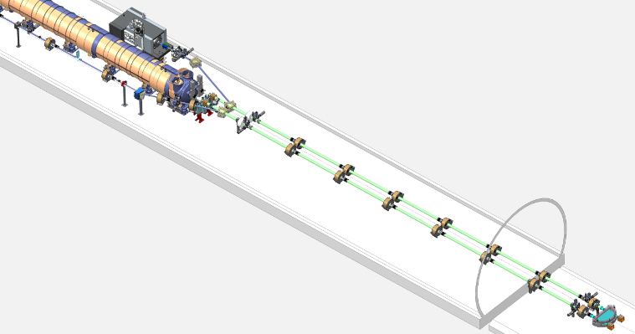
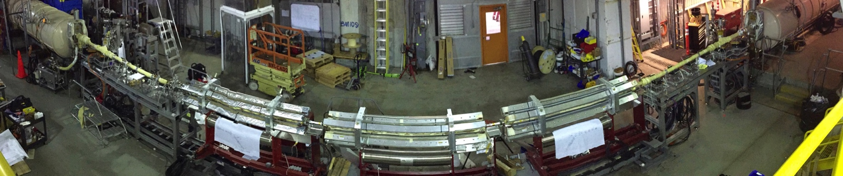
Strong high energy hadron cooling at RHIC
First high energy, bunched beam stochastic cooling gives record heavy ion collision rates
First bunched beam electron cooling for luminosity upgrade of “low” energy heavy ion collisions
Experimental demonstration of Coherent electron Cooling, a combination of stochastic and electron cooling, for fast cooling of high energy hadron beams

Slide 4
Luminosity limits with hadron cooling – burn-off
Burn-off: particles are lost from beam intensity due to collision interaction (total cross section)
  For Au-Au collisions (total cross section ~ 400 barns) maximum luminosity is about 1 x 10²⁸ cm⁻²s⁻¹ at RHIC
  For proton-proton collisions (total cross section ~ 60 mb) maximum luminosity is about 1 x 10³⁴ cm⁻²s⁻¹ at RHIC
LHC and particularly HL-LHC would not benefit much from full energy beam cooling
For electron-ion colliders the total cross section is much smaller and burn-off is not a problem. This is the primary application for strong hadron cooling.

Slide 5
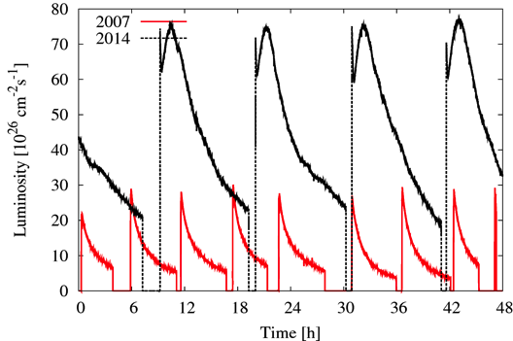
Heavy ion stochastic cooling – reaching burn-off
First high energy, bunched beam stochastic cooling gives record heavy ion collision rates
Reached normalized emittances of
0.3 - 0.8 𝜇m
Au-Au
U - U

Slide 6

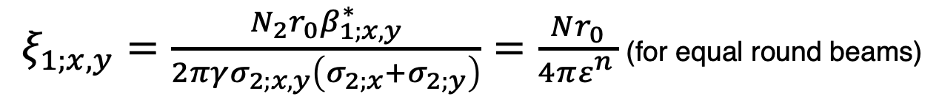
Luminosity limits with hadron cooling – beam-beam
$ξ_{1;x,y}=\frac{N_{2}r_{0}β_{1;x,y}^{∗}}{2πγσ_{2;x,y}\left(σ_{2;x}+σ_{2;y}\right)}=\frac{Nr_{0}}{4πε_{}^{n}}$ (for equal round beams)
$=\frac{N_{2}r_{0}β_{1;x,y}^{∗}}{2πγσ_{2;x,y}σ_{2;x}}$ (for flat beams)
Beam-beam interactions: emittance growth from collision interactions cannot be cooled fast enough.
Beam-beam limitation is greatly reduced for linac (or ERL-ring) colliders with only a single interaction

Slide 7

High bunch frequency and beam cooling
$$ℒ=f_{c}\frac{N^{2}}{4πσ^{2}}= f_{c}γ\frac{N^{2}}{4πβ_{}^{∗}ε_{}^{n}}$$
Increase bunch frequency and reduce bunch charge with constant beam current
Cool beam emittance at lower bunch charge to get the same beam-beam parameter (N/𝜀)
This results in the same luminosity
Now reduce 𝛽*, which is possible because of the smaller emittance, to get increased luminosity
This requires large crossing angle to avoid parasitic collisions and crab cavities

Slide 8
CeC for RHIC: High Luminosity with large Piwinski angle
  If head-on collisions are at beam-beam limit large Piwinski angle collisions of long bunches with very small emittance can increase luminosity (Super B factory)
  Needs strong cooling: synchrotron rad. or CeC
  Separate bunches outside high luminosity region to avoid beam-beam from low luminosity region.
  Reducing beam emittance back to beam-beam limit
  Smaller emittance and shorter overlap region allows for smaller beta-star
  RHIC: overlap length ~ 10 cm, ε^{n} (rms) ~ 0.2 μm ,
  β* ~ 10 cm gives ~ x10 luminosity increase
  ( ~ 5 x10³³ cm⁻² s⁻¹ !)
Head-on collisions
Collisions with
crossing angle
Kicker for Yellow
Kicker for Blue
Amplifier for Yellow
Modulator for Blue
Amplifier for Blue
Modulator for Yellow
Beam dump 1
Beam dump 2
ERL dual-way electron linac
Gun 2
Gun 1

Slide 9
Summary
Strong hadron beam cooling can increase collider luminosities up to the fundamental limit of burn-off and beam-beam interactions
Strong hadron beam cooling is particularly useful for electron-ion colliders because of the absence of the burn-off limit
High bunch frequency with large crossing angle or long bunches with large Piwinski angle can use of strongly cooled beams to increase luminosity

