Slide 1
Options for
Coherent electron Cooling
Vladimir N Litvinenko
Department of Physics and Astronomy, SBU
Collider-Accelerator Department, BNL
Center for Accelerator Science and Education

Slide 2
Outline
Options for Coherent electron Cooling
What are advantages of various schemes
What can be tested?
How to evaluate cooling
Conclusions

Slide 3
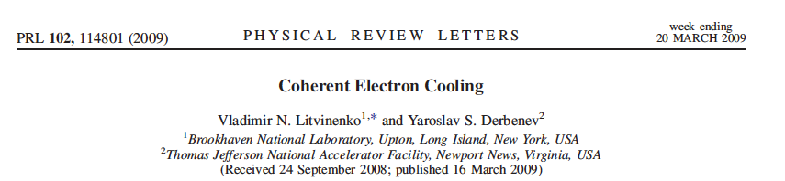
What is Coherent electron Cooling
Short answer – stochastic cooling of hadron beams with bandwidth at optical wave frequencies: 1 – 1000 THz
Longer answer
Amplification
Momentum correction
Imprint by hadrons

Slide 4
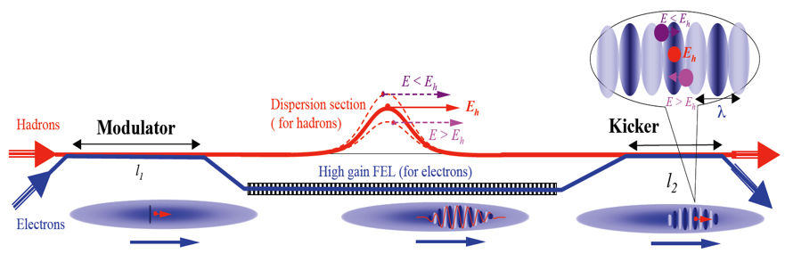
CeC schemes
Litvinenko, Derbenev, PRL 2008
High gain FEL amplifier
Ratner, PRL 2013
Multi- Chicane
Microbunching amplifier
Litvinenko, Wang, Kayran, Jing, Ma, 2017
Plasma cascade
micro-bunching amplifier
Plasma-Cascade Microbunching amplifier
Litvinenko, Cool 13
Hybrid laser-beam
amplifier

Slide 5
Advantages and Disadvantages
The best studied and fully explored scheme
Experimentally demonstrated both as instability and amplifier
3D FEL theory and simulation are very advanced
Can operate at relatively low electron beam peak currents
Allows – in principle – economic option without separating electron and hadron beams
When compared with micro-bunching amplifier, it has relatively lower bandwidth ~ few % of the FEL frequency
FEL saturates at lower gain than micro-bunching amplifier
Semi-periodic structure of the modulation limits the range where cooling occurs
CeC with High gain FEL amplifier

Slide 6
Advantages and Disadvantages
Very broad band amplifier
Micro-bunching instability was experimentally demonstrated
Can operate at significant gain without saturation and can be extended to LHC energies
Ratner’s original scheme is - in principle - insensitive to longitudinal space charge effects in the electron beam
Micro-bunching amplifier was not demonstrated
Less studied – especially numerically in 3D - than other CeC schemes
Requires electron beam with low energy spread
Definitely require separation of electron and hadron beams
Multi-Chicane Microbunching amplifier

Slide 7
Advantages and Disadvantages
Very broad band amplifier, can operate at significant gain without saturation
Plasma-cascade micro-bunching instability was experimentally demonstrated
Has good theoretical model and is extensively studied in 3D numerical simulations
Cool hadrons with all energy deviation (no anti-cooling)
Does not require (full) separation of electron and hadron beams
Micro-bunching amplifier was not demonstrated
Requires better quality electron beam than FEL amplifier
Can operate for medium hadron energies (up to hundreds of GeV, such as US EIC), but can not be extended to LHC energies
Less studied than FEL-based CeC
Plasma-Cascade Microbunching amplifier

Slide 8
Advantages and Disadvantages
Relatively broad-band amplifier
Take advantage of laser technology
Does not require high peak current electron beam
Take advantage of flexibility provided by high K-wigglers to adjust wavelength of radiation to that of the laser-amplifier
Has some synergy with optical-stochastic cooling
Not studied in details
Definitely require separation of electron and hadron beams
Would require rather significant delay of the hadron beam – may require R₅₆ reduction scheme for hadrons
Semi-periodic structure of the modulation limits the energy range where cooling occurs
Hybrid laser-beam amplifier

Slide 9

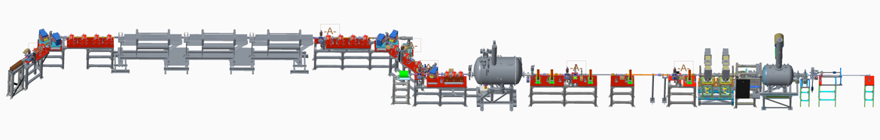
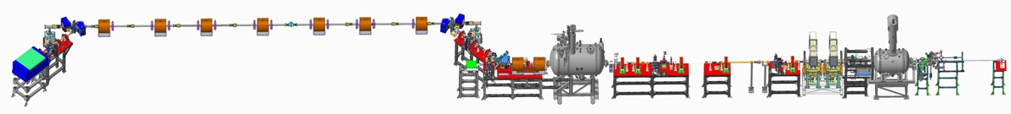
What can be tested experimentally?
High gain FEL amplifier
with low-K wigglers
Cooling test requires serious modification of the RHIC
lattice & superconducting magnets +$20-$30M
OR
Building new CeC system at another hadron storage ring
RHIC Runs 20-22
Plasma-Cascade
Amplifier
Cooling test requires serious modification of the RHIC
lattice & superconducting magnets +$20-$30M
OR
Building new CeC system at another hadron storage ring

Slide 10


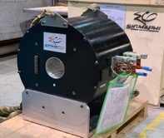
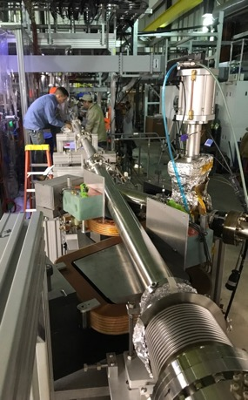
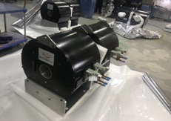
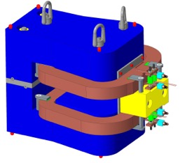
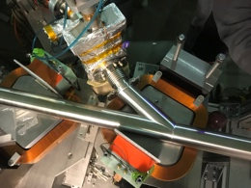
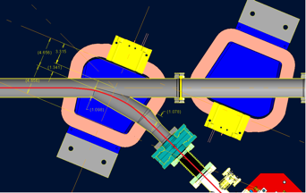
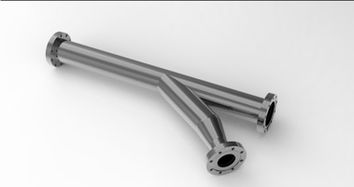
Changing CeC amplifier from FEL to PCA
Small gap in FEL wigglers is not compatible with low energy RHIC operations of the Beam Energy Scan (BES-II) program
CeC SRF accelerator
Unchanged
Kicker
Modulator
4-cell PCA
Unchanged
Mechanical design new of the CeC system is completed. We used SBU NSF “Center for Accelerator Science and Education” grant to procure new hardware
We procured and commissioned new laser system with controllable pulse structure
All new vacuum chambers with beam diagnostics are built and installed
All supports are built and installed
All solenoids are designed, manufactured, delivered and undergo magnetic measurements
Assembly of the plasma-cascade based CeC can be completed during this year’s RHIC shut-down

Slide 11
How to evaluate CeC: the original recipe
Free Electron Lasers and High-energy Electron Cooling,
Vladimir N. Litvinenko, Yaroslav S. Derbenev, Proceedings of 29th International Free Electron Laser Conference, Novosibirsk, Russia, August 27-31, 2007
Linear response of electron beam on perturbations – no saturation, superposition principle
Evaluation of hadron distribution function using Fokker-Plank equation with both damping and diffusion terms
Cooling transversely using coupling with longitudinal degrees of freedom

Slide 12
How to evaluate CeC: the original recipe
Free Electron Lasers and High-energy Electron Cooling,
Vladimir N. Litvinenko, Yaroslav S. Derbenev, Proceedings of 29th International Free Electron Laser Conference, Novosibirsk, Russia, August 27-31, 2007
Linear response of electron beam on perturbations – no saturation, superposition principle
Evaluation of hadron distribution function using Fokker-Plank equation with both damping and diffusion terms
Cooling transversely using coupling with longitudinal degrees of freedom

Slide 13
How to evaluate CeC: the original recipe
Free Electron Lasers and High-energy Electron Cooling,
Vladimir N. Litvinenko, Yaroslav S. Derbenev, Proceedings of 29th International Free Electron Laser Conference, Novosibirsk, Russia, August 27-31, 2007
Linear response of electron beam on perturbations – no saturation, superposition principle
Evaluation of hadron distribution function using Fokker-Plank equation with both damping and diffusion terms
Cooling transversely using coupling with longitudinal degrees of freedom

Slide 14
Transverse cooling: the original recipe
Cooling transversely using coupling with longitudinal degrees of freedom by making energy kick depending on transverse motion (via R₅₁, R₅₂, R₅₃, R₅₄ or by displacing beam center in the kicker section)

Slide 15
Transverse cooling: the original recipe
Cooling transversely using coupling with longitudinal degrees of freedom by making energy kick depending on transverse motion (via R₅₁, R₅₂, R₅₃, R₅₄ or by displacing beam center in the kicker section) – we can only redistribute cooling decrements between three eigen modes
For slow synchrotron oscillations (Q_{s}<<1)
Hence, introduction dependencies on the components of transverse motion and
non-zero dispersion in the kicker section allows to re-distribute cooling decrements

Slide 16
Instead of conclusion
There is a variety of amplifiers suitable for CeC
  In addition to what we discussed now, Yaroslav Derbenev is proposing using coherent synchrotron radiation instability as CeC amplifier – one need a specific schematic to understand how it fit into the CeC family
Theoretical evaluation is typically limited to 1D, but 3D simulation are performed for two CeC schemes
Two CeC options can be tested experimentally at RHIC – we currently pursuing CeC with plasma-cascade amplifier
The evaluation scheme that I presented only looking simple – evil is always in details
Following presentations will give a much deeper view into physics and realities of CeC

Slide 17
Back-up

Slide 18
Sum of decrements theorem

Slide 19
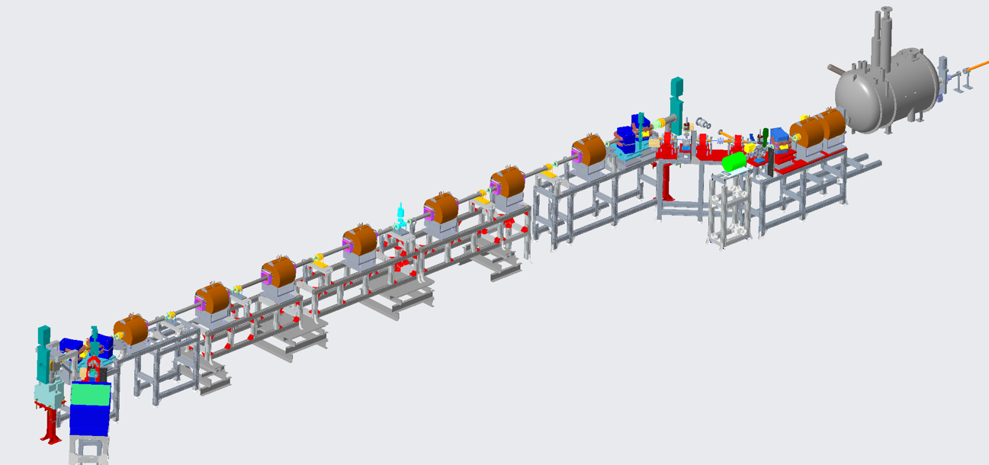



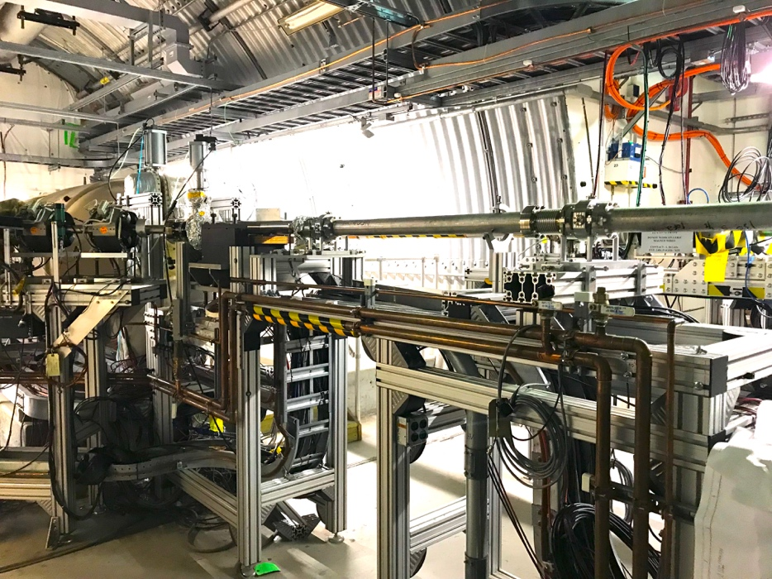
Status: more details in my afternoon talk
Mechanical design new CeC system is completed
We procured and commissioned new laser system with controllable pulse structure
All new vacuum with beam diagnostics are built chambers are installed
All supports are built and installed
All solenoids are designed, manufactured, delivered and undergo magnetic measurements
Assembly of the plasma-cascade based CeC can be completed during this year’s RHIC shut-down period
RHIC beam
Design of CeC section
using Plasma-Cascade Amplifier

Slide 20
Distribution of the decrements

Slide 21
Distribution of the decrements
Uncoupled case

