Slide 1




Hadron Beam Cooling in Particle Accelerators
Vladimir N. Litvinenko, Yichao Jing, Jun Ma, Irina Petrushina
Lectures at 2023 USPAS Winter Session, Houston, Texas
CENTER for ACCELERATOR SCIENCE AND EDUCATION
Department of Physics & Astronomy, Stony Brook University
Collider-Accelerator Department, Brookhaven National Laboratory

Slide 16
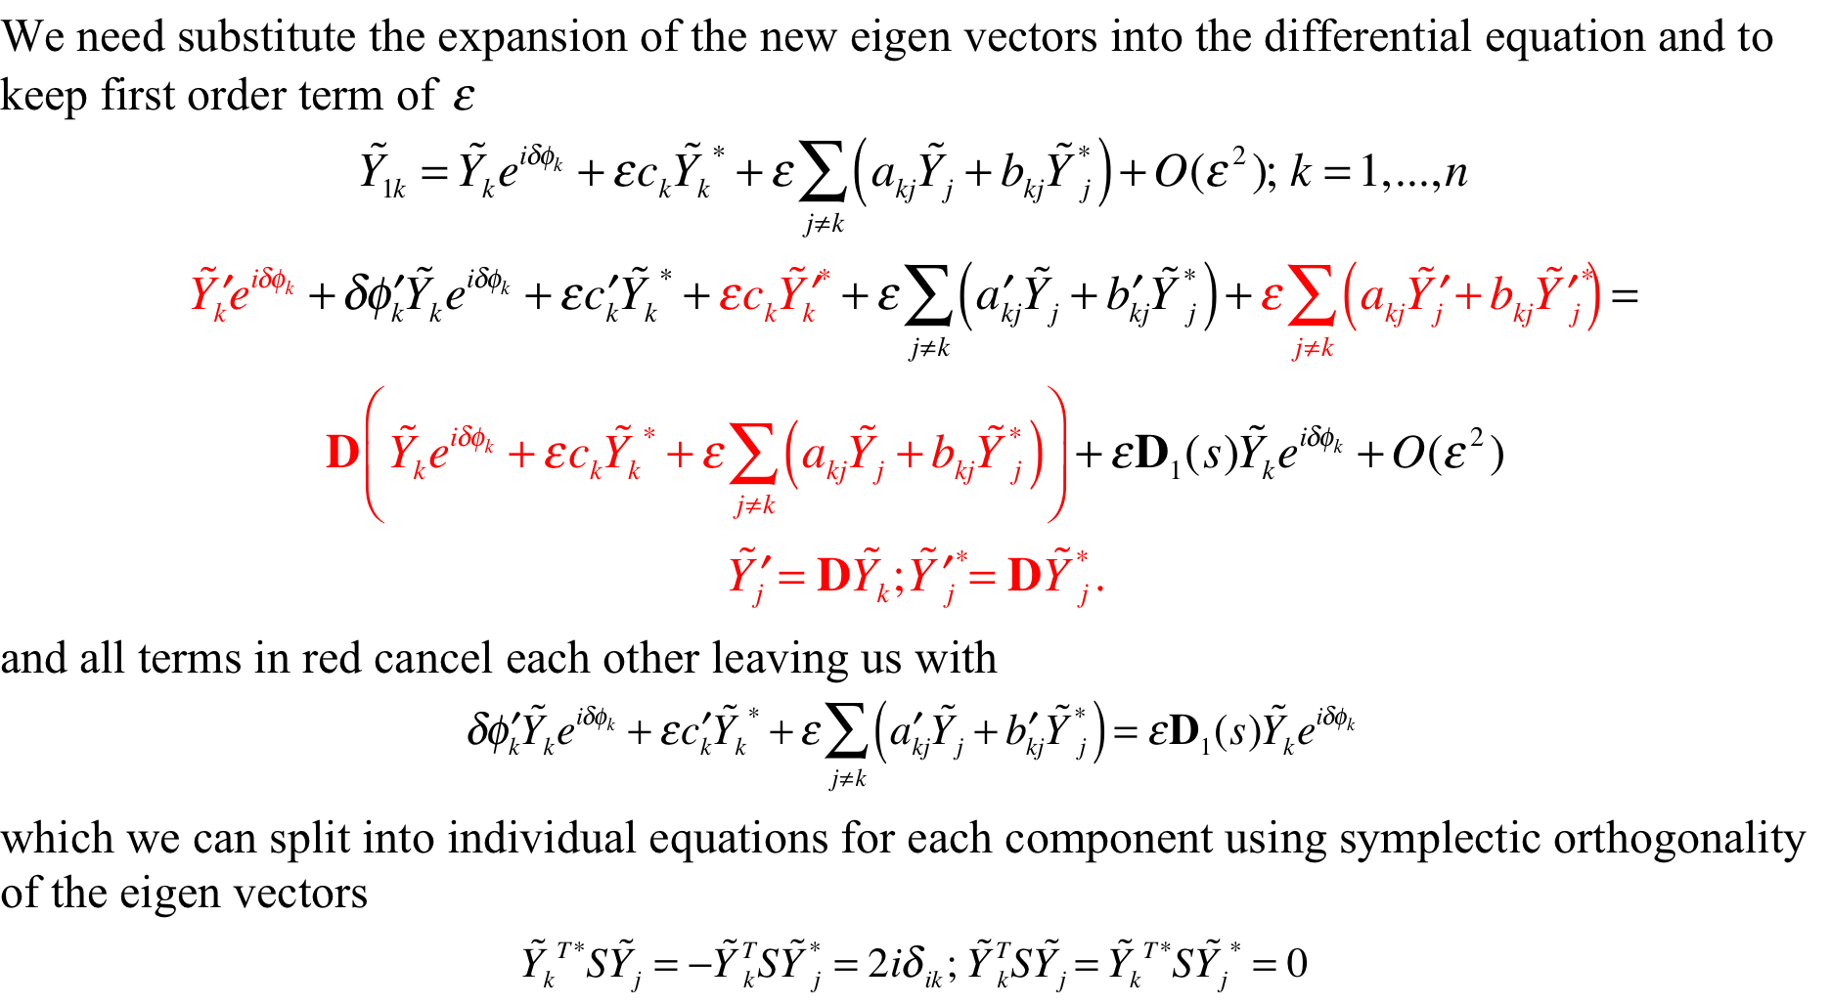

Slide 18
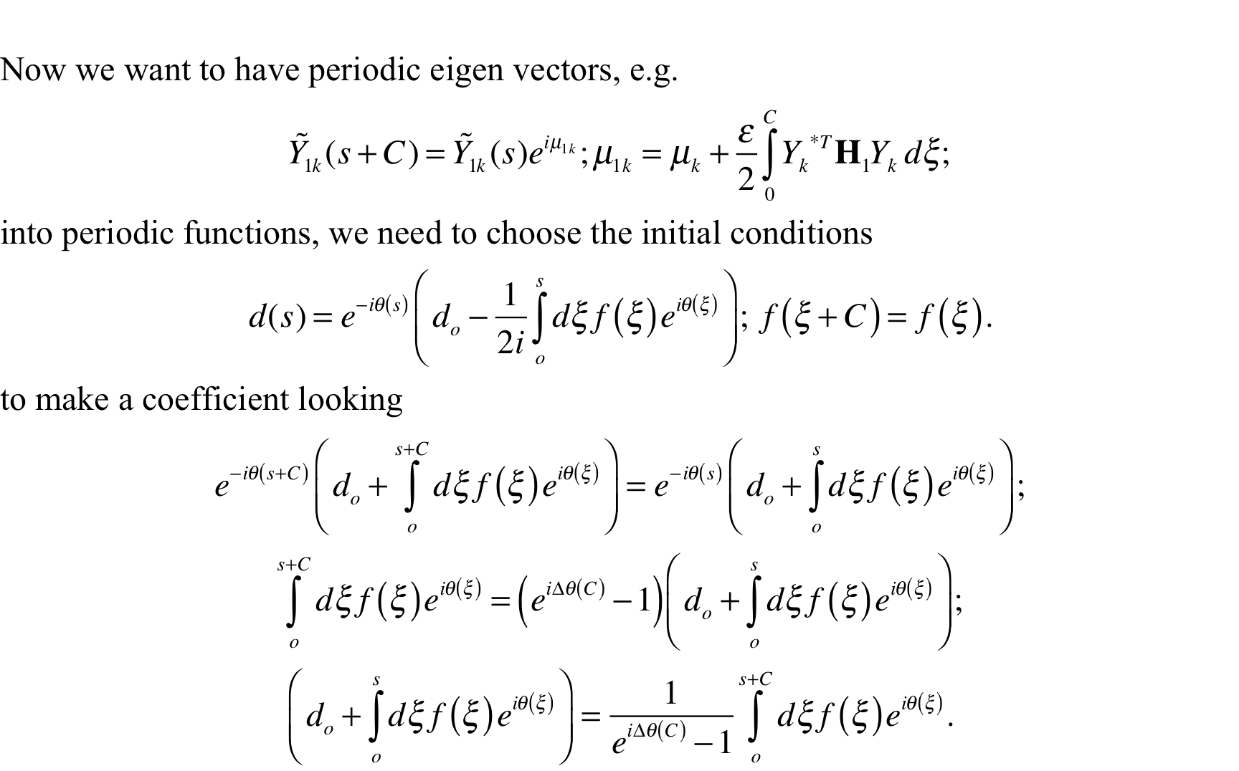

Slide 24
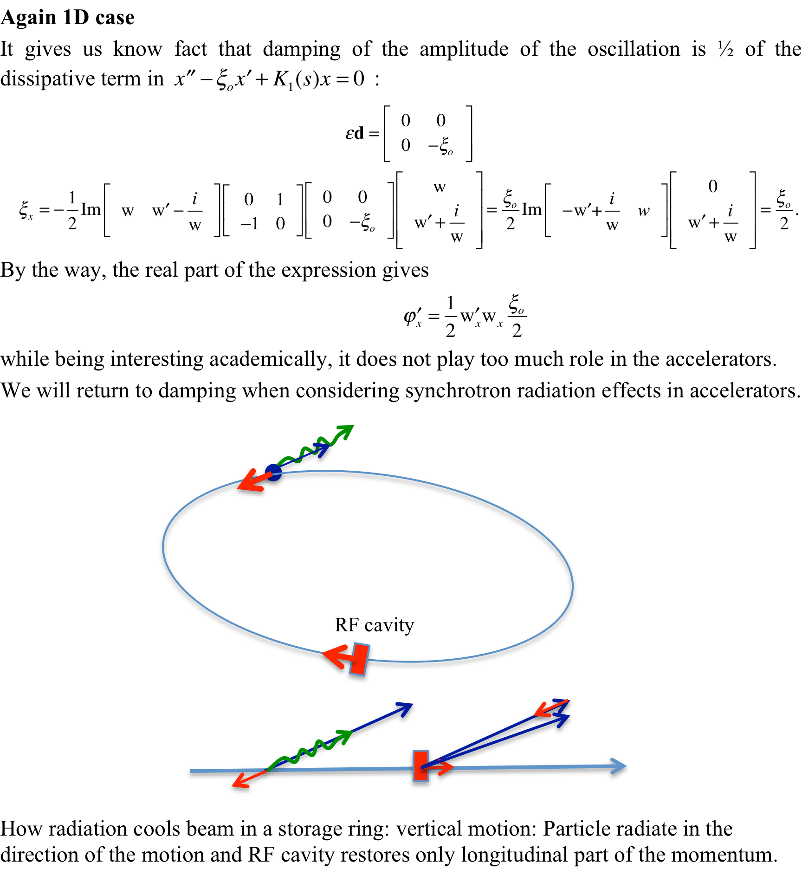

Slide 35
It is not all… But already, not too shabby for a single parameterization
What we found that we can calculate tune shift and tune spread caused by non-linearities, damping and diffusion coefficients. We introduced important notion of Canonically conjugate actions and phases for each degree of oscillations
We also found that in Hamiltonian system actions remain constant (it is actually true for nonlinear systems as well – look Lectures 25 and 26 in our Advanced Accelerator course), while phases are spread uniformly by tune spreads caused by energy spread (chromaticity), dependence on particle’s action (octupole terms in magnets, it driven by sextupole terms, but in a second order of perturbation) and non-linear effects in beam-beam effects. This is the main reason why we can assume – with a large degree of confidence that phases of particles are evenly distributed from 0 to 2π.
Let’s go to next step –finding solutions for particle distributions.

Slide 39
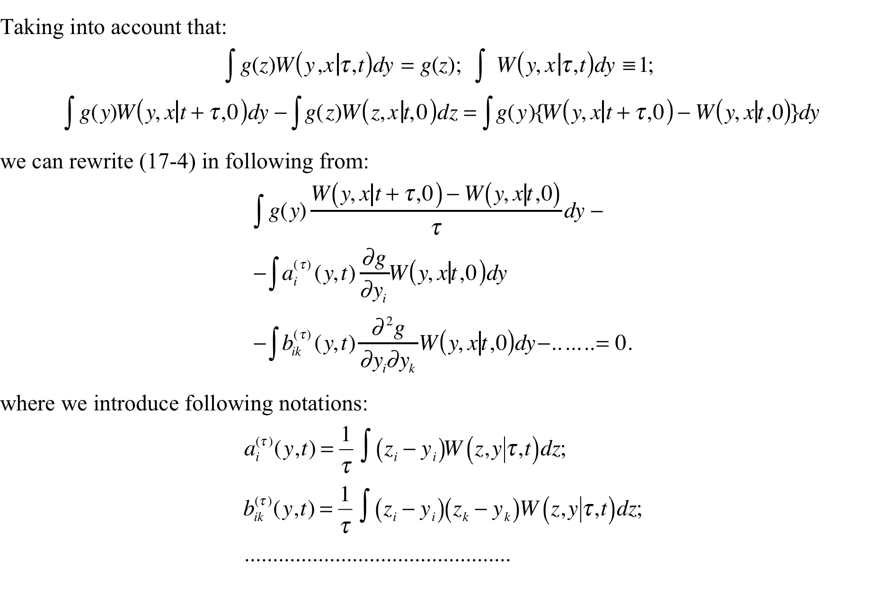

Slide 40
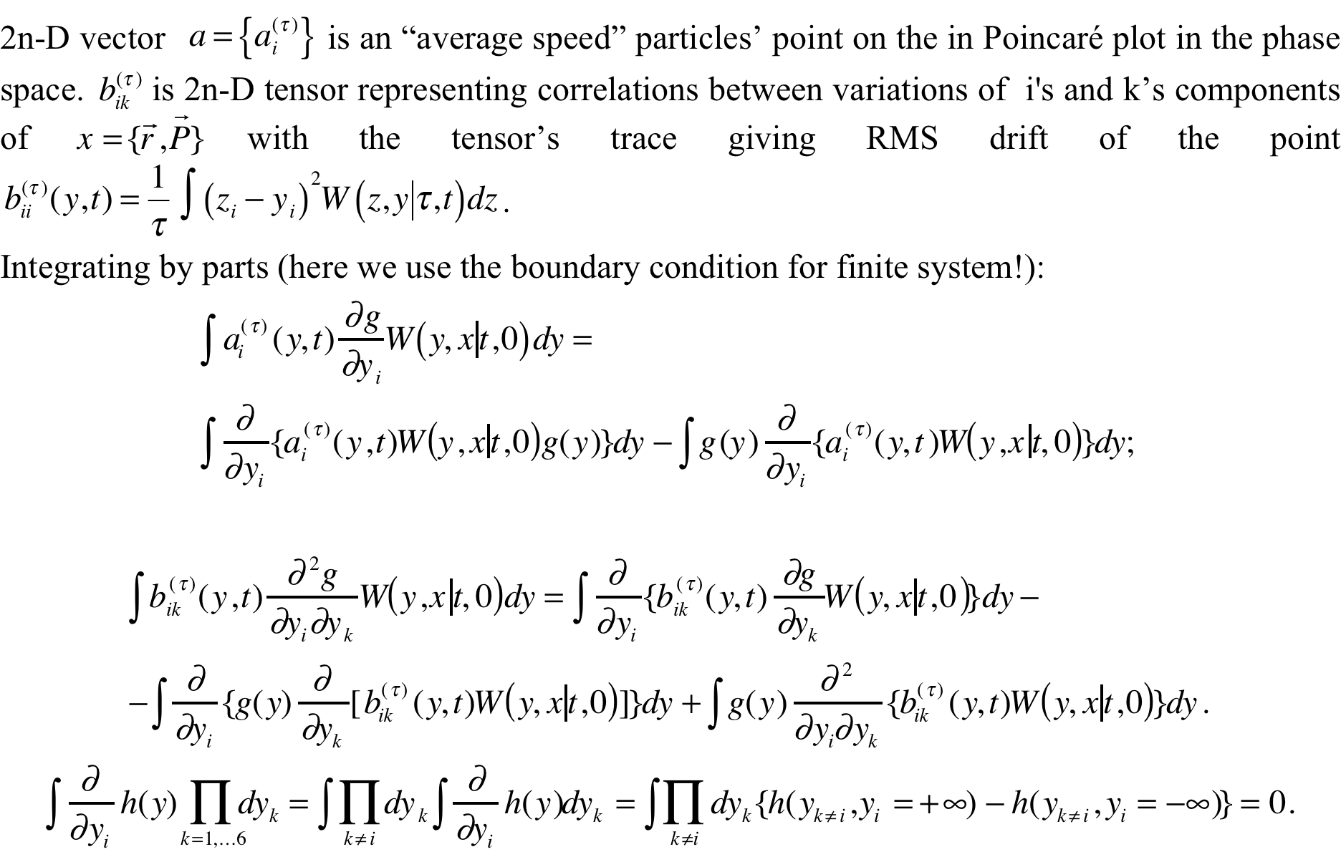

Slide 56
End of the “tools” lectures
Goal of these three lectures was to provide you with a set of tools necessary to evaluate cooling decrements and diffusion coefficients
Actual calculation may include multiple effects, such as partial overlaps of electron and hadron beams, which would result in cooling forces dependence on amplitudes and phases of oscitations. In this case, use of first order perturbation method with averaging over phases of oscillations would provide you with –generally speaking, a nonlinear - evolution equations for three actions.
Similarly, averaging over phases (and sometime multiple turns) will provide you with diffusion coefficients, which in general case will depend on actions.

Slide 57
Additional formulae

Slide 63
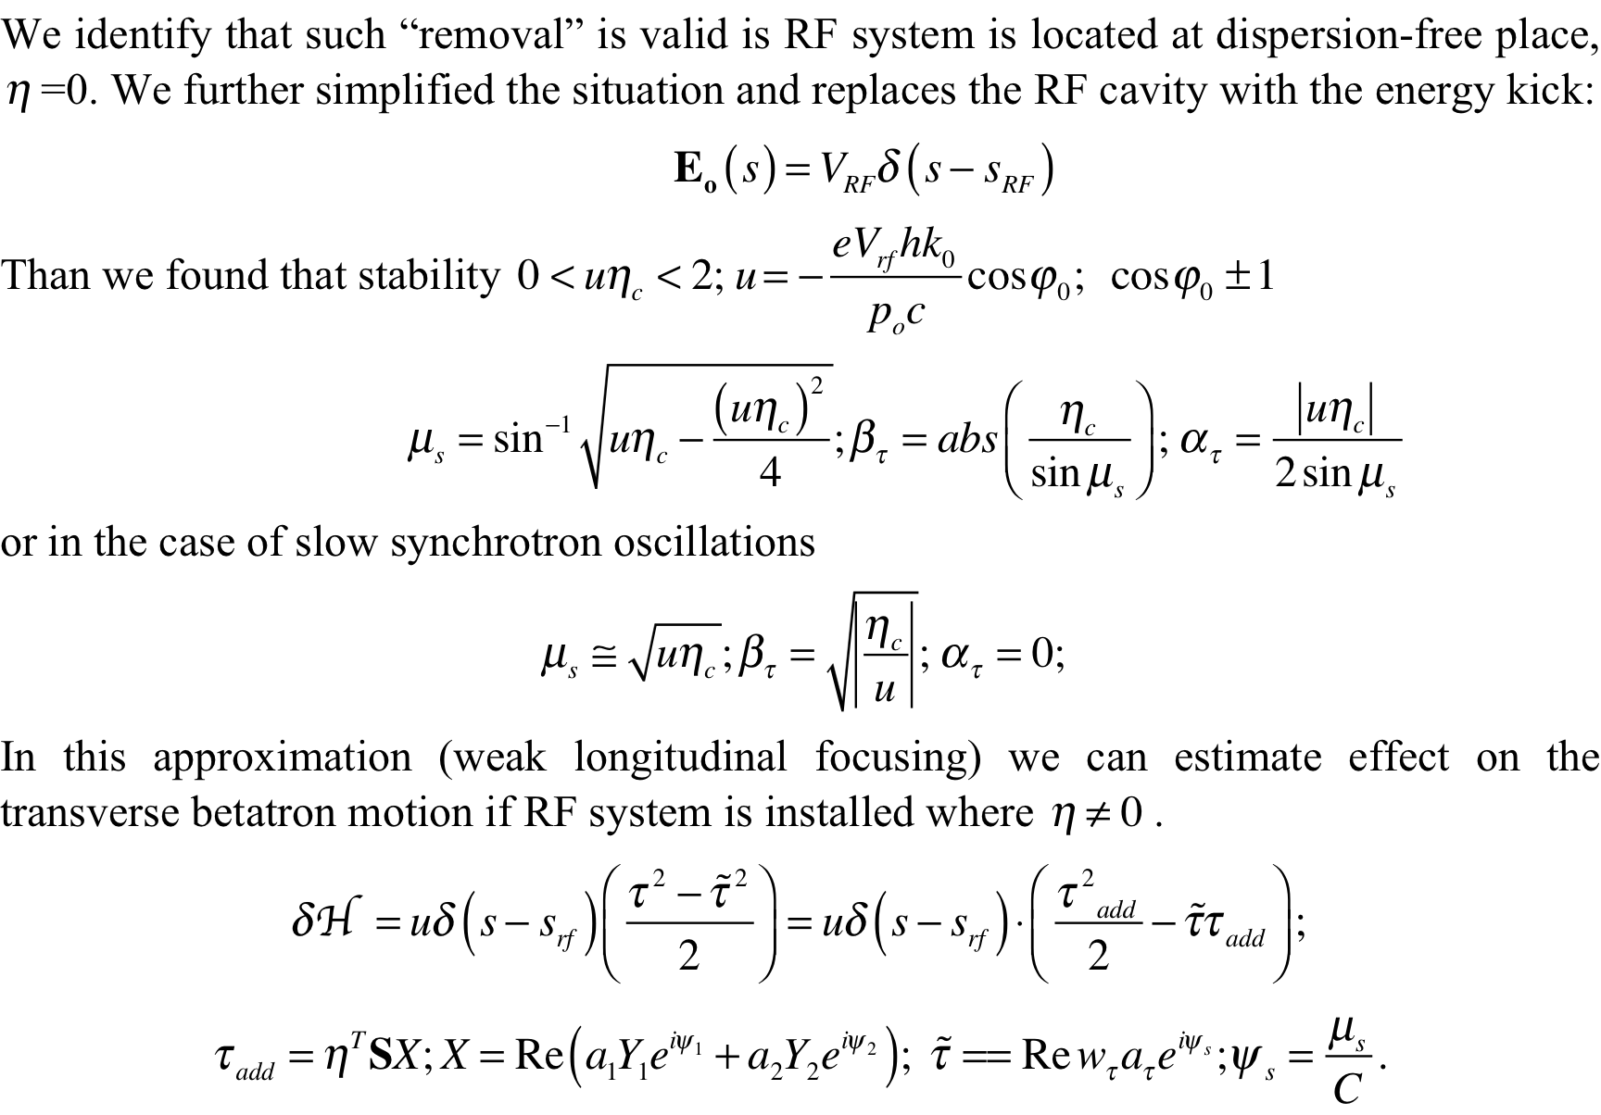

Slide 65
