Slide 1

Development of a Polarized
³He⁺⁺ Ion Source for the EIC
Matthew Musgrave
in collaboration with
R. Milner, J. Maxwell, A. Zelenski, G. Atoian, E. Beebe, A. Pikin,
S. Kondrashev, D. Raparia, and J. Ritter
CASE Seminar
February 13, 2019

Slide 2
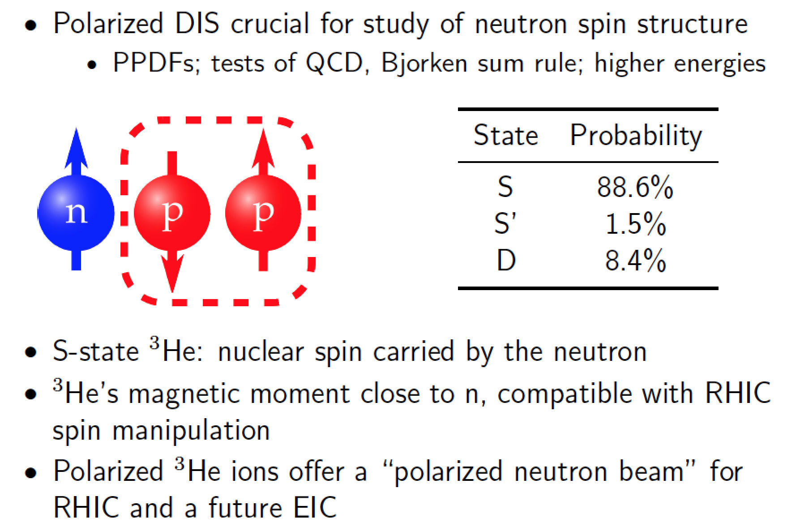
Why a Polarized ³He Ion Source?

Slide 3
Source Concept
Identified as high priority R&D for EIC by EICAC review in 2009, Office of Nuclear Physics Community Review in 2017, and the 2018 assessment of the US National Academy of Sciences.
Requirements
Polarized ³He using optical pumping and injection into EBIS at 5 T
Maximum polarization >70%
Intensity 2.5 × 10¹¹ ³He++ ions in 20 𝜇s pulse (~4 mA peak current)
Spin-flip in the beam transport line

Slide 4
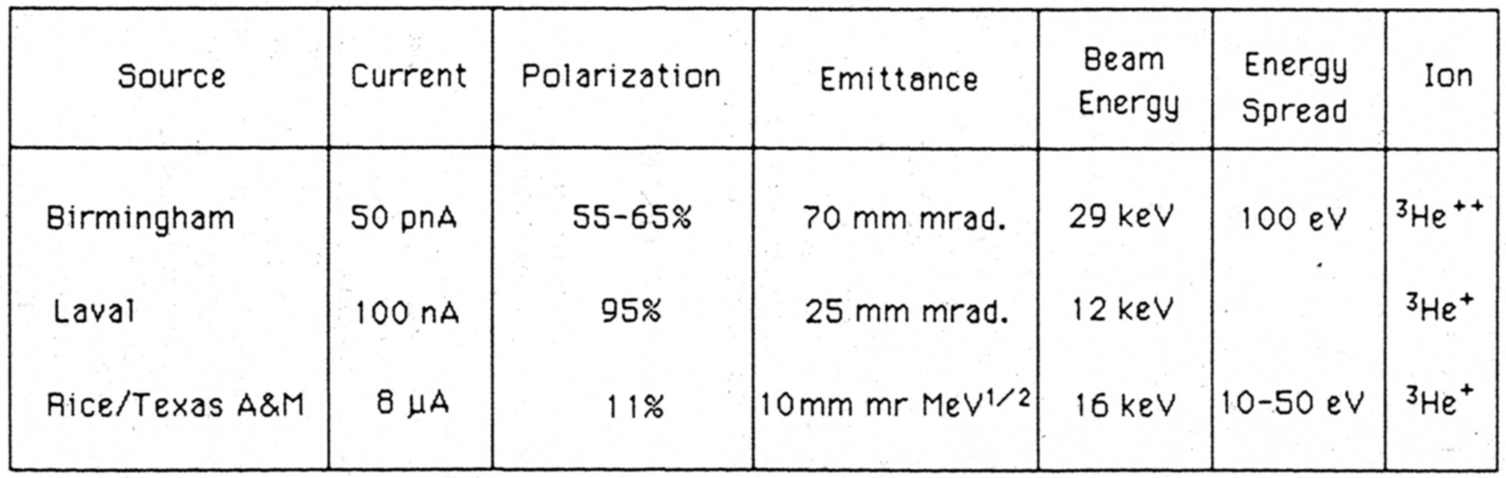
History of Polarized ³He Ion Sources
No new operational ³He ion sources were built since 1984. A number of new ideas were proposed and tested (not successfully).
Spin-exchange and metastability-exchange optical pumping techniques for ³He polarization were greatly improved due to laser development and new applications.

Slide 5
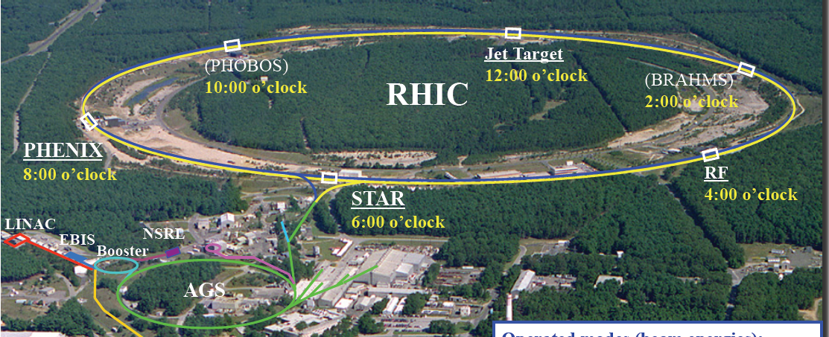
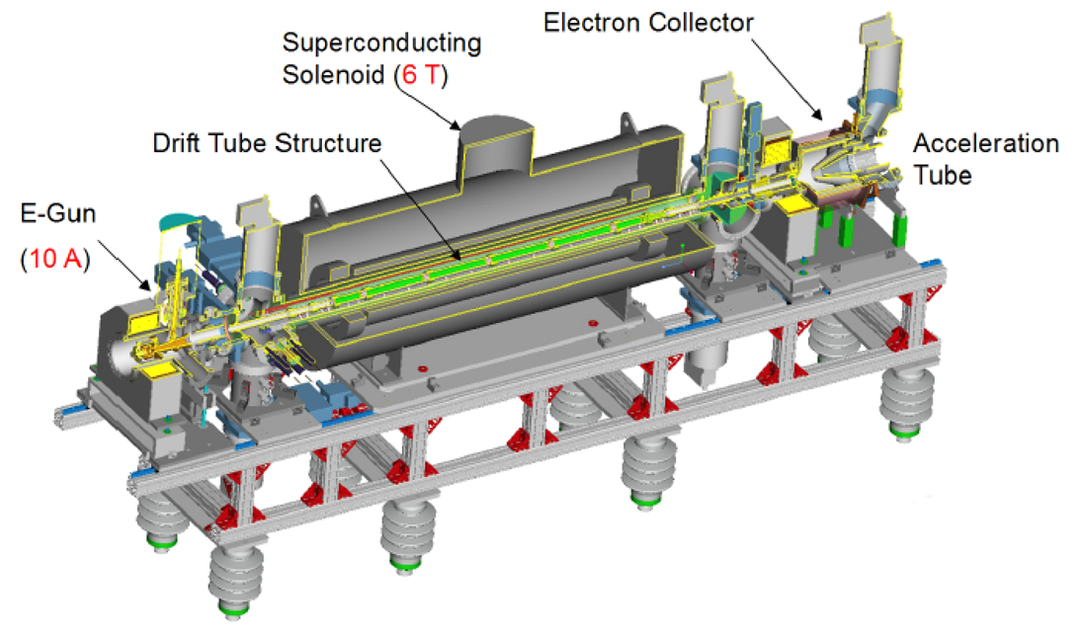
RHIC EBIS
5 T
5T solenoid B Field; 1.5 m ion trap
20 keV electrons up to 10 A
5 Hz maximum repetition rate

Slide 6
Principle of EBIS Operation
Radial trapping of ions by the space charge of the electron beam
Axial trapping by applied electrostatic potentials at ends of trap
Ion output per pulse is proportional to the trap length and electron current
Ion charge state increases with increasing confinement time
Output current pulse is independent of species or charge state

Slide 7
Extended EBIS Upgrade
Add a second 5 T superconducting solenoid for trap length extension: 40% increase in Au intensity
Install ³He polarization and injection system into the upstream solenoid
Opportunity for various vacuum and other minor improvements
trap length
extension
³He polarization and injection systems

Slide 8
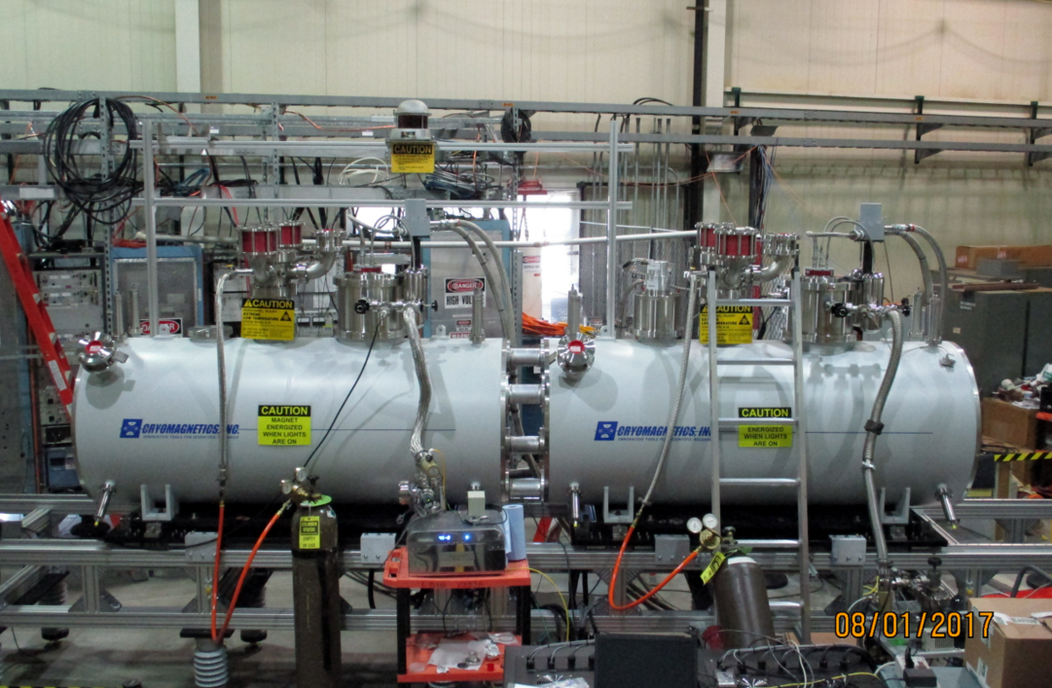
Extended EBIS Superconducting Solenoids
5.0 Tesla field, about 1.0 Tesla at field minimum in solenoid separation (~30 cm)
Electron beam propagation test currently in progress.

Slide 9
Polarized ³He Ion Source

Slide 10
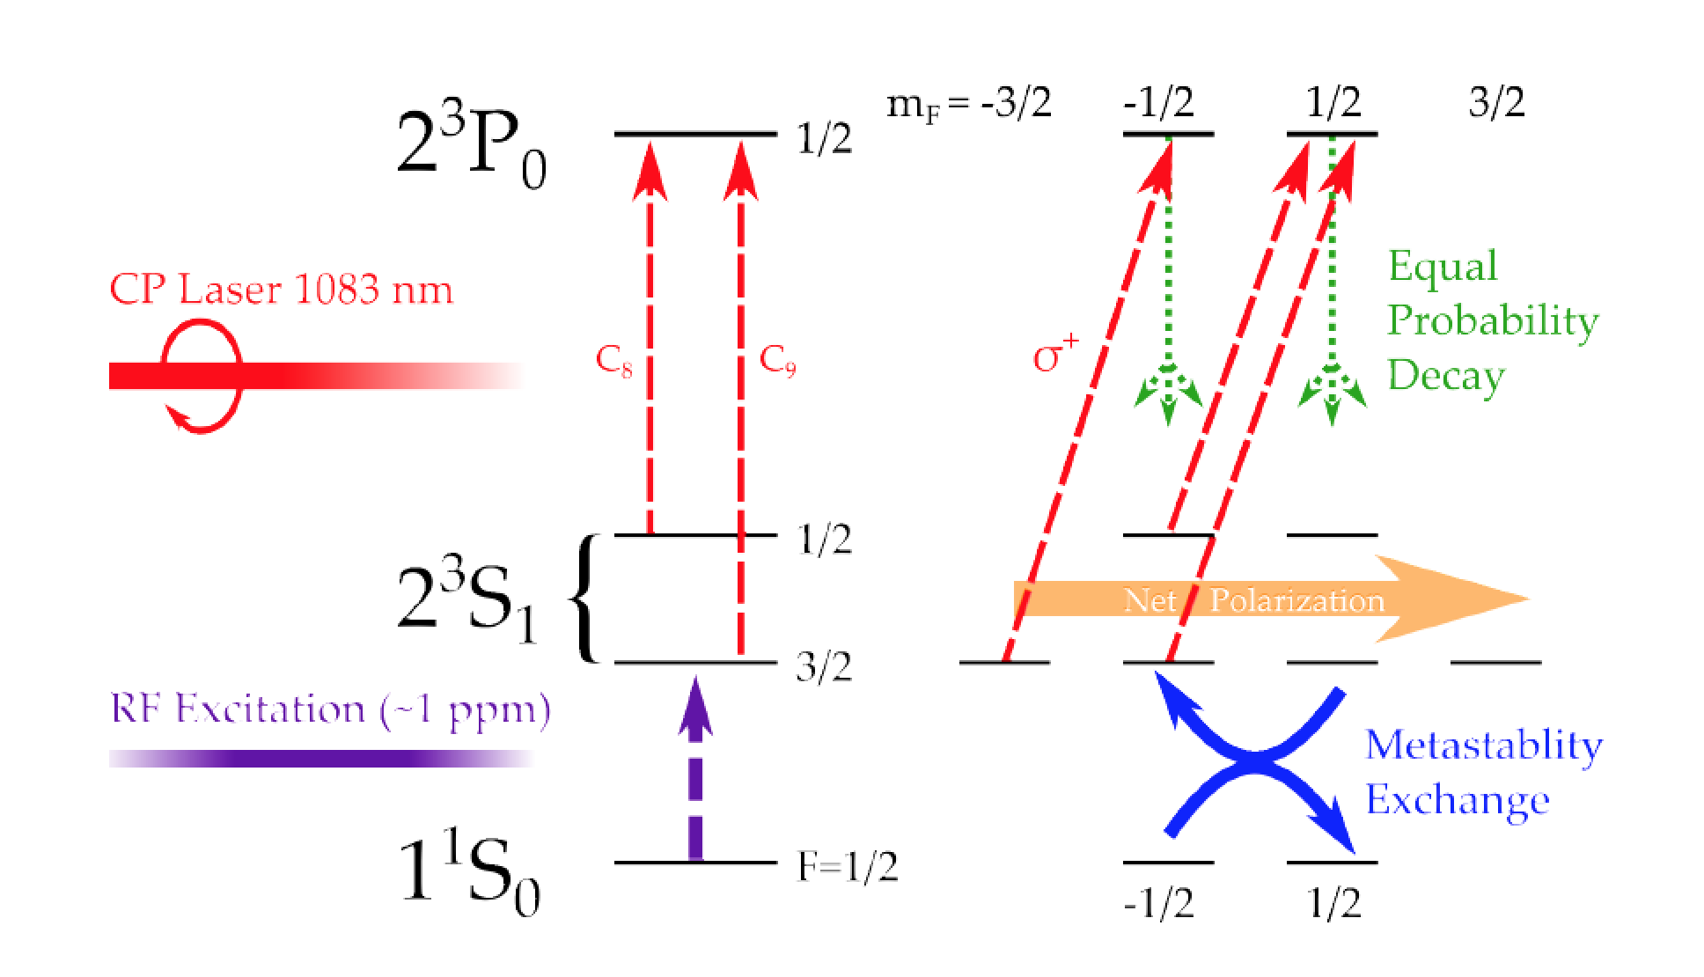
Metastability Exchange Optical Pumping

Slide 11
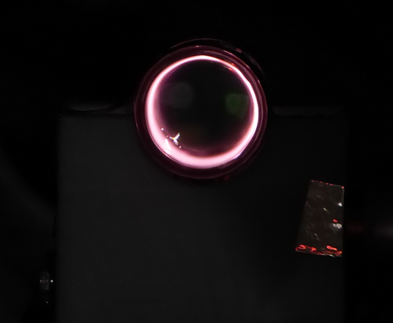
RF Discharge at 2 T
RF discharge parameters strongly affect maximum polarization.
RF discharge power needs to be reduced as ³He polarization increases.
Optimization of the ³He cell geometry and placement of RF electrodes should improve polarization.

Slide 12
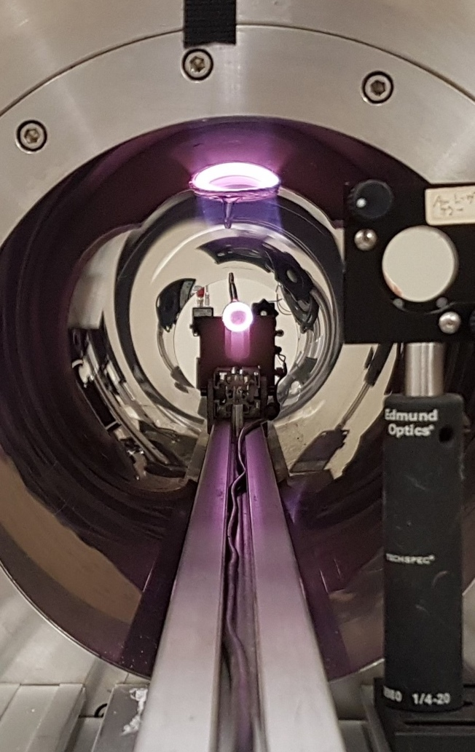
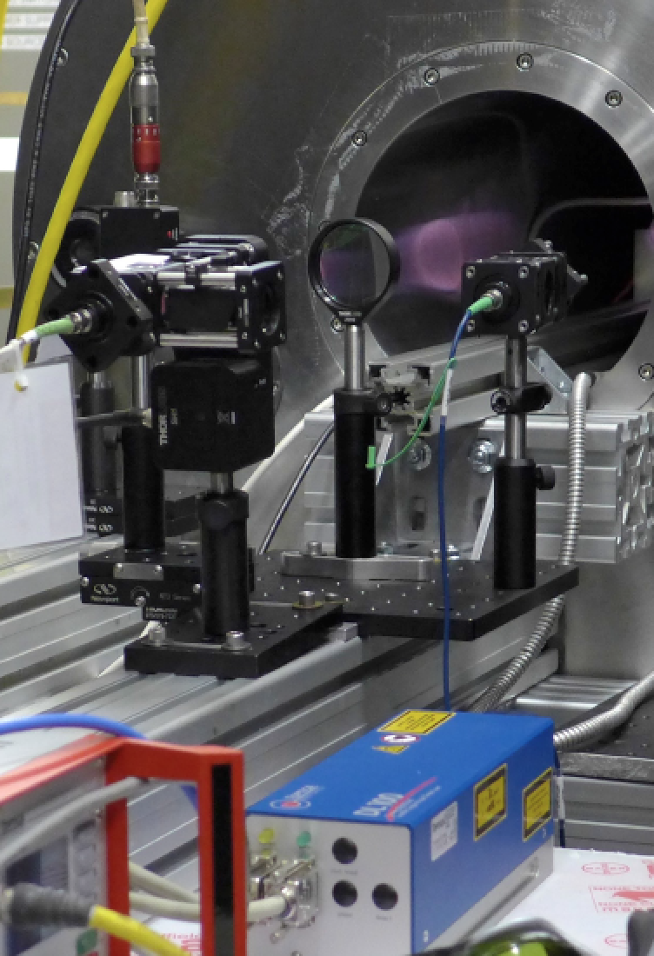
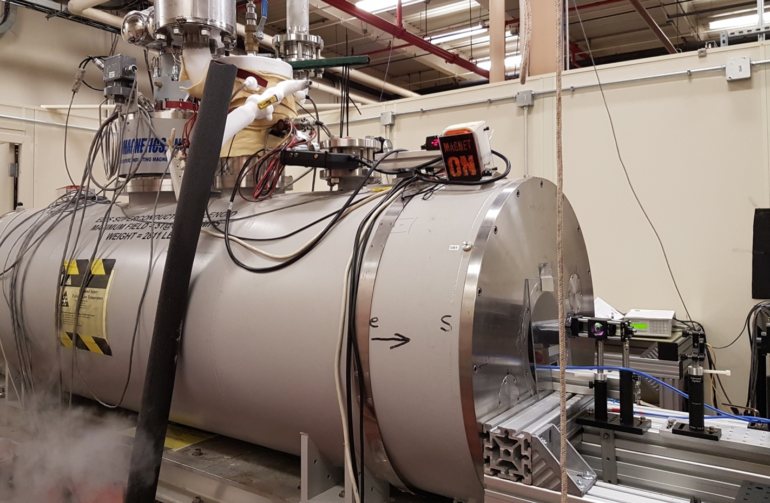
High Field MEOP System in EBIS Spare Solenoid
³He polarization measured with low power probe laser
Operated at magnetics fields of 1, 2, 3, and 4 T
Tested sealed cells at 1 mbar: 5cm OD by 5cm long and 3 cm OD by 10 cm long
Tested open cell system connected to ³He purification system

Slide 13
Optical Probe Polarimetry
Wavemeter
Probe laser, Toptica, diode laser
Pumping laser
³He cell
Detector
Pumping laser-Keopsys 10 W 1083 nm- fiber laser
Notes:
This basic design can be used at high or low field by simply modifying the frequency output of the laser and the light detection method.

Slide 14
Optical Probe Polarimetry

Slide 15
Optical Probe Polarimetry

Slide 16
Measuring Optical Pumping

Slide 17
³He Resonance Lines at 5.5 Tesla

Slide 18
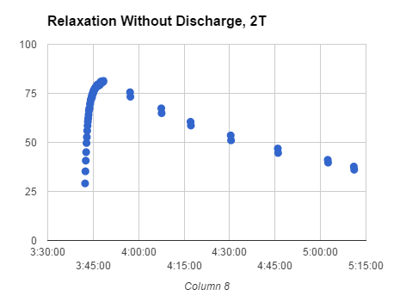
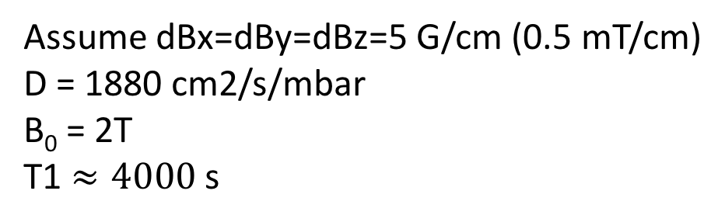
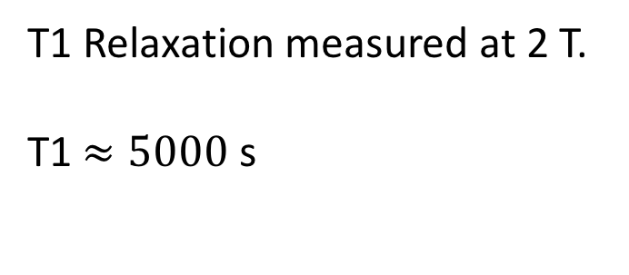
T1 Relaxation in Spare EBIS Solenoid of Sealed Cell
Gauss/cm
T1 Relaxation measured at 2 T.
T1$≈5000$ s
Assume dBx=dBy=dBz=5 G/cm (0.5 mT/cm)
D = 1880 cm2/s/mbar
B₀ = 2T
T1 $≈4000$ s
Notes:
Comparison of the T1 relaxation measured by James Maxwell in 2016 with the laser probe polarimeter and the expected T1 relaxation given the field gradients determined from the plotted field map. The 25% discrepancy could be attributed to the large difference in field gradients at different locations in the 2 T solenoid. There are other factors that could lead to the discrepancy but the field gradients is the big one.

Slide 19
Field Map of Spare EBIS Solenoid
Gauss/cm
In the multi-Tesla regime, field homogeneity needs to be 1-10 ppm to see a clear NMR signal.
The EBIS solenoid was designed for an ion source and has 0.5% homogeneity (the measured homogeneity is 0.01%).

Slide 20
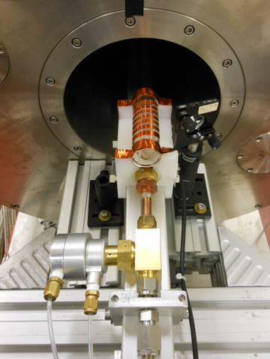
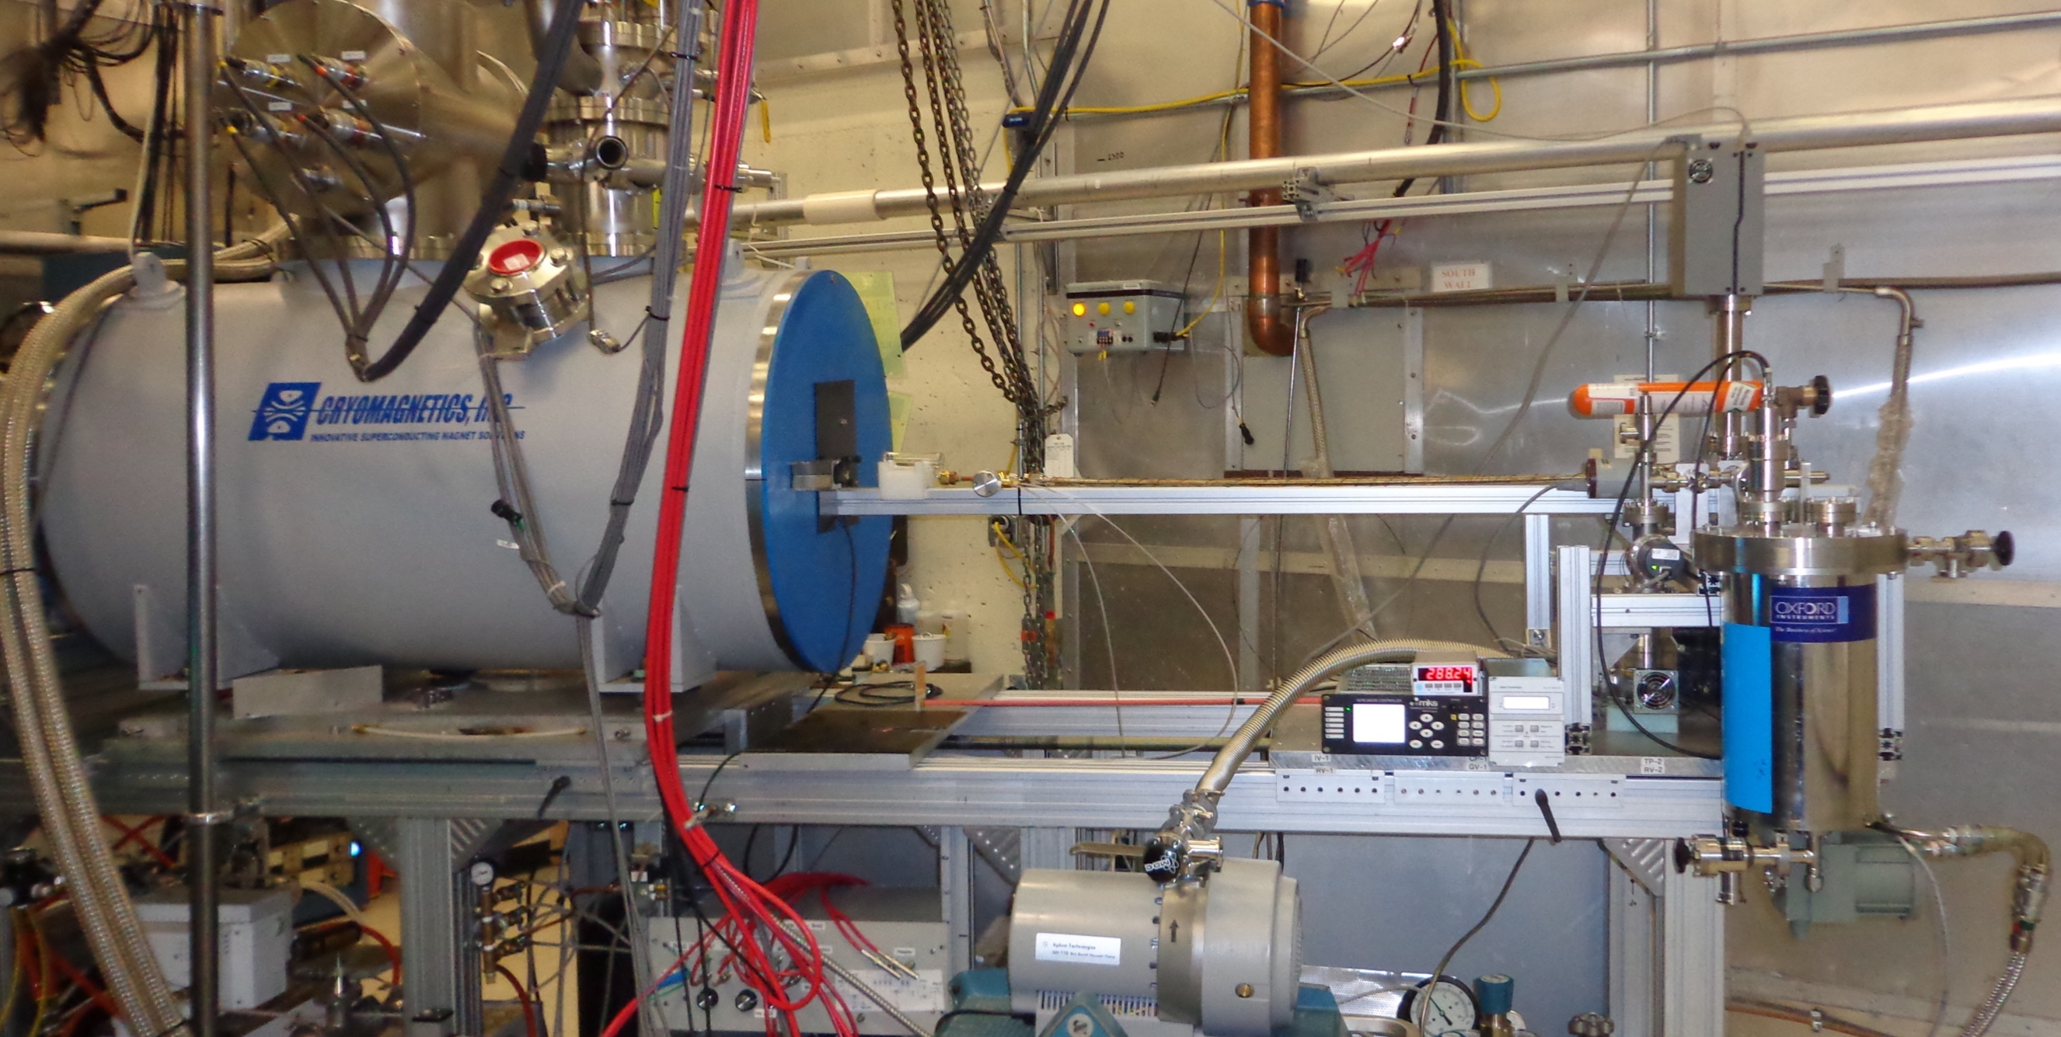
Open ³He Cell and Gas Purification System
OPPIS (RHIC’s polarized proton source) was converted into a high field MEOP system for polarizing ³He.
Non-magnetic brass pneumatic remotely controlled Isolation Valve

Slide 21
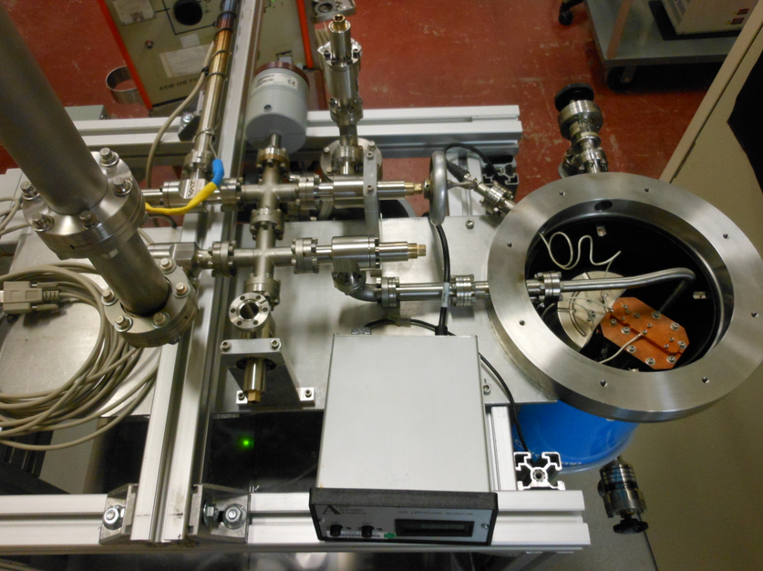
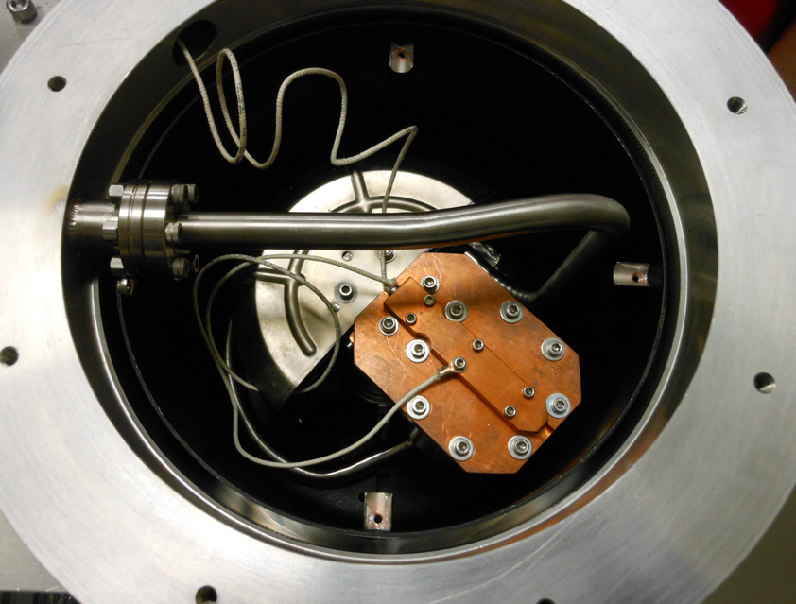
Open ³He Cell and Gas Purification System
³He cyro-purification and storage system was built from a modified cryo-pump. Pumps everything except helium!

Slide 22
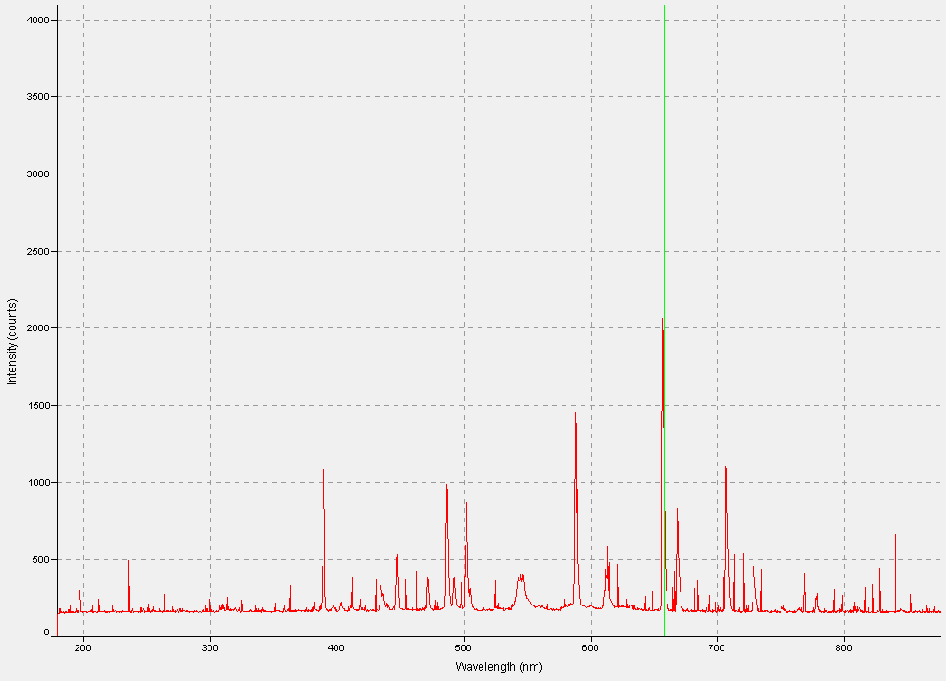
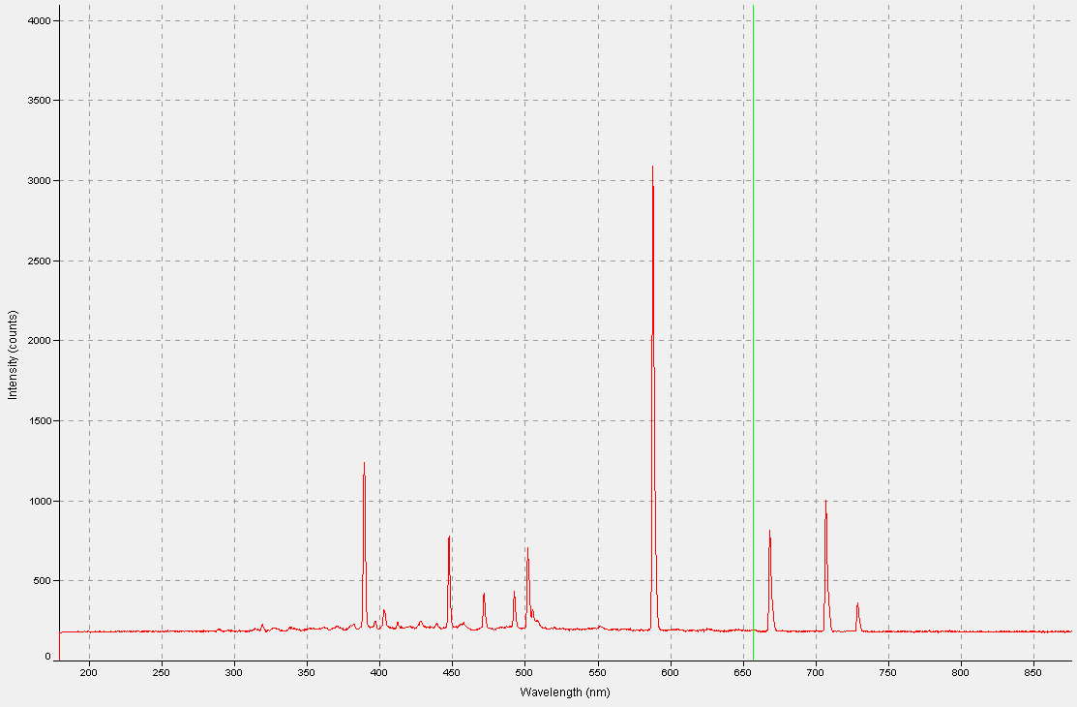
RGA Spectra in ³He Open Cell
Before purification with cryo-pump
After purification with cryo-pump
Large contamination by H2, H2O, Hydrocarbons, Argon as seen in RGA
RGA spectra very clean He signal

Slide 23
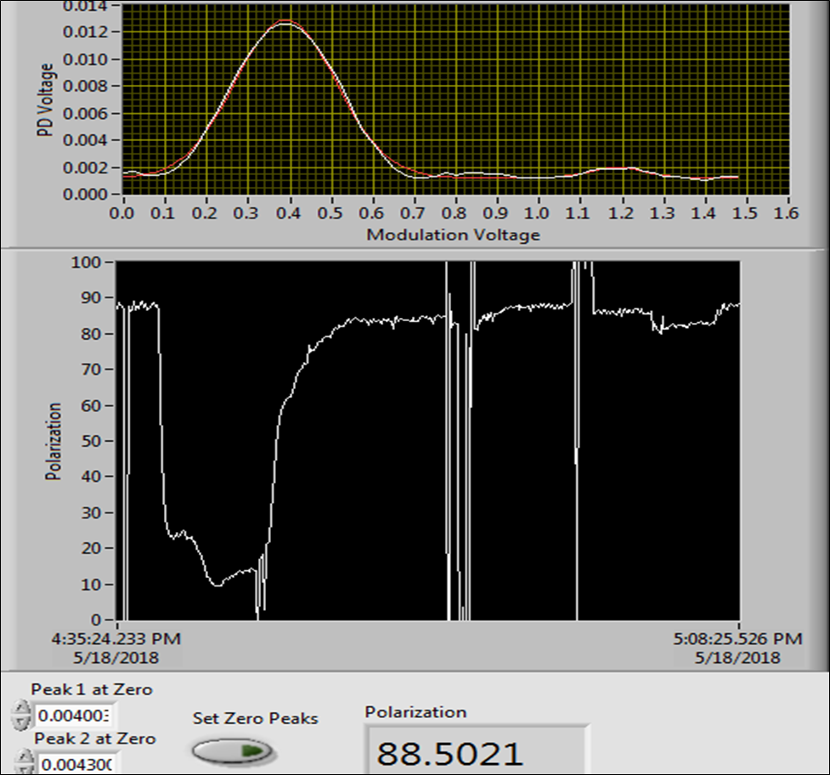
³He Open Cell Results
³He pressure can be controlled with the cryo-pump temperature.
Polarizations have been measured >80% at 2 Torr and high pressures have similar results.
Relaxation time of 30 s measured in open cell. Relaxation rate is limited by metal surfaces in pneumatic valve and gas contamination.
Valve construction and open cell design will be optimized to improve relaxation rate and maximum polarization.

Slide 24
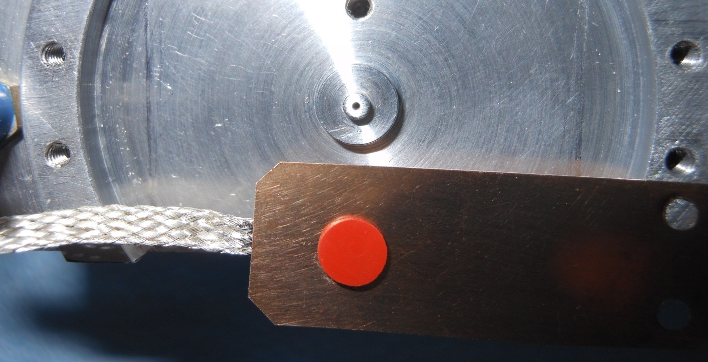
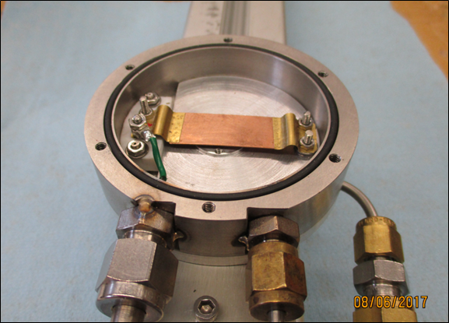
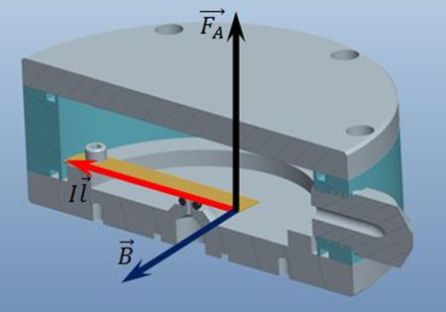
High Speed Pulsed ³He Valve
Pulsed current causes valve to open by Lorentz Force to the conducting plate in high magnetic field.
Valve design has successful long-term operation in OPPIS: B=3 T, I=100 A, L=5 cm, F=15 N, τ=100µs.

Slide 25
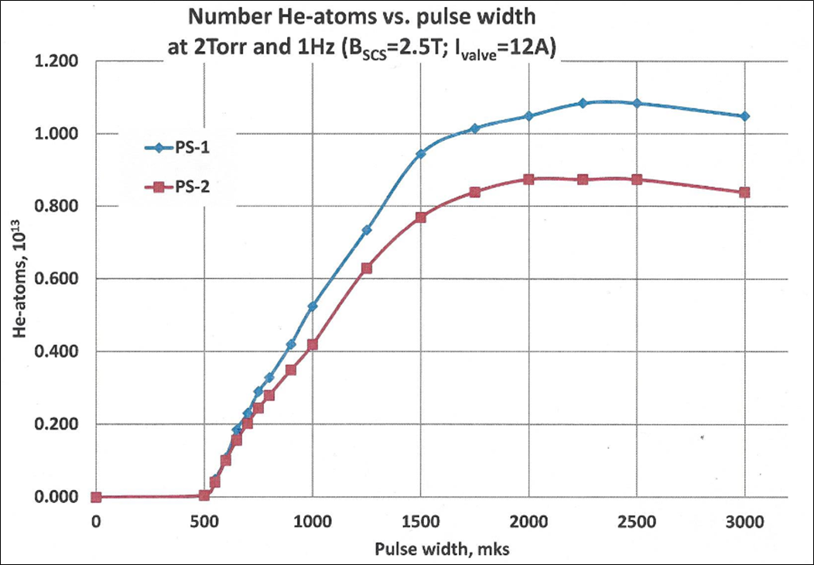
High Speed Pulsed ³He Valve
Test of high speed pulsed valve in a 2.5 T field in the OPPIS solenoid.
B = 2.5 T, I = 12 A, ³He reservoir pressure = 2 Torr
*Actual valve open time will be longer than the electric current pulse width.
µs

Slide 26
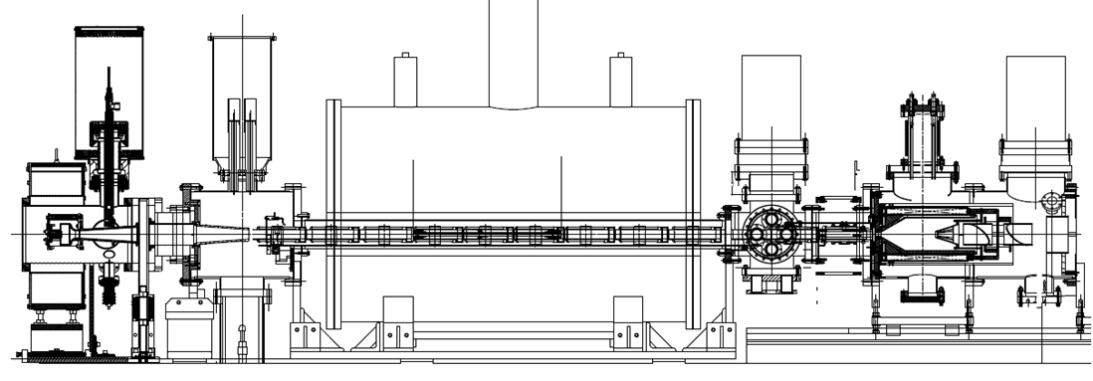
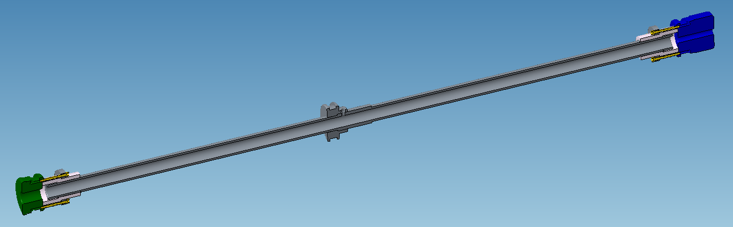
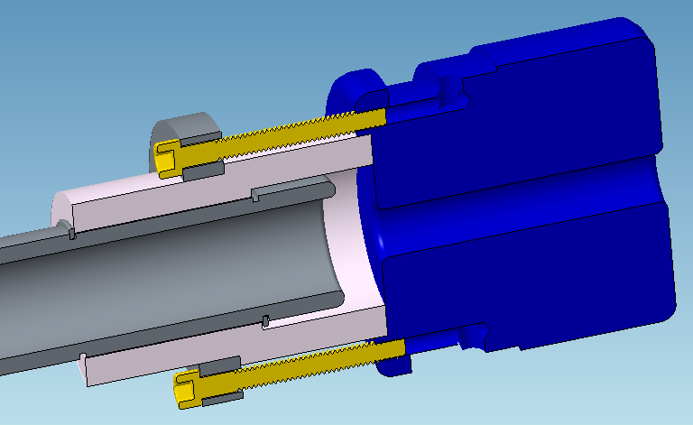
Gas Ionization Cell for Electron Beam Tests in the BNL TestEBIS
46 cm long, 1 cm diameter gas ionization cell
3 cm long, 0.5 cm diameter down stream barrier (blue)
Electron beams of 6 Amps were successfully propagated through the assembly.

Slide 27
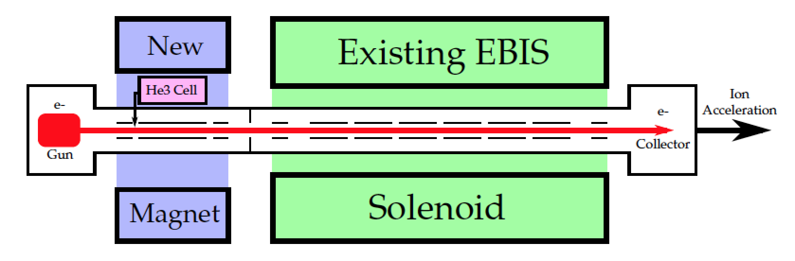
Extended EBIS Parameters
Pressure
1x10⁻⁶ mbar during gas injection
1x10⁻¹⁰ mbar standard operation
Maximum EBIS pulse time = 200 ms
5 T
5 T
Electron Beam
1 mm diameter
10 Amp
10 keV (actual 20-30 keV)
Charge Capacity = ~10¹² elementary charges
³He++ Capacity = ~ 2.5x10¹¹ ³He++

Slide 28
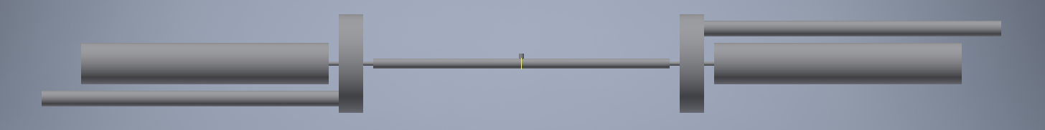
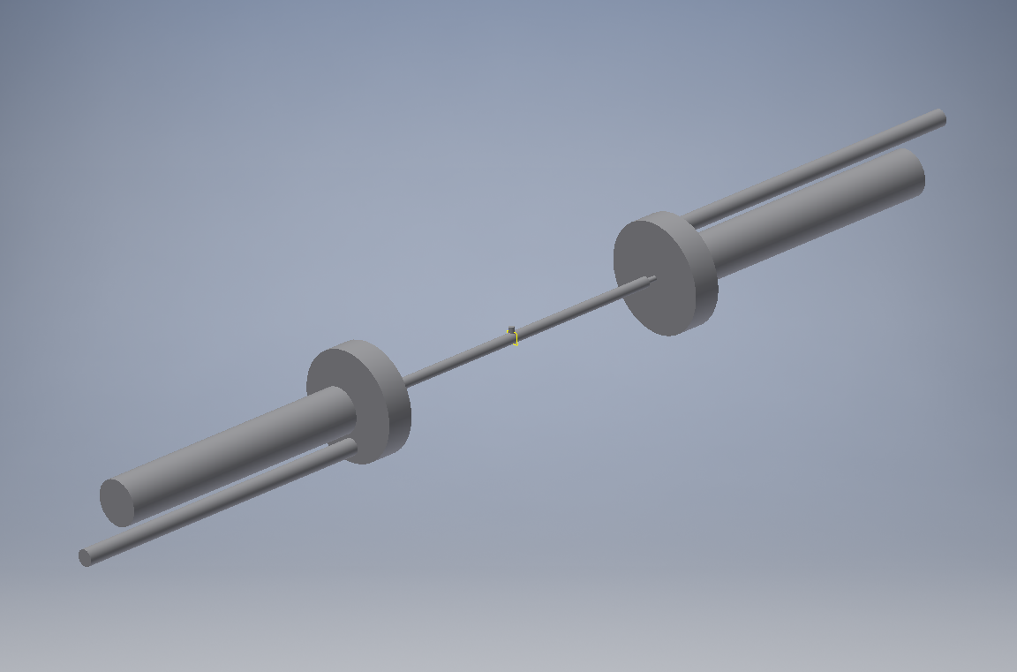
Initial Model of Gas Injection System
Ideal pumps
Gas Pulse
30 cm long, 1 cm diameter gas ionization cell
0.5 cm constrictions on either end of the ionization cell
~5.8x10⁹ ³He molecules injected into 23.6 cm³ volume
1x10⁻⁶ mbar pressure when diffused into ionization cell
Notes:
This is a simple geometry to model the gas diffusion after gas injection into the EBIS system. The ionization cell is 30 cm long. Gas is pulsed into the system by assigning a desorption parameter to the small circular region labeled “Gas Pulse” at the start of the simulation. This desorption parameter is then set to zero for the remainder of the simulation.

Slide 29
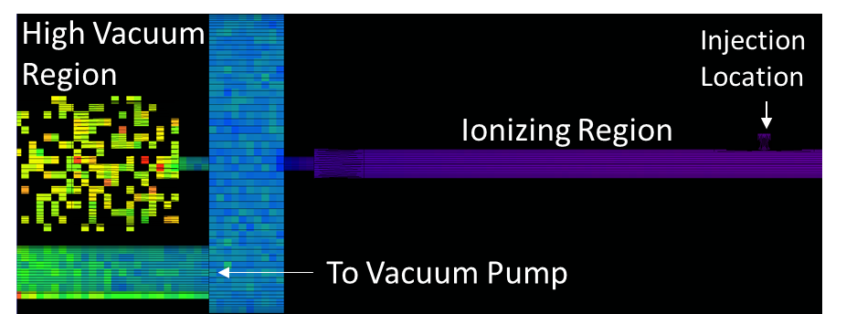
MolFlow Model of Gas Diffusion (2ms)
mbar
Simulation is paused 2 ms after injection when ³He gas is uniformly diffused in ionization region.
Notes:
In this simulation 3He gas is pulsed into the system during the first 0.05 ms. After 2 ms the 3He is equilibrated within the ionization cell with less than a factor of 2 difference in the pressure at the center and ends of the ionization cell.

Slide 30
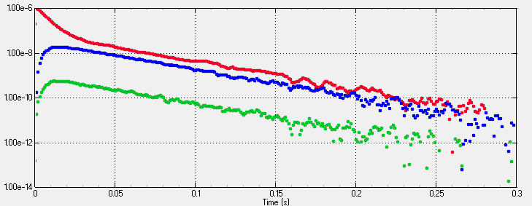
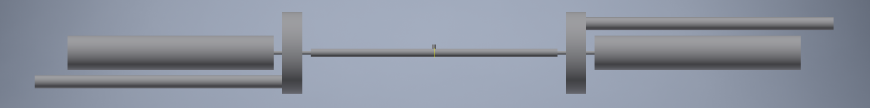
Gas Diffusion and Pumping in Ionization Cell
Simulation is 300 ms long with 1 ms intervals
~ 6.2x10⁹ injected ³He molecules
1x10⁻⁶ mbar when diffused in gas cell (23.6 cm³)
mbar
Maximum EBIS pulse rate = 200 ms
Notes:
The purpose of this simulation was to measure how fast the 3He gas could be pumped out of the gas injection/ionization system. According to Ed the maximum rate the EBIS delivers pulses to the booster ring is once every 200 ms, so we want to be able to achieve ultra-high vacuum in the ionization cell and definitely in the down stream drift tubes 200 ms after gas is injected. This is important for switching between ion species and for achieving high charge states. This is not very important for 3He. This simulation should be redone with injection of heavier gas.

Slide 31
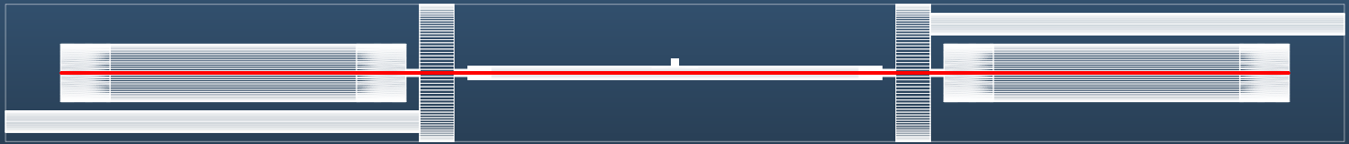

Electron Beam Ionization of ³He
Electron Beam
1 mm diameter
10 Amp
10 keV
1% probability that ³He is ionized during traverse of electron beam
Treat electron beam as ideal pump with 99% transparency.
$$S=\frac{2}{πr}\frac{I}{e}\frac{σ}{v_{He}}$$
no electron beam
10 Amp electron beam
e-beam, 4x gas pulses
Notes:
The electron beam in the EBIS acts as an ion pump on the injected gas. When 3He is ionized it is removed from the gas system and quickly moves downstream into the trap region. The probability of 3He capture during a traverse of the e-beam is determined from the electron impact ionization cross section of 3He, the velocity of 3He, the electron beam current, and the radius of the electron beam. The ionization cross section depends on the electron energy, but the electron energy cancels out elsewhere in determining the probability of 3He capture.

Slide 32
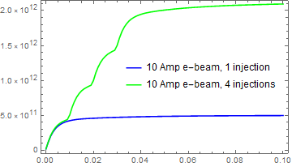
Electron Beam Ionization of ³He
Charge Capacity = ~10¹² elementary charges
10 Amp electron beam
6.2x10¹¹ injected ³He atoms
61% ionized by electron beam
39% pumped out
10 Amp e-beam, 4x gas pulses
24.8x10¹¹ injected ³He atoms
61% ionized by electron beam
39% pumped out
Notes:
Here is a comparison of injection of one pulse of gas and 4 pulses (4x the total 3He atoms injected). The purpose of this simulation is to see if we can quickly neutralize the electron beam while keeping the pressure in the ionization cell below 1x10^-6 mbar during injection and below 10^-10 mbar after 200 ms. This slide shows the pressure plotted against time; next slide shows ionization rate. Keep in mind that the electron beam pumps on the 3He gas until it is neutralized, so this simulation looses some accuracy after the electron beam is neutralized, which is the case for the 4 pulse simulation. In future simulations, this needs to be taken into account. I also want to point out that the electron beam effectively maintains the same pump rate until it is neutralized. This is because the mfp of the electrons in the 3He+ ions is 10s or 100s of kilometers, and thus the do not reduce the current of the electron beam.

Slide 33
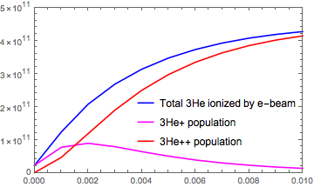
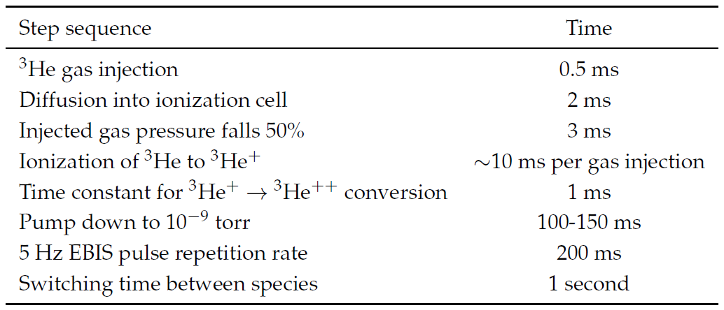
Electron Beam Ionization of ³He

Slide 34
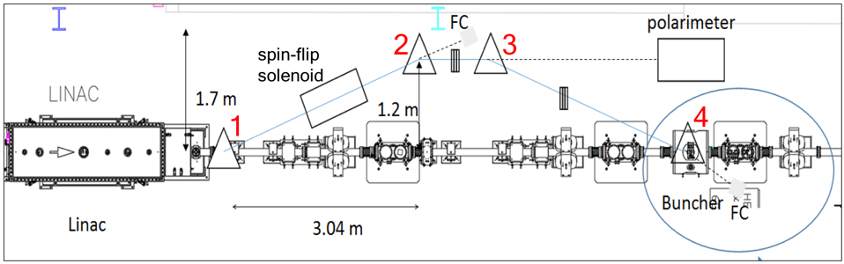
³He⁺⁺ Spin Rotator and 6 MeV Polarimeter
³He⁺⁺ spin rotator and polarimeter in the EBIS HEBT line at 6.0 MeV beam energy.

Slide 35
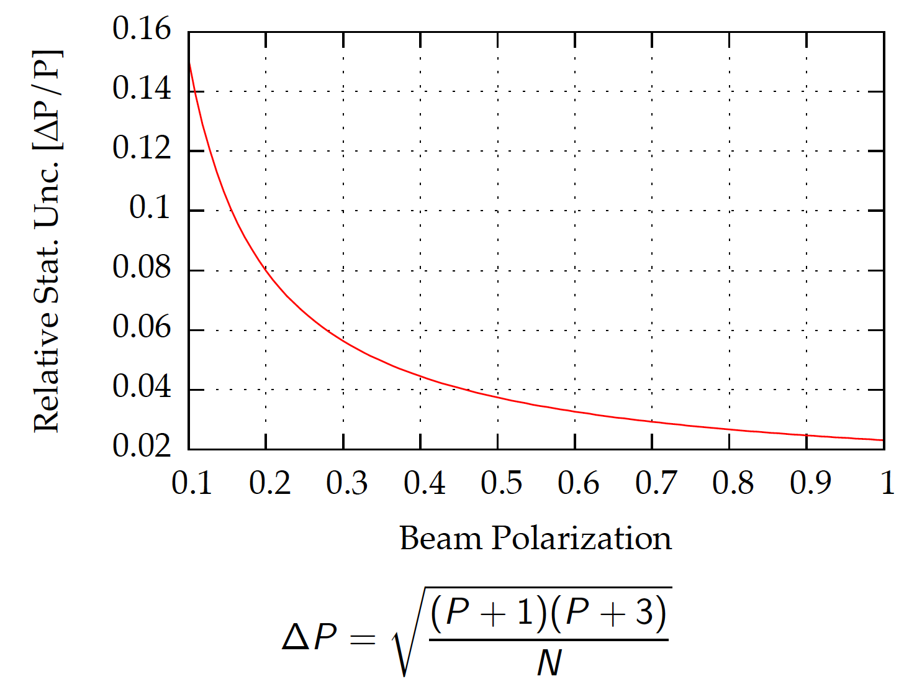
Feasibility Experiment
Precision After 1 Minute at 250 Hz count rate
Use extended EBIS and extract fully stripped polarized ³He⁺⁺ ions accelerated to 6 MeV
Measure ³He + ⁴He → ³He + ⁴He elastic scattering
Analyzing power has been measured to be 100% at 91º_{CM} at ~5.3 MeV
Process yields 2.66 MeV ³He at 53.6º_{lab} and 2.64 MeV recoil ⁴He at 44.5º_{lab}

Slide 36
Thank you for your attention
MIT-BNL Polarized ³He Ion Source Collaboration
M. Musgrave, R. Milner, J. Maxwell, A. Zelenski, G. Atoian, E. Beebe, A. Pikin, S. Kondrashev, D. Raparia, and J. Ritter
This work was supported by DOE Office of Nuclear Physics, R&D for Next Generation Nuclear Physics Accelerator Facilities.

Slide 37
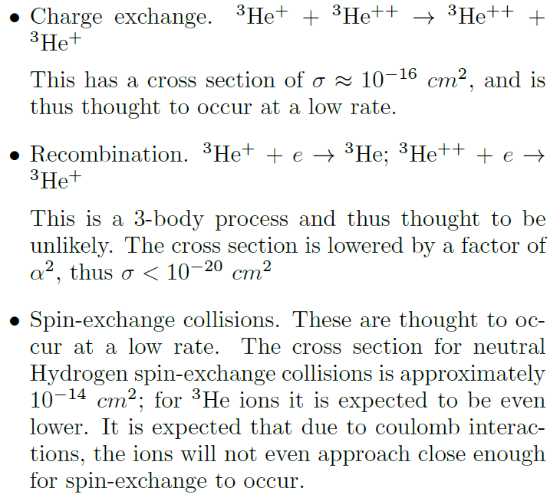
Depolarization Contributions in the Electron Beam
See MIT Senior Thesis of Charles S. Epstein:
Development of a Polarized Helium-3 Ion Source for RHIC using the Electron Beam Ion Source , June 2013.

Slide 38
Polarized ³He at RHIC

Slide 39
Siberian Snakes
Superconducting helical dipoles
4 Tesla, 2.4 m long with 360∘ twist

Slide 40
MolFlow – Monte Carlo Simulator for High Vacuum
MolFlow is a Monte Carlo simulator of molecular flow of gases that tracks the trajectories of test particles and increments hits, momentum transfer, and reciprocal of orthogonal speed component on each geometric surfaces.
Surface Parameters: sticky factor, opacity, gas desorption, temperature, velocity, wall sojourn time, and specular/diffuse reflection
Gas Parameters: mass, temperature, radioactive decay
Time-Dependent: sticky factor, opacity, gas desorption
Notes:
MolFlow simulates one virtual particle at a time, and it is only applicable at high vacuum where the mean free path of the particle is very long compared to the geometer of the system. Sticky factor is used to determine pump rate. Time dependent desorption is used to pulse gas into the system.

