Slide 1
Safety trainings for PHY542
M.Fedurin
01/30/2023

Slide 2
New JTA called “ATF AE63 student” with the following requirements:
- PO-ATF ATF Awareness
- PO-ATF-REF ATF Awareness Exam
- GE-CYBERSEC Cyber Security
- TQ-GERT General Employee Radiological Training
- TQ-GSO Guest Site Orientation
- HP-OSH-151A-W Lockout/Tagout Affected
- TQ-SMF Static Magnetic Fields
- OM-MEDSURV-SMF Static Magnetic Field Medical Surveillance

Slide 3
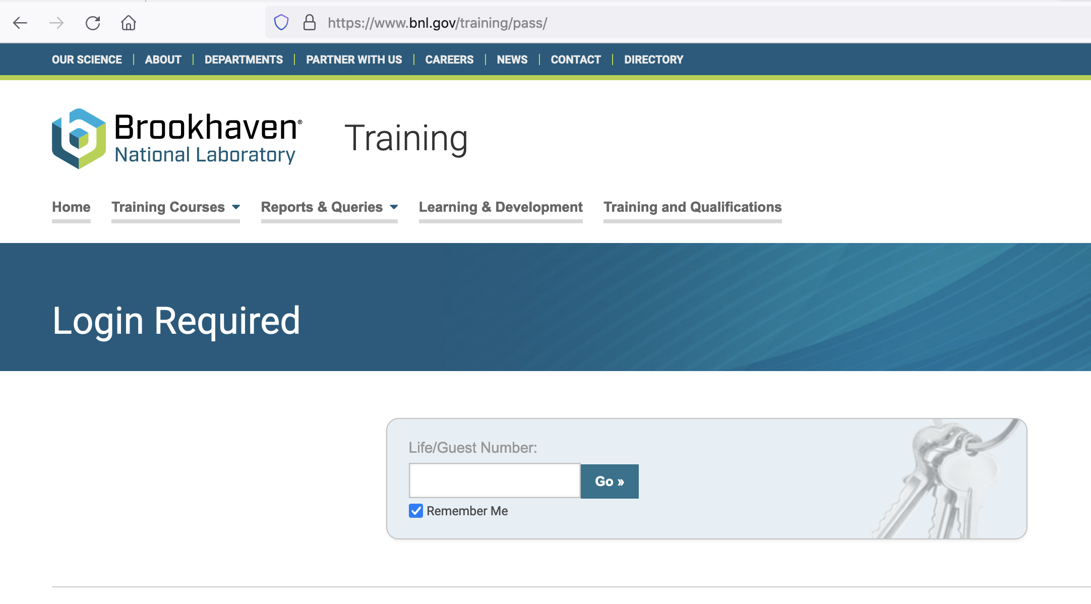
www.bnl.gov/training/pass

Slide 4
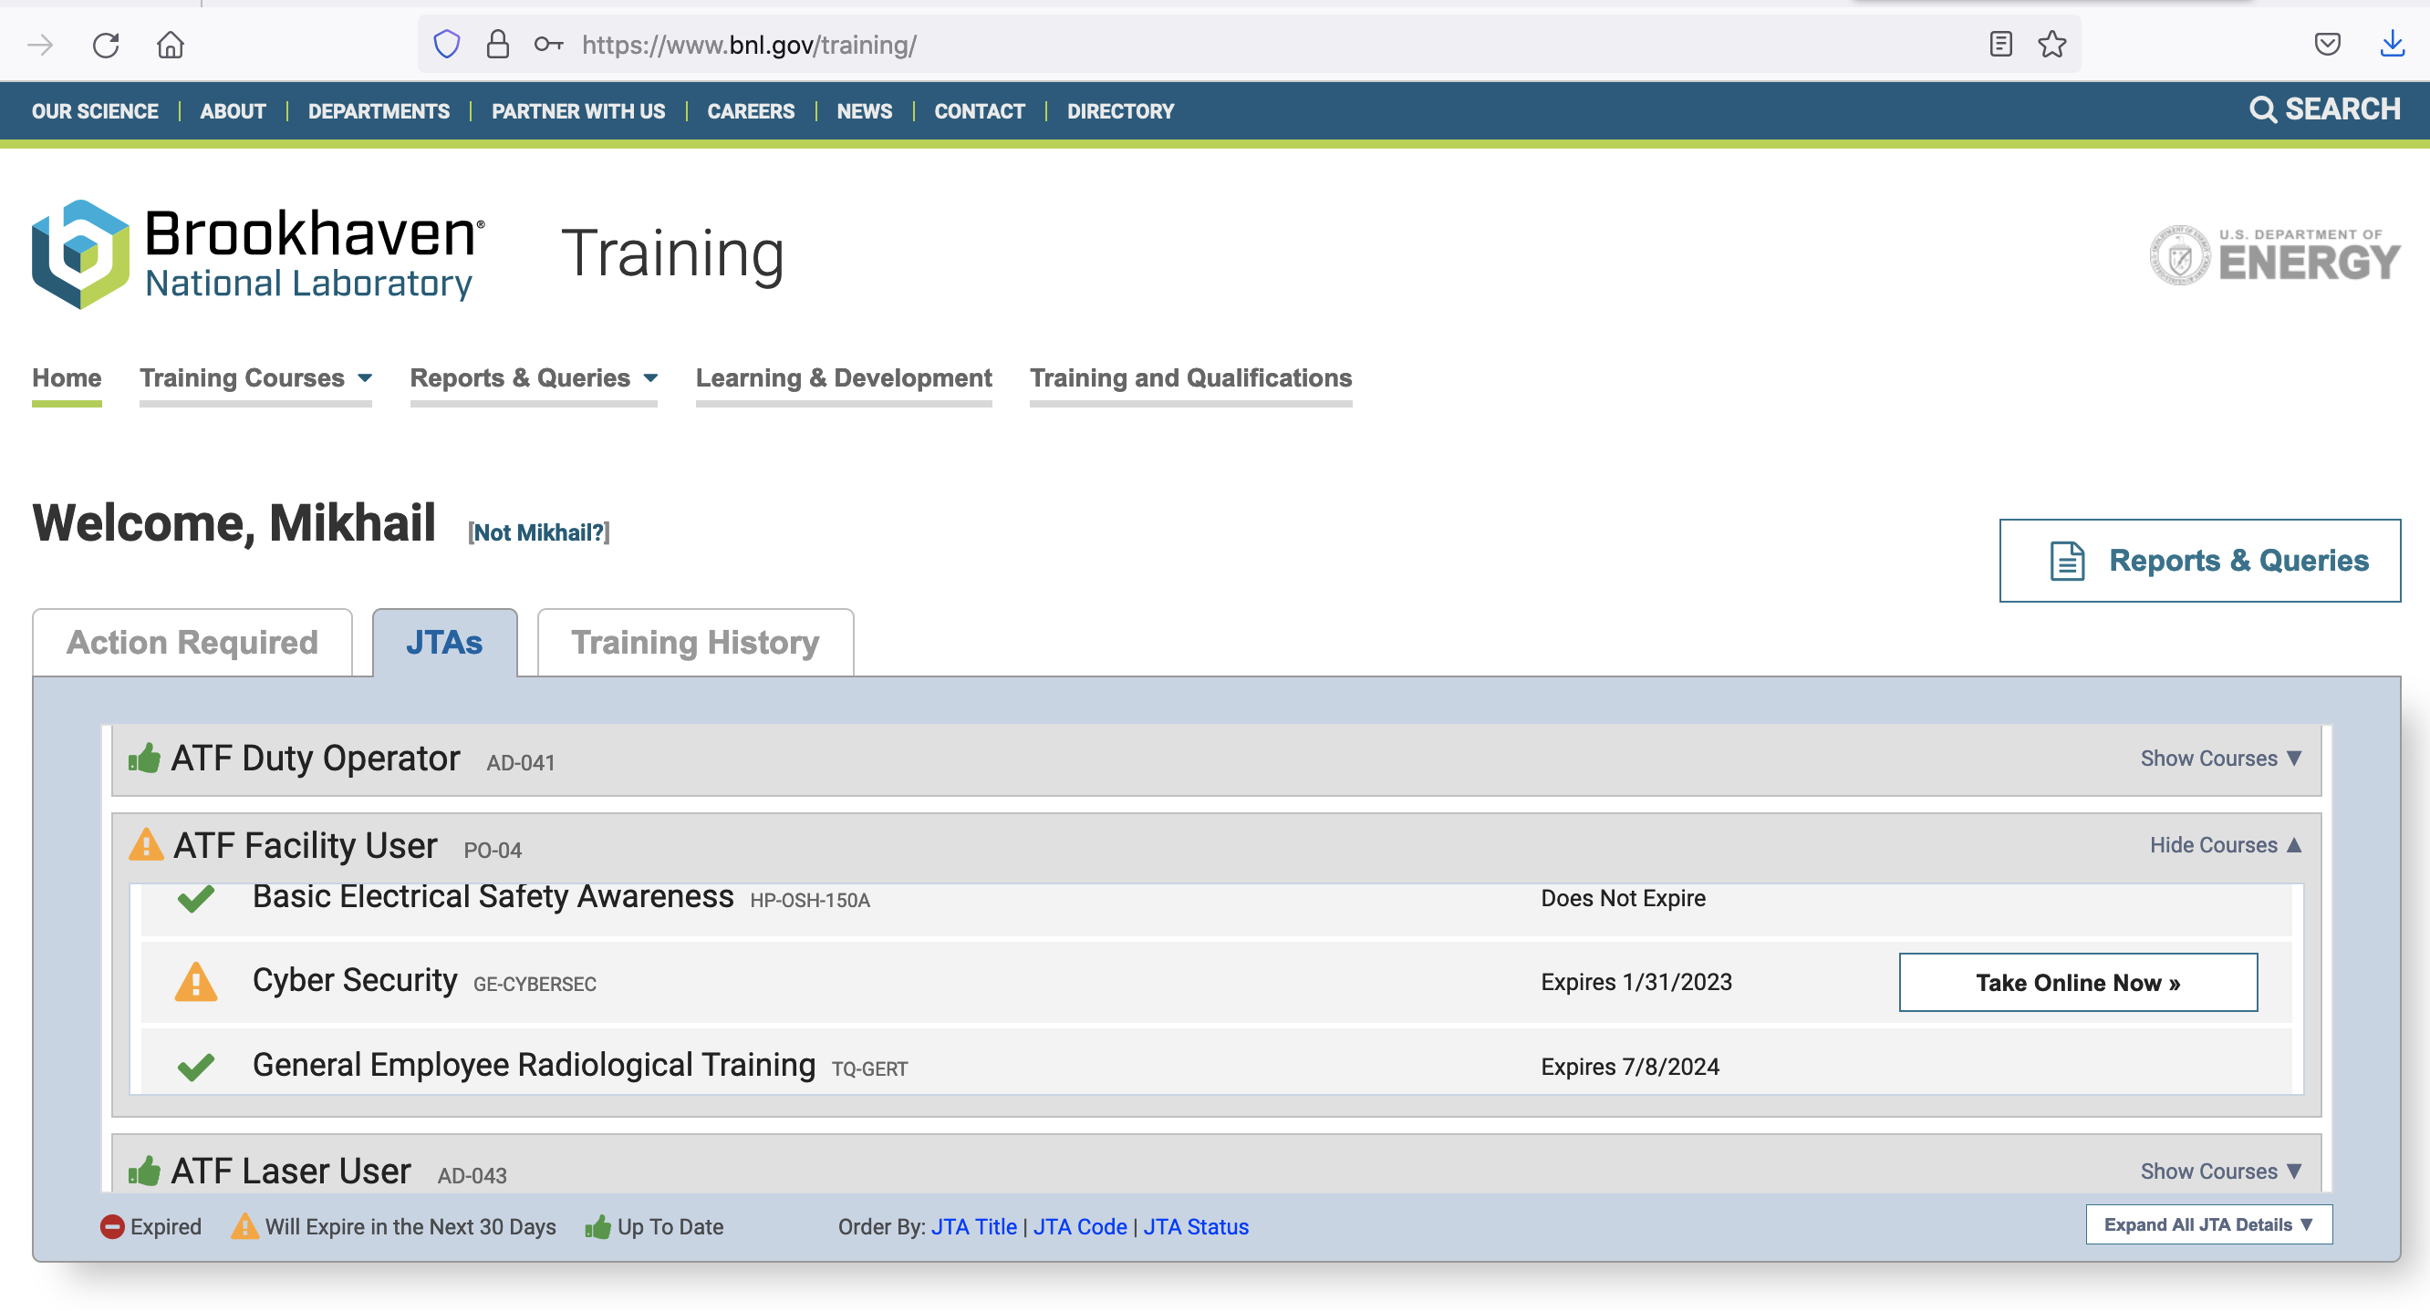

Slide 5
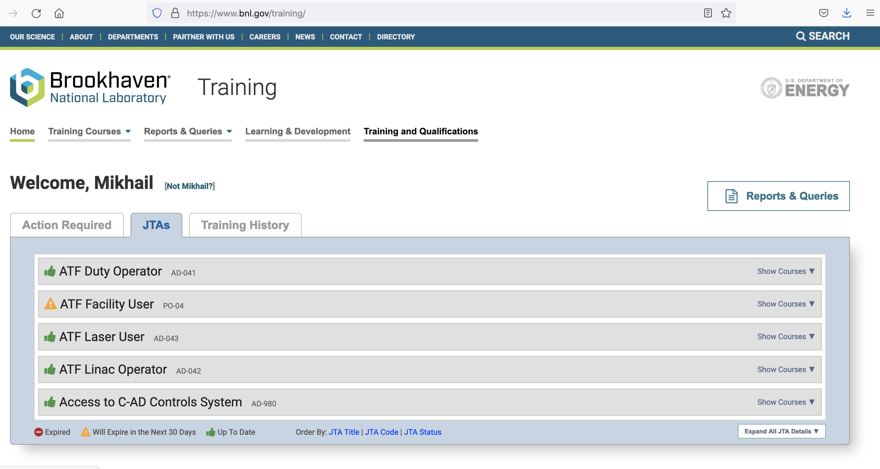

Slide 6
